Slide 1
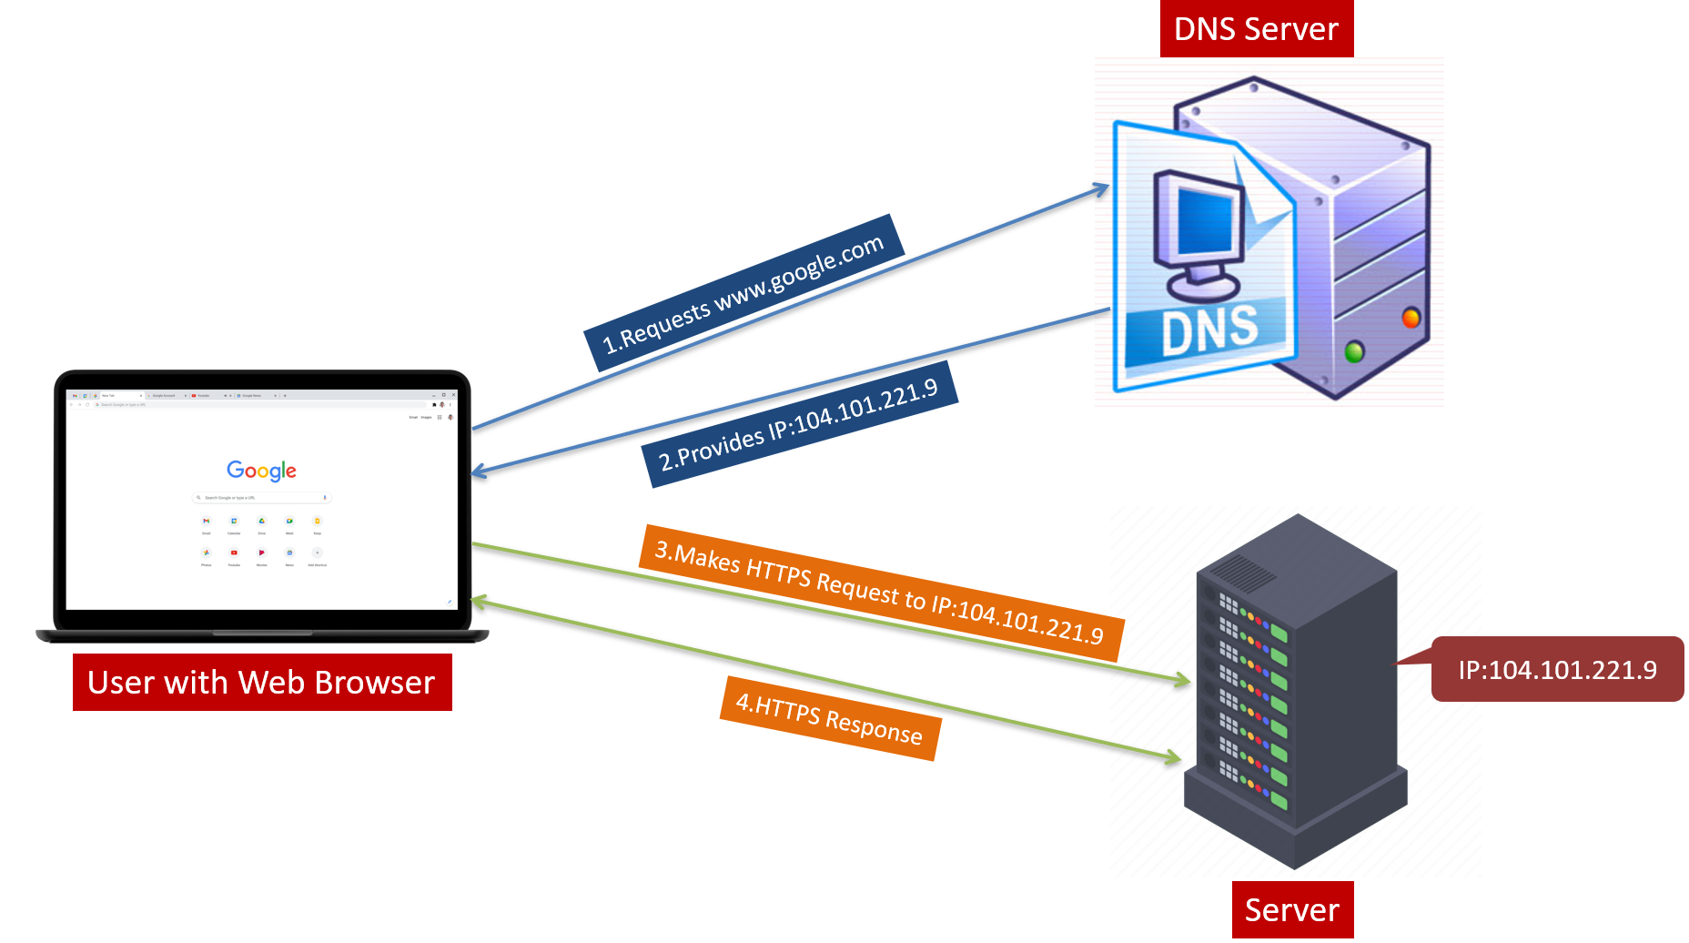
Demystifying DNS: A Layman's Guide to Understanding the Internet's Phone Book
Imagine you want to call your friend, but you only know their name, not their phone number. You'd use a
phone book to look up their phone number, right? Well, DNS is like a giant phone book for the internet.

Slide 2
Demystifying DNS: A Layman's Guide to Understanding the Internet's Phone Book
How DNS Works?
1. Names to Numbers:
Every device connected to the internet, like computers, smartphones, and websites, has a unique number called an
IP address. It's like a phone number for the internet.
But remembering all those numbers would be impossible. So, DNS helps us use easy-to-remember names instead, like website addresses (e.g., www.google.com).

Slide 3
Demystifying DNS: A Layman's Guide to Understanding the Internet's Phone Book
How DNS Works?
2. Address Lookup:
When you type a website address into your browser, like www.google.com, your device needs to find out the IP address associated with that name.
The browser sends a request to a DNS server, which acts like a digital phone book.

Slide 4
Demystifying DNS: A Layman's Guide to Understanding the Internet's Phone Book
How DNS Works?
3. Finding the Number:
The DNS server looks up the website name in its records and finds the matching IP address.
Once DNS server has the IP address, DNS server sends IP address back to your device so it can connect to the website.

Slide 5
Demystifying DNS: A Layman's Guide to Understanding the Internet's Phone Book
How DNS Works?
4. Speed Dial:
DNS servers store this information for many websites, just like a phone book stores lots of numbers.
This way, when you visit a website you've been to before, your device doesn't have to look up the address again. It's like speed dial on your phone!

Slide 6
Demystifying DNS: A Layman's Guide to Understanding the Internet's Phone Book
In simple terms, DNS is like the internet's phone book, translating easy-to-remember names into the unique numbers that computers use to find each other on the web. Without DNS, navigating the internet would be a lot like trying to call your friend without knowing their phone number—it just wouldn't work!

Slide 7
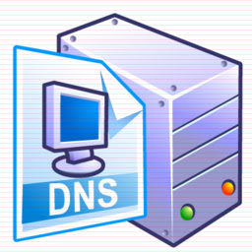
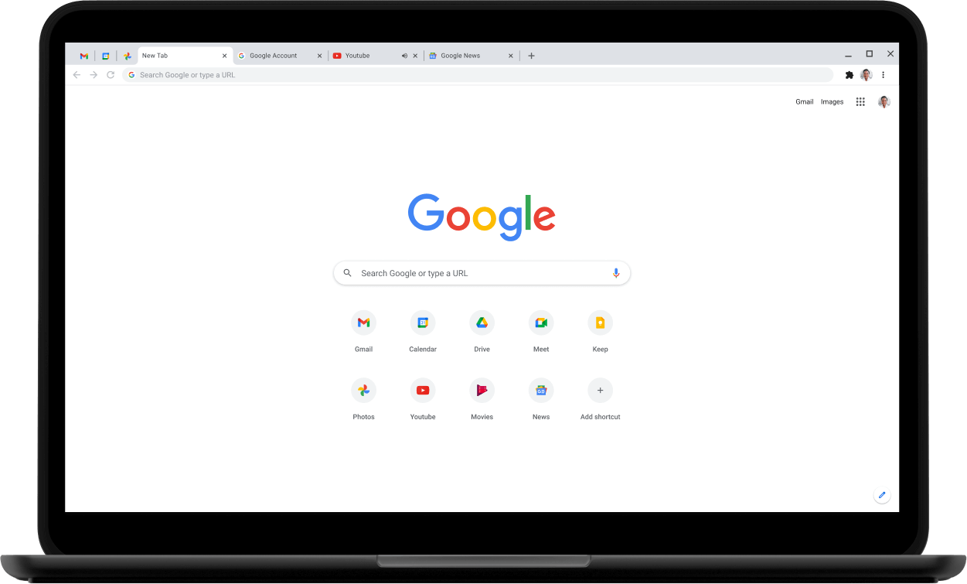

DNS Server
1.Requests www.google.com
2.Provides IP:104.101.221.9
3.Makes HTTPS Request to IP:104.101.221.9
User with Web Browser
IP:104.101.221.9
4.HTTPS Response
Server

