Slide 1
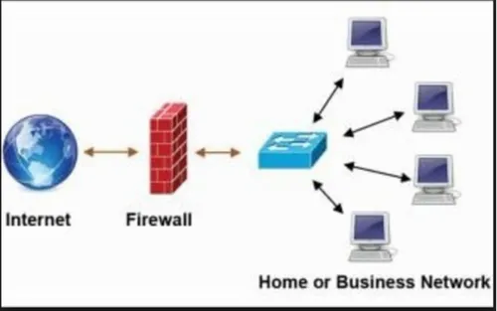
Types of Firewall
Firewalls are an essential security component that monitors incoming and outgoing network traffic, acting as a barrier between a trusted internal network and untrusted external networks (like the internet).
Firewalls can be configured to allow or block specific traffic based on a set of security rules.
Firewalls come in various forms, and the type of firewall you choose will depend on your specific needs.
Computer Network with Firewall

Slide 2
Types of Firewall
By Deployment method
Hardware Firewalls
Software Firewalls
Cloud-based Firewalls (FWaaS)

Slide 3
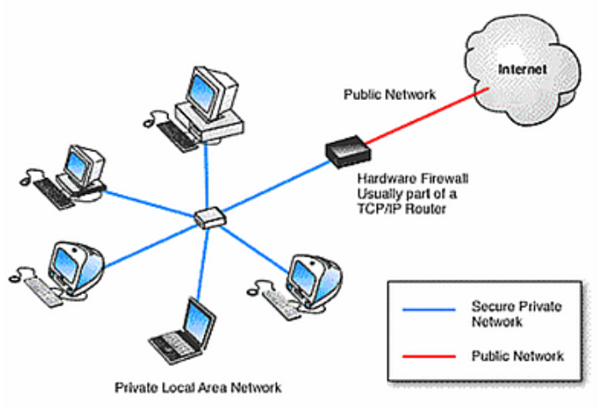
Types of Firewall
Hardware Firewalls: These are standalone devices that sit between your network and the internet. They are powerful and offer high performance but can be expensive.

Slide 4
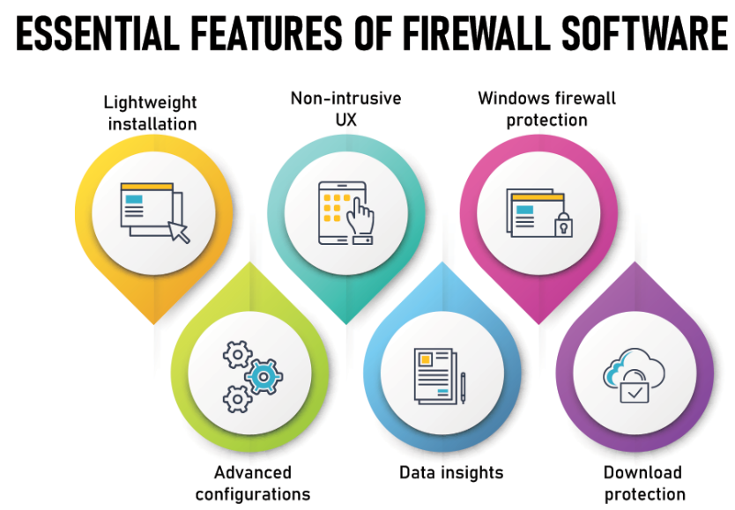
Types of Firewall
Software Firewalls: These are programs that are installed on individual devices like computers or servers. They are less expensive than hardware firewalls but can provide less protection.

Slide 5
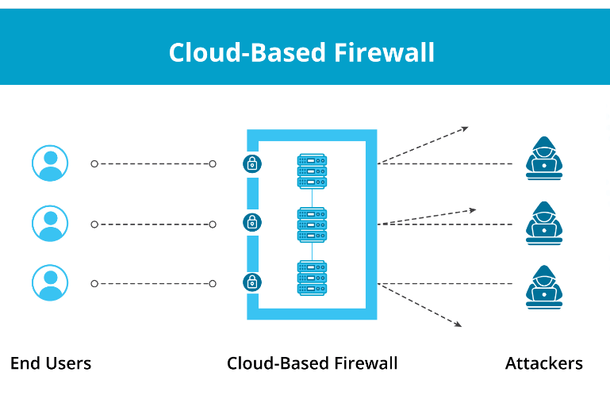
Types of Firewall
Cloud-based Firewalls (FWaaS): These are firewalls that are delivered as a service from a cloud provider. They offer a flexible and scalable solution but can be more expensive than
on-premises firewalls.

Slide 6
Types of Firewall
By Technology
Packet Filtering Firewalls
Stateful Inspection Firewalls
Proxy Firewalls
Next-generation Firewalls (NGFWs)
Unified Threat Management (UTM) Firewall
Application Layer Firewall (ALF)

Slide 7
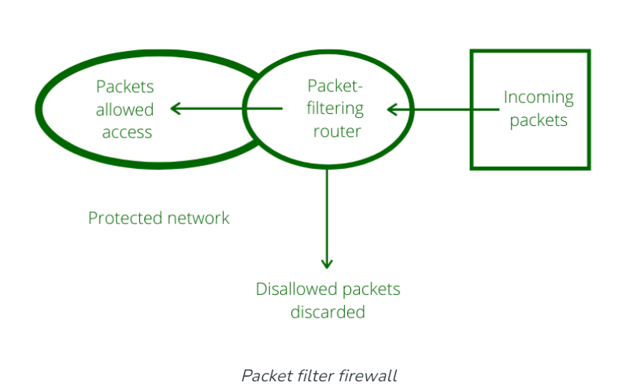
Types of Firewall
Packet Filtering Firewalls: These are the simplest type of firewall. They examine individual data packets and allow or block them based on source and destination IP addresses, port numbers, and other criteria.

Slide 8
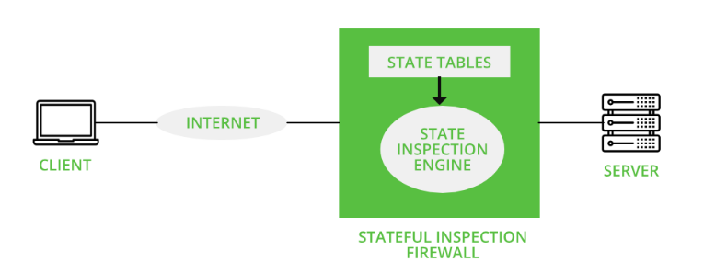
Types of Firewall
Stateful Inspection Firewall: Unlike packet filtering firewalls, stateful inspection firewalls keep track of the state of active connections and make decisions based on the context of the traffic. This enables them to better understand whether incoming packets are part of an established connection or are new and potentially malicious.

Slide 9
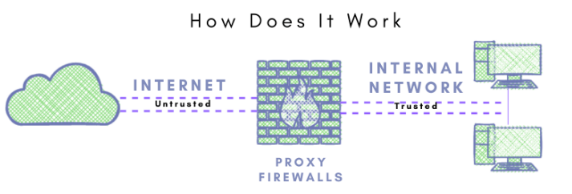
Types of Firewall
Proxy Firewall: Proxy firewalls act as intermediaries between internal and external networks. They receive requests from clients on the internal network, forward them to the external network on behalf of the client, receive the response, and then send it back to the client. This process helps to hide the internal network's IP addresses and enhances security by filtering and inspecting traffic at the application layer (Layer 7) of the OSI model.

Slide 10
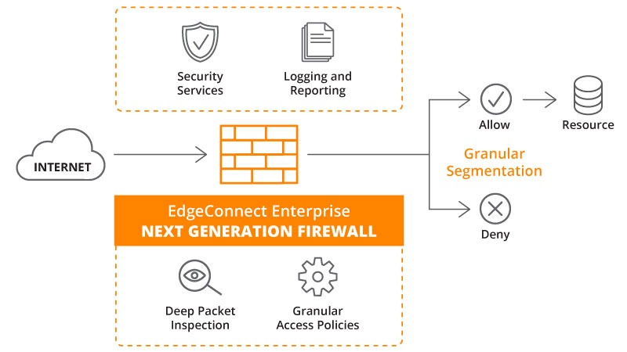
Types of Firewall
Next-Generation Firewall (NGFW): NGFWs combine traditional firewall capabilities with additional features such as intrusion prevention, application awareness, deep packet inspection, and advanced threat protection. They offer more advanced security measures and are designed to protect against modern threats that traditional firewalls may not detect.

Slide 11
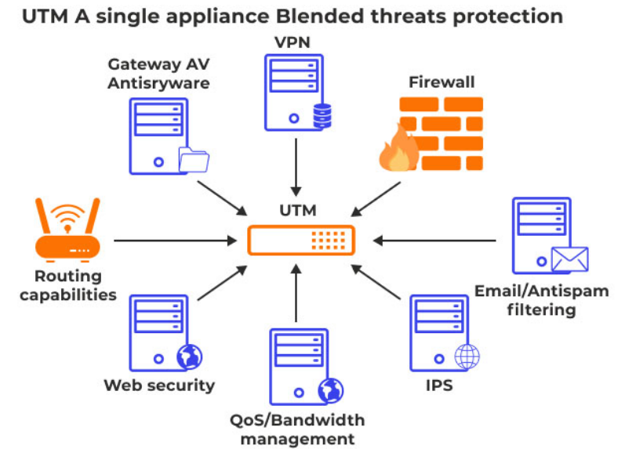
Types of Firewall
Unified Threat Management (UTM) Firewall: UTM firewalls integrate multiple security features into a single platform, including firewalling, intrusion detection and prevention, antivirus, content filtering, and VPN capabilities. This holistic approach to security simplifies management and reduces the need for multiple security appliances.

Slide 12
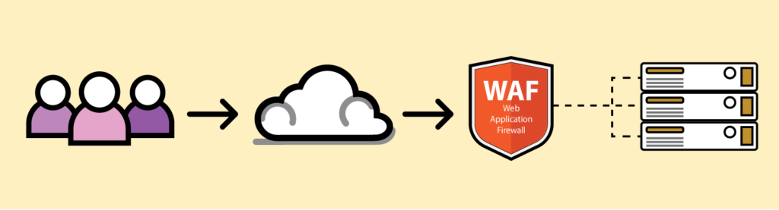
Types of Firewall
Application Layer Firewall (ALF): Also known as Layer 7 firewalls, ALFs operate at the application layer of the OSI model and are capable of inspecting and filtering traffic based on specific applications or protocols. They offer granular control over network traffic and are well-suited for environments where application-level security is a priority.

Slide 13
Types of Firewall
Conclusion
Choosing the right type of firewall for your needs will depend on a number of factors, such as the size and complexity of your network, your security budget, and your specific security requirements.

