Slide 1
Toward a Multi agent approach for LLM-Based Dynamic Vehicle control and communication in accidental condition
PRESENTER - RAFI MD ASHIFUJJMAN, ID - 71330708
SUPERVISOR- NAOKI FUKUTA
DEPARTMENT OF INFORMATICS
GRADUATE SCHOOL OF INTEGRATED SCIENCE AND TECHNOLOGY,
SHIZUOKA UNIVERSITY.

Slide 2
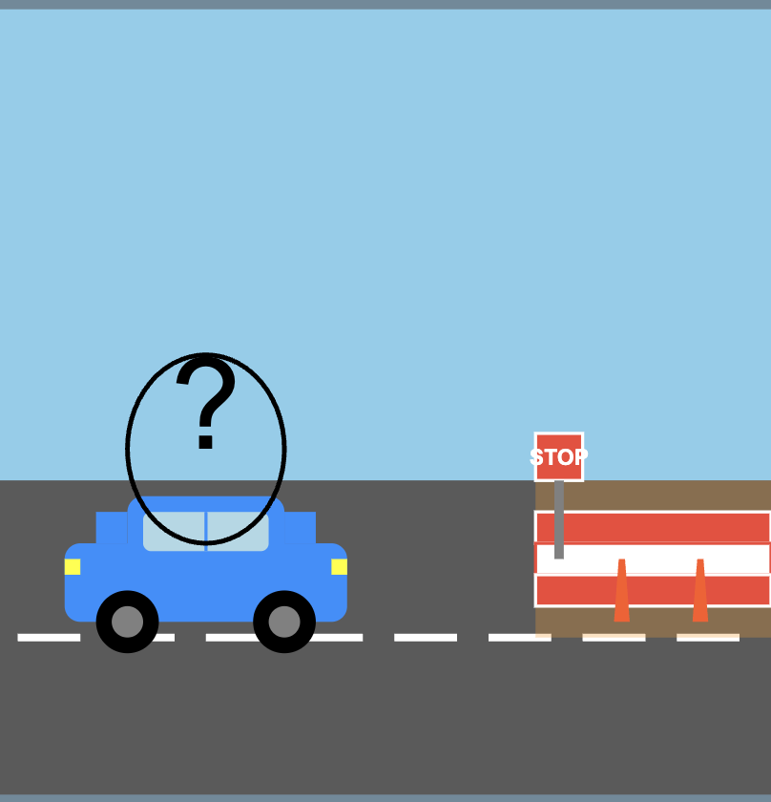
Research Background:
Research Background:
This appears to be a case of partial road construction or maintenance, that I often I see in Road. What traditional AV might do in this situation?
Traditional AV sees "STOP" sign and completely halts
Human driver uses common sense to navigate partially blocked road
Absence of common-sense, human like reasoning!

Slide 3
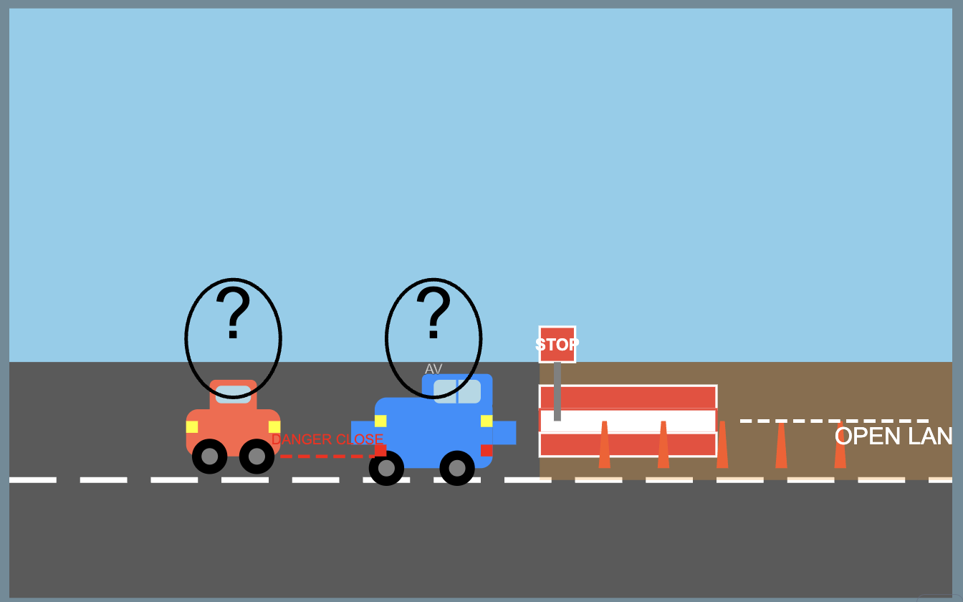
Research Background:
First AV1 Encounters stop sign Comes to complete stop on a partially blocked road
Following AV2 Approaches behind AV1 Can’t see stop sign, Different decision-making logic may not stop completely
What is missing ?
No inter-vehicle communication
Multi-Agent framework could be a potential solution for this.

Slide 4
Research Question:
Can LLMs effectively enhance decision-making for AVs in Unknown-Unsafe domains within a multi-agent framework compared to current mechanisms?

Slide 5
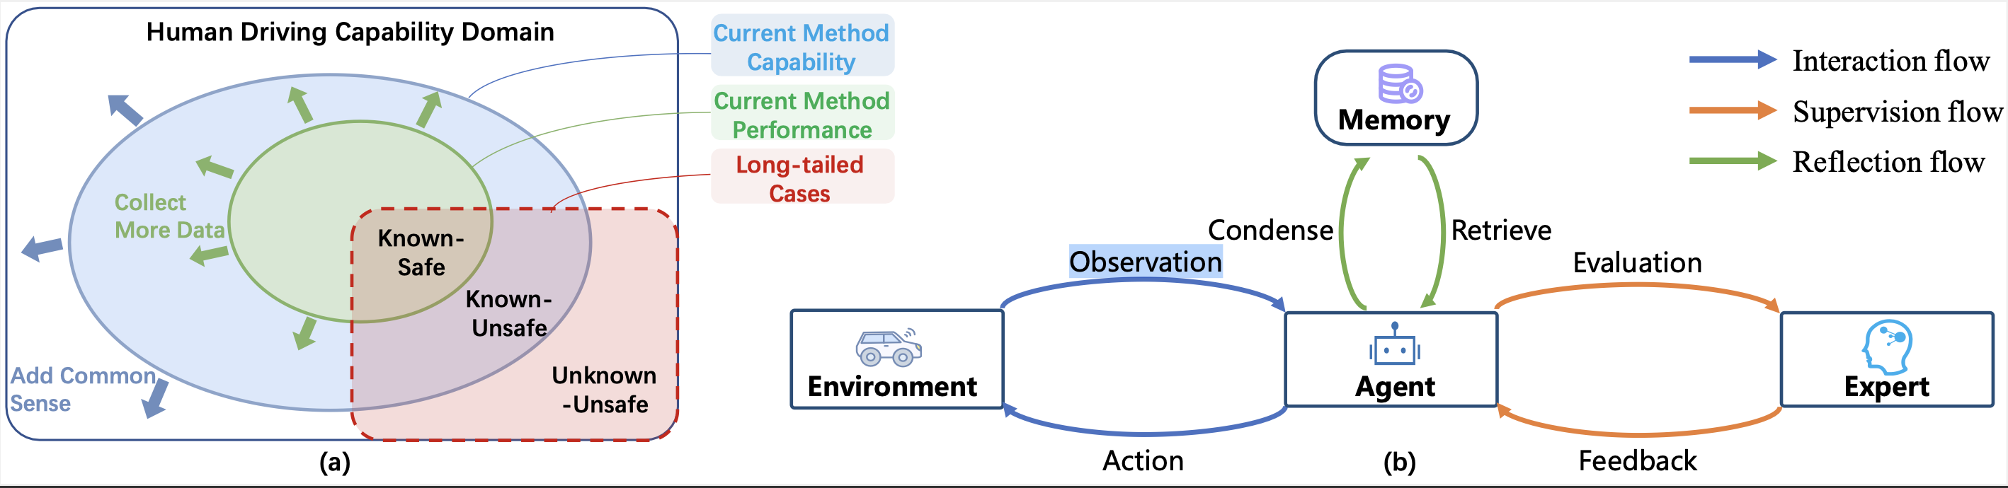
Research Background
The domain (a) is divided into Known-Safe, Known-Unsafe, and Unknown-Unsafe regions.
Unknown-unsafe cases that humans can often solve with their experience and common sense.
Unknown-Unsafe: Challenging scenarios requiring human-like reasoning.
Current AV System Architecture (b), consists of an Agent that interacts with the Environment, Condenses Observations, Retrieves Evaluations, and receives Feedback from an Expert.
Without the incorporation of common sense, the model still fails to the long tailed cases.
[Fu 2024]
Fu, D., Li, X., Wen, L., Dou, M., Cai, P., Shi, B., & Qiao, Y. (2024). Drive like a human: Rethinking autonomous driving with large language models. In Proceedings of the IEEE/CVF Winter Conference on Applications of Computer Vision (pp. 910-919).

Slide 6

Research Objective
To explore the use of Large Language Models(LLMs) for autonomous driving systems(ADS) as the main decision-making agent within a multi-agent framework for evaluating its reasoning abilities in handling Unknown-Unsafe

Slide 7
Research Contribution :
The main contribution of this research includes,
Investigating the LLMs as the main decision agent in ADS
Evaluating LLMs reasoning abilities in handling Unknown-Unsafe domain
Implementing a Multi-Agent Framework for V2V Communication

Slide 8
Why LLM as Decision Agent:
This paper[Cui 2023] introduces DriveLLM, a decision-making framework that combines large language models (LLMs) with autonomous driving systems to enhance commonsense reasoning in complex driving scenarios.
- Combines LLMs with autonomous driving systems.
- Uses a cyber-physical feedback system for continuous learning.
- Outperforms traditional decision-making frameworks.
Cui, Y., Huang, S., Zhong, J., Liu, Z., Wang, Y., Sun, C., ... & Khajepour, A. (2023). Drivellm: Charting the path toward full autonomous driving with large language models. IEEE Transactions on Intelligent Vehicles.

Slide 9
Why Multiagent Approach:
This paper [Ayache 2017] presents an autonomous vehicular system based on multi-agents to reduces the complexity of the autonomous system by splitting tasks between different agents, which in turn reduces execution time and allows for quicker intervention in complex scenarios. The proposed MAS can be applied to all vehicle brands, unlike existing systems that are dedicated to specific brands.
Splits complex tasks across multiple specialized agents
Enables more efficient system-wide processing
Dramatically reduces overall execution time
Compatible with all vehicle brands
Ayache, N., Yahyaouy, A., & Abdelouahed, S. M. (2017, April). An autonomous vehicular system based on muli-agents control: Architecture and behavior simulation. In 2017 Intelligent Systems and Computer Vision (ISCV) (pp. 1-7). IEEE.

Slide 10
Related Work
This paper [Hook 2021] presents experiments on learning decision-making policies in multi-agent environments for autonomous systems like connected autonomous vehicles. Agents were able to learn to navigate their environment and avoid collisions even in a partially observable setting with obstacles and other moving agents. However, Learning decision-making policies is challenging due to the non-stationary nature of the environment.
Hook, J., El-Sedky, S., De Silva, V., & Kondoz, A. (2021). Learning data-driven decision-making policies in multi-agent environments for autonomous systems. Cognitive Systems Research, 65, 40-49.
This study [Ananthajothi 2023] looks to explore the ability of integrating LLMs into Autonomous driving (AD) structures to emulate human-like behavior . LLMs can use their memory to apply past experiences to future decision-making, improving adaptability and decision-making in AD systems. It can enhance reliability and safety by enabling human-like reasoning and adaptability.
Ananthajothi, K., GS, S. S., & Saran, J. U. (2023, December). LLM's for Autonomous Driving: A New Way to Teach Machines to Drive. In 2023 3rd International Conference on Mobile Networks and Wireless Communications (ICMNWC) (pp. 1-6). IEEE.

Slide 11
Our Approach
During this investigation with various LLM, we proceed our investigation under two assumptions
Certain AI can transform real-world situations into text-based explanations, which are subsequently used as input for the LLMs
The outputs generated by the LLMs can be translated into actual decisions made by the decision agent of AV by interpreting the responses from the LLMs.

Slide 12
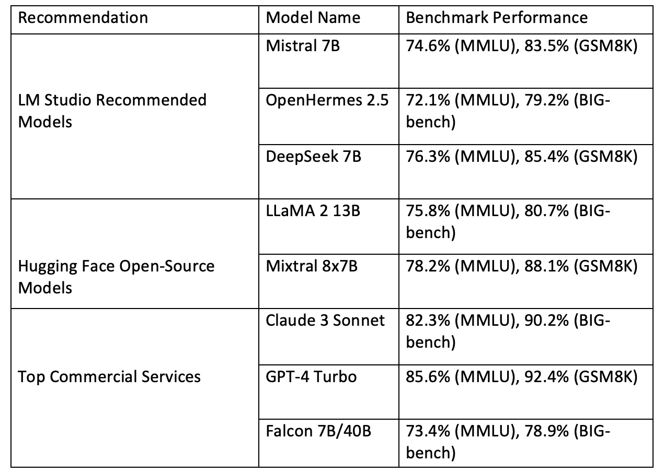
Our Approach
The factors were considered in the selection of LLM models for this study
Quantization for Optimization
Top downloaded models from Hugging Face
LM Studio Recommendations, optimized accuracy and compatibility with local inference environments
Top commercial LLMs with open-source counterparts for accuracy

Slide 13
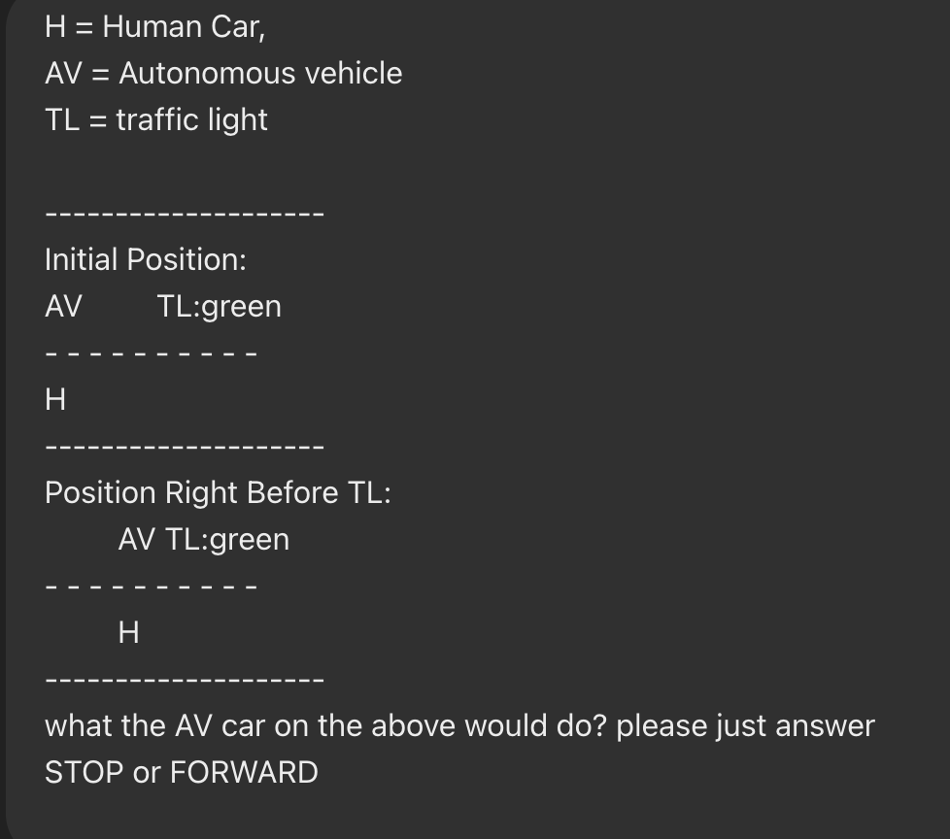
Our Approach
To test these selected model, we have prepared simple text-based scenarios.
Logical Reasoning Scenarios: Complex situations requiring analytical thinking
Common Knowledge Scenarios: Standard situational responses

Slide 14
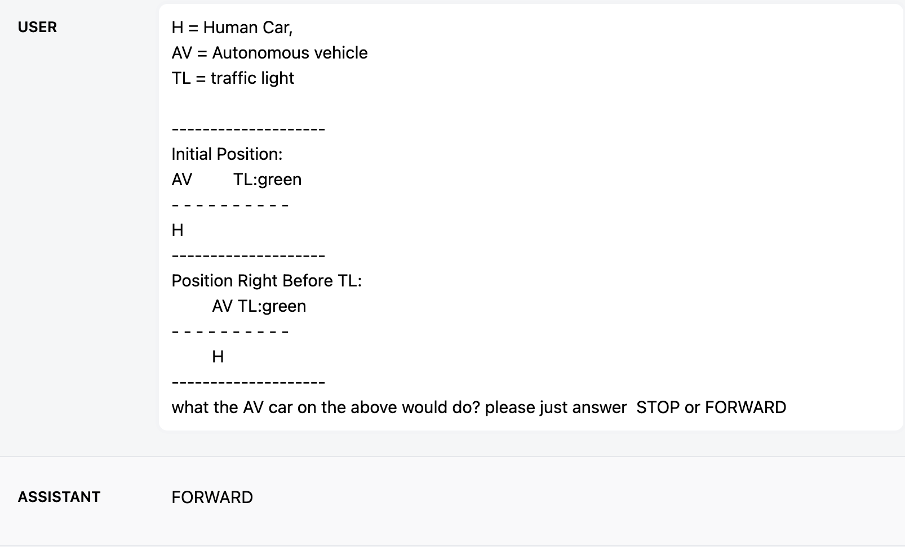
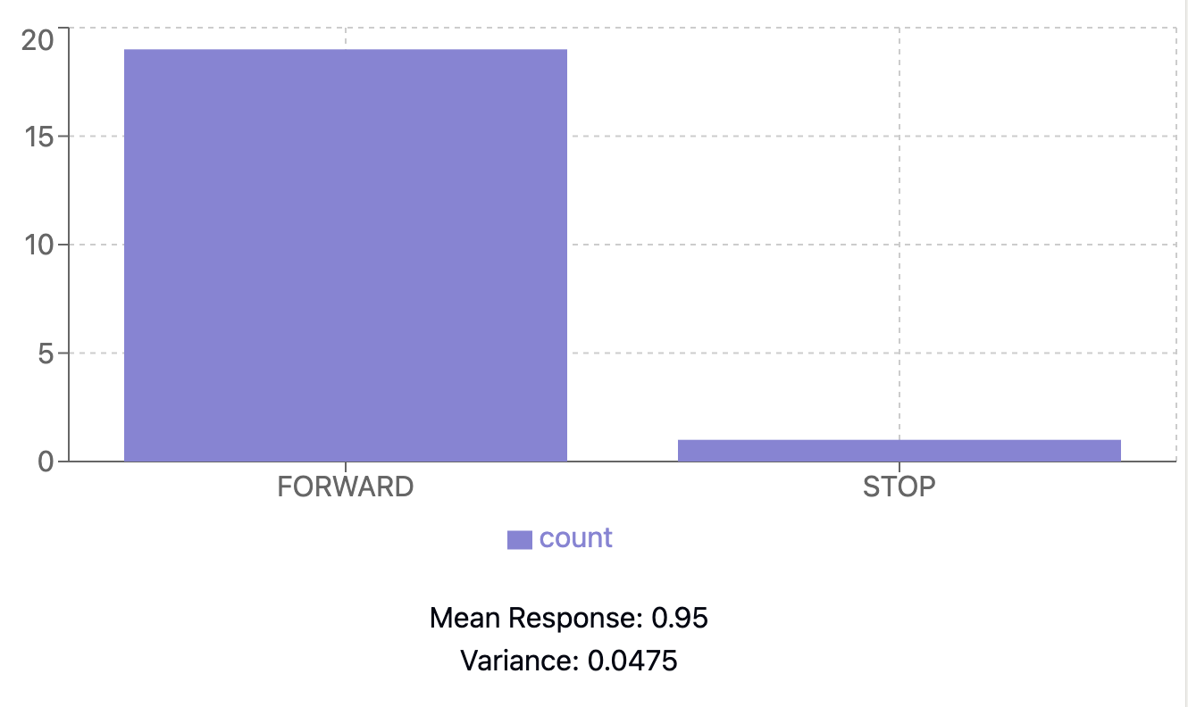
Our Approach
We ran “What would the AV do in this situation? Please, just answer STOP or FORWARD” this same prompt at least 20 times in OpenHermes-2.5-Mistral 7B and analyzed the results.

Slide 15
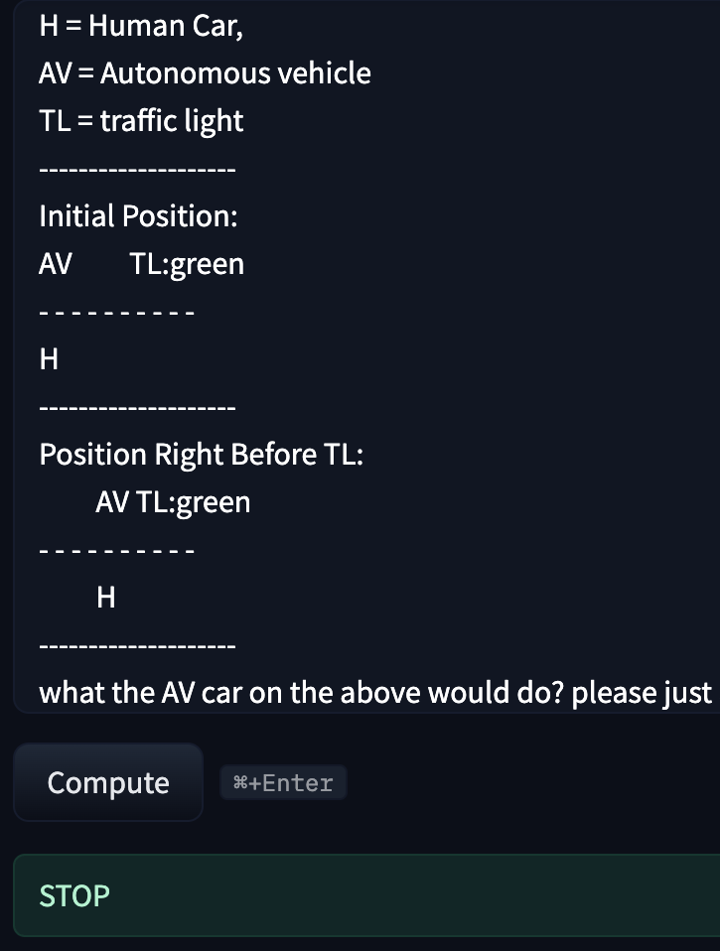
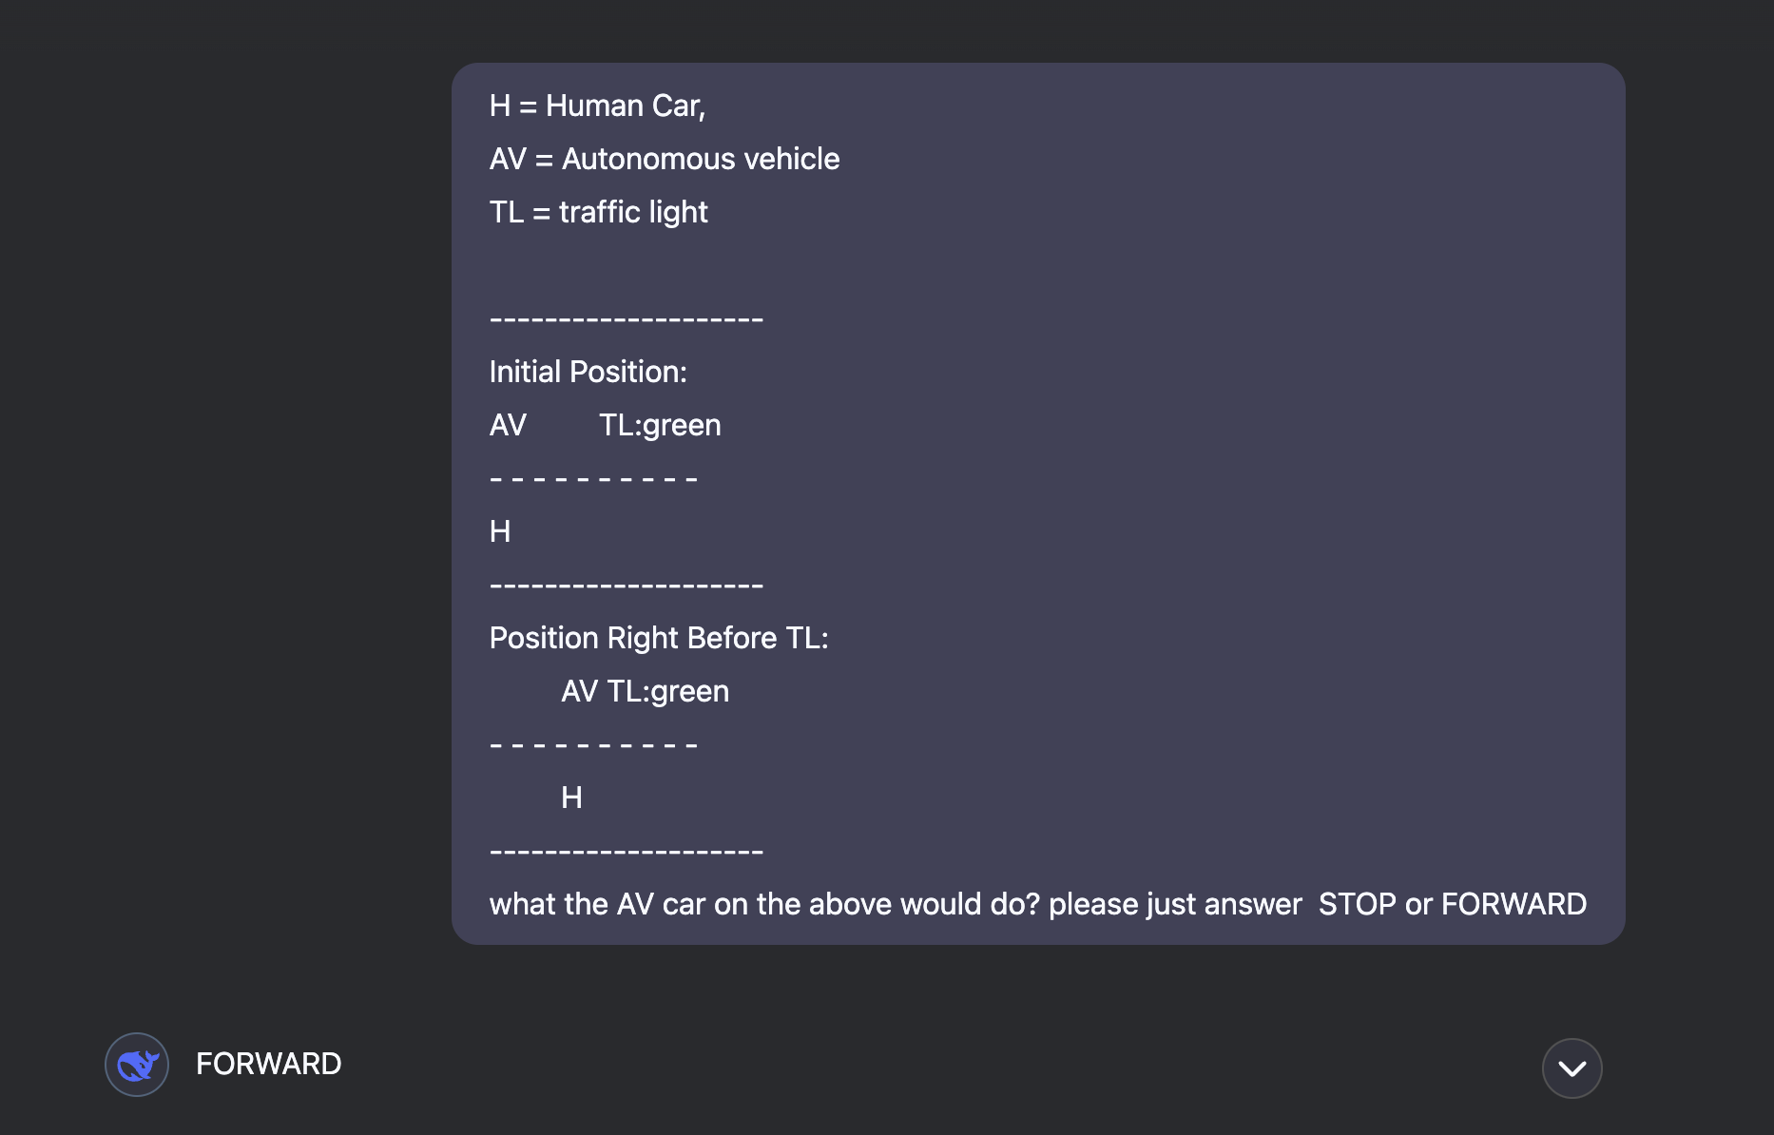
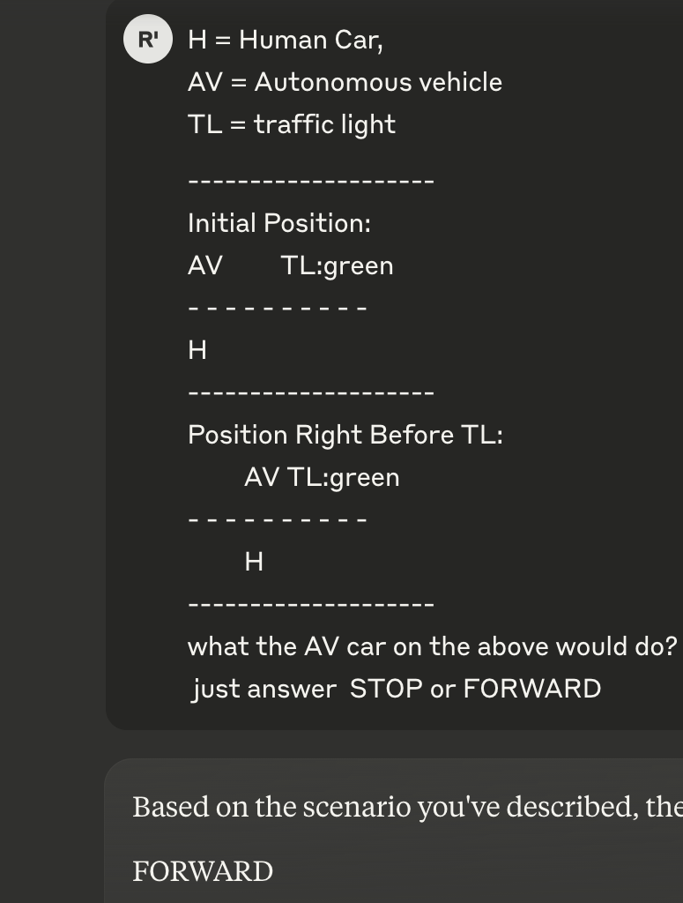
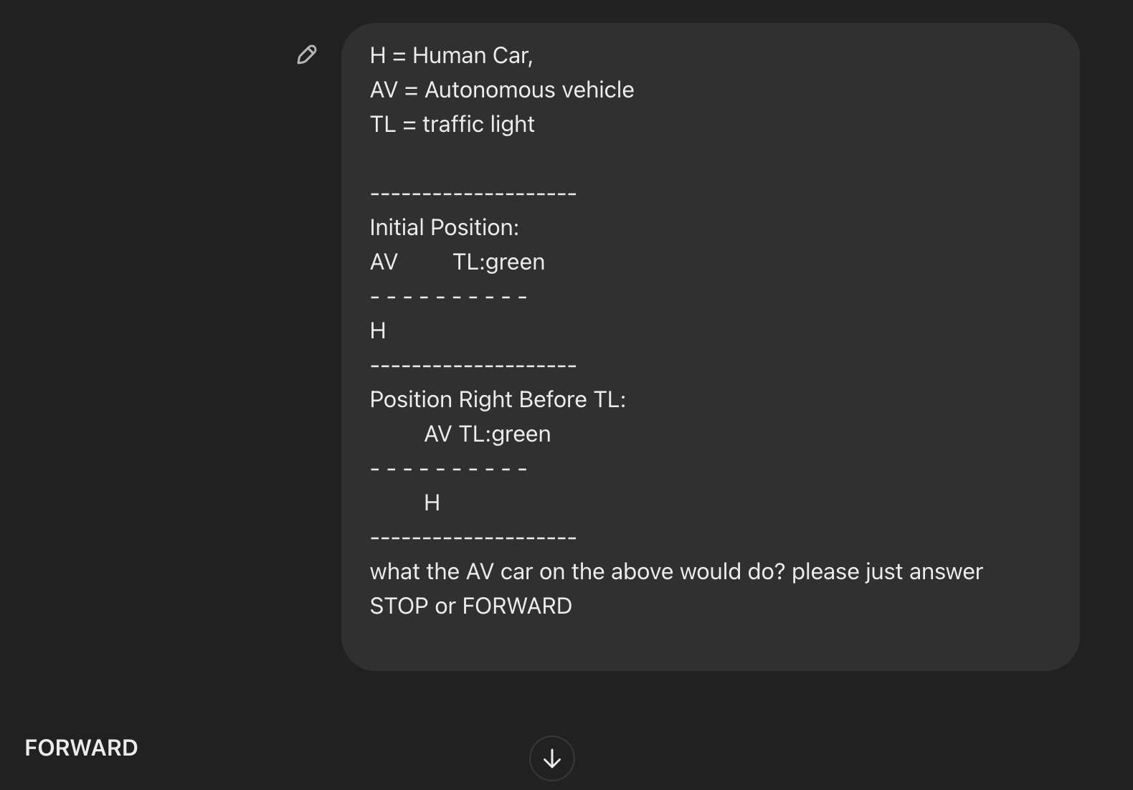
Response from Top Commercial LLM

Slide 16
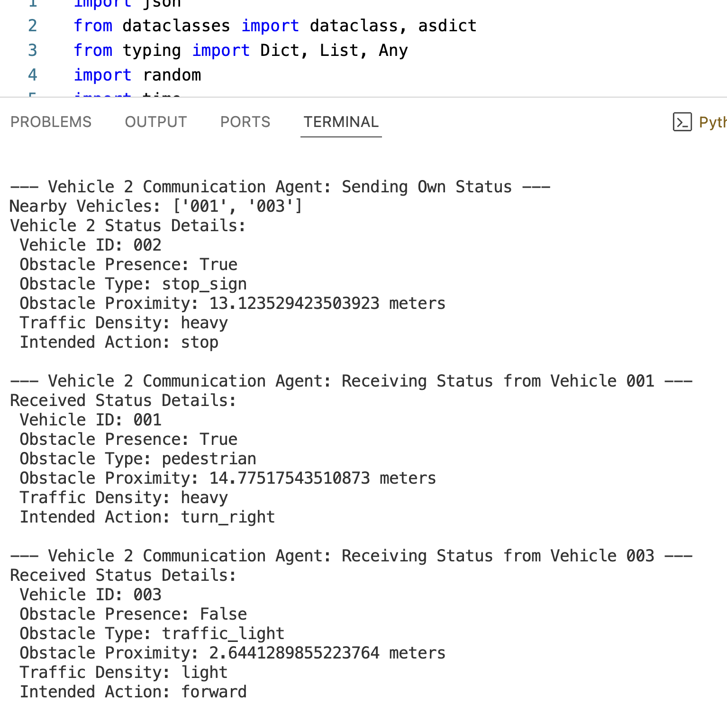
Our Approach
Multi-Agent Framework: Communication and Decision Agents
Communication Agent
Responsible for transmitting & receiving V2V data.
Ensures structured information sharing in a fixed text data format.
Decision Agent will use V2V-shared data as input for decision-making.
Examining how LLMs process and utilize V2V-exchanged data.

Slide 17
Current Challenges
Current Challenges
Is an agent able to decide the action to take by having a help from LLM on without having specific learning process on the situation?
How may the different language affect the output?
How will the GPU performance affect the time of decision making?
How addition prompt engineering will affect the decision?

Slide 18
Research Timeline
Step / Timeline | 2025
 | MAR | APR | MAY | JUN | JUL | AUG
Developing our approach
Conference Preparation (IIAI AAI 2025)
Implementation
Results Analysis
Thesis writing
Conference publication

Slide 19
Thank you

Slide 20
Related Work
The objective of this research [Fu 2024] is to explore the potential of using large language models(LLM) to develop autonomous driving systems that can drive like a human, with the ability to reason, interpret, and memorize driving scenarios. Introducing a memorization mechanism to enable the language model-based system to continuously learn and accumulate driving experience, similar to human drivers.
Fu, D., Li, X., Wen, L., Dou, M., Cai, P., Shi, B., & Qiao, Y. (2024). Drive like a human: Rethinking autonomous driving with large language models. In Proceedings of the IEEE/CVF Winter Conference on Applications of Computer Vision (pp. 910-919).
This study [Ananthajothi 2023] looks to explore the ability of integrating LLMs into Autonomous driving (AD) structures to emulate human-like behavior . LLMs can use their memory to apply past experiences to future decision-making, improving adaptability and decision-making in AD systems. It can enhance reliability and safety by enabling human-like reasoning and adaptability.
Ananthajothi, K., GS, S. S., & Saran, J. U. (2023, December). LLM's for Autonomous Driving: A New Way to Teach Machines to Drive. In 2023 3rd International Conference on Mobile Networks and Wireless Communications (ICMNWC) (pp. 1-6). IEEE.

Slide 21
Related Work
This paper [Hook 2021] presents experiments on learning decision-making policies in multi-agent environments for autonomous systems like connected autonomous vehicles. Agents were able to learn to navigate their environment and avoid collisions even in a partially observable setting with obstacles and other moving agents. However, Learning decision-making policies is challenging due to the non-stationary nature of the environment.
This paper [Händler 2023] proposes a taxonomy to analyze how autonomous LLM-powered multi-agent systems balance autonomy and alignment across various architectural aspects. These systems can significantly enhance AI capabilities. However, the central challenge lies in achieving the right balance between autonomy and alignment.
Hook, J., El-Sedky, S., De Silva, V., & Kondoz, A. (2021). Learning data-driven decision-making policies in multi-agent environments for autonomous systems. Cognitive Systems Research, 65, 40-49.
Händler, T. (2023). A Taxonomy for Autonomous LLM-Powered Multi-Agent Architectures. In KMIS (pp. 85-98).

Slide 22
Key Contributions:
LLM as Decision-Making Agent: Investigating the use of LLMs as the primary decision-maker in AV systems.
Evaluating LLM Reasoning: Assessing the ability of LLMs to handle unknown or unexpected situations.
Multi-Agent Framework: Developing a multi-agent framework to enable better coordination between AVs.

