Slide 1
Toward a Multi Agent Approach for LLM-Based Dynamic Vehicle Control and Communication in Accidental Condition
PRESENTER - RAFI MD ASHIFUJJMAN, ID - 71330708
SUPERVISOR- NAOKI FUKUTA
DEPARTMENT OF INFORMATICS
GRADUATE SCHOOL OF INTEGRATED SCIENCE AND TECHNOLOGY,
SHIZUOKA UNIVERSITY.

Slide 2
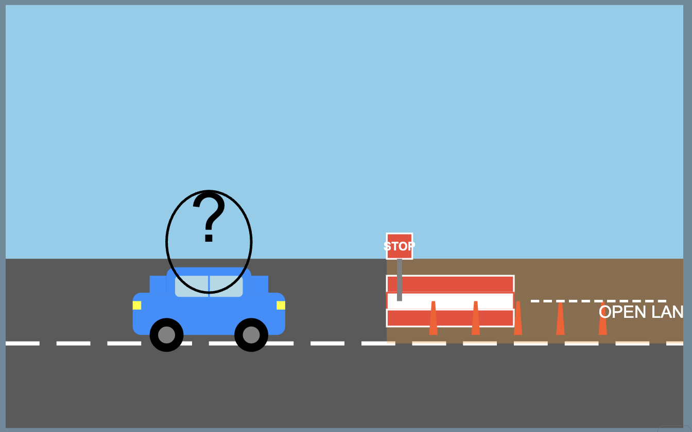
Research Background:
This appears to be a case of partial road construction or maintenance, that I often I see in Road. What traditional AV might do in this situation?
Traditional AV sees "STOP" sign and completely halts
Human driver uses common sense to navigate partially blocked road
Absence of common-sense, human like reasoning!

Slide 3
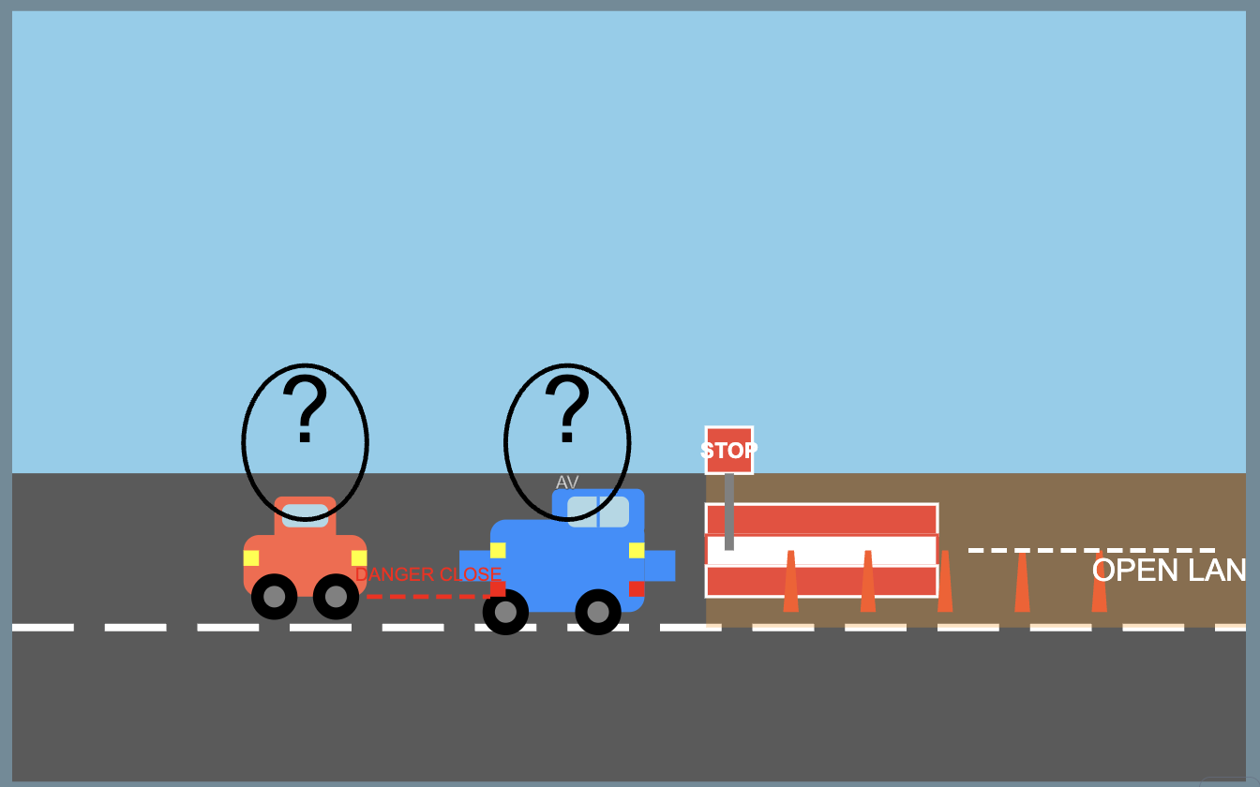
Research Background:
First AV1 Encounters stop sign Comes to complete stop on a partially blocked road
Following AV2 Approaches behind AV1 Can’t see stop sign, Different decision-making logic may not stop completely
What is missing ?
No inter-vehicle communication
Multi-Agent framework could be a potential solution for this.

Slide 4
Traditional AVs Limitations
This appears to be a case of partial road construction or maintenance, that I often we see in Road.
What traditional AV might do in this situation?
Traditional AV sees "STOP" sign and completely halts
Human driver uses common sense to navigate partially blocked road
Traditional AVs follow rigid rules without common sense or reasoning.

Slide 5
Traditional AVs Limitations
First AV1 Encounters stop sign Comes to complete stop on a partially blocked road
Following AV2 Approaches behind AV1 can’t see stop sign, Different decision-making logic may not stop completely
Lack of vehicle-to-vehicle (V2V) communication can lead to accidents

Slide 6
Research Question:
Can LLMs effectively enhance decision-making for AVs in Unknown-Unsafe domains within a multi-agent framework compared to current mechanisms?

Slide 7
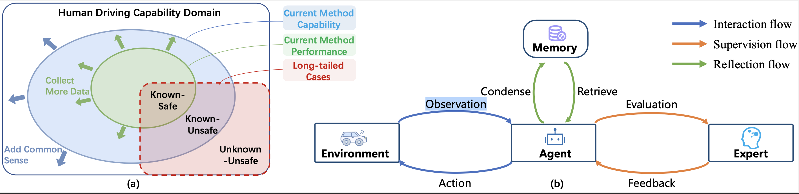
Research Background
The domain (a) is divided into Known-Safe, Known-Unsafe, and Unknown-Unsafe regions.
Unknown-unsafe cases that humans can often solve with their experience and common sense.
Unknown-Unsafe: Challenging scenarios requiring human-like reasoning.
Current AV System Architecture (b), consists of an Agent that interacts with the Environment, Condenses Observations, Retrieves Evaluations, and receives Feedback from an Expert.
Without the incorporation of common sense, the model still fails to the long tailed cases.
[Fu 2024]
Fu, D., Li, X., Wen, L., Dou, M., Cai, P., Shi, B., & Qiao, Y. (2024). Drive like a human: Rethinking autonomous driving with large language models. In Proceedings of the IEEE/CVF Winter Conference on Applications of Computer Vision (pp. 910-919).

Slide 8

Research Objective
To explore the use of Large Language Models(LLMs) for autonomous driving systems(ADS) as the main decision-making agent within a multi-agent framework for evaluating its reasoning abilities in handling Unknown-Unsafe

Slide 9




Research Objective
Explore LLMs
Investigate large language models as primary decision agents
Evaluate Reasoning
Evaluating LLMs reasoning abilities in handling complex scenarios
Multi-Agent Framework
Implement vehicle-to-vehicle communication systems
Enhance Safety

Slide 10
Research Contribution :
The main contribution of this research includes,
Investigating the LLMs as the main decision agent in ADS
Evaluating LLMs reasoning abilities in handling Unknown-Unsafe domain
Implementing a Multi-Agent Framework for V2V Communication

Slide 11
Why LLM as Decision Agent:
This paper[Cui 2023] introduces DriveLLM, a decision-making framework that combines large language models (LLMs) with autonomous driving systems to enhance commonsense reasoning in complex driving scenarios.
- Combines LLMs with autonomous driving systems.
- Uses a cyber-physical feedback system for continuous learning.
- Outperforms traditional decision-making frameworks.
Cui, Y., Huang, S., Zhong, J., Liu, Z., Wang, Y., Sun, C., ... & Khajepour, A. (2023). Drivellm: Charting the path toward full autonomous driving with large language models. IEEE Transactions on Intelligent Vehicles.

Slide 12
Why Multiagent Approach:
This paper [Ayache 2017] presents an autonomous vehicular system based on multi-agents to reduces the complexity of the autonomous system by splitting tasks between different agents, which in turn reduces execution time and allows for quicker intervention in complex scenarios. The proposed MAS can be applied to all vehicle brands, unlike existing systems that are dedicated to specific brands.
Splits complex tasks across multiple specialized agents
Enables more efficient system-wide processing
Dramatically reduces overall execution time
Compatible with all vehicle brands
Ayache, N., Yahyaouy, A., & Abdelouahed, S. M. (2017, April). An autonomous vehicular system based on muli-agents control: Architecture and behavior simulation. In 2017 Intelligent Systems and Computer Vision (ISCV) (pp. 1-7). IEEE.

Slide 13
Related Work
This paper [Hook 2021] presents experiments on learning decision-making policies in multi-agent environments for autonomous systems like connected autonomous vehicles. Agents were able to learn to navigate their environment and avoid collisions even in a partially observable setting with obstacles and other moving agents. However, Learning decision-making policies is challenging due to the non-stationary nature of the environment.
Hook, J., El-Sedky, S., De Silva, V., & Kondoz, A. (2021). Learning data-driven decision-making policies in multi-agent environments for autonomous systems. Cognitive Systems Research, 65, 40-49.
This study [Ananthajothi 2023] looks to explore the ability of integrating LLMs into Autonomous driving (AD) structures to emulate human-like behavior . LLMs can use their memory to apply past experiences to future decision-making, improving adaptability and decision-making in AD systems. It can enhance reliability and safety by enabling human-like reasoning and adaptability.
Ananthajothi, K., GS, S. S., & Saran, J. U. (2023, December). LLM's for Autonomous Driving: A New Way to Teach Machines to Drive. In 2023 3rd International Conference on Mobile Networks and Wireless Communications (ICMNWC) (pp. 1-6). IEEE.

Slide 14
Our Approach: Research Assumptions
During this investigation with various LLM, we proceed our investigation under two assumptions
Certain AI can transform real-world situations into text-based explanations, which are subsequently used as input for the LLMs
The outputs generated by the LLMs can be translated into actual decisions made by the decision agent of AV by interpreting the responses from the LLMs.

Slide 15
Our Approach: Research Assumptions
During this investigation with various LLM, we proceed our investigation under two assumptions
Situation-to-Text Conversion: Certain AI systems can transform real-world situations into text-based explanations for LLM input
LLM-to-Decision Translation: LLM outputs can be translated into actual AV decisions by interpreting responses
V2V Infrastructure: Communication is achieved through standardized networking protocols (LAN-based, low-latency wireless systems)
Fixed Communication Radius: Information sharing between vehicles occurs within defined range

Slide 16
Our Approach: Environment Setup

Slide 17
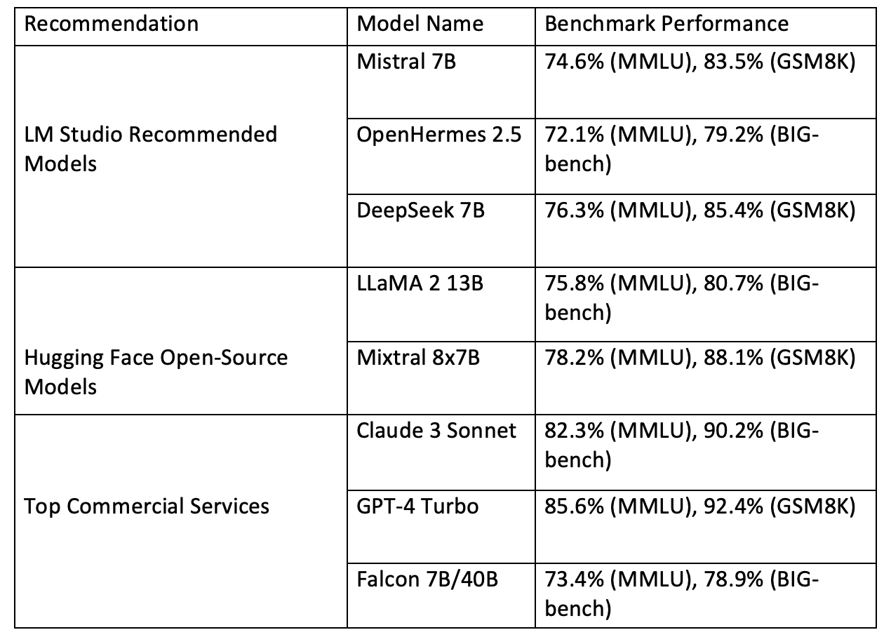
Our Approach: Model Selection
The factors were considered in the selection of LLM models for this study,
Quantization for Optimization
Top downloaded models from Hugging Face
LM Studio Recommendations, optimized accuracy and compatibility with local inference environments
Top commercial LLMs with open-source counterparts for accuracy

Slide 18
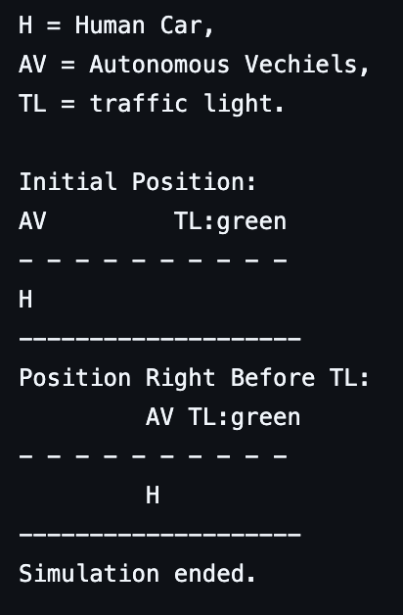
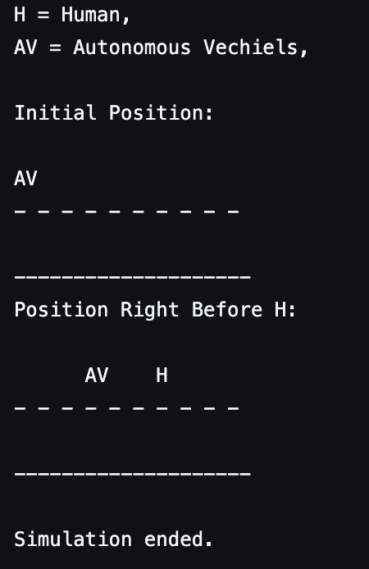
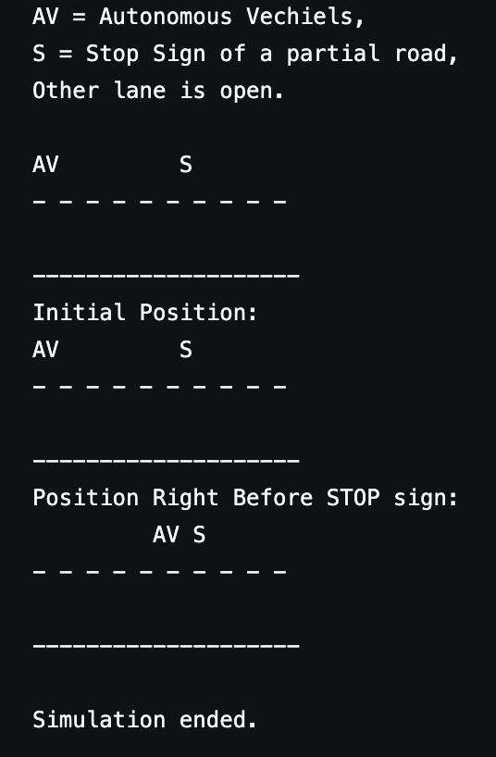
Our Approach: Test Scenarios
Stop Sign on Partial Road
Traffic Light Recognition
Sudden Pedestrian Crossing
Using these scenarios, we will test the LLM's capabilities in logical reasoning, rule compliance, and dynamic decision-making for autonomous systems.

Slide 19
Our Approach: Test Scenarios
Stop Sign on Partial Road
Traffic Light Recognition
Sudden Pedestrian Crossing
Using these scenarios we will test the LLM's capabilities in logical reasoning, rule compliance, and dynamic decision-making for autonomous systems.

Slide 20
Our Approach: Test Scenarios

Slide 21
Our Approach: Extended Test Scenario
Stop Sign on Partial Road
Traffic Light Recognition
Sudden Pedestrian Crossing
Using these scenarios, we will test the LLM's capabilities in logical reasoning, rule compliance, and dynamic decision-making for autonomous systems.

Slide 22
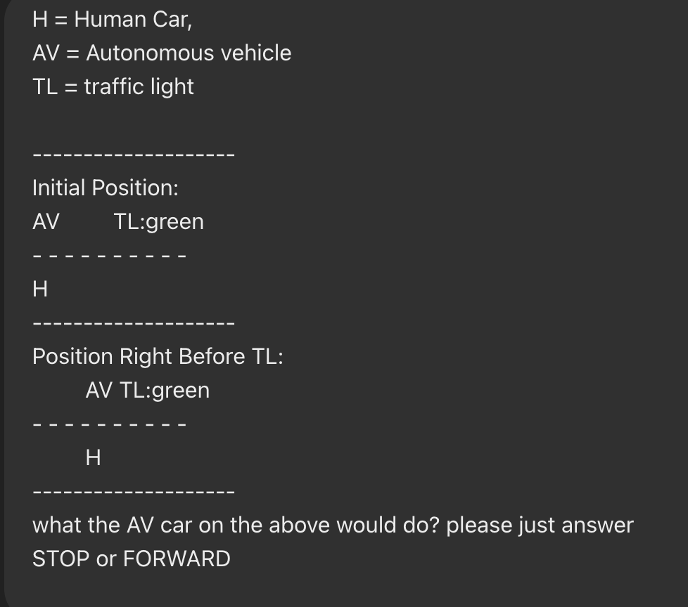
Our Approach
To test these selected model, we have prepared simple text-based scenarios.
Logical Reasoning Scenarios: Complex situations requiring analytical thinking
Common Knowledge Scenarios: Standard situational responses

Slide 23
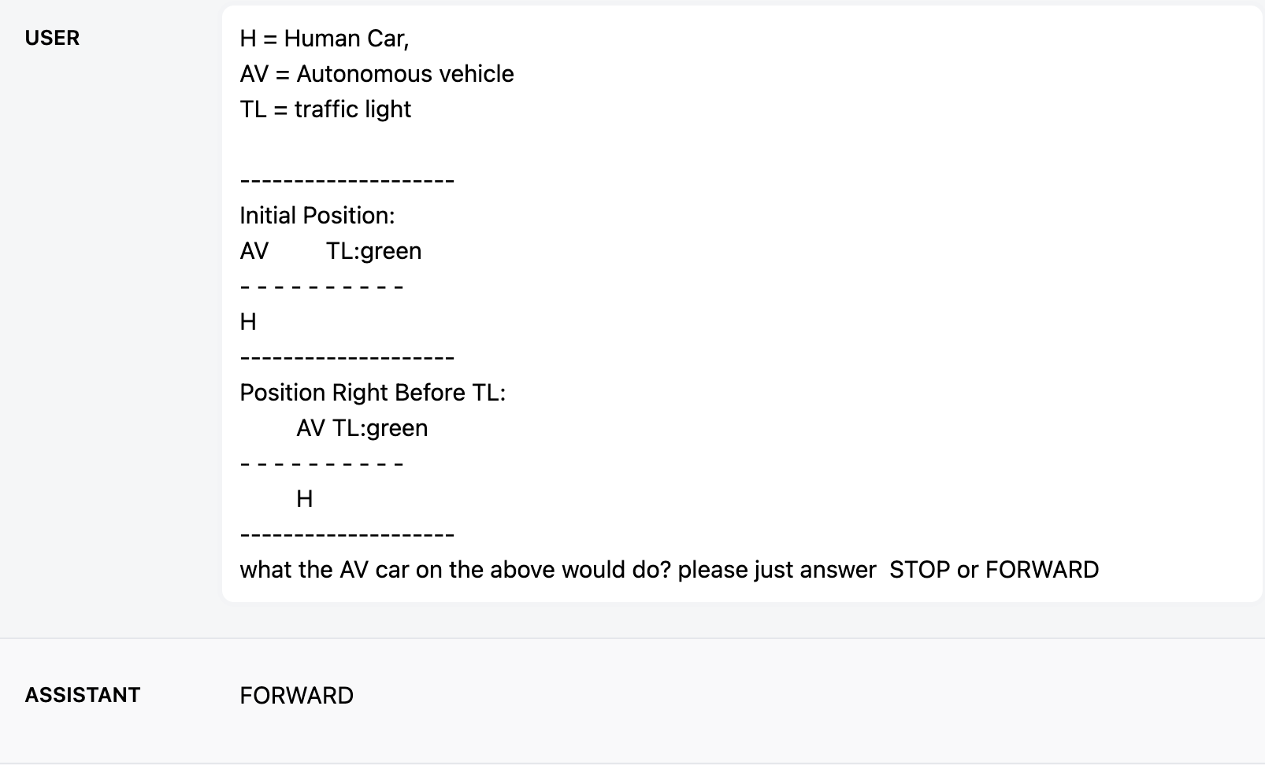
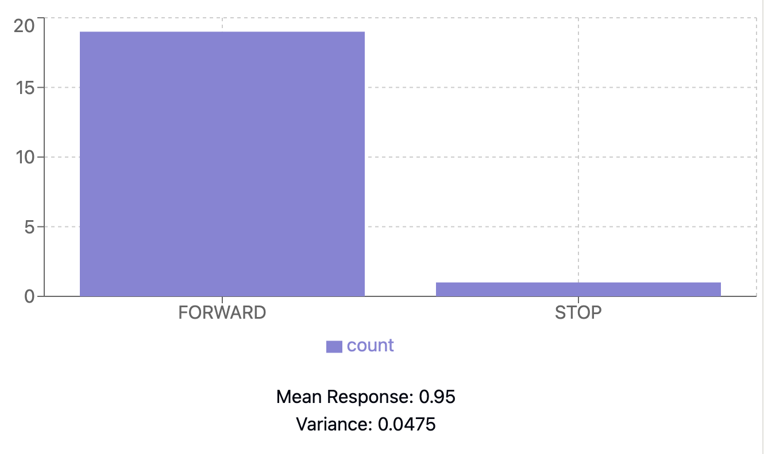
Our Approach
We ran “What would the AV do in this situation? Please, just answer STOP or FORWARD” this same prompt at least 20 times in OpenHermes-2.5-Mistral 7B and analyzed the results.

Slide 24
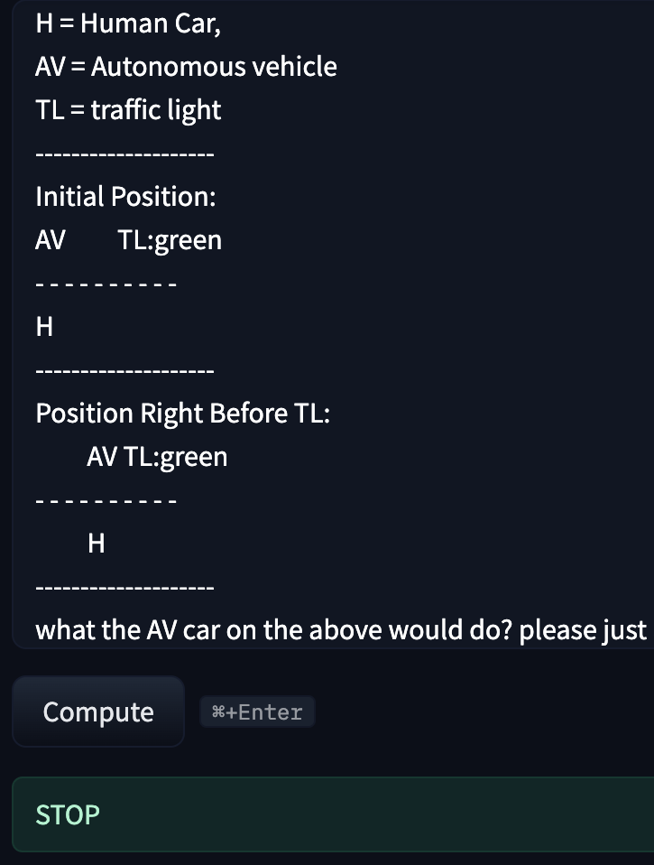
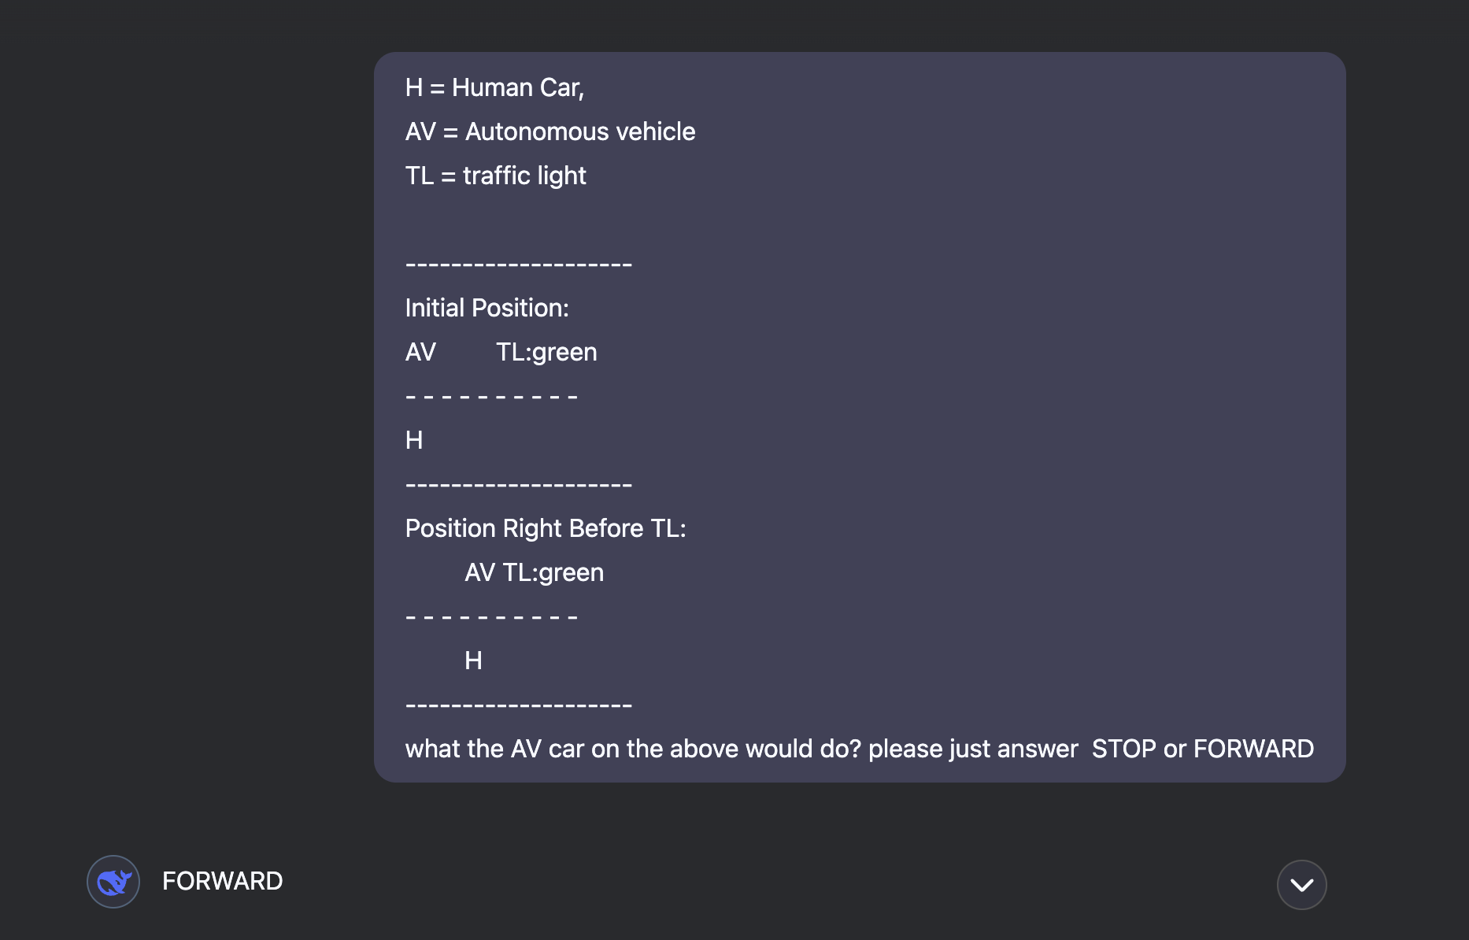
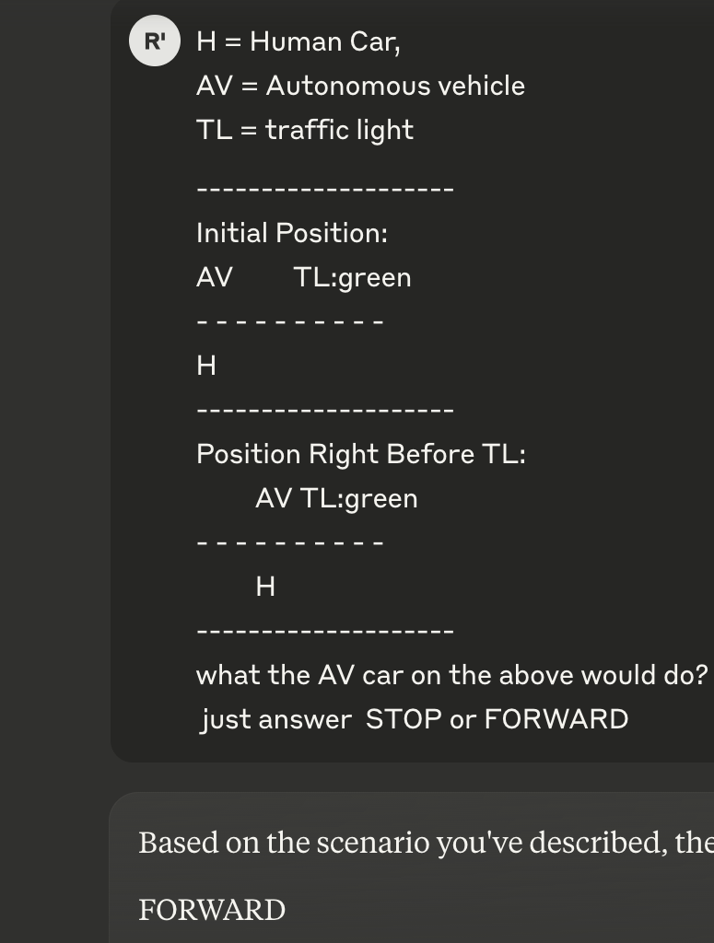
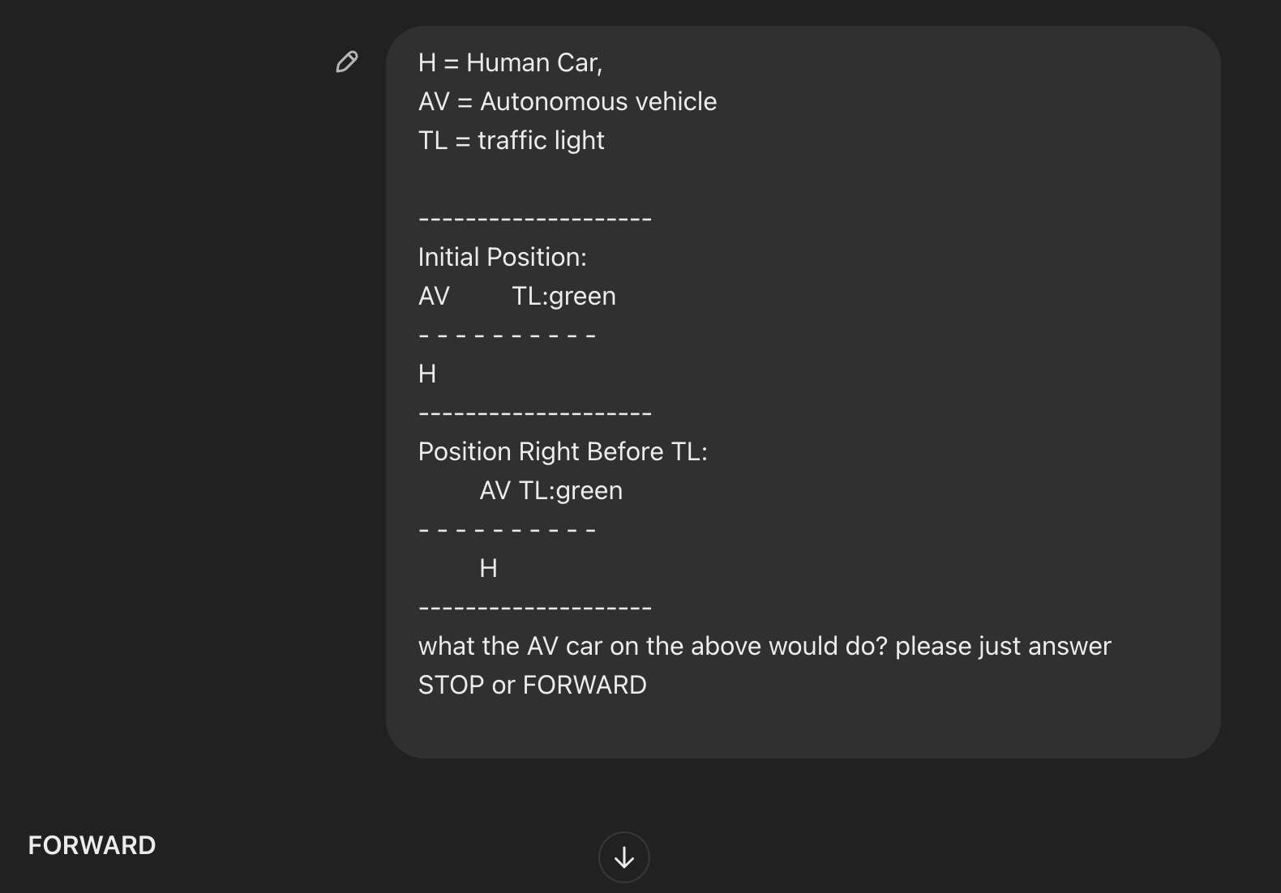
Response from Top Commercial LLM

Slide 25
Our Approach
We are also assuming that,
V2V communication is already achieved and operational through a standardized networking protocol.(LAN-based, Low-latency wireless systems)
Communication occurs within a fixed radius(When a vehicle enters the information sharing radius of another vehicle, they exchange.)
This assumption allows us to focus on how shared data affects autonomous decision-making

Slide 26
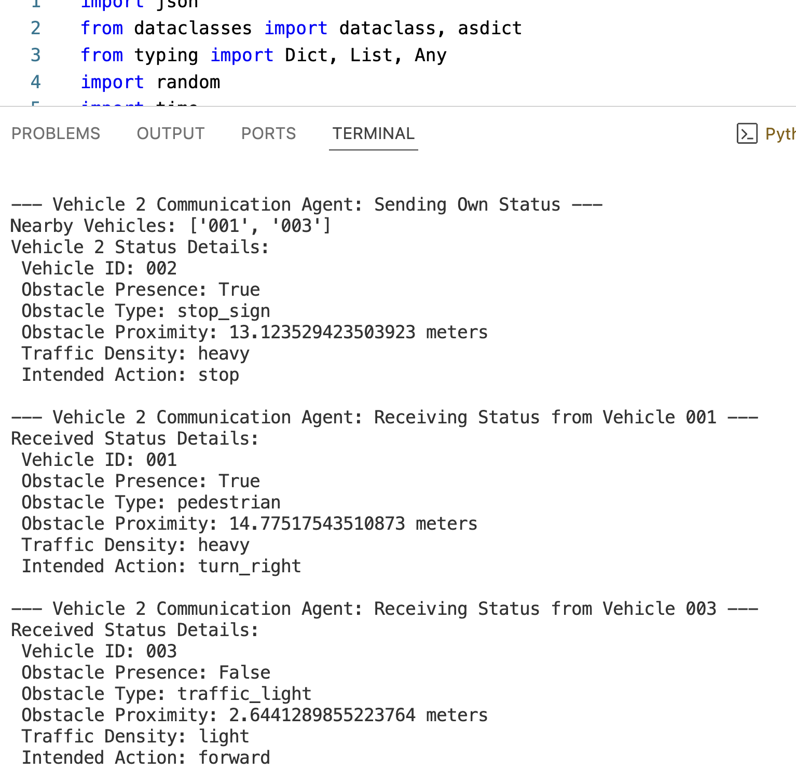
Our Approach
Multi-Agent Framework: Communication and Decision Agents
Communication Agent
Responsible for transmitting & receiving V2V data.
Ensures structured information sharing in a fixed text data format.
Decision Agent will use V2V-shared data as input for decision-making.
Examining how LLMs process and utilize V2V-exchanged data.

Slide 27
Current Challenges
Current Challenges
Can an agent make decisions with the help of an LLM without undergoing a specific learning process for each new situation?
How may the different language affect the output?
How will the GPU performance affect the time of decision making?
How addition prompt engineering will affect the decision?

Slide 28
Research Timeline
Step / Timeline | 2025
 | MAR | APR | MAY | JUN | JUL | AUG
Developing our approach
Conference Preparation (IIAI AAI 2025)
Implementation
Results Analysis
Thesis writing
Conference publication

Slide 29
Thank you

Slide 30
Our Approach: Test Scenarios
Stop sign on Partial road: Testing common-sense reasoning Traffic Light: Testing basic rule following Human suddenly crossing road: Testing emergency response hese scenarios are designed to cover
situations that require logical reasoning or the application of
common rules knowledge, such as recognizing a red traffic
light and stopping accordingly.

Slide 31
Our Approach: Model Selection
The factors were considered in the selection of LLM models for this study
Quantization for Optimization
Top downloaded models from Hugging Face
LM Studio Recommendations, optimized accuracy and compatibility with local inference environments
Top commercial LLMs with open-source counterparts for accuracy

