Slide 1

MNIST Handwritten Digit Classification using Convolutional Neural Network (CNN)
Presented By:
Sujan Kumar Roy, Ph. D. (Australia), M. A. Sc. (Canada)
Department of Computer Science and Engineering
University of Rajshahi, Bangladesh
http://rurfid.ru.ac.bd/ru_profile/public/teacher/

Slide 2
Outlines
What is CNN?
Why CNN over Simple Feed-Forward NN (FFNN)
MNIST Digit Classification using CNN
CNN Architecture Details
Convolution Operation
Pooling Operation
Task to be completed Today.
Ref:https://towardsdatascience.com/a-comprehensive-guide-to-convolutional-neural-networks-the-eli5-way-3bd2b1164a53

Slide 3
What is CNN?
CNN, is a well-known method in computer vision applications.
It is a class of deep neural networks that are used to analyze visual imagery.
This type of architecture is dominant to recognize objects from a picture or video.
It is used in applications like image or video recognition, neural language processing, etc.

Slide 4
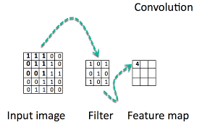

Why CNN Over FNN?
In cases of extremely basic binary images, FFNN might show an average precision score while performing prediction of classes.
when it comes to complex images having pixel dependencies throughout (shapes/textures)– FFNN reduces prediction accuracy.
A CNN is able to successfully capture the Spatial and Temporal dependencies in an image through the application of relevant filters.

Slide 5
MNIST Digit Classification with CNN (1/9)
You will follow the steps below for image classification using CNN:
Step 1: Upload Dataset
Step 2: Input layer
Step 3: Convolutional layer
Step 4: Pooling layer
Step 5: Second Convolutional Layer and Pooling Layer
Step 6: Dense layer
Step 7: Logit Layer

Slide 6
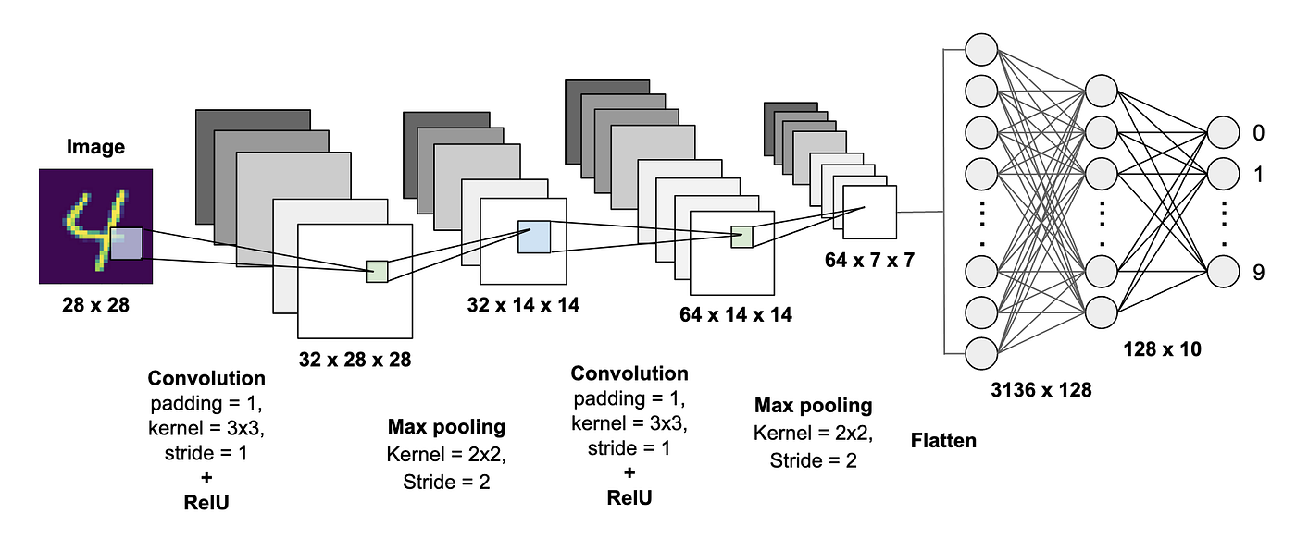
MNIST Digit Classification with CNN (2/9)
Graphical View of CNN steps for handwritten digit classification:

Slide 7
MNIST Digit Classification with CNN (3/9)
Conv2D Function in TensorFlow
tf.keras.layers.Conv2D(
filters,
kernel_size,
strides=(1, 1),
padding='valid',
data_format=None,
dilation_rate=(1, 1),
……
)
Filters: The number of output filters in the convolution– filters can be different, such as, edge detect, horizontal info detect, mixed, etc. (familiar with image processing with filters/kernels).
kernel_size: An integer or tuple/list of 2 integers, specifying the height and width of the 2D convolution window, (3,3) or (5,5), etc.
Etc.

Slide 8
MNIST Digit Classification with CNN (4/9)
Components of Convolutional Neural Network (ConvNet or CNN)
There are four components of a Convnets
Convolution
Non Linearity (ReLU)
Pooling or Sub Sampling
Classification (Fully Connected Layer)

Slide 9
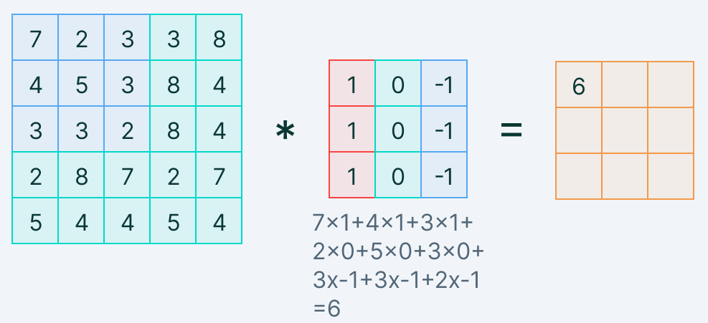
MNIST Digit Classification with CNN (5/9)
Convolution Operation

Slide 10
MNIST Digit Classification with CNN (6/9)
Animated Example of Convolution Operation

Slide 11
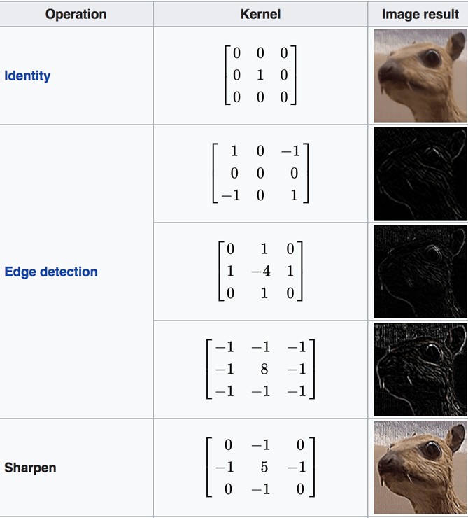
MNIST Digit Classification with CNN (7/9)
Examples of Different Convolution Kernels
Capturing Complex Patterns (Edge, Identity)

Slide 12
MNIST Digit Classification with CNN (8/9)
ReLU Activation Function

Slide 13
MNIST Digit Classification with CNN (9/9)
Pooling Operation

Slide 14
Task to be Completed Today
Design a Customize CNN for Handwritten Digit Classification with the following specifications:
Generate a CNN model with:
Two CNN hidden layers (Conv2D) of sizes 32, 64 followed by
ReLU Activation and
MaxPooling2D with Kernel size (3, 3), and
Stride= (1,1)
2. Use Flatten Layers to convert the feature map into 1D
3. Use simple Dense layer of size 64 followed by output Dense Layer of size 10 with SoftMax Activation Function
4. Use the MNIST database for training and testing
5. Carefully read the problem specifications and implement the CNN accordingly.

