Slide 1

Bluestock Mutual Fund Analytics Capstone Project
Submitted By: Ashi Dwivedi Organization: Bluestock Fintech Duration: Internship Capstone Project

Slide 2

Problem Statement & Objectives
The mutual fund industry generates large volumes of data related to fund performance, investor transactions, SIP inflows, and market trends. Extracting meaningful insights from this data is essential for informed investment and business decisions.
Project Objectives
Build an end-to-end ETL pipeline
Analyze mutual fund industry trends
Evaluate risk and performance metrics
Study investor behavior and SIP patterns
Develop interactive dashboards
Generate actionable business insights

Slide 3
Data Sources
Data Sources Used
Fund Master Data – Scheme details and classifications.
NAV History – Historical NAV values for return analysis.
AUM Data – Industry and AMC-wise asset growth.
SIP Inflows – Monthly SIP investment trends.
Category Inflows – Investment flow across fund categories.
Investor Transactions – Investor behavior and transaction analysis.
Portfolio Holdings – Portfolio composition and concentration analysis.
Benchmark Indices – Market performance comparison.
Highlights
Integrated 8+ datasets into a unified analytics platform.
Combined fund, investor, and market-level data.
Enabled risk analysis, performance evaluation, and dashboard reporting.

Slide 4
Project Architecture
End-to-End Analytics Workflow
Raw Data Sources
ETL Pipeline
Data Cleaning & Transformation
Exploratory Data Analysis
Advanced Analytics
Tableau Dashboards
Business Insights

Slide 5
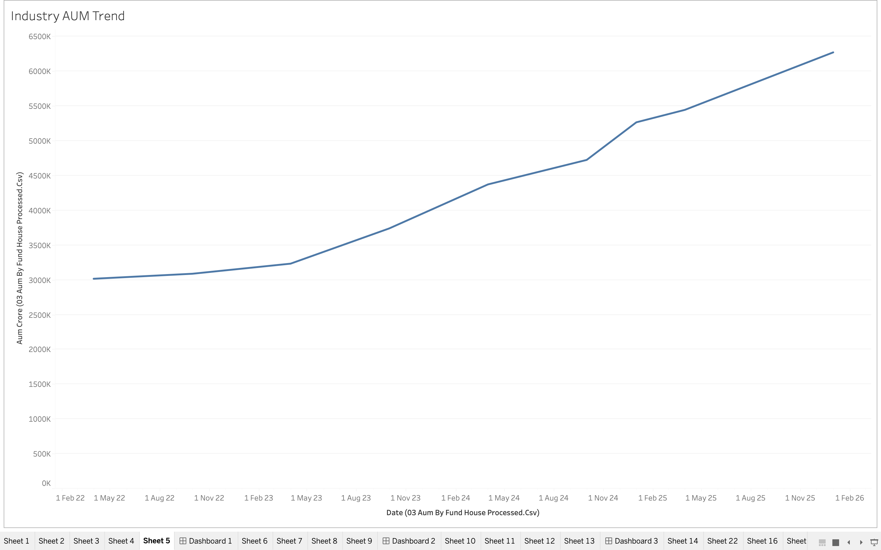
EDA Highlights – Industry Trends
Industry Growth Analysis
Key Findings
Industry AUM showed consistent growth from 2022–2025
SIP participation increased significantly
Large AMCs dominate overall market share
Insights
Growing investor confidence
Strong retail participation
Expansion of mutual fund ecosystem

Slide 6
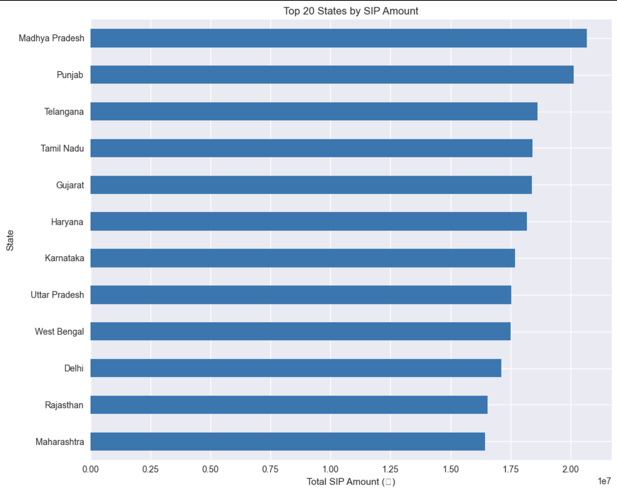
EDA Highlights – Investor Behavior
Key Findings
The 26–35 age group forms the largest segment of mutual fund investors.
Male investors contribute a higher share of total investments than female investors.
SIP contributions are concentrated in major states such as Madhya Pradesh, Punjab, and Telangana.
Tier-30 (T30) cities account for the majority of investments, indicating strong urban participation.
Total folios grew significantly between 2022 and 2025, reflecting increasing retail investor adoption.
Business Insights
Young professionals are the primary drivers of mutual fund growth.
Expanding investor awareness among underrepresented groups can increase market penetration.
Continued folio growth signals strong confidence in mutual fund investments.

Slide 7
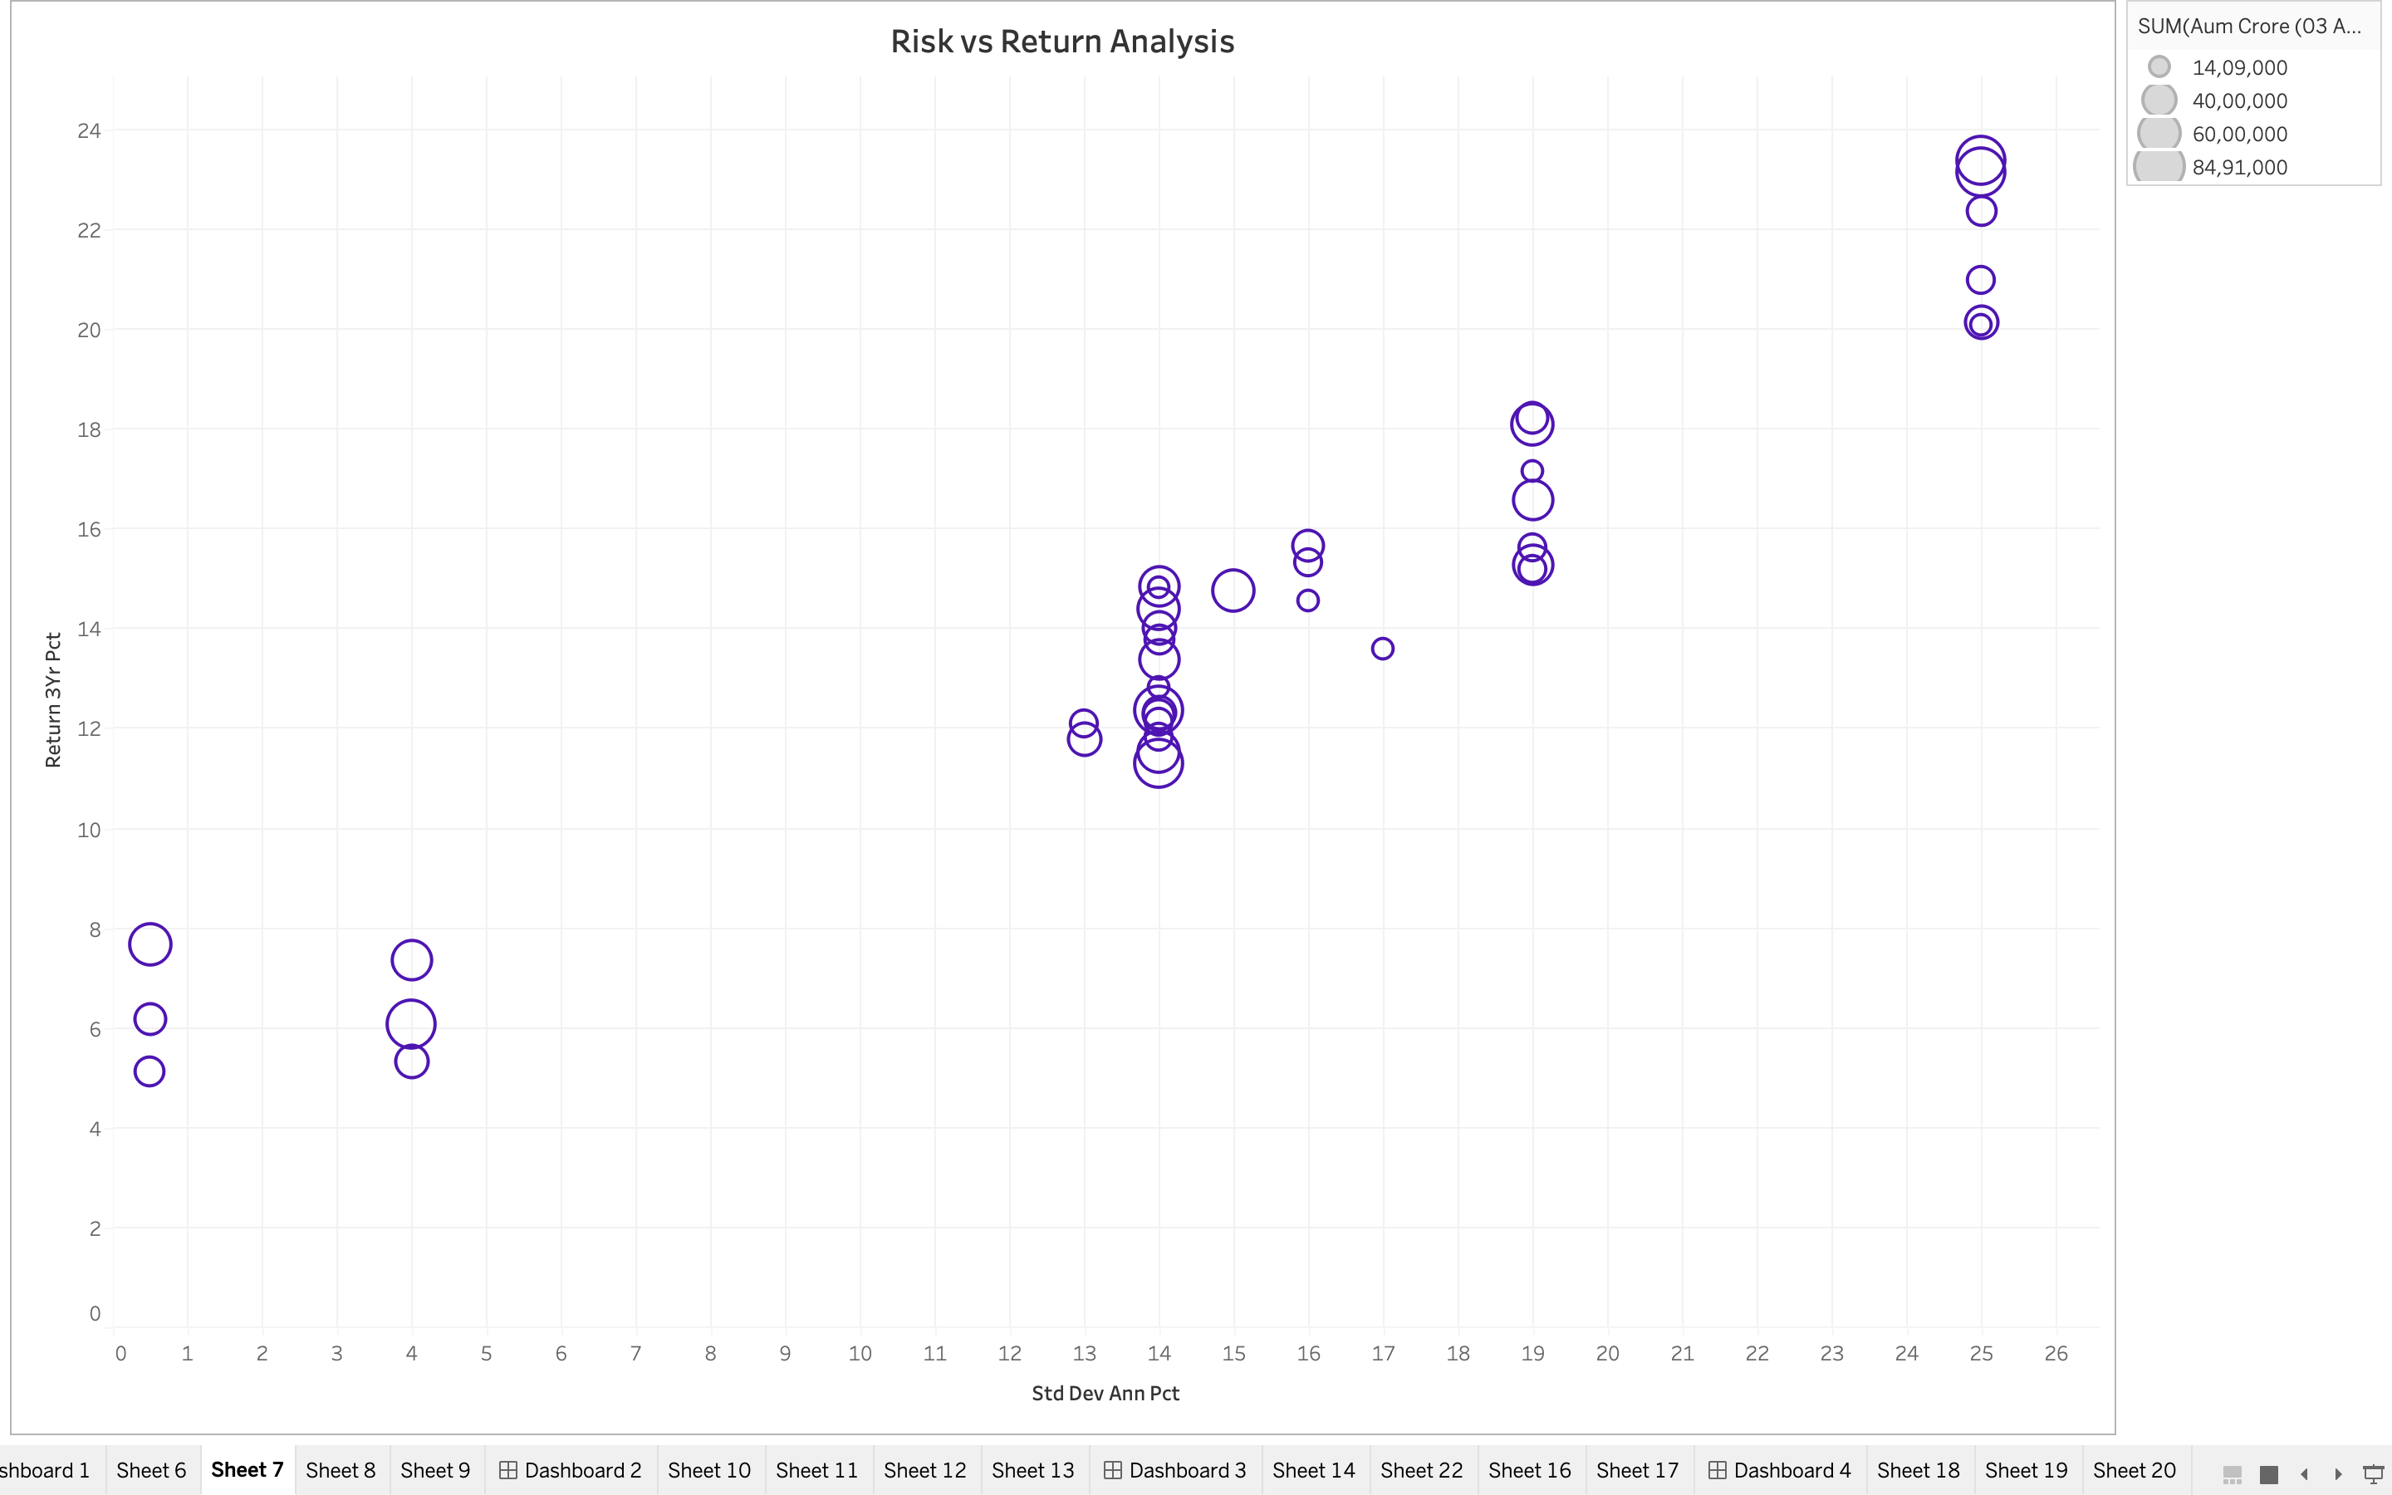
Performance Metrics – Risk & Return Analysis
Fund Performance Evaluation
Metrics Used
3-Year Return %
Standard Deviation
Sharpe Ratio
Observations
Higher returns generally corresponded to higher risk
Several funds delivered strong risk-adjusted performance
Sharpe Ratio helped identify efficient funds

Slide 8
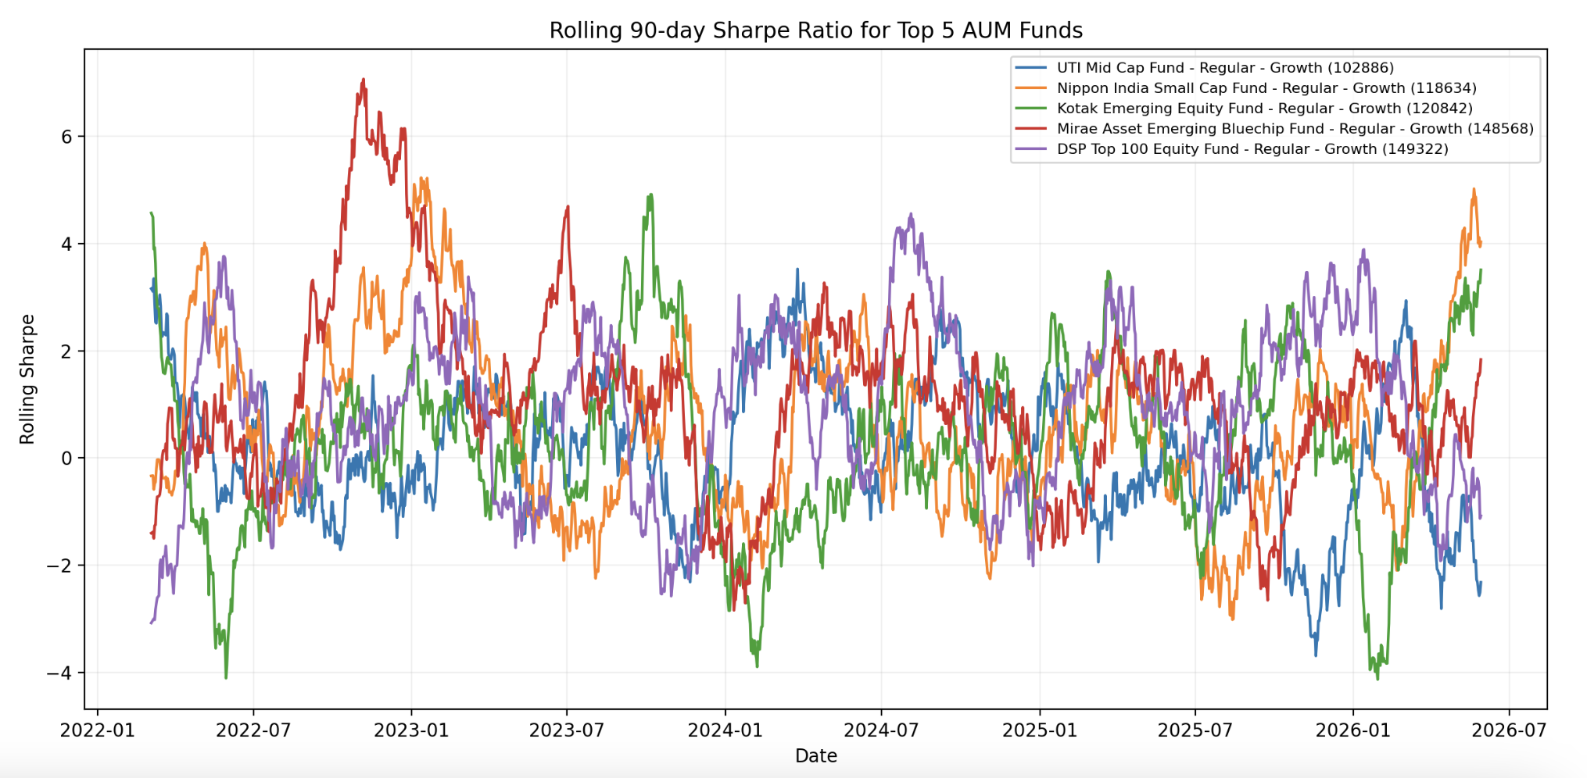
Performance Metrics – Advanced Analytics
Advanced Risk Assessment
Techniques Implemented
Historical VaR (95%)
Conditional VaR (CVaR)
Rolling 90-Day Sharpe Ratio
HHI Concentration Analysis
Key Findings
Small-cap funds showed higher downside risk
Portfolio concentration varied across schemes
Risk-adjusted performance changed over time

Slide 9
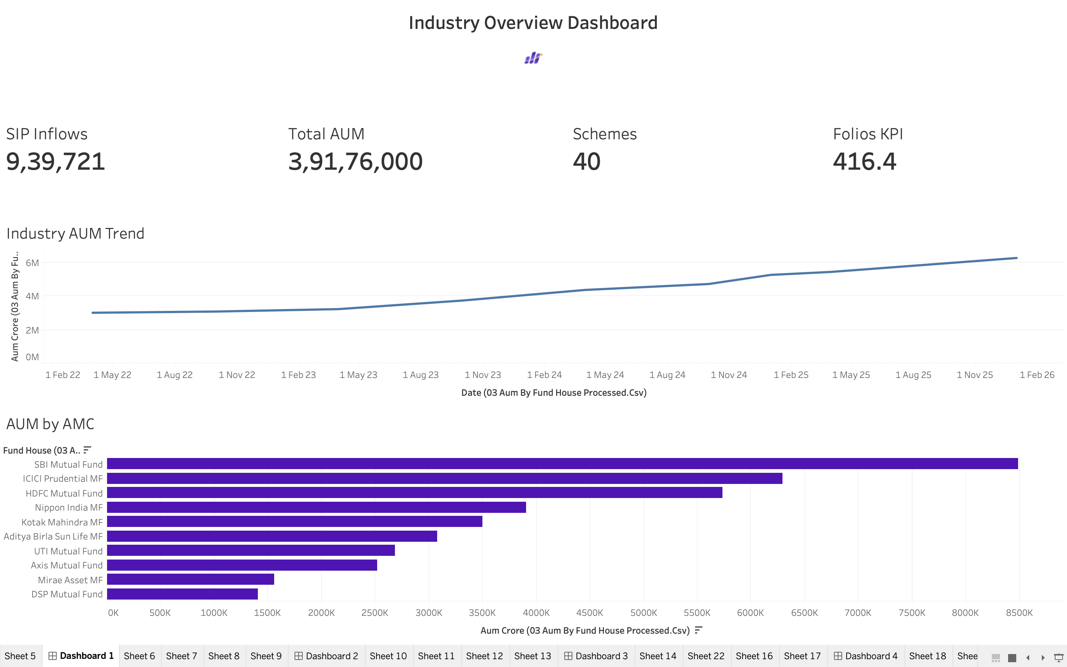
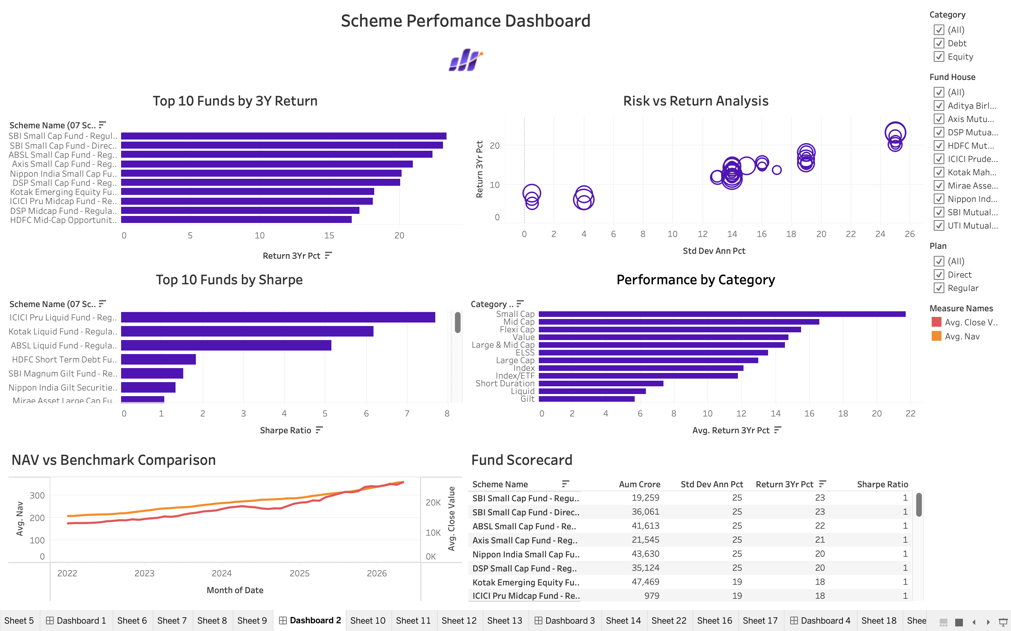
Dashboard Showcase – Industry Overview
Dashboard 1: Industry Overview
Features
Total AUM
SIP Inflows
Folios
Schemes
AUM Trend Analysis
AUM by AMC
Dashboard 2 : Scheme Performance
Fund Performance Dashboard
Risk vs Return
Sharpe Analysis
NAV vs Benchmark

Slide 10
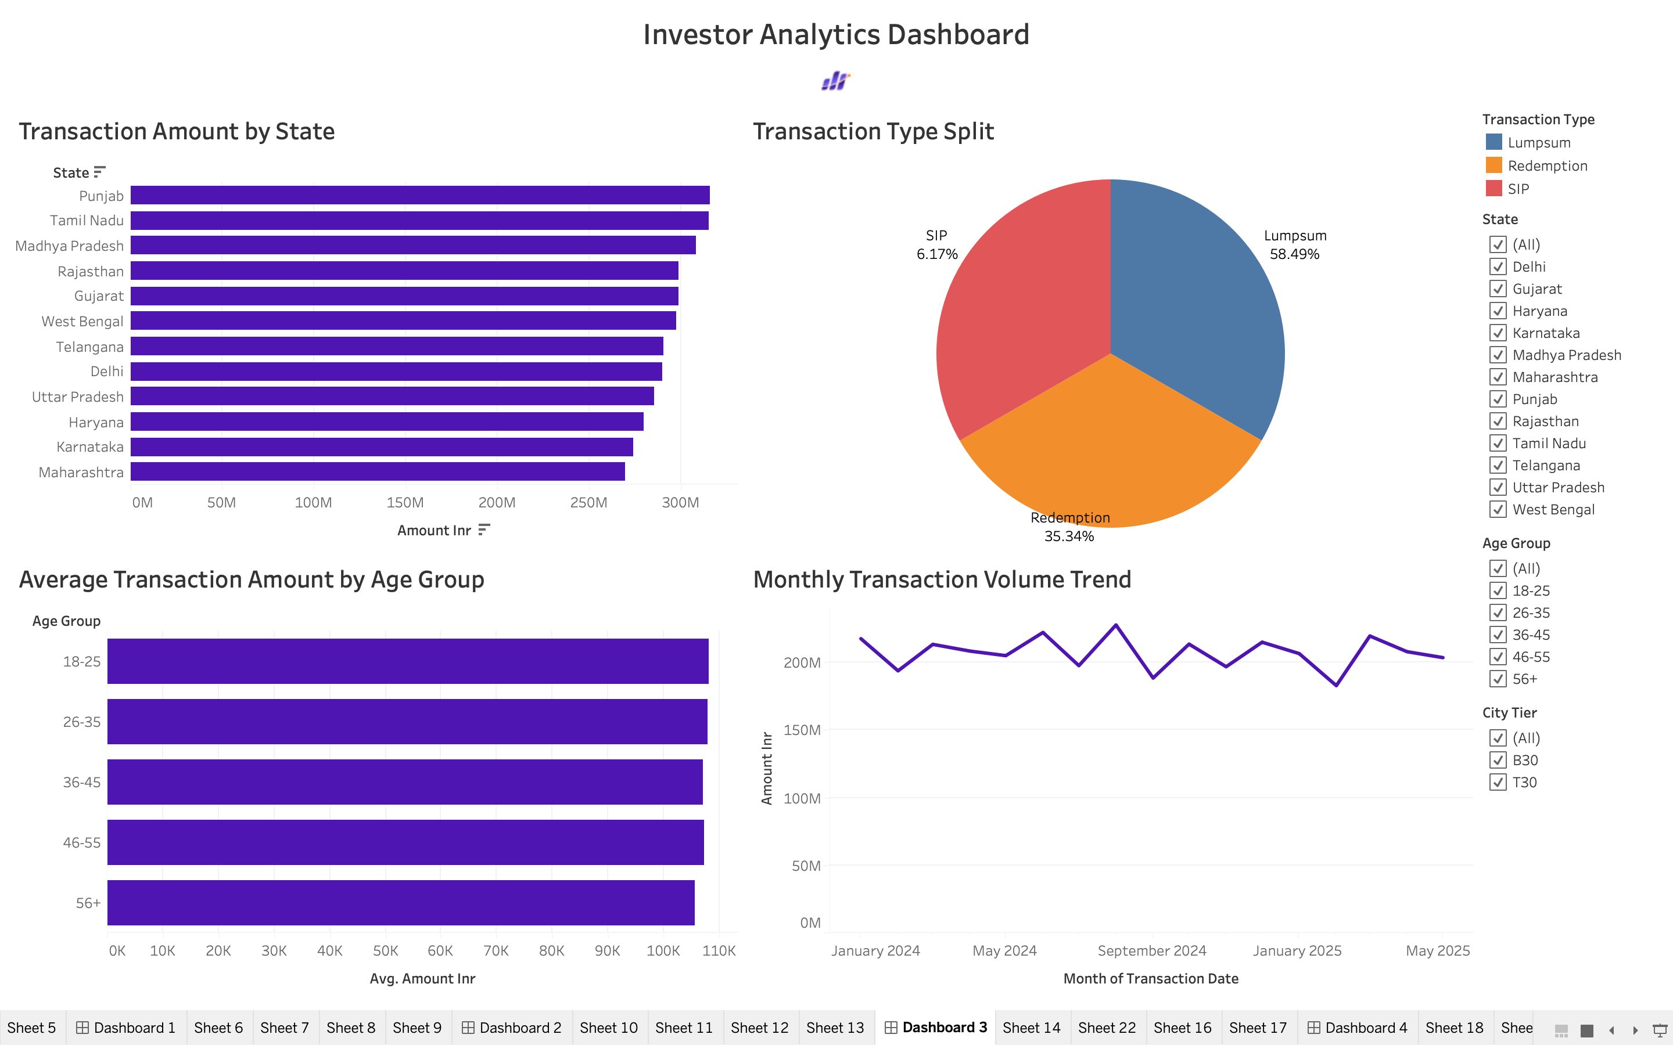
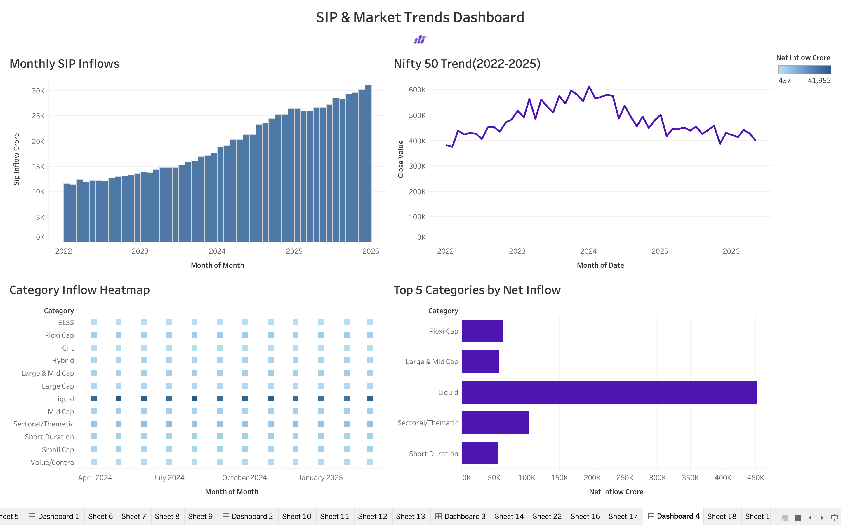
Dashboard Showcase – Investor Analytics
Dashboard 3
Investor Analytics Dashboard
Transaction Analysis
Age Group Analysis
Geographic Insights
Dashboard 4
SIP & Market Trends Dashboard
SIP Trends
Market Comparison
Category Inflows

Slide 11
Key Findings & Recommendations
Key Findings
Industry AUM grew consistently during the study period.
SIP inflows showed strong upward momentum.
Small-cap funds generated higher returns but carried greater risk.
High-Sharpe funds delivered superior risk-adjusted performance.
Investor participation increased across multiple regions.
Recommendations
Encourage SIP-based investing.
Monitor high-risk funds carefully.
Use Sharpe Ratio alongside returns for fund selection.
Promote portfolio diversification.

Slide 12
Thank You

