Slide 1

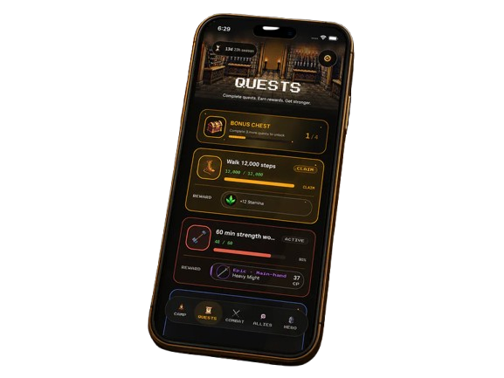
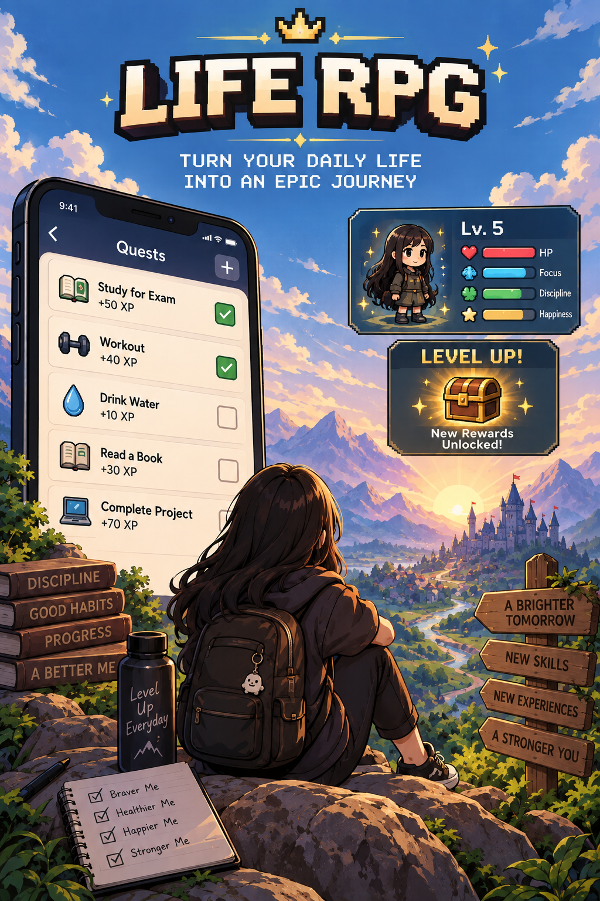
LIFE RPG
Life RPG is a mobile application that combines everyday productivity with RPG-style gaming.
Instead of treating tasks as simple to-do items, the application transforms them into quests that users can complete to earn XP, level up their character, improve stats, and unlock rewards.
Turn Your Everyday Life Into an Adventure
A Gamified Personal Productivity
&
Goal Management Application
REET | ASHNA

Slide 2

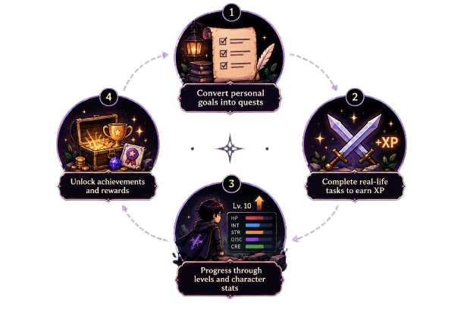
INTRODUCTION
Life RPG transforms everyday goals into an interactive journey — turning tasks into quests, progress into XP, and achievements into rewards.
Life RPG is a mobile application that combines everyday productivity with RPG-style gaming.
Instead of treating tasks as simple to-do items, the application transforms them into quests that users can complete to earn XP, level up their character, improve stats, and unlock rewards.

Slide 3

Life RPG transforms everyday goals into an interactive journey — turning tasks into quests, progress into XP, and achievements into rewards.

Slide 4
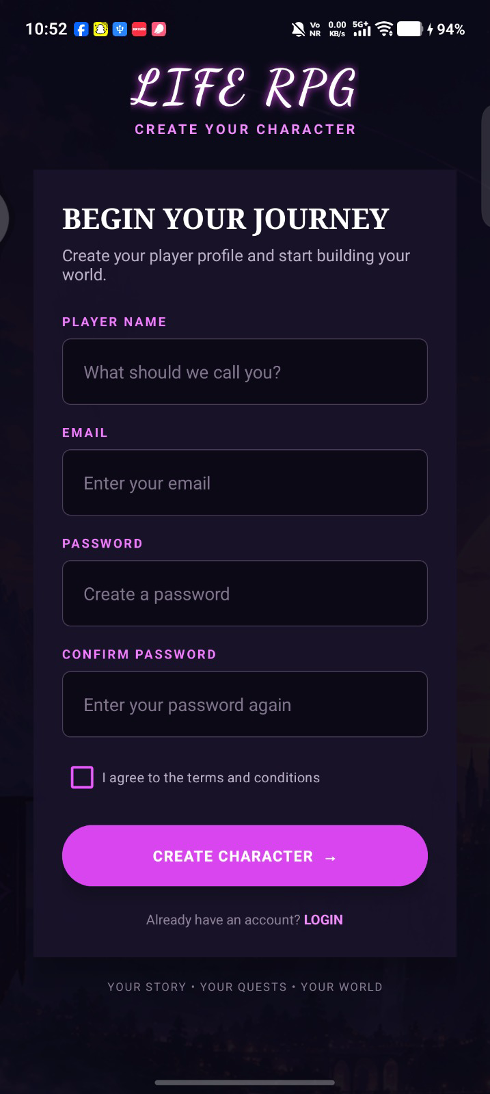
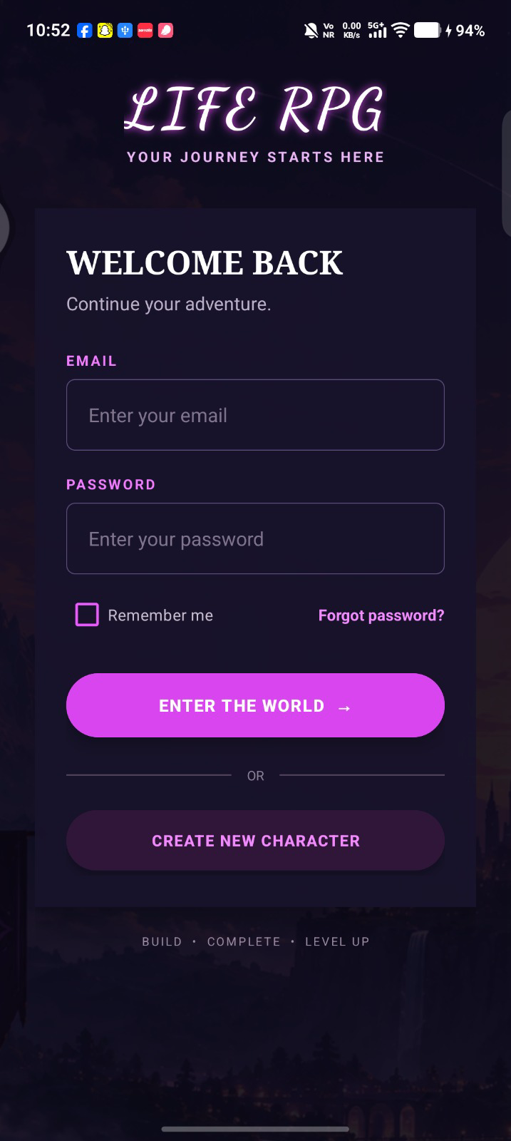
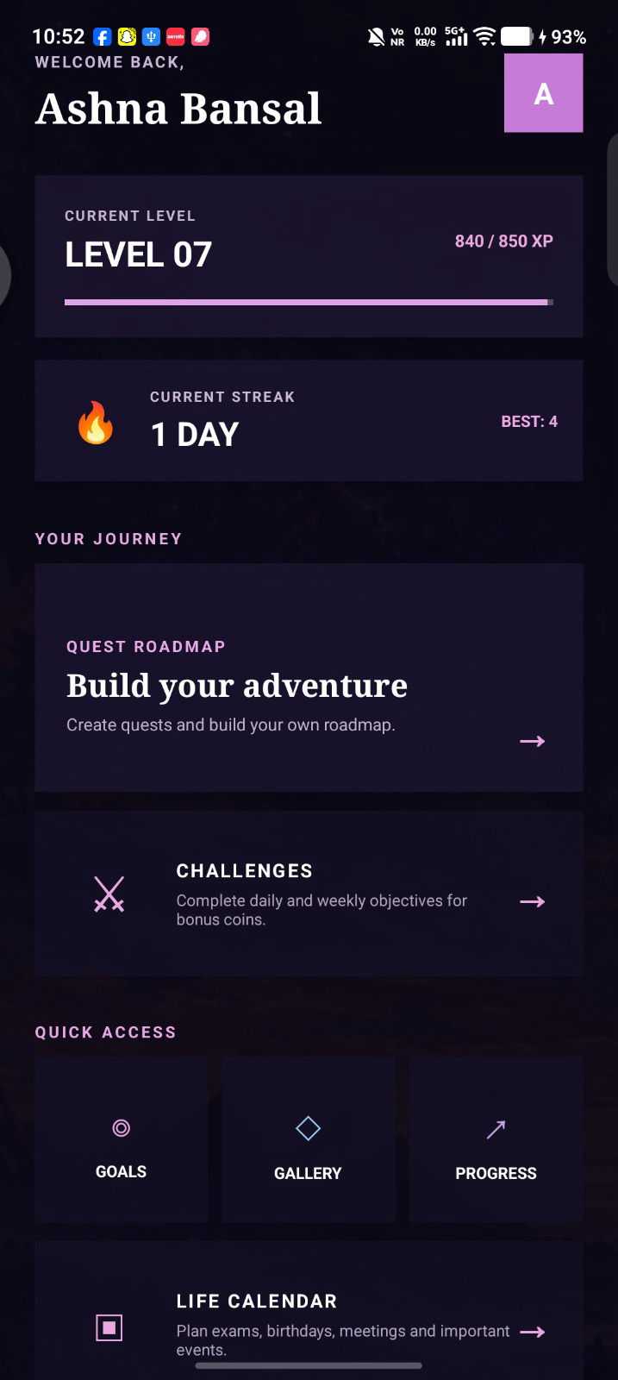
1. Login —
MainActivity.java
Intent
SharedPreferences
Patterns
TextUtils
CheckBox
ActivityCompat
ContextCompat
AlphaAnimation
ScaleAnimation
2. Registration —
register.java
Intent
Patterns
TextUtils
CheckBox
ProgressBar
AlphaAnimation
ScaleAnimation
Toast
3. Home —
home.java
Intent
SharedPreferences
ProgressBar
AlphaAnimation
ScaleAnimation

Slide 5


Life Gallery
Quest Notes
Create Quests: Add personal goals as individual quests.
Add Details: Give each quest a title and description.
Visual Roadmap: Display quests as numbered nodes connected in a roadmap.
View Quest Details: Tap a quest to see its title and description in a pop-up.
Interactive UI: Use animations and a simple interface to make the experience engaging.

Slide 6
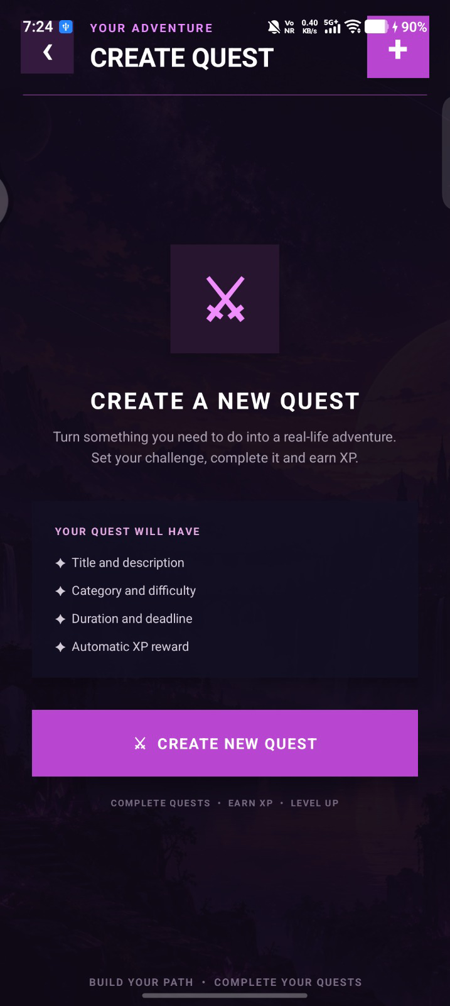
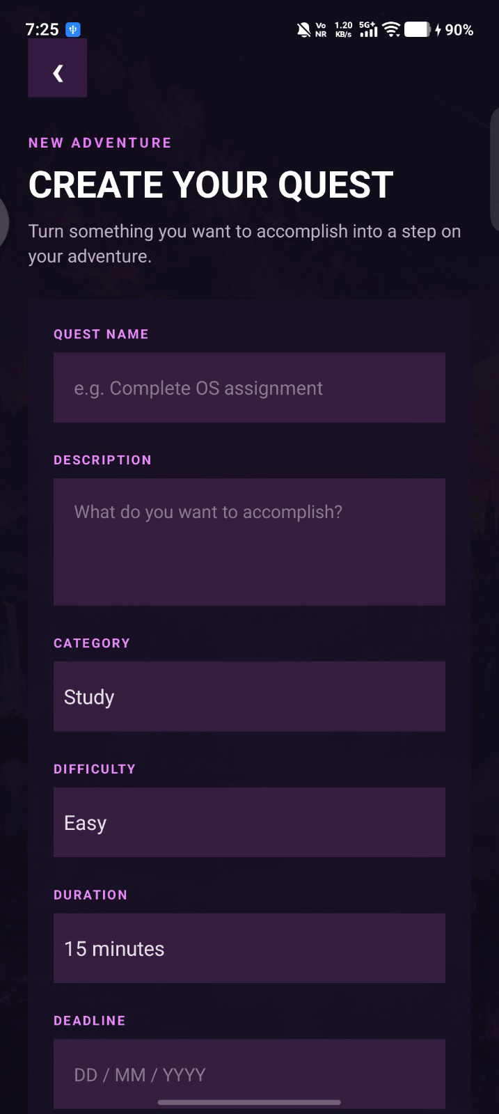
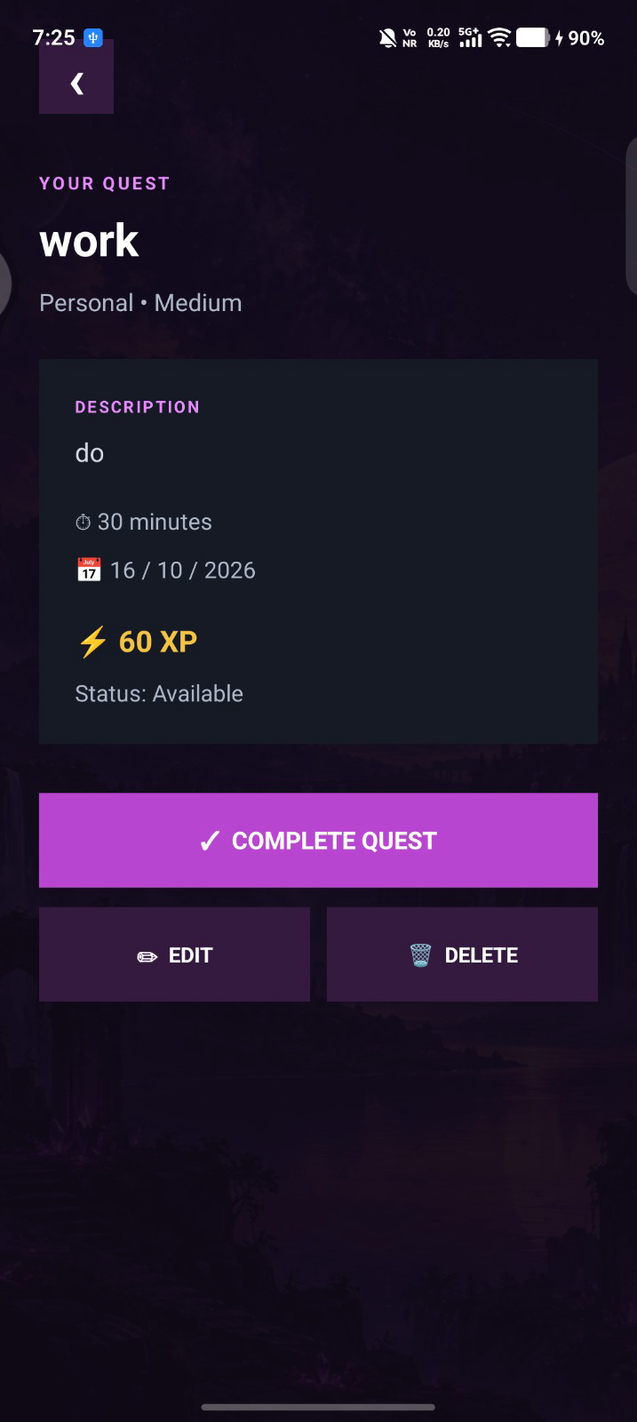
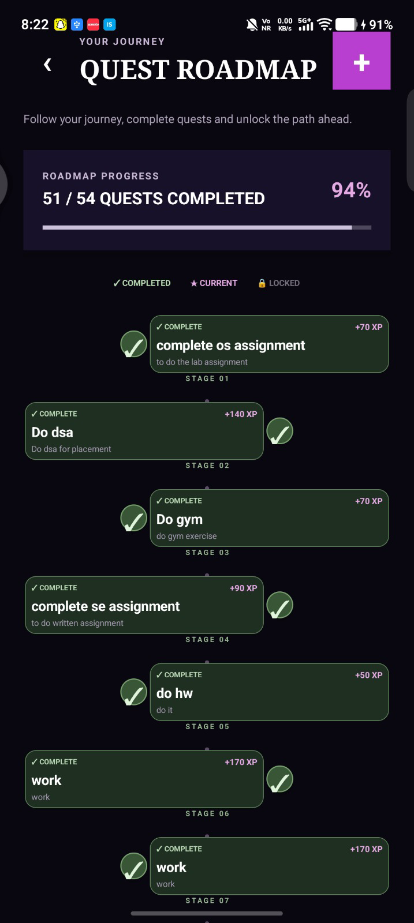
File 1 · Quest Roadmap
QuestActivity.java
activity_quest.xml
Displays quests as a visual roadmap with numbered nodes. Users can create quests, add titles and descriptions, and tap a quest to view its details in a pop-up.
File 2 · Entry screen
quest.java
activity_quest.xml
Shows the Create Quest introduction screen. The + and Create New Quest buttons open the form.
File 3 · Create/edit form
quest_details.java
activity_quest_details.xml
Collects quest information, calculates XP, validates inputs, saves new quests or updates existing ones, and schedules notifications.
File 4 · Quest detail/actions
quest_view.java
activity_quest_view.xml
Loads a saved quest, displays its details, and handles completion, editing and deletion. Completion also connects to rewards, streaks and achievements.
Spinner
ArrayAdapter ⁠
Toast ⁠
DatePickerDialog
ContentValues⁠
AlarmManager
PendingIntent ⁠
Calendar ⁠
SimpleDateFormat
Locale ⁠
⁠
ProgressBar
GradientDrawable
DatabaseHelper
Cursor
⁠ Typeface ⁠
Gravity
⁠
Intent ⁠
getIntent()
AlphaAnimation
ScaleAnimation
finish() ⁠
Handler
StringBuilder
Cursor
⁠ ⁠

Slide 7
Calendar
Life Gallery
A personal space to store important photos, memories, notes, and life moments, helping users preserve meaningful experiences and revisit them whenever they want.
Quest Notes

Slide 8
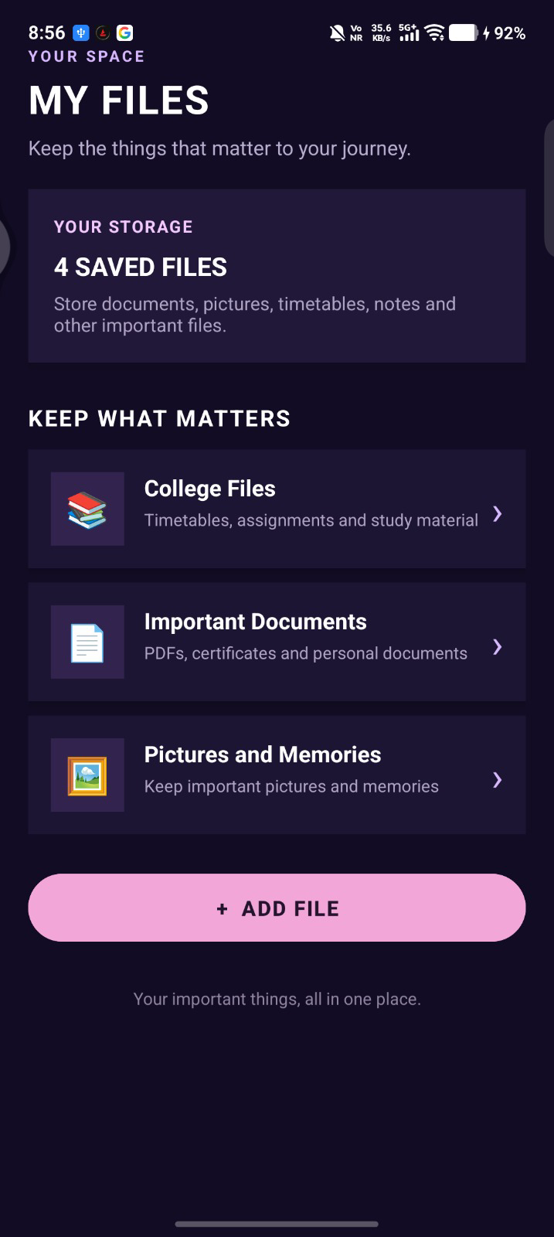
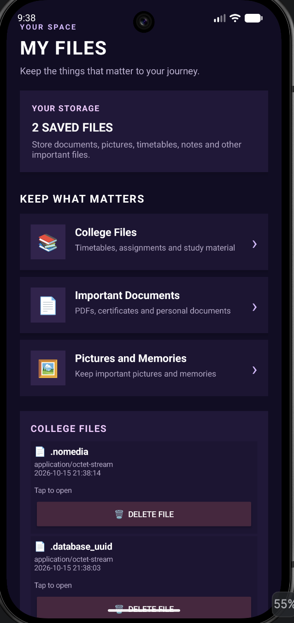
ScrollView
⁠Cursor
OpenableColumns ⁠
FileProvider
⁠Bitmap ⁠
⁠BufferedReader
FileOutputStream
FileReader
InputStream ⁠
FILE_PICKER_REQUEST

Slide 9
Knowledge Vault
Calendar
View quests, deadlines, achievements, and daily progress by date.
Life Gallery

Slide 10
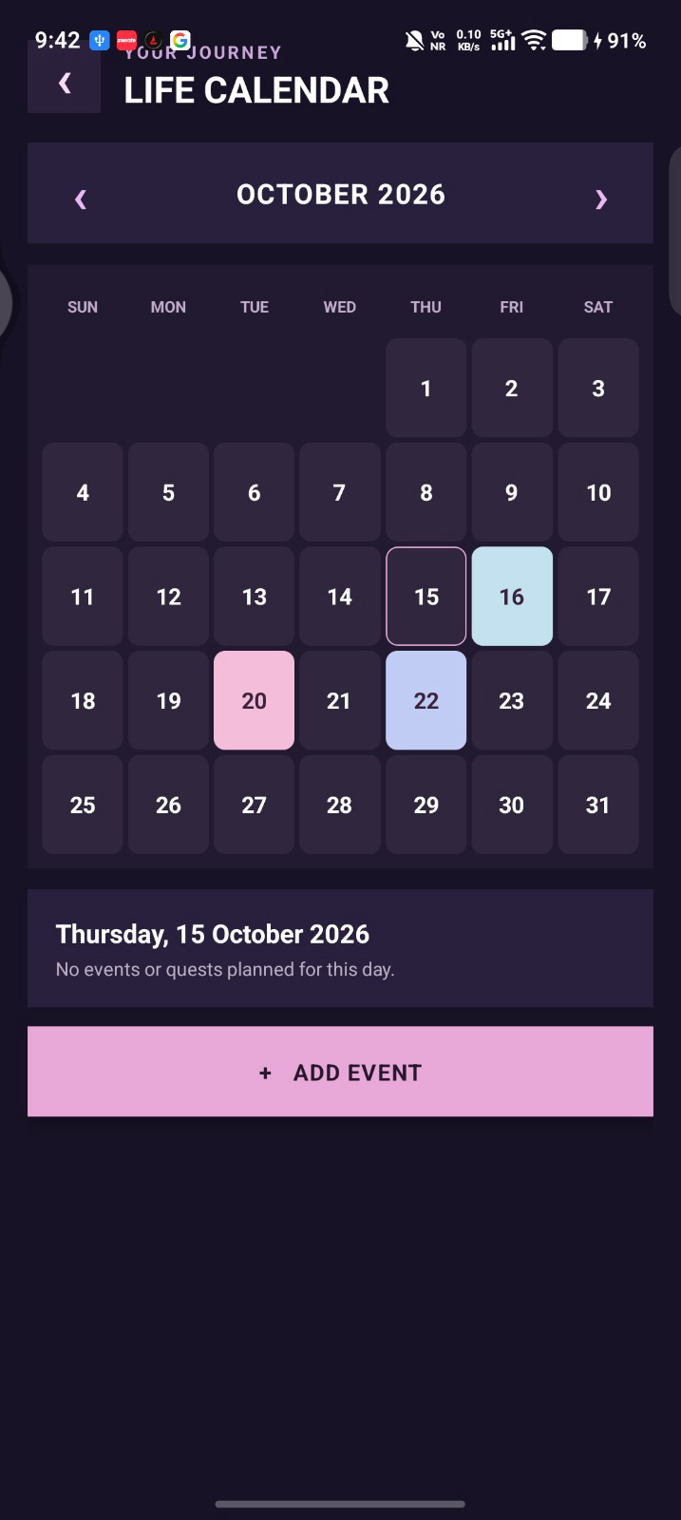
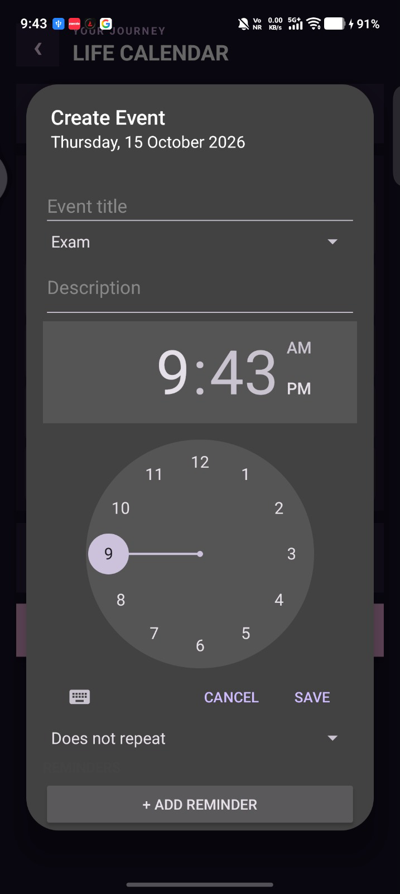
AlarmManager
PendingIntent ⁠ ArrayList<String>
NotificationReceiver
Datepicker
Timepicker

Slide 11
Goal Tracker
Knowledge Vault
Save useful study notes, ideas, concepts, and personal information.
Life Calendar

Slide 12
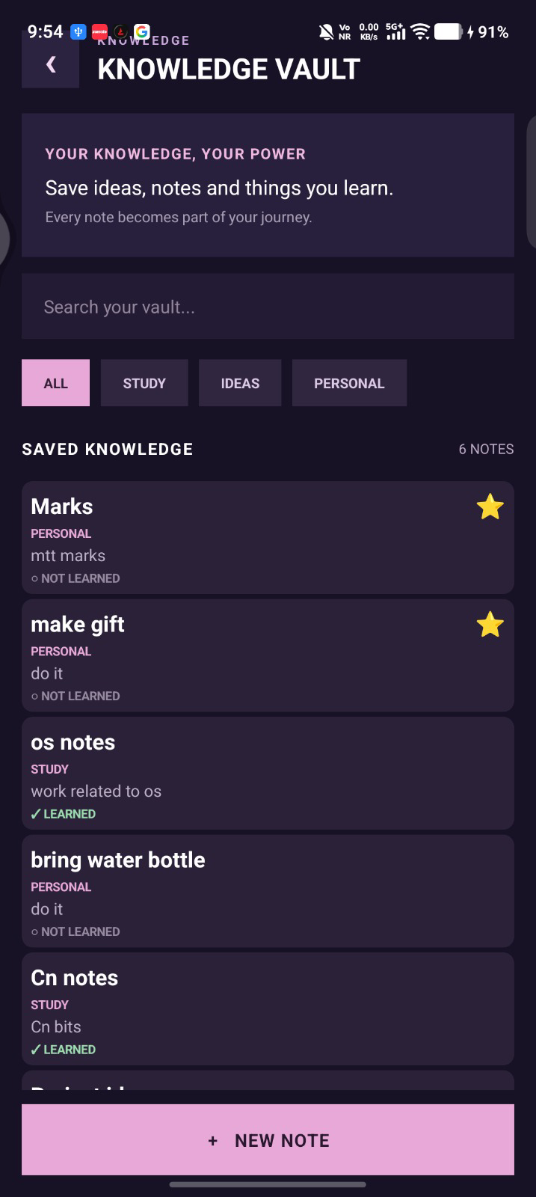
ScrollView
Spinner ⁠
CheckBox ⁠
⁠Editable
TextWatcher ⁠(Search Bar)
NoteData
SharedPreferences ⁠

Slide 13
Smart Reminders
Goal Tracker
Break larger goals into smaller milestones and track overall progress.
Knowledge Vault

Slide 14
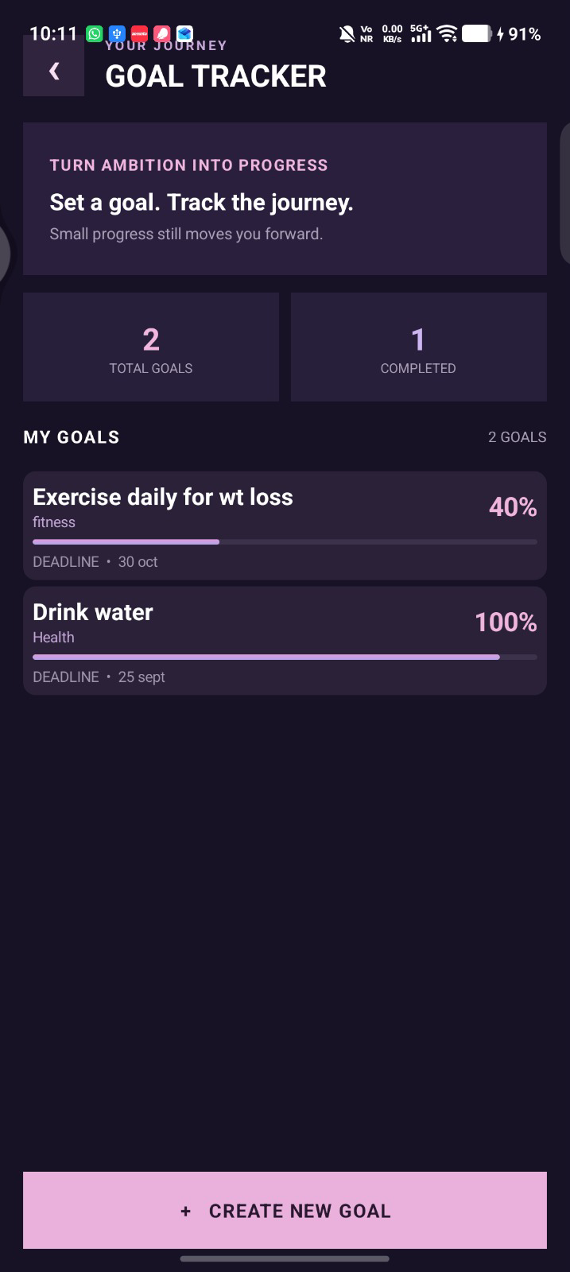
ProgressBar
Intent
Cursor
ContentValues
AlertDialog

Slide 15
Progress History
Smart Reminders
Receive reminders for upcoming quests, deadlines, and streaks.
Goal Tracker

Slide 16
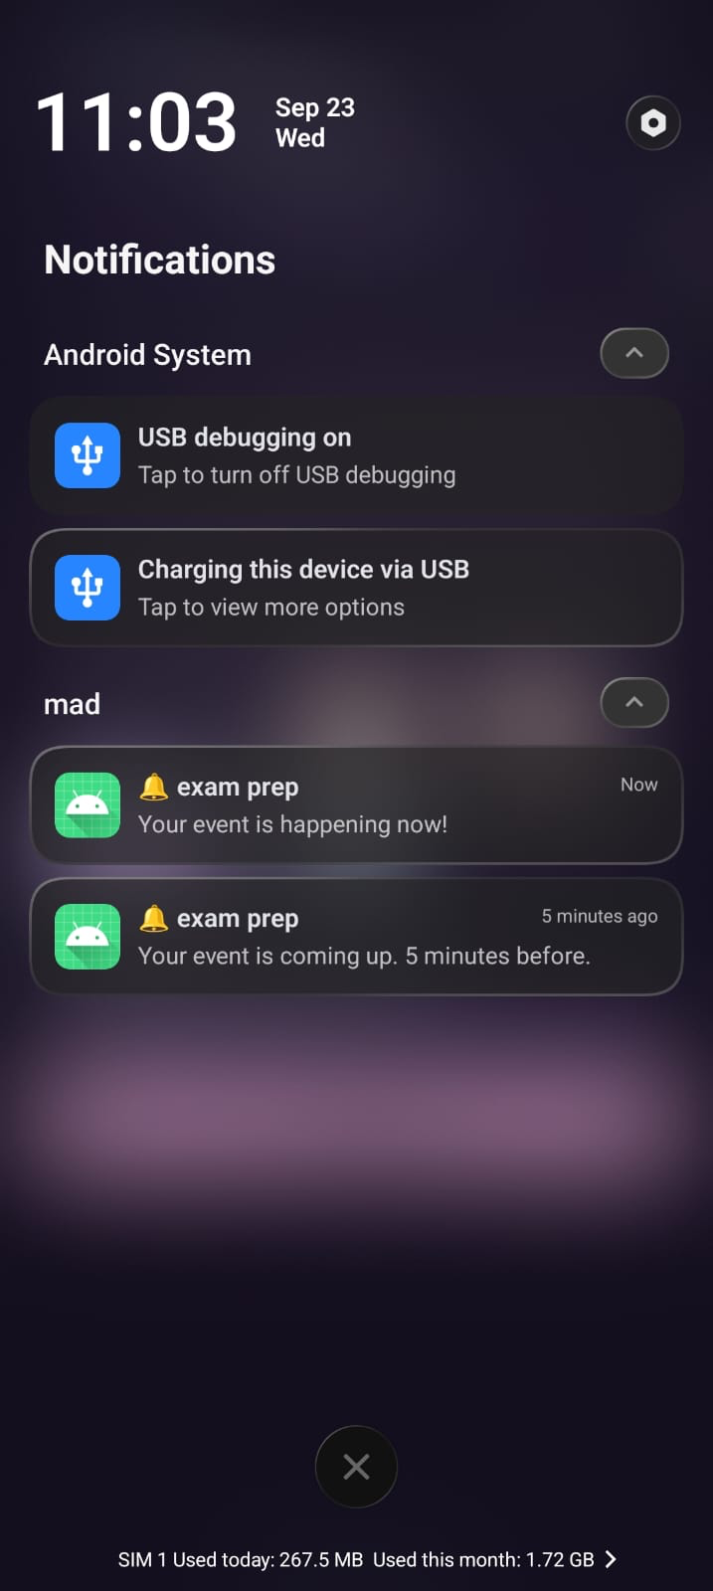
NotificationChannel – Creates a channel for delivering notifications.
NotificationManager – Manages notification channels and notifications.
Context – Provides access to Android system services and application information.
Build – Provides information about the Android device’s software version.
NotificationManager.IMPORTANCE_HIGH – Sets the notification channel’s importance to high.
Build.VERSION.SDK_INT – Returns the device’s Android API level.
Build.VERSION_CODES.O – Represents Android 8.0 (Oreo), which introduced notification channels.
getSystemService() – Retrieves the Android system’s NotificationManager.
setDescription() – Sets a description for the notification channel.
enableVibration() – Enables vibration for notifications from the channel.
createNotificationChannel() – Registers the notification channel with the Android system.
CHANNEL_ID – Defines the unique identifier of the notification channel.
CHANNEL_NAME – Defines the display name of the notification channel.

Slide 17
Data Export
Progress History
Review completed quests, XP earned,
statistics, and past achievements.
Smart Reminders

Slide 18
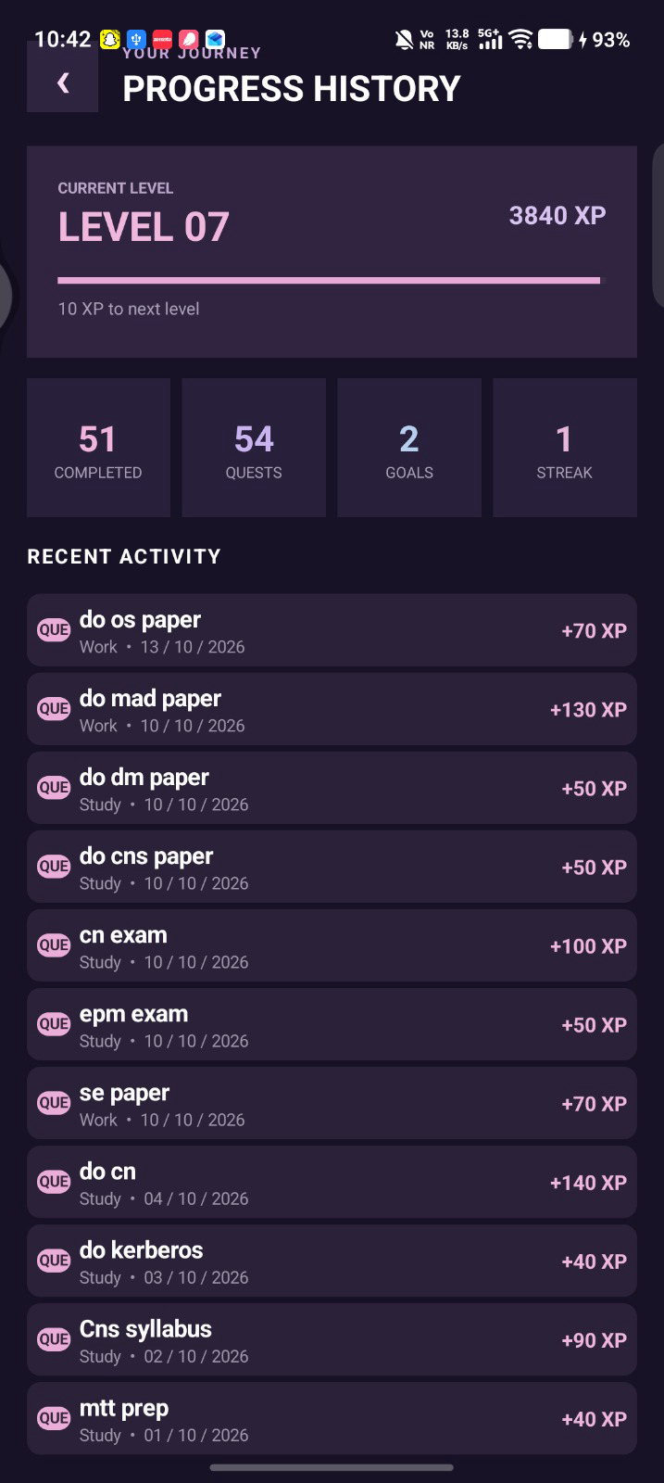
ProgressBar
SQLiteDatabase
DatabaseHelper
Cursor
GradientDrawable
Color
Scroll view

Slide 19
Data Export
Export quest history and progress
as CSV/TXT files.
Life RPG combines productivity tools with an interactive RPG experience.
Progress History
.

Slide 20
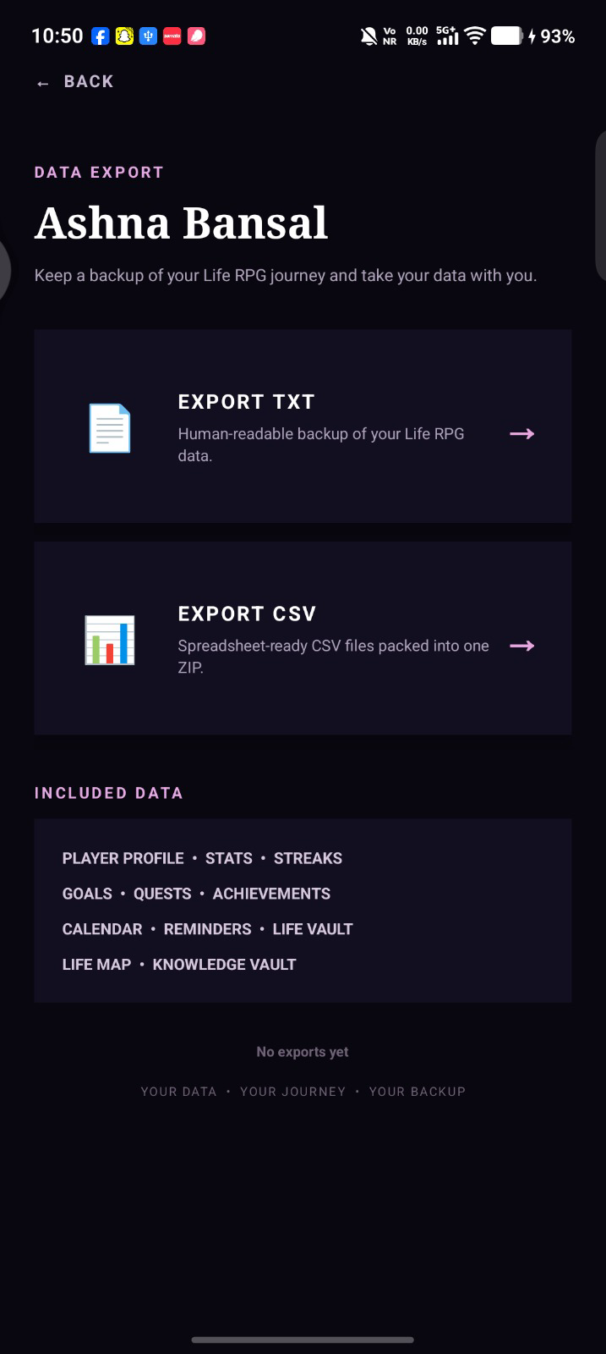
ZipOutputStream
BufferedWriter
StringBuilder
Intent.ACTION_CREATE_DOCUMENT — the Java component used to open Android’s file picker and allow users to choose where to save exported data.

Slide 21
ZipOutputStream
BufferedWriter
StringBuilder
Intent.ACTION_CREATE_DOCUMENT — the Java component used to open Android’s file picker and allow users to choose where to save exported data.

Slide 22
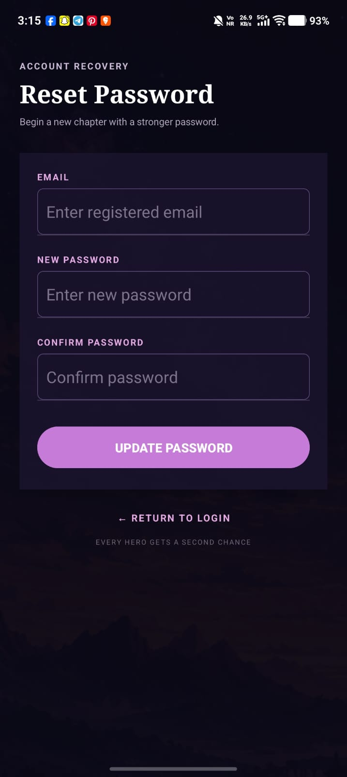
Additional Features
Forgot Password —
forgot_password.java
Patterns
TextUtils
Toast
ContentValues

Slide 23
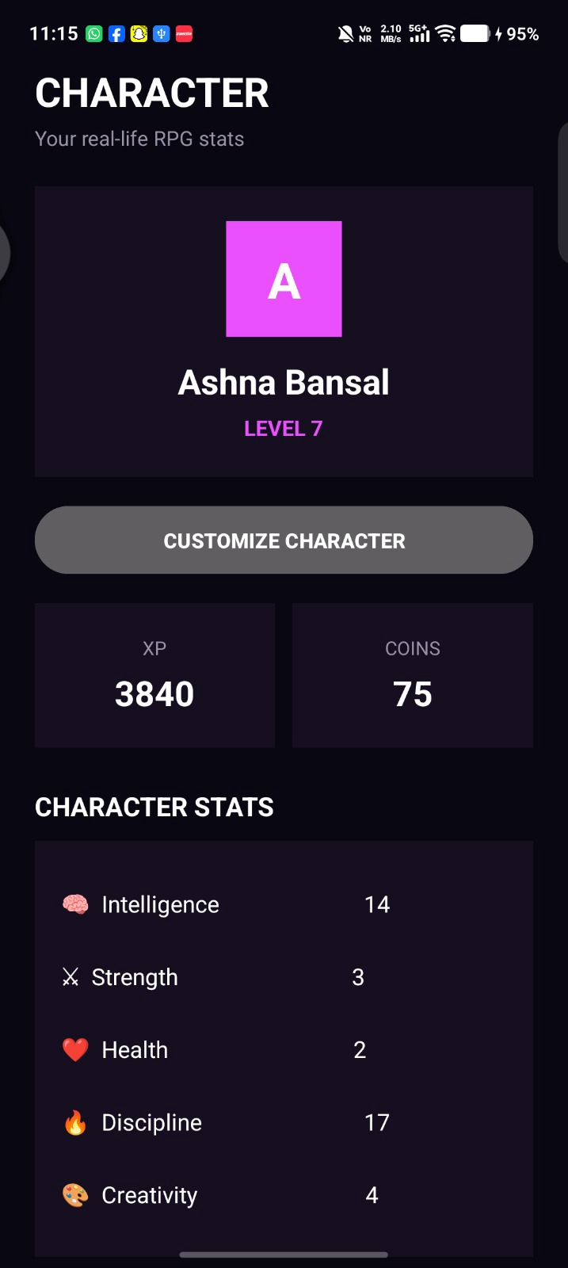
Additional Features
Profile —
profile.java
Intent
Toast

Slide 24
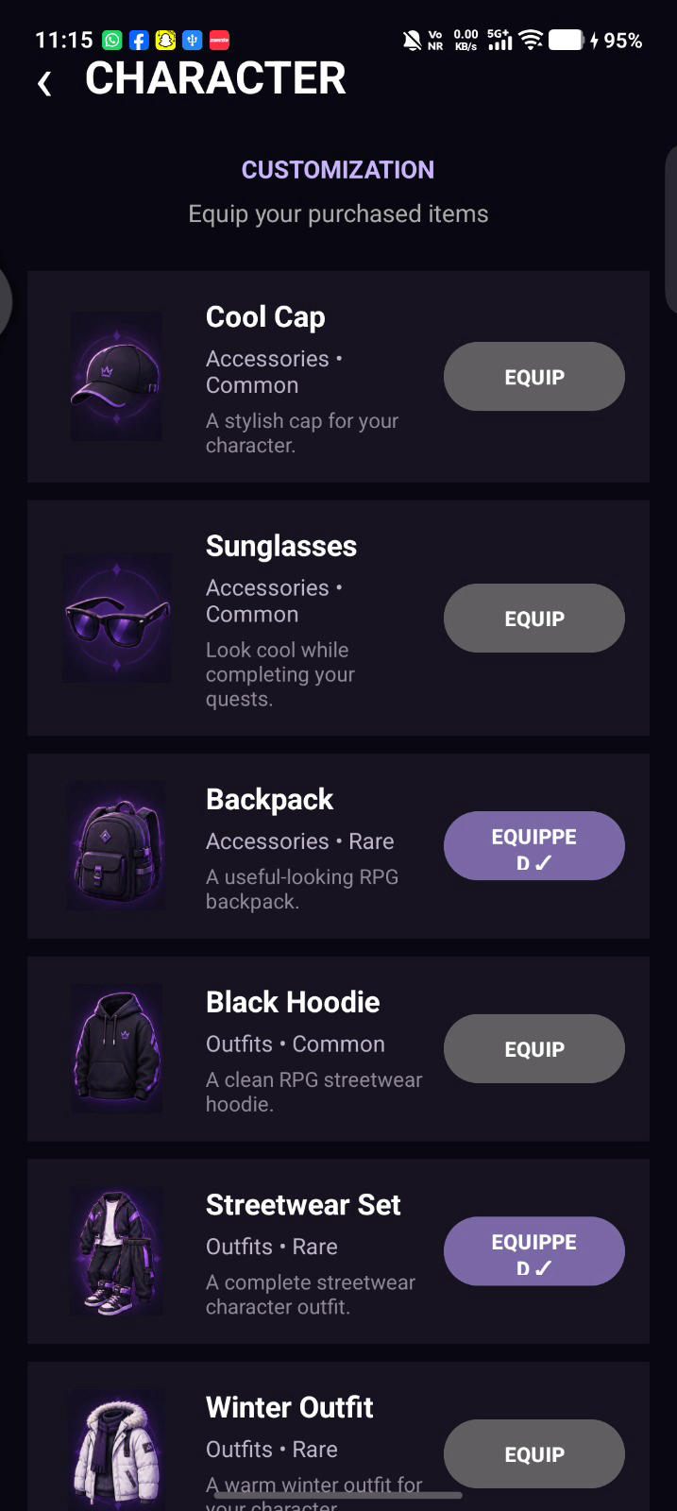
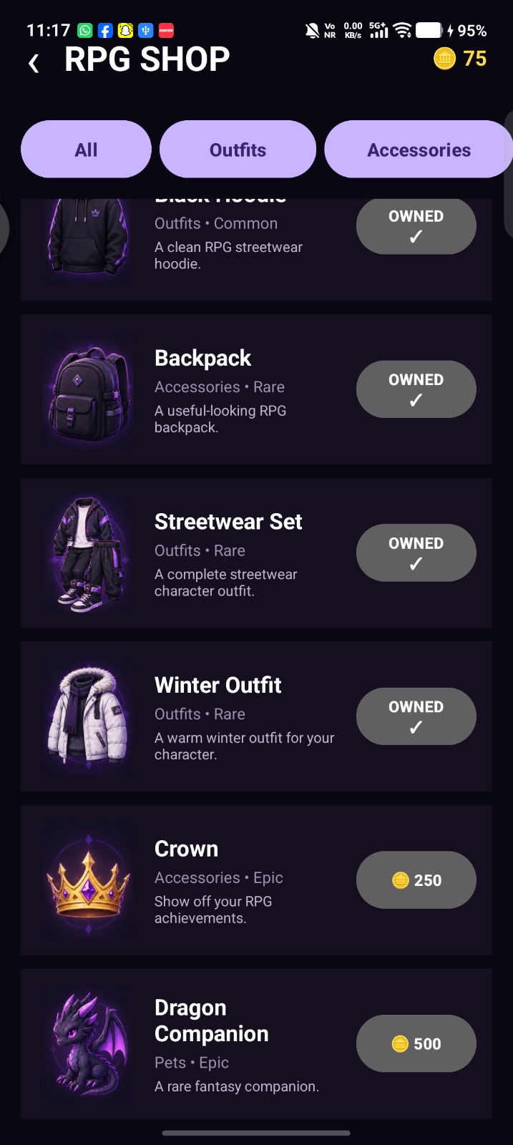
Additional Features
Shop —
shop.java
ListView
ShopAdapter
ArrayList
Toast

Slide 25
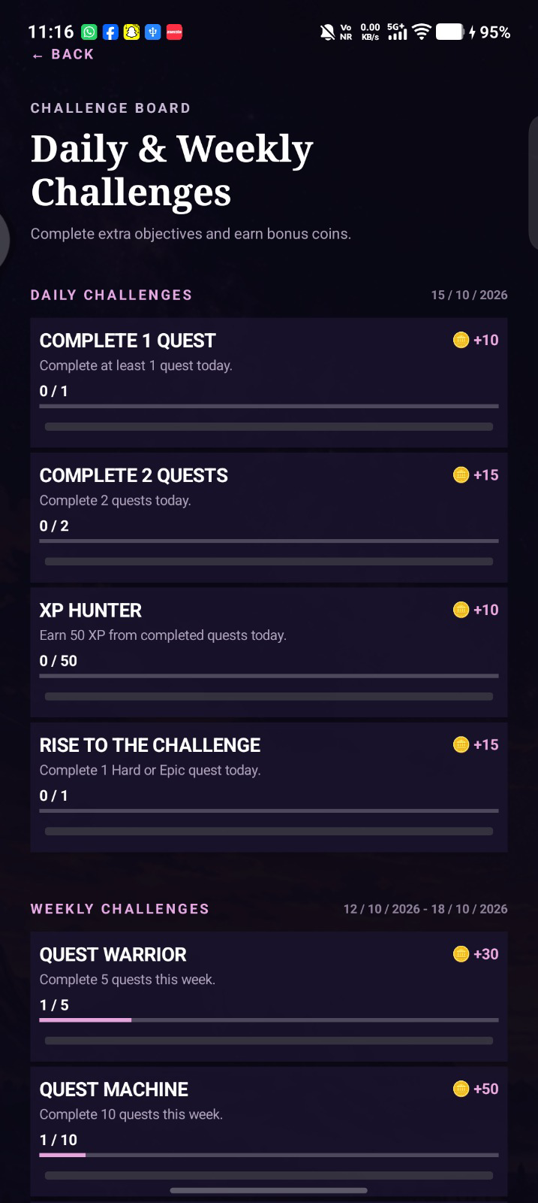
Additional Features
Challenges —
challenges.java
Calendar
SimpleDateFormat
Locale
ContentValues
Toast

Slide 26
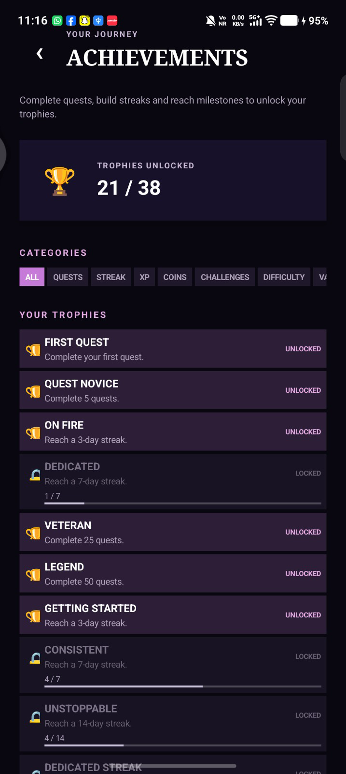
Additional Features
Achievements —
achievement.java
ProgressBar
HorizontalScrollView
ArrayList
List
Typeface
Gravity

Slide 27
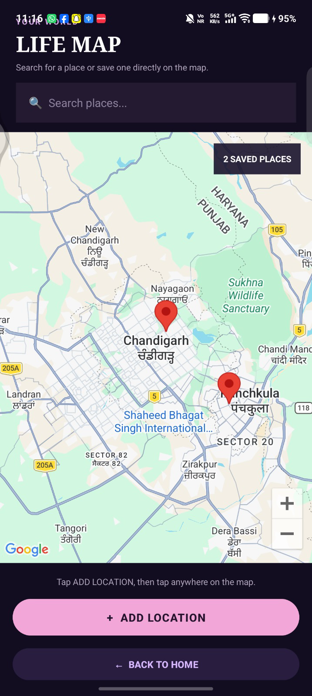
Additional Features
Life Map —
lifemap.java
GoogleMap
SupportMapFragment
OnMapReadyCallback
LatLng
Marker
MarkerOptions
PlacesClient
AutocompletePrediction
Handler
Looper
ArrayAdapter
AlertDialog

Slide 28
Life RPG combines productivity tools with an interactive RPG experience.
Data Export
Export quest history and progress
as CSV/TXT files.
Progress History
Review completed quests, XP earned,
statistics, and past achievements.

Slide 29
Thank you!!
Data Export
Export quest history and progress
as CSV/TXT files.
Progress History
Review completed quests, XP earned,
statistics, and past achievements.

