Slide 1
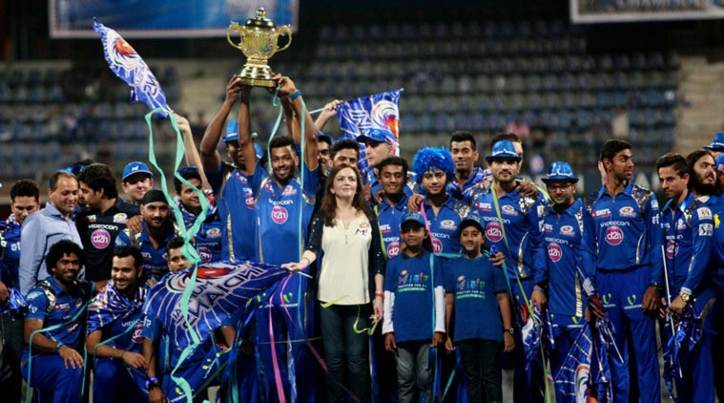
IPL Matches Survey
By Alok & Ashish

Slide 2
Story
The Indian Premier League (IPL), is a professional Twenty20 cricket league in India contested during April and May of every year by teams representing Indian cities and some states. The league was founded by the Board of Control for Cricket in India (BCCI) in 2008, and is regarded as the brainchild of Lalit Modi, the founder and former commissioner of the league.
The IPL is the most-attended cricket league in the world and in 2014 ranked sixth by average attendance among all sports leagues. In 2010,the IPL became the first sporting event in the world to be broadcast live on YouTube. The brand value of IPL in 2018 was 6.3 billion US dollors, according to Duff & Phelps. According to BCCI, the 2015 IPL season contributed 11.5 billion (US$182 million) to the GDP of the Indian economy.
There have been eleven seasons of the IPL tournament. The current IPL title holders are the Chennai Super Kings, who won the 2018 season. The most successful franchises in the tournament are the Chennai Super Kings and Mumbai Indians with 3 tournament wins each.

Slide 3
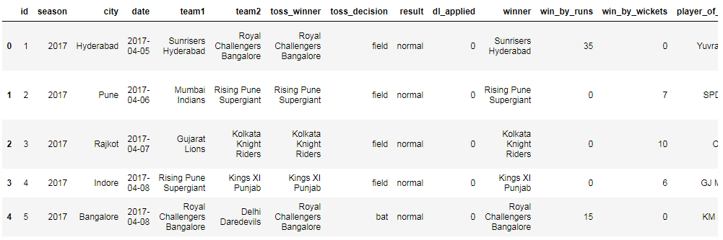
Data Description

Slide 4
Problem Statement
This dataset is survey that shows how teams performed in IPL. We are considering performance of top 2 teams (Mumbai Indians and Chennai Super Kings) against each other.

Slide 5
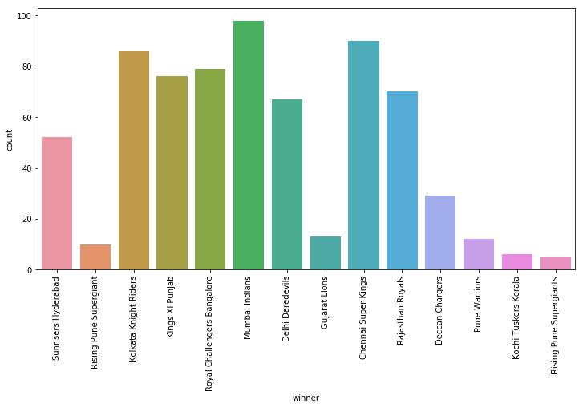
Count Plot for Match winning count of each teams across seasons
Observation: Mumbai Indians has won maximum numbers of matches

Slide 6
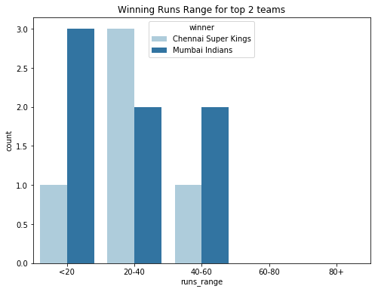
Winning runs range for top 2 teams
Observation: It depicts Mumbai Indians dominated in close matches (<20 runs margin) as well as higher runs margin of 40-60 runs.

Slide 7
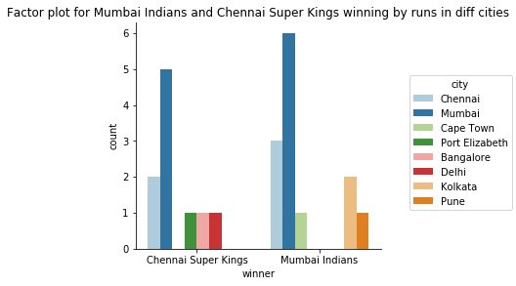
Did any of the team within (Mumbai Indians and Chennai Super Kings) got home ground advantage
Observation: Mumbai Indians performed better than Chennai , Also Mumbai Indians got more advantage of home ground as compared to Chennai Super Kings and its performance is good in other cities also than Chennai Super Kings.

Slide 8
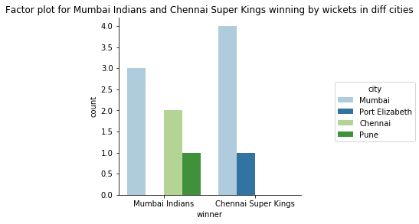
Observation: Mumbai got more advantage of home ground as compared to Chennai Super Kings as Chennai Super Kings didn't got any victory in chennai. Although Chennai got more wins in mumbai as compared to Mumbai.

Slide 9
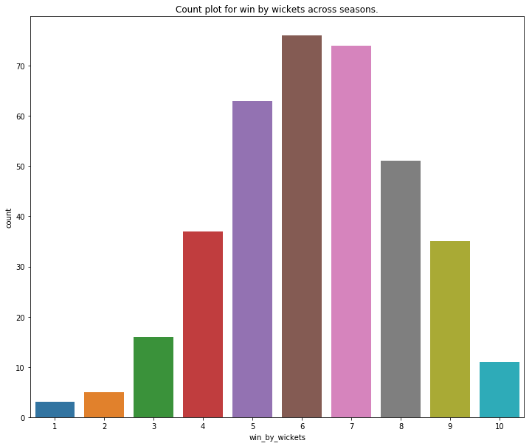
Frequency of Winning matches by wickets across seasons
Observation: Most of the team win by between 4 to 8 wickets. it shows that in IPL batsman dominate and it will be helpful for auction to select good batsman/all rounder as compare to bowler.

Slide 10
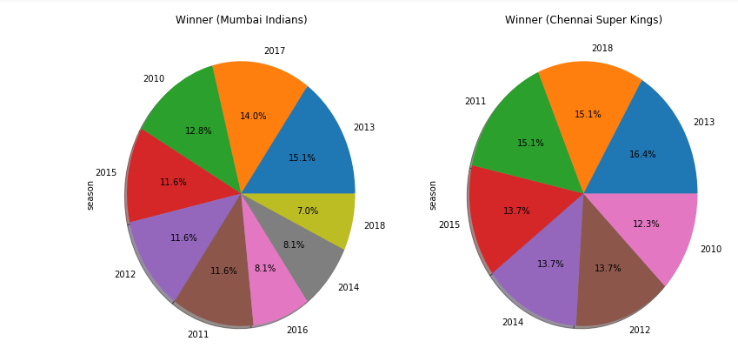
Top 2 teams winning percentage across all seasons
Observation: It shows the season wise winning percentage of Mumbai Indians and Chennai Super Kings. Overall Mumbai Indians has performed well but we also noticed that since CSK was banned for two season so Mumbai Indians took benefit of it as it won IPL season of 2017.

Slide 11
Conclusion
Hypothesis: Mumbai Indians Performed better than Chennai Super Kings across the season
Mumbai Indians won 49 % matches at its home ground. This shows that Mumbai Indians got home ground advantage
CSK won 38% matches at its home ground. This shows that Mumbai Indians got more home field advantage as compared to CSK.
RG Sharma was one of the valuable player for Mumbai Indians.

