Slide 1


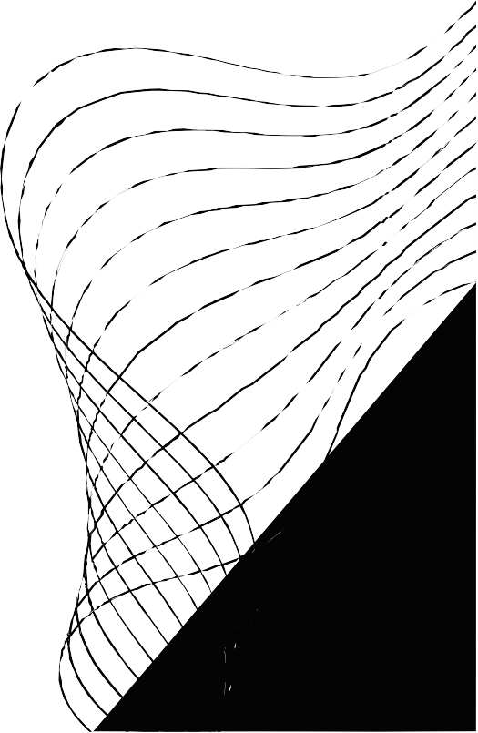
PROJECT
DIGITAL HEALTH ECO- SYSTEM
GROUP NO. - 39
Under the Guidance of
- Mr. Vinu Josy
1. Ashi Jain PRN- 220940120036
Ashutosh A. Mane PRN- 220940120038
DINESH P. CHAUDHARI PRN- 220940120052
Sanket H. Chaudhari PRN- 220940120054
Neeraj K. Gund PRN- 220940120077
Sajid N. Shaikh PRN- 2209401200168

Slide 2

CONTENT
01
02
03
04
05
06
07
08
PROJECT INTRODUCTION
PROJECT ARCHITECTURE
TECHNOLOGY PLATFORM USED FOR PROJECT
USER ROLES AND RESPONSIBILITIES
DIVISION OF WORK WITHIN TEAM
DETAILS OF MY CONTRIBUTION
FUTURE EXTENSIONS
CONCLUSION

Slide 3


PROJECT INTRODUCTION
To provide an efficient and user-friendly bed availability system and related required emergency services like Ambulance booking and other medical facilities.
To provide easy information of all available hospitals, its facilities and external services like ambulance booking etc.
To help all people to achieve their full potential for health and well-being across the lifespan.
Patient-Oriented platform to deal with medical emergencies and minimize overall panic situations and losses in this healthcare sector.

Slide 4




PROJECT ARCHITECHTURE
Back-End
Project Architecture mainly comprises of three parts :-
Front-end Layer: used for User Interfacing And Basic Data Validation.
Technologies used are- HTML, CSS, Javascript, ReactJS
Server Layer: It is used for Response Handling and Database Operations and also for server-side validations (if needed).
Technologies used is Spring boot REST API.
Database Layer: It is used for permanent data storage and db-level validations
Technology used is MYSQL.
Front-End

Slide 5

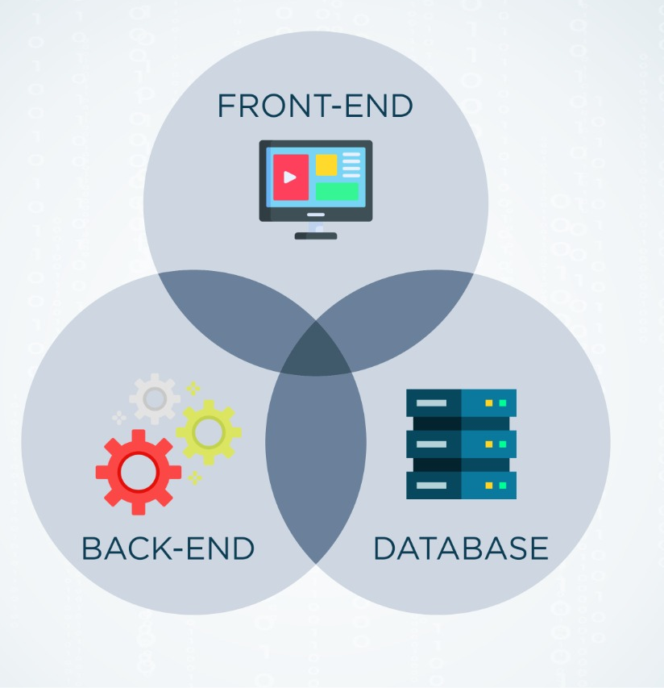

Technology Platform Used For Project
We used Front-End technologies like HTML, CSS, Javascript, ReactJS and Database As MYSQL . Backend Technologies we use Spring boot and Spring boot REST API.
HTML and CSS is used for proper formatting and look and feel and Javascript for additional functionality which isn’t achievable by HTML.
We used ReactJS because it provides a lot of handy features that add interactivity and complex logic to websites.
Some features of ReactJS which makes it a top choice to be used in frontend.
1)- Allows writing custom components
2)- Performance, Flexibility, Speed, Simplicity, Extensions

Slide 6


User Roles And Responsibilities
It has 4 User Roles which are as described below
1)- Admin:- Admin have access to control and manipulate everything.
Used cases: He can verify credentials, Add or remove Vendors and can make according to requests or updates.
2)- Hospital:- Hospitals can register their specialized services or equipment on our platform for better exposure through which they can reach out more and more audiences/patients.
Used cases: Hospitals can update bed information, check booking entry , login, logout etc
3)- Patient:- Patients who seeking for any emergency services can visit site and accordingly selects what they are exactly looking for .e.g. any appointment, specialist doctor visit, lab test etc.
Used Cases: Register, Login, Book Services, update profile, search etc.
4) - External Service Providers(Ambulance): Medical service provider from outside world can give / register their specialized services or equipment on our platform for better exposure through which they can reach out more and more audiences/patients.
Used Cases: Update Profile, delete information, update information, delete account.

Slide 7


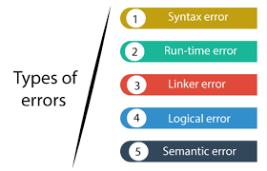
Known Issues (if Any)
As such there are no issues or bugs floating into our project and whole project is in 100% running state.
We wish to add few more features but being time Bound we left it for the future scope

Slide 8

Future Scope
Future Scope:- By observing on-growing needs into this emergency sector we are yet to update with some emergency requirements like Blood Bank Stock Availability and Bookings, Feedbacks etc.
This enhancements will be done efficiently and according to the varying needs of the people/users and it’ll be integrated with minimal modifications .
Thus our project is flexible and can be enhanced at any time with more advanced features in the future.

Slide 9


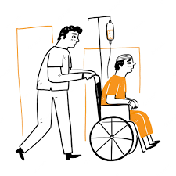

Conclusion
Digital Health Eco System provides a better efficient and user-friendly bed availability system and related required emergency services like ambulance booking and required medicinal and Hospital facilities like bed availability.
We help people in achieving their full potential for health and well-being across the lifespan which results in bringing a positive change into the lives of people medically and supporting them in panic or emergency situations.
Ambulance
Hospitals
Patients

Slide 10

THANK YOU

