Slide 1
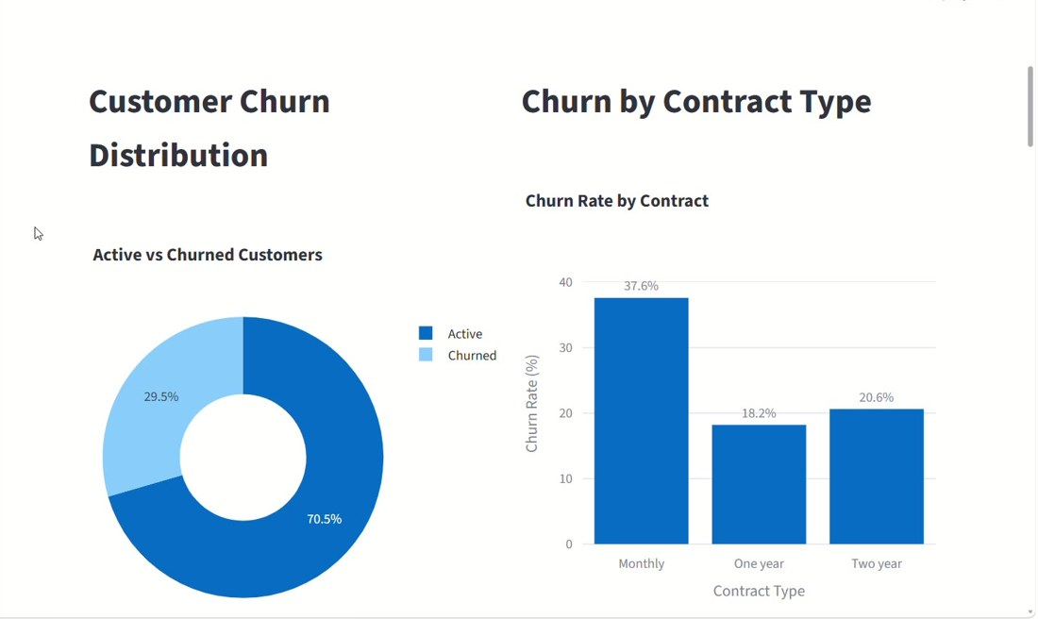
DATA SCIENCE / RETENTION ANALYTICS
Know who is leaving
before they do.
Customer Churn Prediction for Subscription Businesses
XGBoost • SHAP • Streamlit

Slide 2
THE PROBLEM
Churn quietly eats growth
5–25×
cost to acquire vs retain
5% vs 3%
monthly churn, huge 5-year gap
30 days
prediction horizon

Slide 3
THE PIPELINE
From raw logs to a save play
Data
Features
Model
Explain
Act
CRM, billing, usage, support
RFM, deltas, friction index
XGBoost with imbalance handling
SHAP reasons per customer
CRM alerts and campaigns
Nightly Airflow batch → MLflow registry → Reverse ETL to Salesforce, Zendesk and Marketo, with drift monitoring and auto-retraining.

Slide 4
MODEL RESULTS
XGBoost wins on recall
Why not accuracy?
95% accuracy by always saying "stays" is useless.
What we track
Recall, precision and PR-AUC.
Threshold
Tuned by cost: $50 discount vs $5,000 CLV.

Slide 5
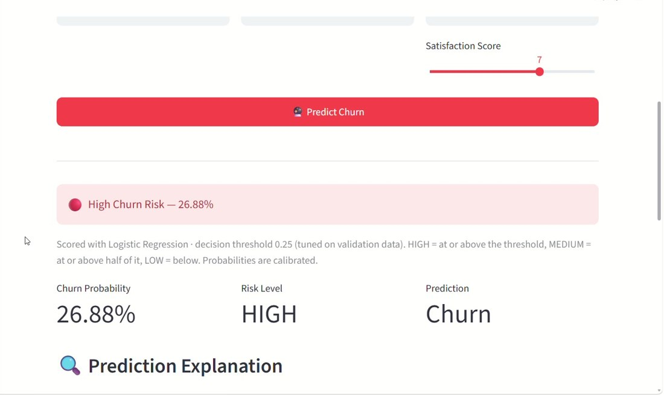
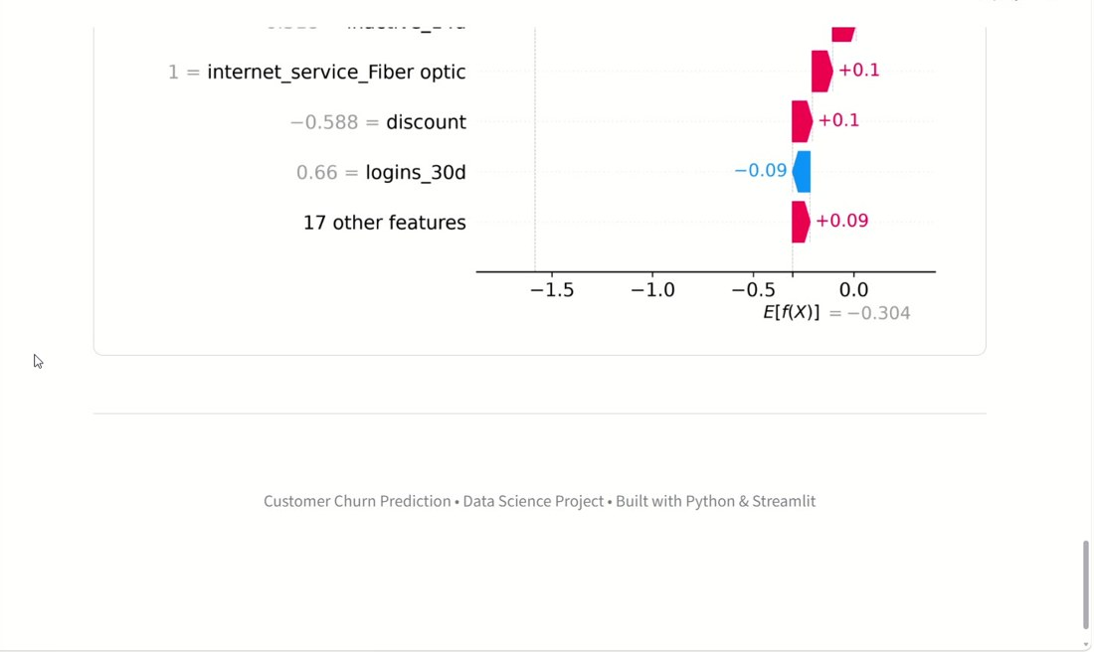
EXPLAINABILITY
Every score comes with a reason
Prediction: 26.88% churn probability, HIGH risk
SHAP waterfall: which features push risk up or down
CSMs see the why (no login for 21 days, open ticket) and tailor the save play.

Slide 6
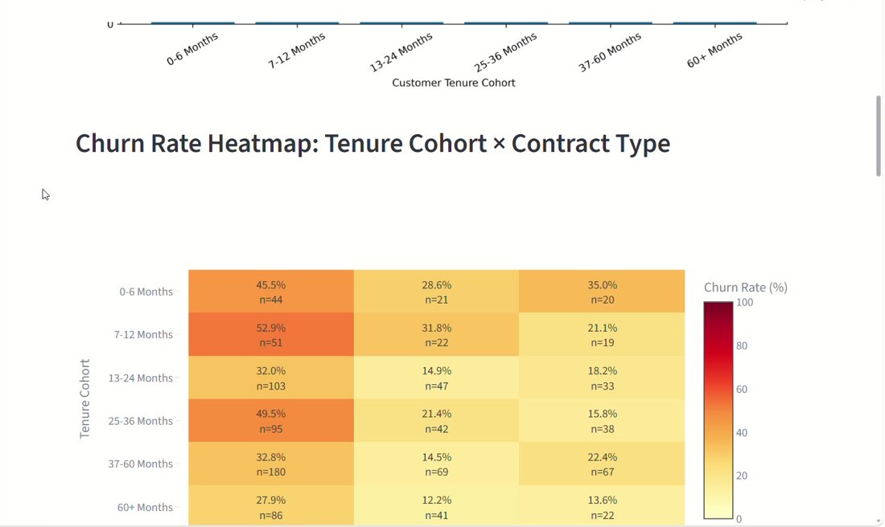
STRATEGY
Match the save play to the customer
White Glove
Automated
Payment Fix
High risk, high CLV
Medium risk, low CLV
Involuntary risk
Senior CSM call using SHAP reasons
Email drips, webinars, 15% discount
SMS prompt before card expires
Churn heatmap: tenure cohort × contract type
Next: uplift modeling to avoid "Sleeping Dogs", customers who cancel because we contacted them.

Slide 7
Explore the project
1
Source code
https://github.com/ashik-code-design/CUSTOMER_CHURN_PREDICTION_SUBSCRIPTION
2
Survey analysis
https://github.com/ashik-code-design/automated-survey-analysis
3
Live app
https://customer-churn-prediction-subscription.streamlit.app/

