Slide 1
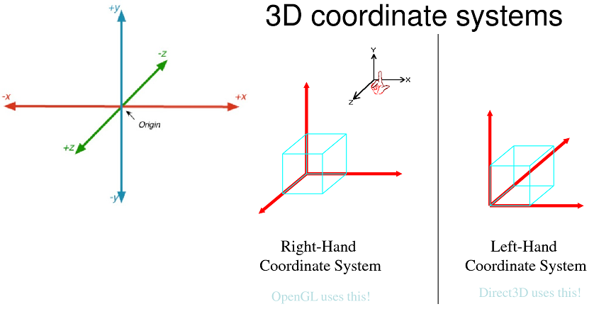

Slide 2
void DrawCube(void) { glMatrixMode(GL_MODELVIEW); // clear the drawing buffer. glClear(GL_COLOR_BUFFER_BIT); glLoadIdentity(); glTranslatef(0.0,0.0,-10.5); glRotatef(xRotated,1.0,0.0,0.0); // rotation about Y axis glRotatef(yRotated,0.0,1.0,0.0); // rotation about Z axis glRotatef(zRotated,0.0,0.0,1.0);
glBegin(GL_QUADS); // Draw The Cube Using quads glColor3f(0.0f,1.0f,0.0f); // Color Blue glVertex3f( 1.0f, 1.0f,-1.0f); // Top Right Of The Quad (Top) glVertex3f(-1.0f, 1.0f,-1.0f); // Top Left Of The Quad (Top) glVertex3f(-1.0f, 1.0f, 1.0f); // Bottom Left Of The Quad (Top) glVertex3f( 1.0f, 1.0f, 1.0f); // Bottom Right Of The Quad (Top)

Slide 3
void reshape(int x, int y) { if (y == 0 || x == 0) return; //Nothing is visible then, so return
//Set a new projection matrix glMatrixMode(GL_PROJECTION); glLoadIdentity(); //Angle of view:40 degrees //Near clipping plane distance: 0.5 //Far clipping plane distance: 20.0 gluPerspective(40.0,(GLdouble)x/(GLdouble)y,0.5,20.0); glMatrixMode(GL_MODELVIEW); glViewport(0,0,x,y); //Use the whole window for rendering }

Slide 4
#include <GL\glut.h> GLfloat xRotated, yRotated, zRotated; void init(void) { glClearColor(0,0,0,0); } void DrawCube(void) { glMatrixMode(GL_MODELVIEW); // clear the drawing buffer. glClear(GL_COLOR_BUFFER_BIT); glLoadIdentity(); glTranslatef(0.0,0.0,-10.5); glRotatef(xRotated,1.0,0.0,0.0); // rotation about Y axis glRotatef(yRotated,0.0,1.0,0.0); // rotation about Z axis glRotatef(zRotated,0.0,0.0,1.0); glBegin(GL_QUADS); // Draw The Cube Using quads glColor3f(0.0f,1.0f,0.0f); // Color Blue glVertex3f( 1.0f, 1.0f,-1.0f); // Top Right Of The Quad (Top) glVertex3f(-1.0f, 1.0f,-1.0f); // Top Left Of The Quad (Top) glVertex3f(-1.0f, 1.0f, 1.0f); // Bottom Left Of The Quad (Top) glVertex3f( 1.0f, 1.0f, 1.0f); // Bottom Right Of The Quad (Top) glColor3f(1.0f,0.5f,0.0f); // Color Orange glVertex3f( 1.0f,-1.0f, 1.0f); // Top Right Of The Quad (Bottom) glVertex3f(-1.0f,-1.0f, 1.0f); // Top Left Of The Quad (Bottom) glVertex3f(-1.0f,-1.0f,-1.0f); // Bottom Left Of The Quad (Bottom) glVertex3f( 1.0f,-1.0f,-1.0f); // Bottom Right Of The Quad (Bottom) glColor3f(1.0f,0.0f,0.0f); // Color Red
void animation(void) { yRotated += 0.01; xRotated += 0.02; DrawCube(); } void reshape(int x, int y) { if (y == 0 || x == 0) return; //Nothing is visible then, so return //Set a new projection matrix glMatrixMode(GL_PROJECTION); glLoadIdentity(); //Angle of view:40 degrees //Near clipping plane distance: 0.5 //Far clipping plane distance: 20.0 gluPerspective(40.0,(GLdouble)x/(GLdouble)y,0.5,20.0); glMatrixMode(GL_MODELVIEW); glViewport(0,0,x,y); //Use the whole window for rendering } int main(int argc, char** argv){ glutInit(&argc, argv); //we initizlilze the glut. functions glutInitDisplayMode(GLUT_SINGLE|GLUT_RGB); glutInitWindowPosition(100, 100); glutCreateWindow(argv[0]); init(); glutDisplayFunc(DrawCube); glutReshapeFunc(reshape); //Set the function for the animation. glutIdleFunc(animation); glutMainLoop(); return 0; }
glVertex3f( 1.0f, 1.0f, 1.0f); // Top Right Of The Quad (Front) glVertex3f(-1.0f, 1.0f, 1.0f); // Top Left Of The Quad (Front) glVertex3f(-1.0f,-1.0f, 1.0f); // Bottom Left Of The Quad (Front) glVertex3f( 1.0f,-1.0f, 1.0f); // Bottom Right Of The Quad (Front) glColor3f(1.0f,1.0f,0.0f); // Color Yellow glVertex3f( 1.0f,-1.0f,-1.0f); // Top Right Of The Quad (Back) glVertex3f(-1.0f,-1.0f,-1.0f); // Top Left Of The Quad (Back) glVertex3f(-1.0f, 1.0f,-1.0f); // Bottom Left Of The Quad (Back) glVertex3f( 1.0f, 1.0f,-1.0f); // Bottom Right Of The Quad (Back) glColor3f(0.0f,0.0f,1.0f); // Color Blue glVertex3f(-1.0f, 1.0f, 1.0f); // Top Right Of The Quad (Left) glVertex3f(-1.0f, 1.0f,-1.0f); // Top Left Of The Quad (Left) glVertex3f(-1.0f,-1.0f,-1.0f); // Bottom Left Of The Quad (Left) glVertex3f(-1.0f,-1.0f, 1.0f); // Bottom Right Of The Quad (Left) glColor3f(1.0f,0.0f,1.0f); // Color Violet glVertex3f( 1.0f, 1.0f,-1.0f); // Top Right Of The Quad (Right) glVertex3f( 1.0f, 1.0f, 1.0f); // Top Left Of The Quad (Right) glVertex3f( 1.0f,-1.0f, 1.0f); // Bottom Left Of The Quad (Right) glVertex3f( 1.0f,-1.0f,-1.0f); // Bottom Right Of The Quad (Right) glEnd(); // End Drawing The Cube glFlush(); }

