Slide 1


DEPARTMENT OF COMPUTER SCIENCE & ENGINEERING · UTTARA UNIVERSITY
HookGuard: Runtime-Verified Detection of npm Malicious Packages
via multi-layer behavioral-chain verification — static analysis, ML, canary deception, and eBPF kernel enforcement
PRESENTED BY
SUPERVISED BY
[Ashiqur Rahman Bhuiyan , Ayesha Akter ]
[Zarin Tasnim]
ID: [2223081147 , 2223081110] · B.Sc. in Computer Science & Engineering
Thesis Defense [ 27/10/2026 ]
[Lecturer ,Dept of CSE ,Uttara Univerisity ]
Notes:
Welcome the committee. Introduce yourself and the title. HookGuard is an install-time gate for npm: it combines static analysis, machine learning, canary deception, Docker, and eBPF kernel monitoring, and it keeps evidence for every verdict.

Slide 2
PRESENTATION OUTLINE
What We'll Cover
From the install-time threat to measured evidence, limitations, and conclusions.
01
Introduction & Background
07
Methodology & System Design
02
Problem Statement
08
Implementation
03
Research Questions
09
Experimental Setup
04
Objectives
10
Results & Analysis
05
Literature Review & Gap
11
Comparison & Limitations
06
Novelty & Contributions
12
Conclusion & Future Work
Department of CSE · Uttara University
02 / 22
Notes:
Walk through the outline in one breath. The deck follows the thesis: threat, gap, questions, design, implementation, experiments, evidence, limits, and conclusion.

Slide 3
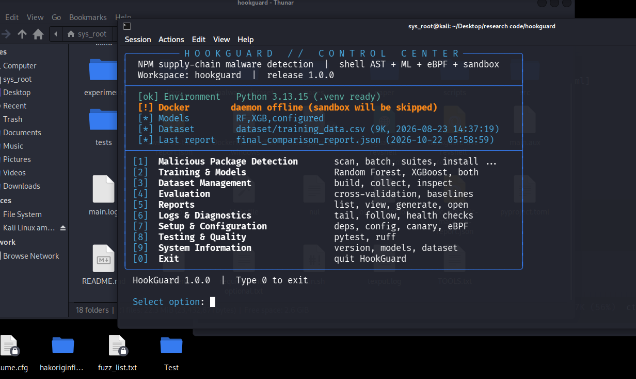
01 — INTRODUCTION
Introduction & Background
The install phase is executable code
CONTEXT
npm runs preinstall, install, and postinstall hooks with the installing user's privileges — before the application imports a single line.
MOTIVATION
Attackers now place payloads in package.json hooks, binding.gyp, and packed binaries. Miasma reached 57 packages; IronWorm shipped packed preinstall binaries with eBPF rootkits.
SCOPE
This thesis evaluates malicious npm packages that execute during install on Linux. Require-time-only malware is outside the declared threat model.
Department of CSE · Uttara University
03 / 22
Notes:
Set the context: npm install executes lifecycle hooks with the developer's privileges. Payloads have moved into package.json hooks and native build paths. Keep the scope explicit: install phase, Linux host. The right panel shows the exposure chain.

Slide 4
02 — PROBLEM STATEMENT
The Problem We Address
An install hook can steal credentials before any scanner sees intent — and most detectors cannot observe or stop it.
WHO IS AFFECTED
CURRENT LIMITATION
WHY NOW
Developers and CI pipelines that run npm install with real credentials and no install-time enforcement.
Static and learned models see capability, not intent; ptrace is evadable; scores arrive without reviewable evidence.
Supply-chain worms hide payloads in hooks, native build files, and packed binaries; known-bad databases cannot cover zero-days.
FOUR LINKED FAILURES
Capability ≠ intent
Models drift
ptrace is evadable
Scores ≠ evidence
Result: a blocking gate that developers will keep enabled is still missing.
Department of CSE · Uttara University
04 / 22
Notes:
State the gap in one sentence, then the supporting points. The key distinction is capability versus intent. The result is not another score; it is a usable blocking decision with evidence.

Slide 5
03 — RESEARCH QUESTIONS
Four Questions, Four Evidence Paths
RQ1
RQ2
Can a multi-layer behavioral-chain pipeline detect malicious npm packages while keeping the false-positive rate low enough for an install gate?
Does active canary deception add intent evidence beyond what static analysis and machine learning provide?
Evidence: 0.34% blocking FPR on q2; 1.36% on the Guo holdout.
Evidence: PoC case studies; Docker+strace pilot (+7 catches, p = 0.016); no isolated canary-only ablation.
RQ3
RQ4
Can eBPF kernel monitoring provide install-time observation and enforcement, including process termination, without ptrace?
How does HookGuard compare with GuardDog, Packj, and OSSGadget on real-world corpora and under hook-evasion mutation?
Evidence: four tracepoint programs; live verifier; 98.7% pipeline recall under mutation.
Evidence: head-to-head tables; Wilson intervals; exact McNemar tests [1].
Department of CSE · Uttara University
05 / 22
Notes:
Each question maps to a specific result later. RQ1 is the low-FPR claim; RQ2 asks whether canary deception adds intent evidence, and the honest answer is that the PoC case studies and the Docker+strace pilot support the dynamic path, but we did not isolate a canary-only ablation. RQ3 is the eBPF observation and kill path; the 98.7% figure is pipeline recall under mutation, not an eBPF-only metric. RQ4 is the executed comparison.

Slide 6
04 — OBJECTIVES
Research Objectives
01
Analyze
02
Design
Map the install-time threat surface and the limits of static, ML, dynamic, and registry-gate defenses.
Specify seven layers with distinct evidential roles: shell, ML, risk gate, canary, Docker, eBPF, and fusion.
03
Implement
04
Evaluate
Build the 45-feature classifier, six canaries, four eBPF programs, sandbox, and evidence serializer.
Run six corpora, executed baselines, layer ablation, mutation study, and a validity analysis.
.
Department of CSE · Uttara University
06 / 22
Notes:
Each objective maps to a result: analysis to the gap, design to the seven layers, implementation to the artifact, and evaluation to the six corpora and the ablation.

Slide 7
05 — LITERATURE REVIEW
Related Work & the Gap
WORK · YEAR | APPROACH | LIMITATION FOR THIS THESIS
GuardDog · 2024 [4] | Static entropy, obfuscation, and API-surface rules; executed baseline | Capability, not intent; 43.0% alert-level FPR on q2
SAP · 2023 [5] | Supervised cross-language ML for npm and PyPI | Distribution-dependent; no runtime evidence
Packj · 2024 [7] | Static heuristics plus a strace sandbox | ptrace-level; F1 only 66.7 → 71.2 on the Guo benchmark
Socket · 2024 [8] | Registry-backed install gate | Known-bad only; cloud dependency; no local evidence
eBPF monitors · 2022–25 [9], [13] | Falco, Tracee, Tetragon [9], Bomfather [13] | No npm semantics, canaries, or verdict fusion
WHAT THE LITERATURE LEAVES OPEN
Intent evidence
Kernel-level enforcement
Auditable evidence chain
To our knowledge, no existing npm detector unites all three in one install-time pipeline.
Department of CSE · Uttara University
07 / 22
Notes:
Show only the most relevant works and group them by approach. GuardDog is the strongest conventional baseline but misses intent. SAP drifts. Packj and MalOSS use ptrace. Socket is known-bad only. eBPF monitors lack npm semantics. That is the gap.

Slide 8
06 — NOVELTY & CONTRIBUTIONS
What Is New in HookGuard
C1
Seven-layer pipeline with graceful degradation
C2
Active canary deception for npm
Still returns a verdict when Docker, eBPF, or the model is unavailable — the user sees which protection is actually present.
Six credential tripwires. Access is evidence of intent, not merely a suspicious string or a dangerous capability.
C3
Kernel enforcement with an evidence chain
C4
Executed-baseline evaluation
Four eBPF programs, phase-gated SIGKILL, and the syscall events that produced each verdict. No ptrace.
Six corpora, paired Wilson/McNemar statistics, a disclosed leakage defect, and negative results that bound the claim.
Novelty in one sentence: turn “what can this package do?” into “what did it do on this host?”
Department of CSE · Uttara University
08 / 22
Notes:
Four contributions carry the thesis. The architectural novelty is the coupling: intent evidence from canaries, observation and enforcement from eBPF, and a reviewable evidence chain, all in one install-time gate.

Slide 9
07 — METHODOLOGY
Research Methodology
1
2
3
4
5
Threat & corpora
Offline ML
Static + risk gate
Dynamic verification
Fusion & analysis
Six corpora: PoC, q2, mutants, Guo holdout, medium, generated. Generated fixtures are regression-only.
45 features in five groups; Random Forest; frozen artifact; τ = 0.4; leakage audit.
L1 shell analysis, L2 ML, L3 Phase A/B gate. A clean package takes the sub-second fast path.
Six canaries, Docker as uid 65534, four eBPF programs, kernel SIGKILL on a kill-marked access.
Priority fusion; TPR, FPR, precision, F1, average precision; Wilson 95% CI; exact McNemar; runtime.
DESIGN LOGIC
Each layer has a distinct evidential role, not a redundant vote. Uncertainty routes the package to dynamic confirmation; every verdict, benign or malicious, retains its evidence record.
Reproducibility: frozen model artifact · provenance sidecar · per-package verdict JSON · released evaluation scripts.
Unit of analysis: one npm tarball or extracted package directory. Defender: Linux 5.15+, Docker, and root or CAP_BPF.
Department of CSE · Uttara University
09 / 22
Notes:
Walk left to right through the pipeline. The design is not seven independent votes: each layer answers a different question. The risk gate keeps the expensive dynamic path reserved for packages that need it.

Slide 10
07 — SYSTEM DESIGN
Seven-Layer Behavioral-Chain Architecture
STATIC EVIDENCE
· FAST PATH
L1 SHELL
Shell analysis
15 shell features; Unix,
PowerShell and CMD dialects.
L7 DECISION
Behavioral fusion
PRIORITY ORDER
L3 TRIAGE
Risk gate
Phase A risk signals + Phase B
content cache. Needs dynamic?
INPUT
npm package
.tgz + package.json
lifecycle hooks
UNTRUSTED CODE
FAST PATH · 0.60 s MEDIAN
L2 LEARNED
ML classifier
45 features · Random Forest
τ = 0.4 · frozen artifact.
MALICIOUS
SUSPICIOUS
UNDETERMINED
BENIGN
Confidence from agreeing layers; every verdict keeps its evidence record.
ONLY IF GATED
DYNAMIC EVIDENCE
OUTPUT
Verdict + evidence
Layer results · canary hits ·
filtered syscall events
JSON · AUDIT-READY
· ISOLATED SANDBOX
L4 DECEPTION
Canary deploy
6 credential tripwires
laid before install.
L5 CONTAINMENT
Docker sandbox
uid 65534 · resource caps
no network by policy.
L6 KERNEL
eBPF monitor
exec · file · connect · DNS
kernel SIGKILL on tripwire.
static
dynamic
fusion
Fast path 0.60 s · cached verdict 0.3 s · dynamic package ≈ 6 s
Department of CSE · Uttara University
10 / 22
Notes:
Point to the two paths. L1 and L2 produce static evidence, L3 decides whether the package needs dynamic confirmation, and the fast path goes directly to L7. On the dynamic path, L4 lays six canaries before install, L5 runs the install as uid 65534, and L6 observes the run with four eBPF programs and can SIGKILL a kill-marked access. L4, L5 and L6 all report to L7; fusion then produces the verdict and its evidence record. The key architectural point is that the dynamic path does not bypass fusion.

Slide 11
07 — SYSTEM DESIGN
The Install Gate Is a Wrapper, Not a Proxy
IMPLEMENTED CONTROL FLOW
COOPERATIVE, NOT TRANSPARENT
DIRECT FETCH
HTTPS + SRI
Metadata and tarball come straight from the npm registry. The SRI digest is checked before analysis; npm then resolves the package independently.
1 WRAPPER
hookguard-install <spec>...
explicit invocation, not a proxy
2 SCAN
hookguard install <spec>
HTTPS fetch · SRI check · L1–L7 pipeline
EXPLICIT SCOPE
Named specs only
Plain npm install is untouched. Only named specs are checked; transitive dependencies are not individually scanned.
all verdicts
BENIGN?
LOCAL EVIDENCE
Nothing external
CLI verdict, JSON/HTML report, and logs. No webhook, SIEM, or live registry feed.
yes
no
3 RELEASE
npm install <specs>
only after clearance
BLOCKED
exit 1 + evidence
request never reaches npm
No HTTP proxy · no registry rewrite · no ordinary-npm interception
SCOPE Runtime detection here means install-phase lifecycle hooks — not a long-lived monitor and not require-time execution.
Department of CSE · Uttara University
11 / 22

Slide 12
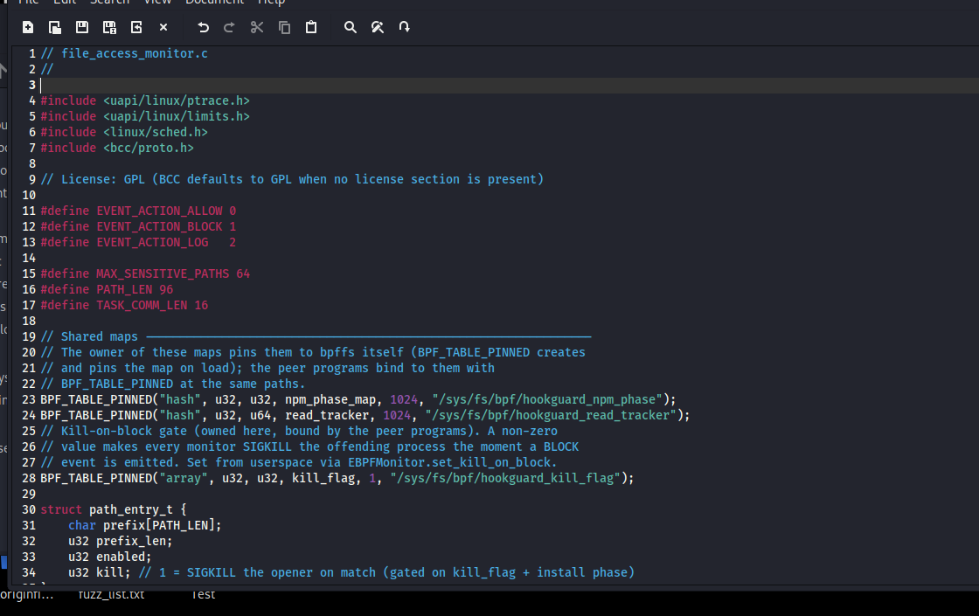
08 — IMPLEMENTATION
Implementation Details
TOOLS & TECHNOLOGIES
Python 3.11+
BCC / eBPF
Docker
scikit-learn
734 tests
YAML / JSON
KEY IMPLEMENTATION DECISIONS
—
≈16,000 lines of Python + 1,000 lines of C; 734 collected unit tests.
—
45-feature contract with fixed order and a loud drift check; RF τ = 0.4.
—
Canaries injected through the Docker archive API so paths match the host.
NARROW KILL CONTRACT
—
Four eBPF programs share pinned maps; kill is phase-gated to uid 65534.
•
Install phase only
•
Kill-marked access only
—
Dynamic decisions serialize the filtered syscall events into JSON evidence.
•
Untrusted uid 65534 only
Reproducibility: frozen feature order · provenance sidecar · JSON evidence · released scripts.
Department of CSE · Uttara University
12 / 22
Notes:
Mention only the decisions the committee will ask about: the feature contract prevents silent column drift; canaries are injected into the container so their paths are realistic; the kernel kill is deliberately narrow and gated.

Slide 13
09 — EXPERIMENTAL SETUP
Experimental Setup & Data
CORPUS | BEN | MAL | TOTAL | EVIDENTIAL ROLE
PoC | 14 | 5 | 19 | Layer coverage; ablation
q2 real-world | 293 | 64 | 357 | Main baseline comparison
Mutation | — | 78 | 78 | Hook-evasion robustness
Guo holdout | 2,064 | 146 | 2,210 | Large real-world comparison
Medium | 150 | 150 | 300 | In-distribution end-to-end check
Generated | 800 | 5,000 | 5,800 | Static regression only
PROTOCOL
•
Same tarballs for every tool; baselines re-measured offline.
•
Registry-dependent metadata rules excluded on both sides.
•
HookGuard flags MALICIOUS or SUSPICIOUS; GuardDog strict vs alert.
METRICS
TPR · FPR · precision · F1 · average precision · Wilson 95% CI · exact McNemar · runtime.
BASELINES
GuardDog 3.2.0 · Packj static · OSSGadget 0.2.20 · Docker+strace pilot.
ENVIRONMENT
Linux 6.8 · Docker 24.0 · BCC 0.29. Re-verified on Linux 7.0.12 · Docker 28.5.2 · BCC 0.35. Timing from one 10-core host.
Generated corpora are regression-only. q2 malicious labels: OpenSSF [3]; Guo split: [1].
Department of CSE · Uttara University
13 / 22
Notes:
Explain the evidential role of each corpus. The real-world evidence is q2 and the Guo holdout. The generated corpora are regression checks only. All baselines were run on the same tarballs under an offline protocol.

Slide 14
10 — RESULTS & ANALYSIS
Results: Ablation & PoC
100%
7.1%
98.7%
PoC detection (5/5 malicious)
PoC false-positive rate (1/14)
recall on 78 hook mutants
Proof-of-concept corpus: detection vs. false positives
WHAT THE ABLATION SHOWS
•
Static only: catches 2/5 malicious but flags 9/14 benign.
•
ML only: catches 3/5 at 0 FPR — but its training leakage is disclosed.
•
Full pipeline: catches 5/5 at 1/14 FPR; dynamic layers catch the two concatenated-command Linux samples.
•
The single FP: esbuild downloads and runs a native binary — a genuine capability/intent ambiguity.
•
Read ML rows: as indicative, not as an operating point.
5 malicious / 14 benign. Detection counts only MALICIOUS; FPR counts MALICIOUS or SUSPICIOUS.
Department of CSE · Uttara University
14 / 22
Notes:
Lead with the headline: the full pipeline detects all five PoC samples at 7.1% FPR. Static-only floods benign packages; ML-only misses two but has disclosed leakage. Dynamic verification is what makes the pipeline usable.

Slide 15
10 — REAL-WORLD RESULTS
Results: Real-World Corpora
CORPUS | TOOL | TPR [95% CI] | FPR [95% CI] | F1
q2 · 357 | HookGuard | 53.1% [41.1, 64.8] | 0.34% [0.06, 1.9] | 0.69
q2 · 357 | GuardDog strict | 68.8% [56.6, 78.8] | 7.9% [5.3, 11.5] | 0.67
q2 · 357 | GuardDog alert | 75.0% [63.2, 84.0] | 43.0% [37.5, 48.7] | 0.40
q2 · 357 | Packj static | 20.3% [12.3, 31.7] | 6.1% [3.9, 9.5] | 0.27
q2 · 357 | OSSGadget any-tag | 93.8% [85.0, 97.5] | 97.6% [95.2, 98.8] | 0.29
Guo · 2,210 | HookGuard | 72.6% [64.9, 79.2] | 1.36% [0.94, 2.0] | 0.76
Guo · 2,210 | GuardDog strict | 84.9% [78.2, 89.8] | 10.1% [8.9, 11.5] | 0.52
Guo · 2,210 | GuardDog alert | 90.4% [84.6, 94.2] | 49.2% [47.1, 51.4] | 0.20
Guo · 2,210 | Packj static | 33.3% [26.2, 41.4] | 11.3% [10.0, 12.8] | 0.24
Guo · 2,210 | OSSGadget any-tag* | 83.3% [70.4, 91.3] | 95.8% [93.7, 97.3] | 0.14
READ THE TRADE-OFF
•
q2: 0.34% vs 7.9% blocking FPR (≈23× lower), at lower recall.
•
Guo: 72.6% TPR at 1.36% FPR vs 84.9% at 10.1% (7.4× lower FPR); precision 0.79 vs 0.37.
•
Guo: GuardDog catches 26 HookGuard misses; HookGuard catches 8 (p = 0.003).
•
q2 two-tool union: 87.5% (56/64) at HookGuard’s blocking FPR.
•
Composition — review alerting in front of a blocking gate — beats replacement.
*OSSGadget partial: shard 1 (553); BackdoorRules missing in 0.2.20. Wilson 95% CIs. q2 paired strict McNemar p = 0.12; Guo p = 0.003. Docker+strace pilot: 42.2% TPR at 0.34% FPR. Labels: [1], [3]; baselines [4], [7], [9].
HookGuard is not the highest-recall detector; it is the strongest precision/evidence trade-off at the blocking point.
Department of CSE · Uttara University
15 / 22
Notes:
This is the key comparison. GuardDog has higher recall on both real corpora, but HookGuard holds a sub-percent blocking FPR. On q2 the FPR is 0.34% versus 7.9%, roughly 23 times lower; the 7.4 times figure belongs to the Guo holdout, 1.36% versus 10.1%. The q2 paired strict difference is not significant (p = 0.12); the Guo paired difference is significant (p = 0.003). The failure modes are asymmetric, which is why composition works: review-only alerting in front of a blocking gate.

Slide 16
10 — ROBUSTNESS & SCALE
Mutation, Scope & Runtime
Hook-evasion mutation: recall holds when syntax changes
34 / 35
0 / 9
hook-carrying q2 malversions caught (97.1%)
require-time samples caught — scope limit
0.60 s
286 s
median benign runtime; 0.3 s cached
full 357-package run at four lanes
SCALE CHECK
2,210-package Guo holdout · 300-package medium benchmark (100% TPR / 0% FPR, in-distribution) · 5,800-package generated fixture used only as a software regression check.
GuardDog alert recall falls 61.5% → 23.1%; HookGuard holds 98.7% ([93.1, 99.8]; McNemar p < 0.001). Mutant idioms follow [1], [2].
The mutation result is the clearest evidence that the dynamic layers observe behavior, not hook text.
Department of CSE · Uttara University
16 / 22
Notes:
The mutation study is the strongest evidence for the dynamic layers: a one-line encoding erases most of GuardDog's recall but leaves HookGuard's kernel-observed behavior intact. Also state the scope limit honestly: 0 of 9 require-time samples.

Slide 17
11 — COMPARISON & DISCUSSION
How It Compares
APPROACH | INTENT | KERNEL | GATE | EVIDENCE | q2 FPR*
Static (GuardDog) | — | — | — | Rule score | 7.9%
ML (SAP) | — | — | — | Probability | n/a
Static + strace (Packj) | Partial | — | — | ptrace trace | 6.1%*
Registry gate (Socket) | — | — | Yes | Label | n/a
eBPF (Tetragon/Bomfather) | — | Yes | Partial | Syscalls | n/a
HookGuard | Yes | Yes | Yes | Full chain | 0.34%
q2 FPR measured in this study. Packj 6.1% is its offline static component; Packj_dynamic/MalOSS were not rerun on q2. Tetragon enforces; Bomfather observes. Sources: [4], [7], [8], [9], [13].
DISCUSSION
•
HookGuard does not win raw recall; it wins the precision/evidence trade-off at the blocking point.
•
Failure modes are asymmetric — compose review-only GuardDog alerts with HookGuard’s blocking gate.
•
Deployment argument: a double-digit FPR is hard to keep enabled; a sub-percent gate is operable.
Department of CSE · Uttara University
17 / 22
Notes:
Highlight the row where HookGuard wins: evidence and the blocking false-positive rate. It is not the highest-recall tool. Note that the 6.1% is Packj's offline static component, not a dynamic result; Packj_dynamic and MalOSS were not rerun on q2. Tetragon enforces; Bomfather observes builds. The practical posture is layered: review alerting in front of a blocking gate.

Slide 18
11 — LIMITATIONS
Limitations & Threats to Validity
SCOPE
CORPORA & PROTOCOL
•
Install phase only: 0/9 require-time samples caught.
•
357 and 2,210 packages are not random registry samples.
•
Dependency-relay attacks are outside the threat model.
•
Baselines were re-measured offline, without metadata rules.
•
Windows payloads were exercised through emulation, not natively.
•
No full dynamic ablation at Guo-holdout scale.
PLATFORM
EVIDENCE QUALITY
•
eBPF requires Linux 5.15+ and root or CAP_BPF.
•
Original ML training leakage is disclosed, not hidden.
•
Host compromise is outside the containment boundary.
•
Generated benign covers collapse to six feature vectors.
•
Six canary paths are fixed, not user-configurable yet.
•
Timing is from one host; the mutator shares our design intuitions.
Claim boundary: install-hook malware on Linux, evidenced by these corpora — not a registry-wide operating point.
Department of CSE · Uttara University
18 / 22
Notes:
Be explicit about the boundaries. The biggest is install-phase scope: HookGuard catches 34/35 hook carriers but 0/9 require-time samples. The ML leakage and generated-corpus duplication are disclosed, and the generated F1 is excluded from every claim.

Slide 19
12 — CONCLUSION & FUTURE WORK
Conclusion & Future Work
CONCLUSION
FUTURE WORK
Seven layers turn the install phase into an observed, enforceable boundary.
Full dynamic ablations at Guo scale and a complete 13,708-package run.
q2: 53.1% TPR at 0.34% FPR; Guo: 72.6% at 1.36%; 34/35 hook carriers.
User-configurable canaries and unprivileged eBPF.
Mutation: 98.7% vs GuardDog’s 23.1% — the kernel sees behavior, not text.
BPF LSM hardening; extend coverage to require-time code.
Every verdict retains its evidence record; dynamic verdicts add syscall chains.
Native Windows execution and a longitudinal campaign study.
Precision and evidence are deployment requirements, not afterthoughts.
The implementation, corpora, and evaluation scripts are released so the claims can be reproduced, challenged, and extended.
Department of CSE · Uttara University
19 / 22
Notes:
Close the loop back to the research questions: the gate is usable because FPR is low, the canaries add intent evidence, eBPF observes and enforces, and the comparison is asymmetric. Every verdict retains an evidence record; dynamic verdicts add syscall chains. End with the claim boundary: install-hook malware on Linux, evidenced by these corpora.

Slide 20
REFERENCES
References
[1] W. Guo et al., “How Effective Are NPM Malicious Package Detectors? A Large-Scale Empirical Study,” ASE, 2026. doi:10.1145/3832783.3837427.
[8] Socket Security, “Socket: Proactive Supply Chain Security,” 2024. socket.dev.
[2] M. Ohm, H. Plate, A. Sykosch, and M. Meier, “Backstabber’s Knife Collection: A Review of Open Source Supply Chain Attacks,” DIMVA, 2020, pp. 23–43.
[9] Isovalent, “Tetragon: eBPF-based Security Observability and Runtime Enforcement,” 2022. cilium.io/tetragon/.
[3] OpenSSF Package Analysis Team, “Malicious-Packages,” 2026. github.com/ossf/malicious-packages.
[10] Snyk, “The Rising Trend of Malicious Packages in Open Source Ecosystems,” 2025. snyk.io/blog/malicious-packages-open-source-ecosystems.
[4] DataDog, “GuardDog: A Threat Detection Tool,” v3.2.0, 2024. github.com/DataDog/guarddog.
[11] Phoenix Security, “Miasma Wave 2: npm Worm Bypasses Postinstall via binding.gyp,” 2026. phoenix.security/miasma-wave2-npm-supply-chain-bindingyp-zero-cve-2026.
[5] P. Ladisa et al., “On the Feasibility of Cross-Language Detection of Malicious Packages in npm and PyPI,” ACSAC, 2023. doi:10.1145/3627106.3627138.
[12] S. Satou, “IronWorm Returns as jscrambler, Rustier Than Ever,” JFrog Security Research, 2026. research.jfrog.com/post/ironworm-returns-rustier-than-ever/.
[6] R. Duan et al., “Towards Measuring Supply Chain Attacks on Package Managers for Interpreted Languages,” NDSS, 2021. doi:10.14722/ndss.2021.23055.
[13] N. Srinivasan, N. Naveen, and N. Naveen, “Bomfather: An eBPF-based Kernel-level Monitoring Framework for Accurate Identification of Unknown, Unused, and Dynamically Loaded Dependencies in Modern Software Supply Chains,” arXiv:2503.02097, 2025.
[7] Packj, “Packj: Find Malicious Open-Source Packages,” 2024. github.com/ossf/packj.
Full reference list: thesis References section and paper references.bib.
Department of CSE · Uttara University
20 / 22
Notes:
Do not read these aloud. Keep them for committee reference. The full bibliography is in the thesis and the paper.

Slide 21
ACKNOWLEDGEMENT
Acknowledgement
Thank you to the people who made this work possible.
I would like to express my sincere gratitude to my supervisor, Zarin Tasnim, for her invaluable guidance, constructive feedback, and continued support throughout this research. Her insights and academic guidance have been instrumental in shaping this work.
I also extend my sincere appreciation to my teammate, Ayesha Akter, for her collaboration, dedication, and contributions to the development of HookGuard: Runtime-Verified Detection of npm Malicious Packages.
Furthermore, I am grateful to the faculty and staff of the Department of Computer Science and Engineering at Uttara University for providing an academic environment that supported this research. Finally, I would like to thank my family and friends for their unwavering encouragement and support throughout this journey.
All errors and limitations remain my own.
Department of CSE · Uttara University
21 / 22
Notes:
Keep this brief and sincere. Thank the supervisor, examiners, department, family, and peers.

Slide 22
Thank You
Questions & Discussion
[Ashiqur Rahman Bhuiyan ] · [2223081147@uttarauniversity.edu.bd]
[Ayesha Akter] · [2223081110@uttarauniversity.edu.bd ]
Notes:
Invite questions from the committee. Keep the evidence tables and the thesis open for reference.

