Slide 1

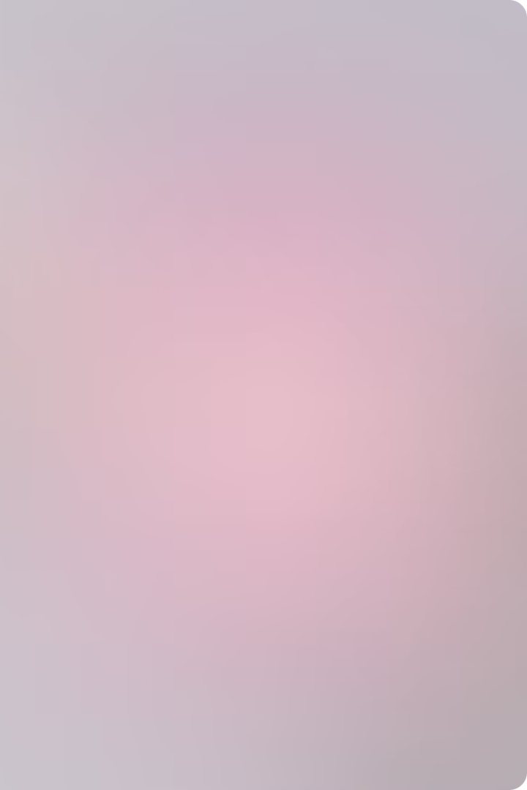
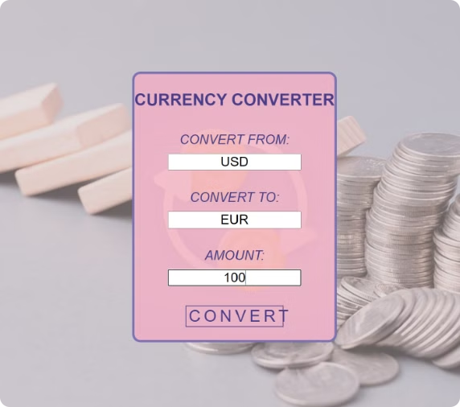
Currency Converter Web Application
Mohamed Ashik
Milica Gareski
Matheus Zago
ReDi - Python Foundation Course

Slide 2

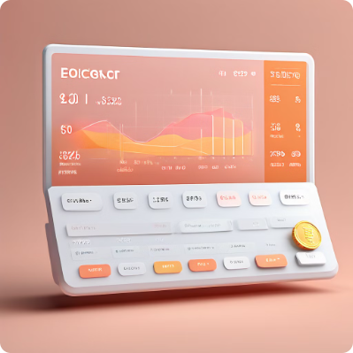
Project Overview
1
Objective
2
Key Features
Provide a web-based tool for converting currency amounts using skills learned during the ReDi Python Foundation
Input validation for currencies and amounts, real-time exchange rate retrieval, and a simple and user-friendly web interface.
3
Technologies
Git/GitHub, Python, Flask, Fixer API, HTML/CSS

Slide 3
Application Architecture
Modular Components
Framework
External API
currency_validation.py
Flask for web server
Fixer API for real-time currency rates
amount_validation.py
currency_converter.py
main.py
allinone.py

Slide 4
Currency Validation
1
Input Currencies
User enters currencies to convert from and to.
2
API Request
Send request to Fixer API for valid currency symbols.
3
Validation Check
Check if entered currencies exist in API's symbols.
4
Result
Return valid currencies or prompt for re-entry.

Slide 5
Amount Validation
Purpose
Input
Ensure the input amount is a valid positive number.
User enters the amount to be converted.
Validation
Result
Check if input is a positive float.
Return valid amount or prompt for re-entry.

Slide 6




Currency Conversion Logic
Inputs
API Request
Response Processing
Output
Validated from_currency, to_currency, and amount.
Send conversion request to Fixer API.
Extract conversion result from API response.
Return converted amount.

Slide 7

Running the Application
1
Setup
Ensure all modules are in the same directory.
2
Execution
Run the Flask application with python main.py.
3
Access
Open the web app at http://127.0.0.1:5000.

Slide 8
Web Interface and User Experience
HTML Form
Flask Route
User Interaction
Includes input fields for 'Convert from', 'Convert to', and 'Amount', along with a 'Convert' button.
Handles GET and POST requests, processes form inputs, and renders the result.
Users input currencies and amount, submit the form, and receive the converted amount.

