Slide 1

CUSTOMER RETENTION CASE STUDY
Presented by:
ASHIKA YASMEEN

Slide 2
Problem Statement
Customer retention is the loss of customers in the E-commerce industry.
Product price is not the only factor that causes customer retention.
Factors like availability of payment method, delivery period and many more affects the customers loyalty. Hence, the customers move from one company to other.
It costs more to acquire new customers than to retain existing ones.

Slide 3
Machine Learning
Machine Learning is a subfield of Artificial Intelligence (AI) that works with algorithms and technologies.
Machine Learning (ML) is categorized into two groups:
Supervised ML: In supervised ML, we are given a dataset and already know our output, having the idea of relationship between input and output data. Supervised machine learning problems are categorized into regression and classification problems.
Unsupervised ML: In Unsupervised ML, there is no information or idea about output is known i.e there is no relationship between input and output data. We can derive structure by clustering the data based on the relationships among the variables in the data.
In this project, we used supervised machine learning to predict the customer retention in Indian E-commerce using classification models.

Slide 4
Exploratory Data Analysis
Data Visualization
Data Pre-Processing
Data Transformation
Splitting the data into features and target
Building a model
Choosing the best model
Saving the model

Slide 5
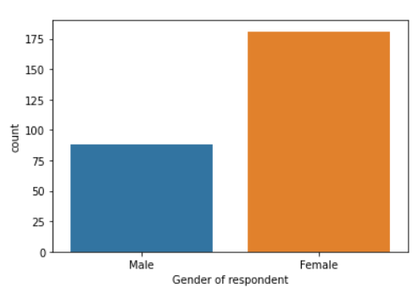
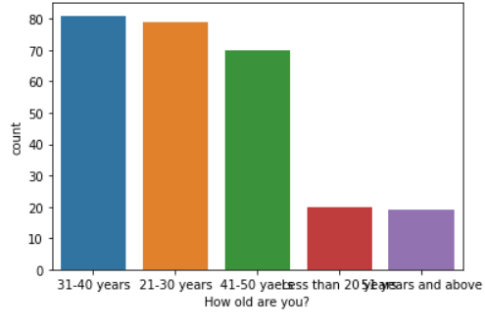
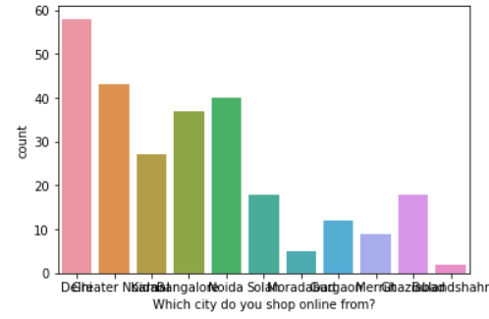
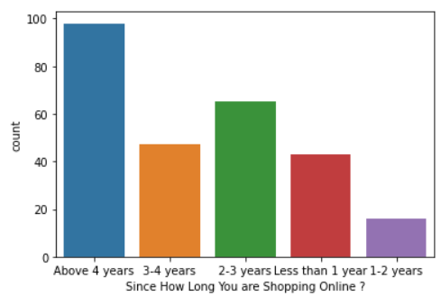
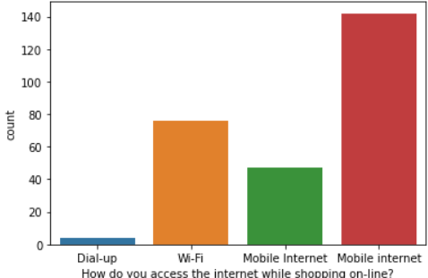
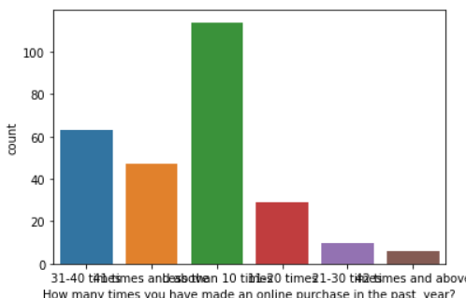
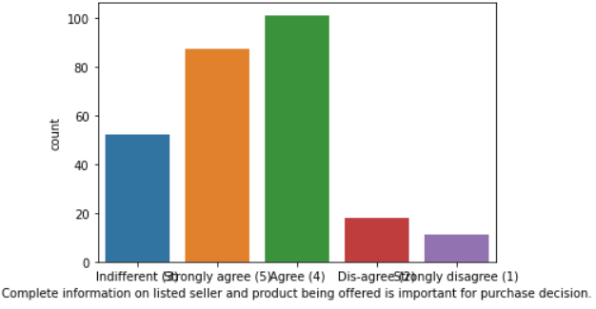
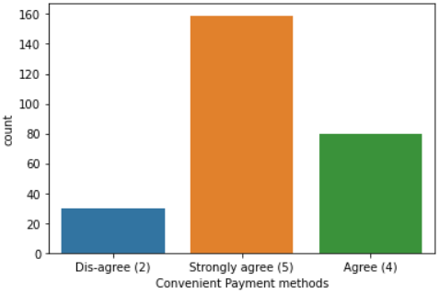
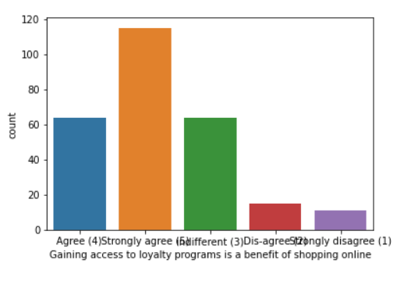
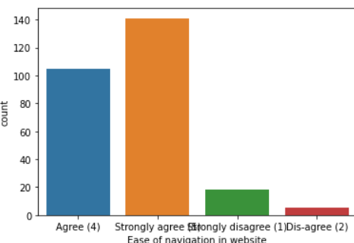
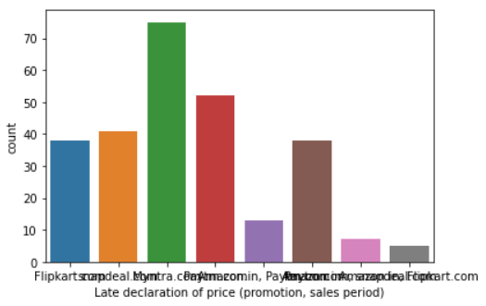
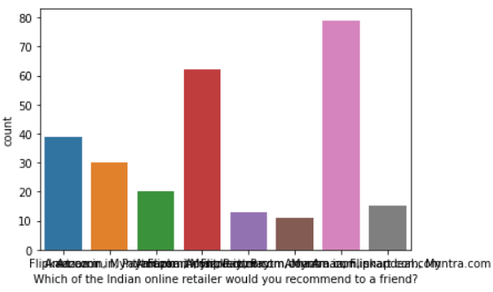
Visualizations
For the categorical data count plot is used to observe the relationship between input and target data.

Slide 6
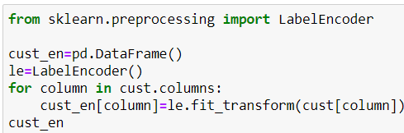
Steps and Assumptions used
Label Encoding: The data in label form is converted into numeric form which is in machine-readable form.
There are no null values present in the dataset.
Correlation: Finding the correlation between the target and input columns.
Describe of dataset: This gives the mean, standard deviation, maximum and minimum value.
Outliers: Outliers have been checked using box plot and the outliers present have been removed by z-score technique.
Skewness: Skewness has been checked using normal distribution curve and been removed using power transform method.
Dropping the columns: The columns which are not correlated to the target column have been deleted.
The dataset has been divided into features and vectors.
Data scaling is done using standard scaler.
Building the model using classification technique and the best model is saved.

Slide 7
Model Dashboard
Classification models are used to predict the customer retention in this project.
Logistic Regression: It gives the relationship between the dependent and independent variables. It is used when the value of the target variable is categorical in nature.
Decision Tree Classifier: It is a tree-structured classifier, where internal nodes represent the features of a dataset, branches represent the decision rules and each leaf node represents the outcome.
Random Forest Classifier: It consists of many decision trees. It uses bagging and feature randomness when building each individual tree and try to create an uncorrelated forest of trees whose prediction by committee is more accurate than that of any individual tree.

Slide 8
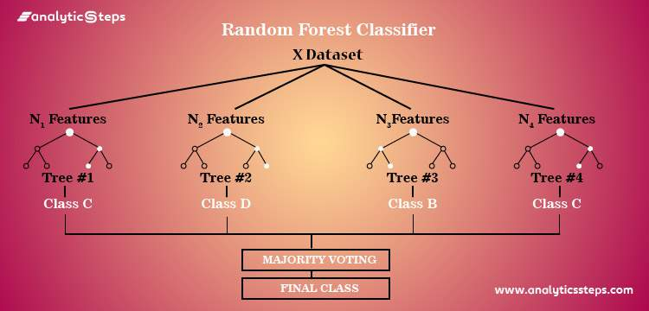
Finalized Model
Random Forest Classifier is chosen as the best model for the customer retention prediction.

Slide 9
Conclusion
The goal is to find the factors affecting the customer retention in an Indian E-commerce industry.
All the websites are not equally preferred by customers.
Amazon was the most preferred online store followed by Flipkart.
These two companies are most trusted and highly reliable.
These two companies have comparitively lesser possibilities of customer retention.

