Slide 1
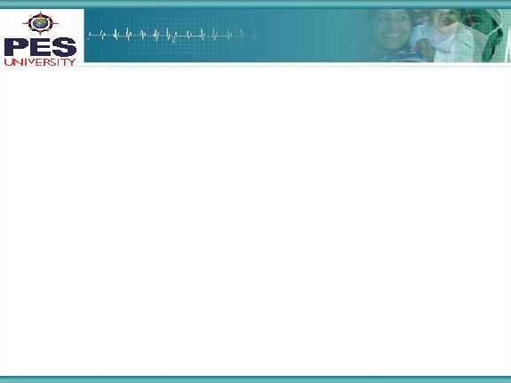

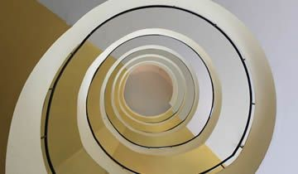

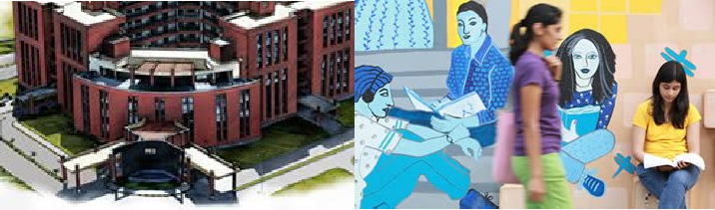

Project Presentation
(Final - ESA)
Project Title
: Example :Automatic Music Generation using RBMs
Project Team :Rachana Sudhindra Dani PES1201700950
Ashika Meryl Pinto PES1201701346
1

Slide 2
Project Abstract and Scope
Automatic Music Generation with Restricted Boltzmann Machines-
WHY? – Creating music is a time consuming task. To help music composers spend much time on the lyrics rather than the playback sound.
Uniqueness? – Unlike many models that use LSTMs our model is based on Restricted Boltzmann Machines that eliminates the need of target output for comparison and weight updates.

Slide 3
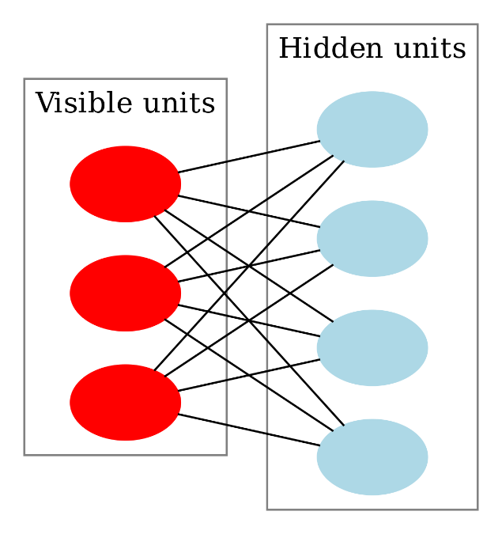
Solution Architecture
Modules – required: Tensorflow to build and train the model, py-midi for midi format music files manipulation.
Number of neurons in visible layer: 1560
Number of neurons in hidden layer: 100
Data Preparation
Train Model
Generate Test music files
Combine music files
3

Slide 4
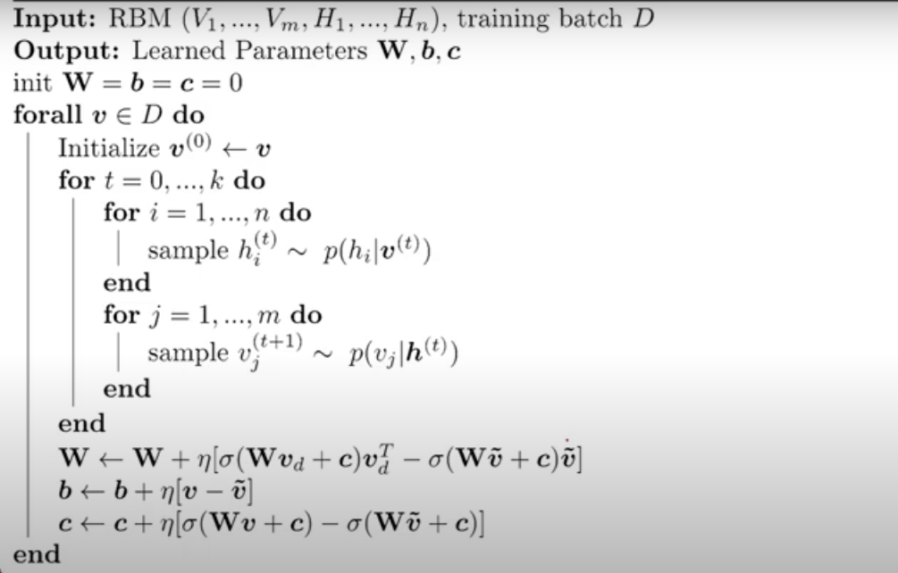
Algorithm

Slide 5
Solution-
The algorithm we chose for the purpose is Contrastive Divergence algorithm.
Total number of steps in Gibbs Chain were chosen to be 1.(practically works well).
Total number of epochs 200
Batch size 100
Learing rate: .005
Training:
X- input, X_{sample}-gibbs sample from the network
W-weights, BH, BV-biases for the hidden and visible layer
Sample function randomly samples from the given vector based on uniform distribution
Gibbs chain for r iterations
For kth iteration in range(r):
Forward pass:
h_{sample} = sample(sigmoid(W X+BH))
x_{sample} = sample(sigmoid(h_{sample} W^{T} + BV))
return x_{sample}(also the point estimate for the second expectation term)

Slide 6
Weight updates:
W = W + η[sigmoid(W X+BH)X^{T}) – sigmoid(W X_{sample} + BH)X_{sample}^{T}]
BV = BV + η[X - X_{sample}]
BH = BH + η[sigmoid(W X+BH)) – sigmoid(W X_{sample} + BH)]
Generation of the music from the trained model:
Randomly generate vectors of size 1X1560.
Generate X_{sample} corresponding to that vector.
Convert that vector to midi format.

Slide 7
How do we know if the solution is good?
We cannot say – Because the aim of our project is to generate the music on a press of a key. As long as the music is melodious we can say that the output is good.

Slide 8
Dependencies
Python midi was installed using the following commands.
git clone -b feature/python3 https://github.com/vishnubob/python-midi.git cd python-midipython setup.py install
8

Slide 9
Future work plan
As of now the data available is only for piano. We would like to extend our work for music files consisting of notes corresponding to multiple musical instruments.
9

Slide 10
References
A. Sharma “https://towardsdatascience.com/restricted-boltzmann-machines-simplified-eab1e5878976”.
Deep Learning Part-II “https://www.youtube.com/watch?v=NSQ7NwSe7Zc” Training RBMs using Constrastive Divergence algorithm.

Slide 11
Thank You

