Slide 1
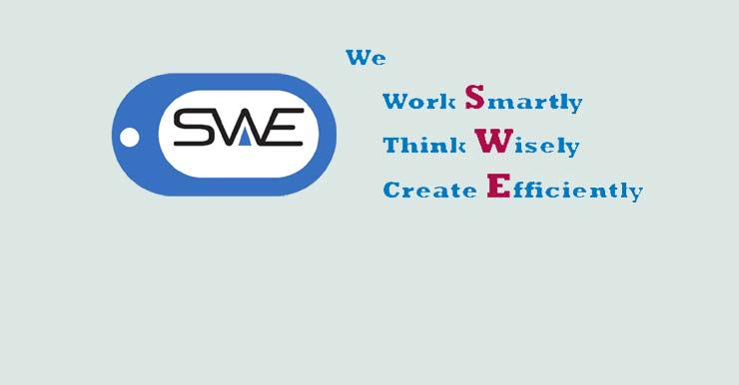
Welcome To My Presentation

Slide 2
Course Code : SE-231
Course Title: System Analysis And Design Project
Presented BY:
Name : Ashik Bhuyan
ID : 183-35-2585
Department Of SE
Daffodil International University
Presented to:
Md. Mushfiqur Rahamn
Senior Lecturer
Department Of SWE
Daffodil International University

Slide 3
Presentation Topic:
----------------- project Proposal ------------
------------------ Introduction -----------------
------------------ Problem Statement --------
------------------ Proposed Solution ----------
----------------- Design & Implementation Constraints -------
----------------- User Classes & Characteristics ------------
---------------- Project’s Technologies -------
----------------- Use Case Diagram ------------
---------------- DB Schema Diagram ------
---------------- ER Diagram ----------------
--------------- Admin Panel -----------------
----------------- Some UI Demo ----------------

Slide 4
Project Proposal :
Archive
2. Project-Thesis-Archive
3. Python(Django)
4. It has all the needed tools and features to build a super-fast responsive software.
Support and Update
Banners Slideshow

Slide 5
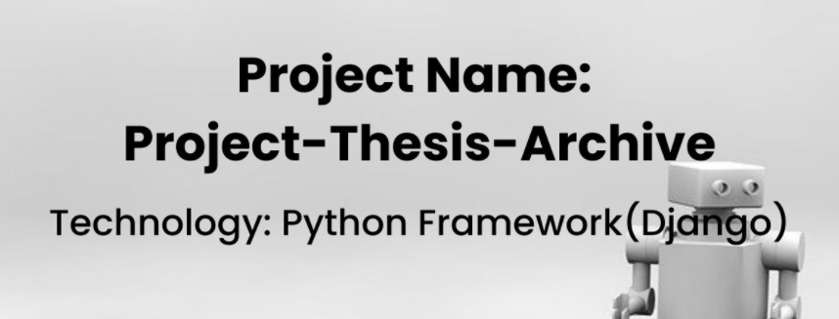
Introduction :
It is a clean and elegant Multipurpose Landing Page Template . It will fit perfectly for Startup, Web App or any type of Web Services . It has 4 background styles with 6 homepage styles. 6 pre-defined color scheme.
All variations are organized separately so you can use / customize the template very easily.
It has all the needed tools and features to build a super-fast responsive software
Support and Update
Banners Slideshow
Also Editing

Slide 6
Problem Statement :
Proposed Solution :
In web-based system we have to install software every desktop pc or laptops.
We have to synchronization and monitoring every time to our main database.
Need much memory and space.
Not work with any OS and device.
Not work at anywhere.
Difficult to trace the PTA with their location .
User can visit the website site with no fear of insecurity from PTA.
The system can be handled by the PTA manager .
Easy Monitoring.
Compatible with any device and system.
Work at anywhere.

Slide 7
Design & Implementation Constraints :
1. Operating Environment:
The PTA(Project-Thesis-Archive)will be web-based system. Thus, anyone having a browser can hit the specific link and can get access to it. Thus, it will ensure its best usage and will ease the means of getting access to the system.
Moreover, it will remove the complexities of running the system
in multiple platforms as it will be deployed in a web server.
2. Software Language Used:
The application has developed using Django Framework. The used
language is Python and besides Bootstrap, HTML, CSS also has used.
3. Development Tools:
For the development purpose Pycharm : Python IDE for
community edition has used.

Slide 8
User Classes & Characteristics :
Admin
Admin will play a significant role in this system.
Admin will store student’s information, teacher’s information.
2. Student
Student will register , login and upload there project information
with their addresses. They upload multiple project and edit their personal information.
3. Teacher
Teacher will register , login and check student’s posts Every teacher check which students
upload a project or who doesn't upload a project.

Slide 9
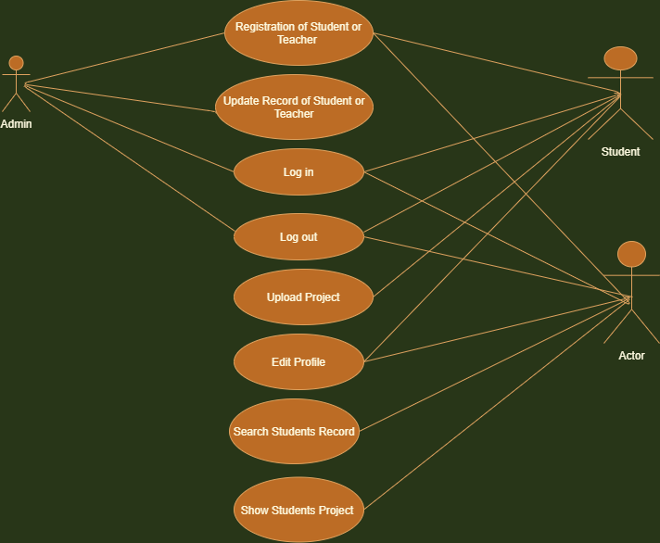
Use Case Diagram :

Slide 10
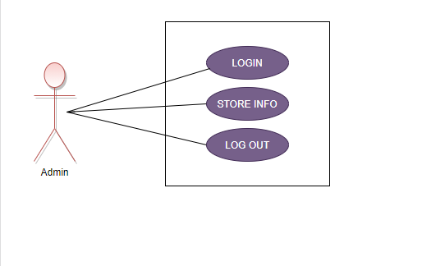
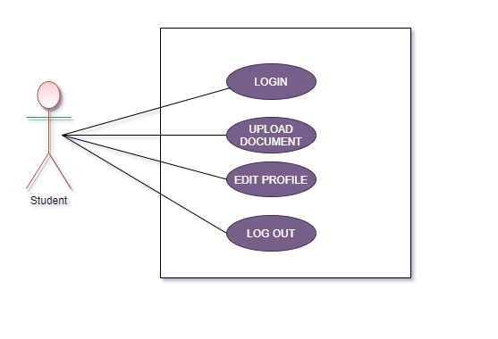
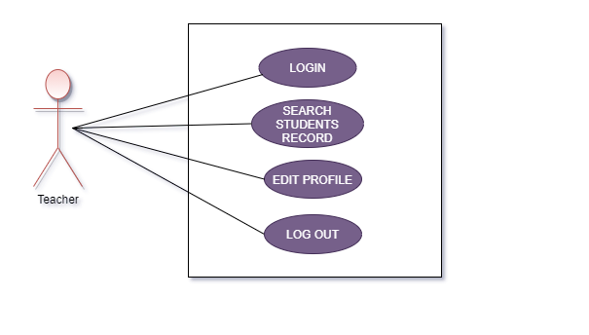

Slide 11
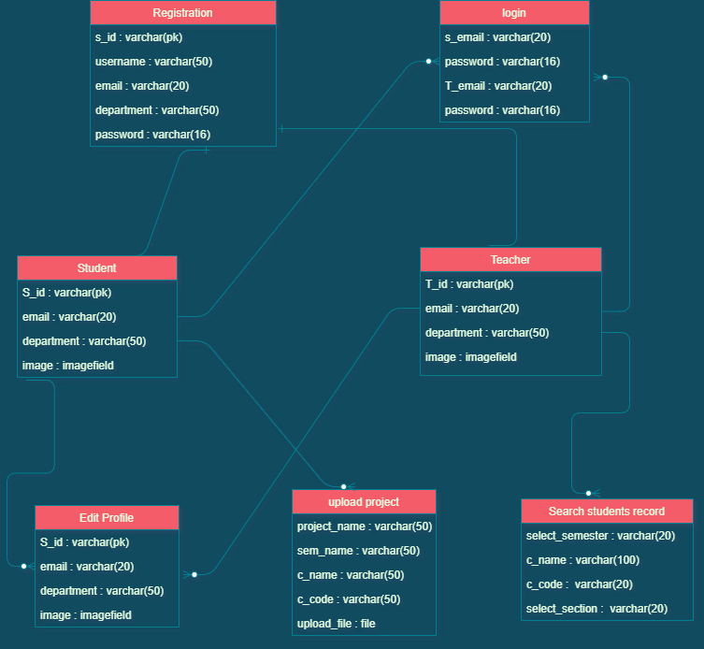
DB Schema Diagram :

Slide 12
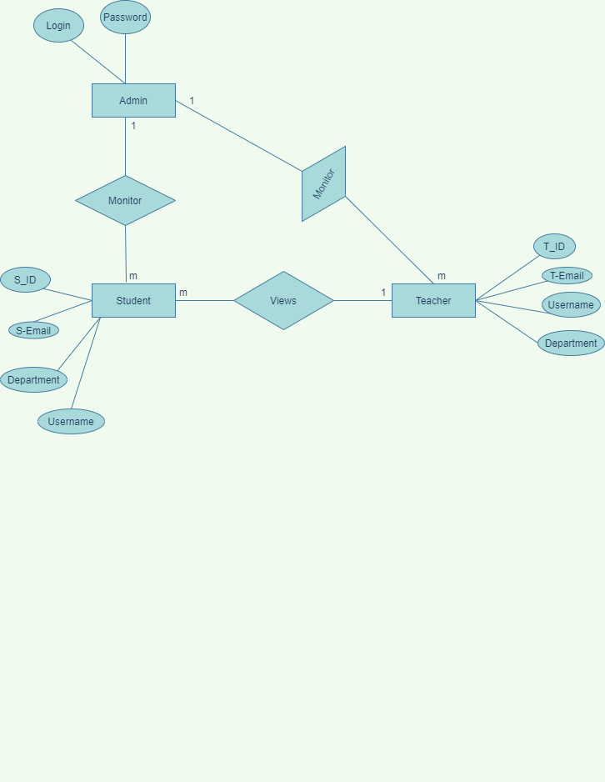
ER Diagram :

Slide 13
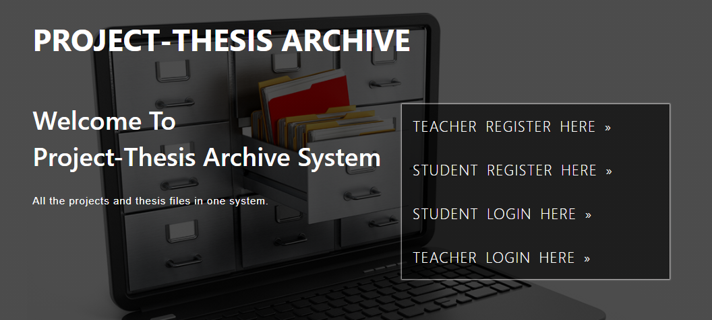
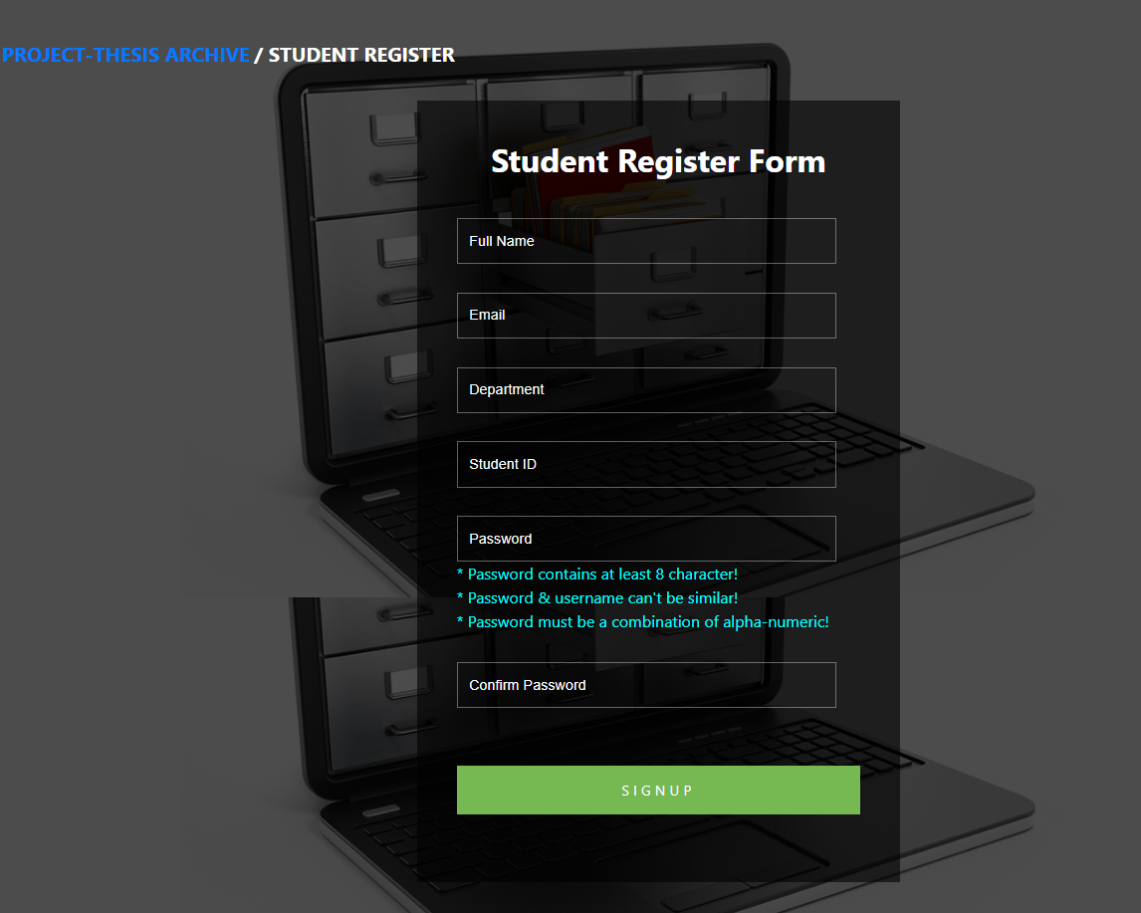
Screenshots of UI :

Slide 14
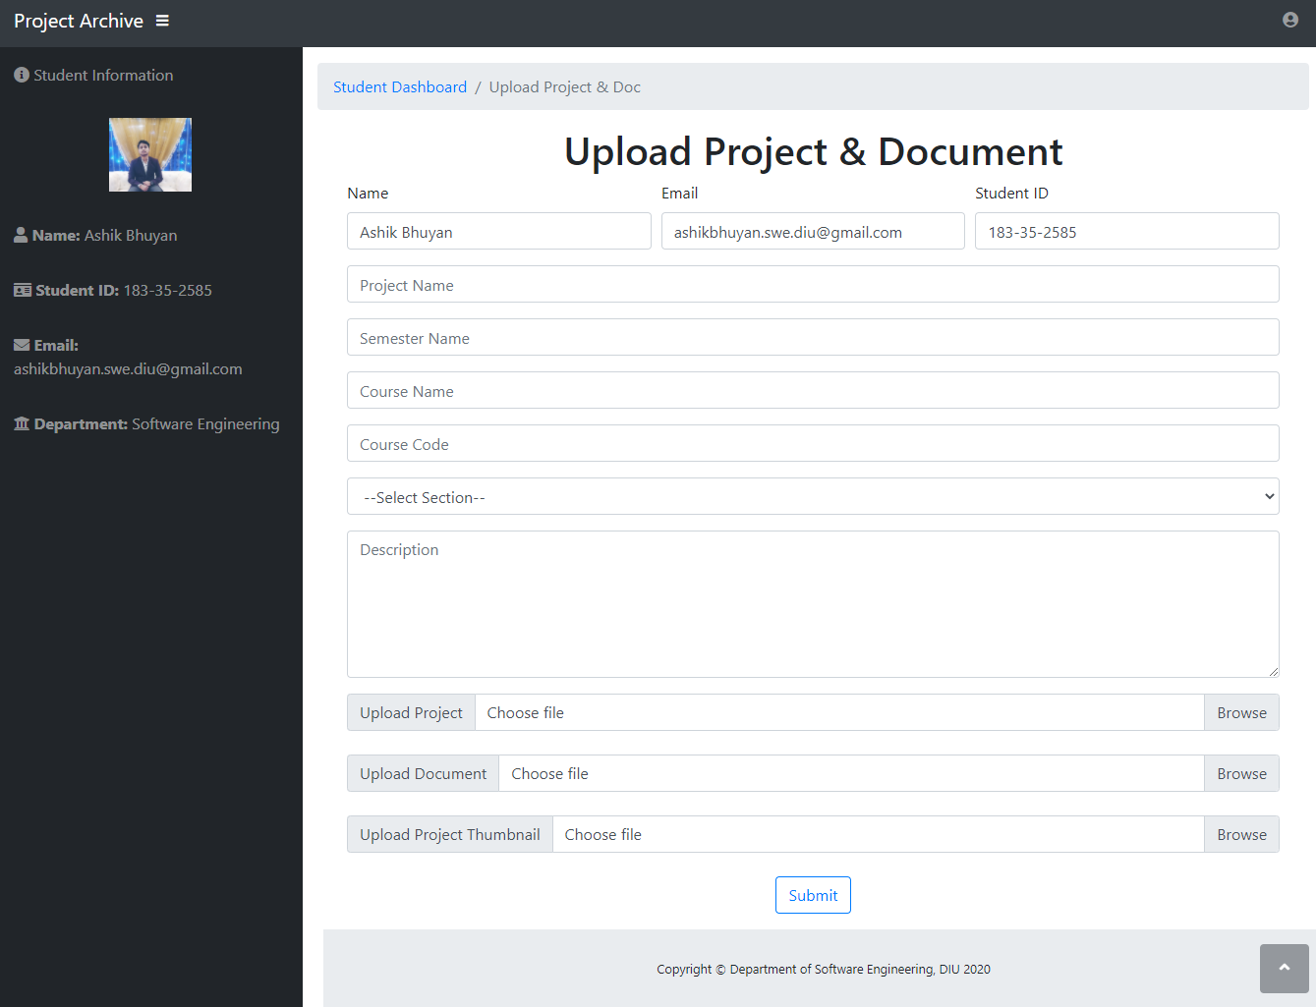
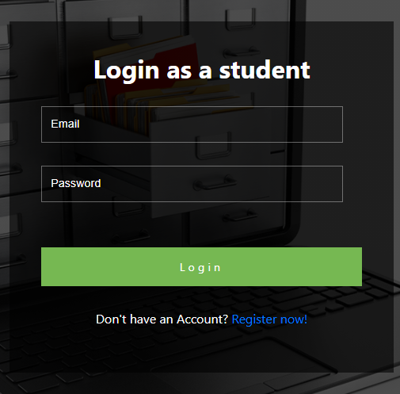

Slide 15
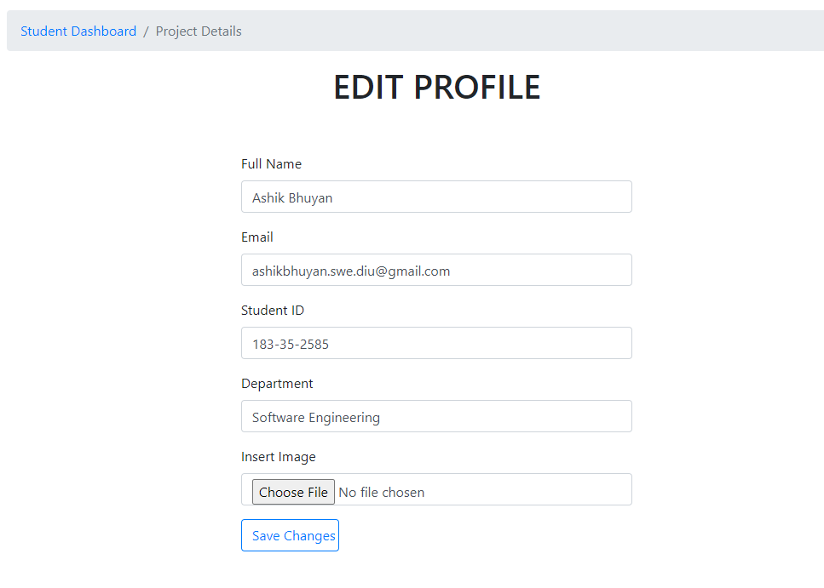
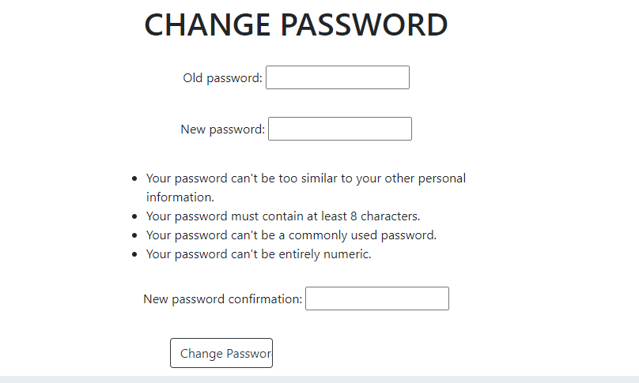

Slide 16
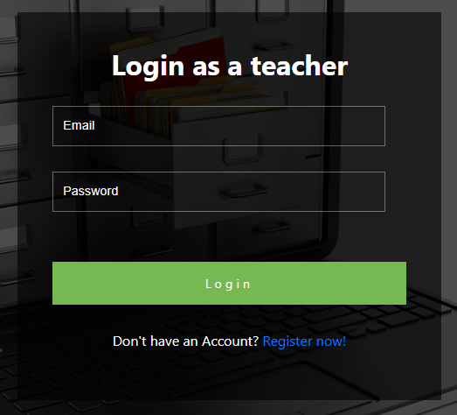
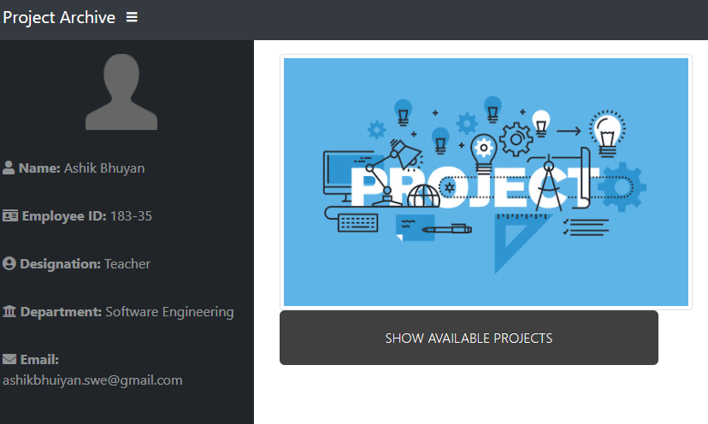

Slide 17
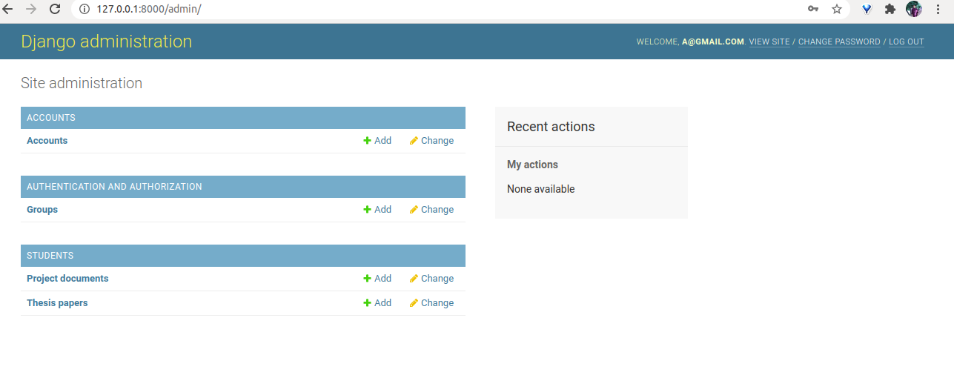
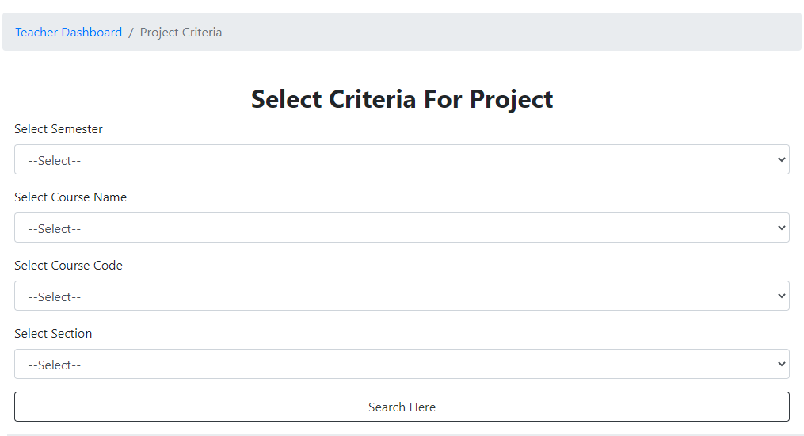

Slide 18
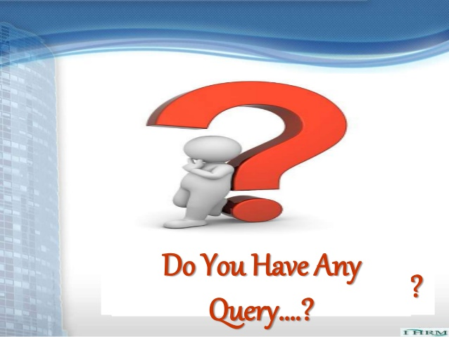

Slide 19
