Slide 1
Mobicrop APP

Slide 2

Welcome

Slide 3
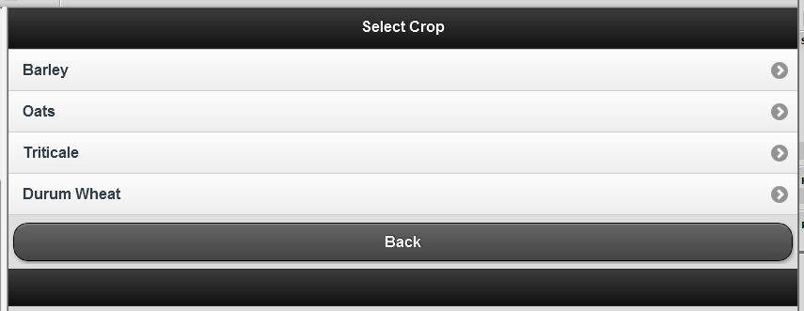
Select Crop

Slide 4
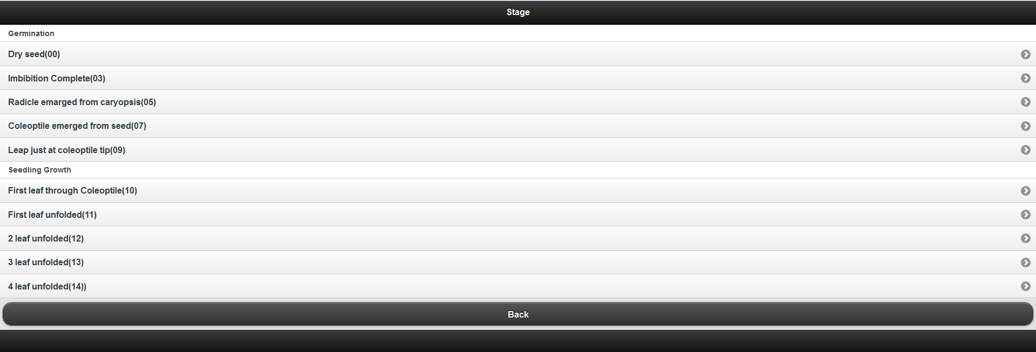
Crop Stage

Slide 5
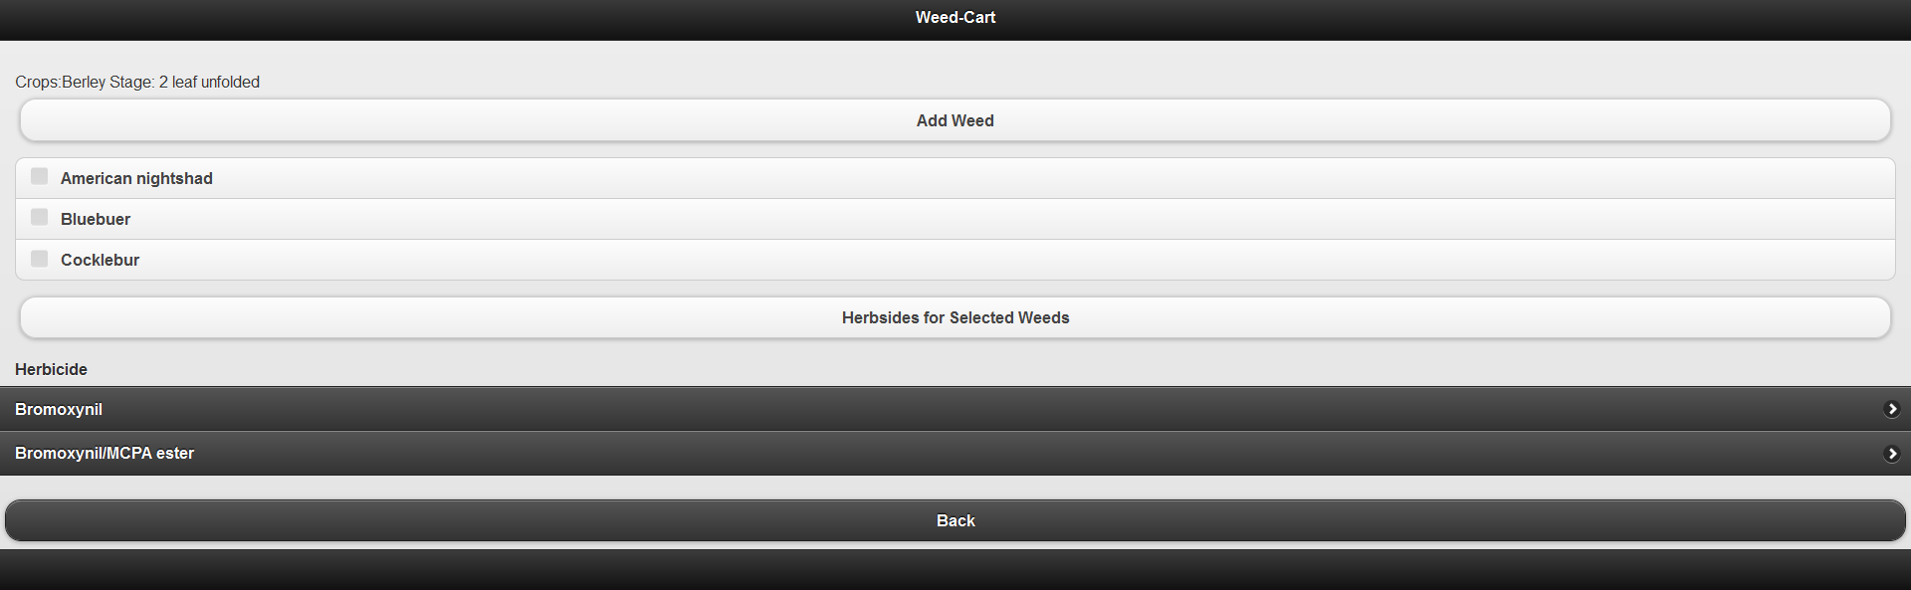
Weed Cart

Slide 6
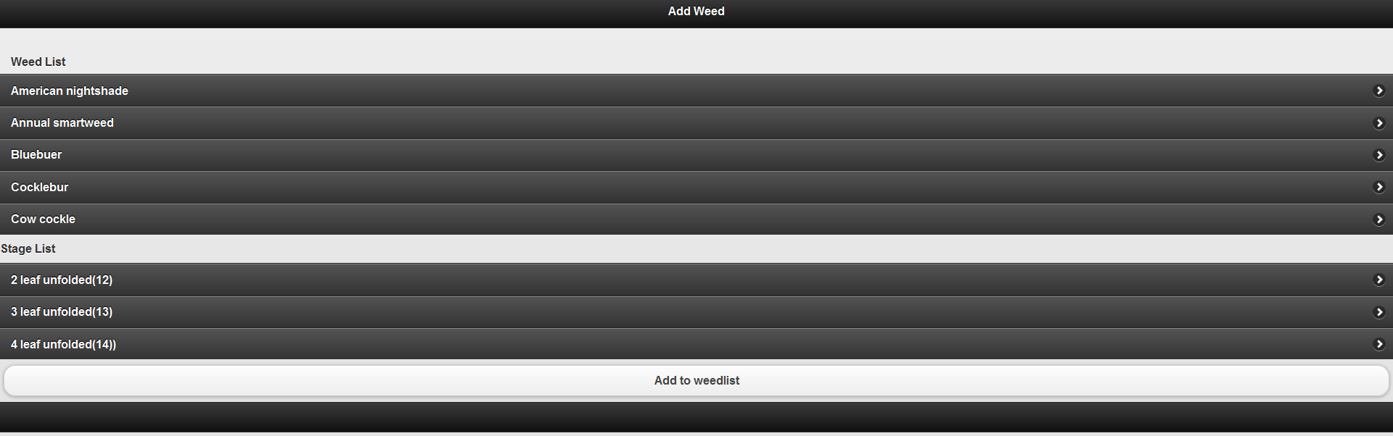
Add Weed

Slide 7
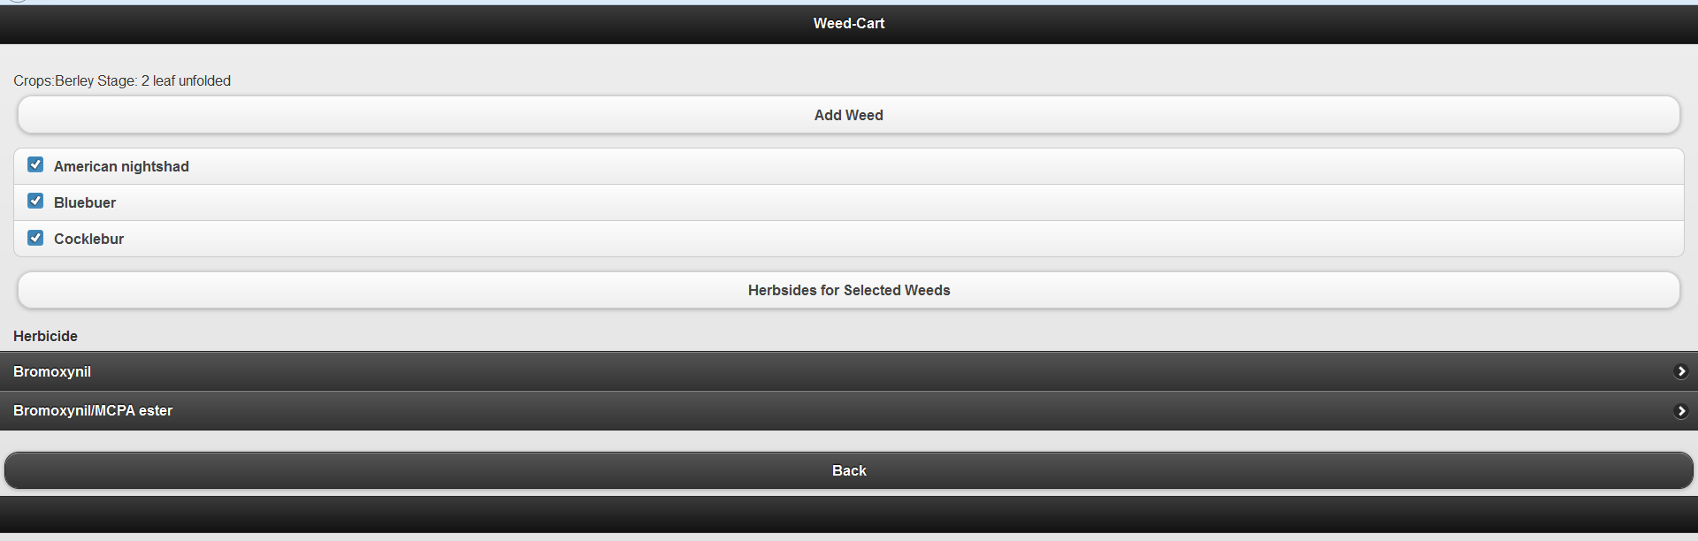
Show Herbicide

Slide 8
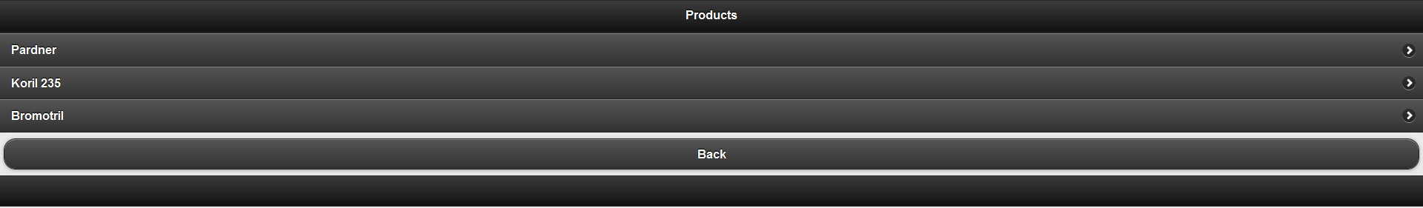
Show Products

Slide 9
Product Details

Slide 10
Database

Slide 11
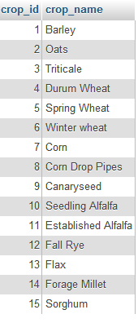
Crop Table

Slide 12
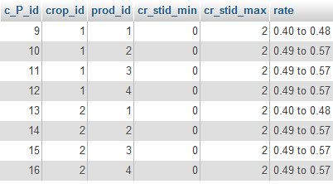
Crop Product Table

Slide 13
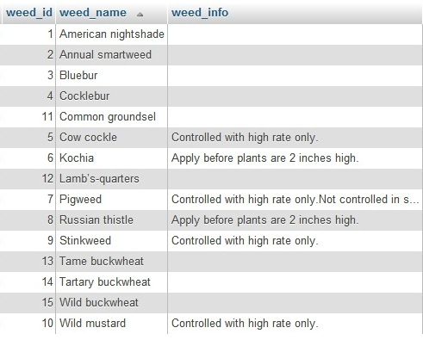
Weed Table

Slide 14

Herbicide Table

Slide 15
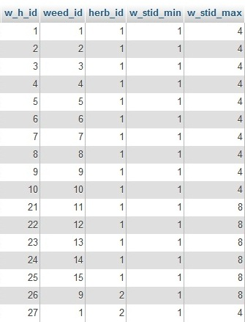
Weed herbicide Table

Slide 16
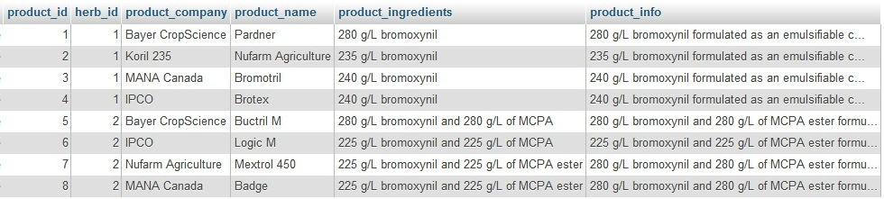
Products Table

