Slide 1

The oxford college of engineering
Dept, mca
A Proxy Re-Encryption Approach to Secure Data Sharing in the Internet of Things Based on Blockchain
ASHIK E D [USN : 1OX21MC016]
Under the guidance of : Dr. Puja Shashi
Professor & HOD

Slide 2



AGENDA
Introduction
Problem Statement
Existing System
Proposed System
Data Flow Diagram
Literature Survey
Implementation
Screenshots
Architecture
Hardware and Software Requirements
Future Enhancement
Conclusion
Reference

Slide 3
INTRODUCTION
IoT revolutionizes connectivity and data exchange.
Security challenges arise with increased data sharing.
Blockchain offers a tamper-proof solution for IoT data security.

Slide 4
PROBLEM STATEMENT
Security and privacy concerns in IoT systems are prevalent.
Blockchain and Proxy Re-Encryption are proposed as solutions.
Objectives:
Enable secure and private data sharing.
Ensure data integrity.
Protect user privacy.
Optimize scalability in IoT systems.
Proposed approach combines blockchain and Proxy Re-Encryption.
Goal:
Provide a trusted and efficient solution for secure IoT data sharing.

Slide 5
Existing system
Centralized data sharing.
Vulnerability to breaches.
Dependency on trusted third parties.
Single points of failure.
Potential data leaks.
Additional :
Lack of transparency and accountability.
Difficulty in establishing trust for data handling.
Significantly pertinent in sensitive industries (e.g., healthcare, finance).
Critical need for data protection in these sectors.

Slide 6
Proposed system
Proxy Re-Encryption + Blockchain
Addresses IoT security and privacy.
Proxy Re-Encryption
Enables secure data sharing.
Protects encryption keys.
Uses a proxy server.
Blockchain Benefits
Ensures data immutability.
Provides transparency.
Establishes trustless environment.
Enhanced Security
Mitigates IoT data risks.
Privacy Assurance
Safeguards shared data.
Decentralization
Boosts security by moving away from central systems.
Transparency and Trust
Offers visibility and reliability in data transactions.

Slide 7
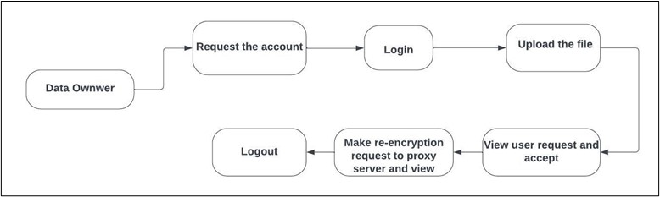
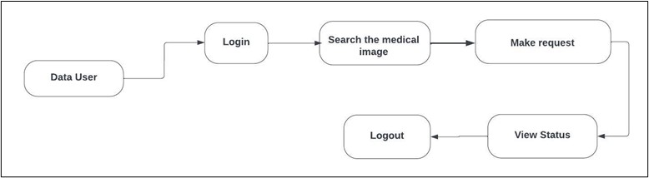
Data FLOW DIAGRAM
LEVEL-1 DFD:
Data Owner
LEVEL-2 DFD:

Slide 8
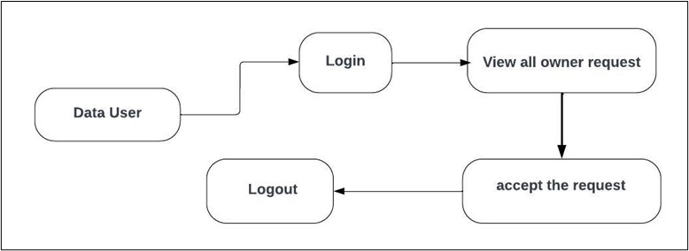
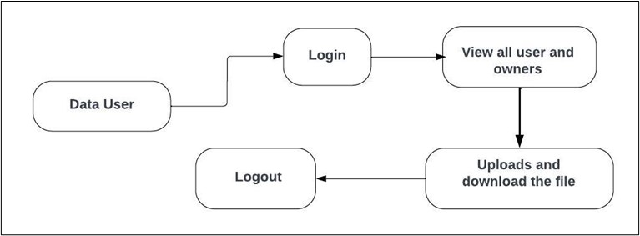
Data FLOW DIAGRAM
LEVEL-3 DFD:
Proxy Server
LEVEL-4(1) DFD:
Cloud Server

Slide 9
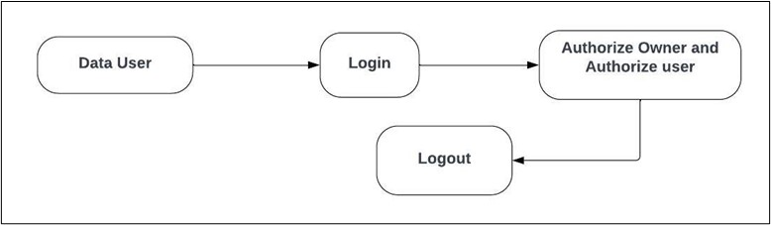
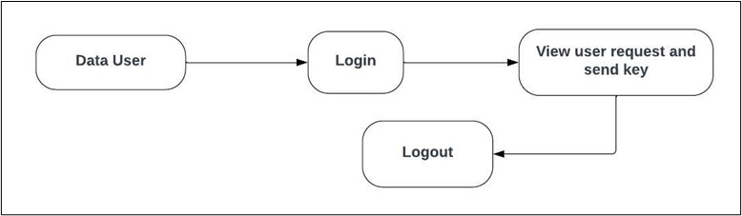
Data FLOW DIAGRAM
LEVEL-4(2) DFD:
Trust Authority
LEVEL-4(3) DFD:
Key Management

Slide 10
LITERATURE SURVEY
Zhang et al. (2017)
Proposed proxy re-encryption for IoT data sharing.
Integrated blockchain for transparency and data integrity.
2. Liu et al. (2018)
Combined proxy re-encryption and blockchain for privacy preservation.
Developed a decentralized platform for secure data sharing.
3. Sharma et al. (2019)
Integrated smart contracts and proxy re-encryption for data security.
Evaluated security and efficiency in IoT data sharing.
4. Chen et al. (2020)
Introduced a blockchain-based access control and proxy re-encryption model.
Conducted assessments on performance, security, and scalability.
5. Wang et al. (2021)
Established a decentralized blockchain platform with proxy re-encryption.
Assessed performance and security aspects in IoT data sharing.

Slide 11
IMPLEMENTATION
System Architecture
Encryption and Decryption
Proxy Re-Encryption
Blockchain Integration
User Management and Access Control
Secure Communication
Scalability and Efficiency
User Interface

Slide 12
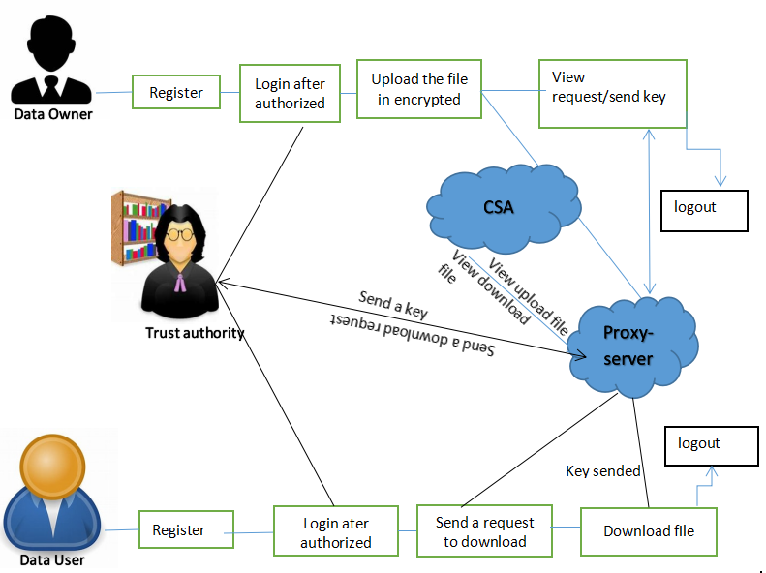
architecture
Proxy Re-Encryption and Blockchain Integration
Data Encryption with Proxy Re-Encryption
Blockchain Storage
Node-Based Infrastructure
Node Functionality

Slide 13
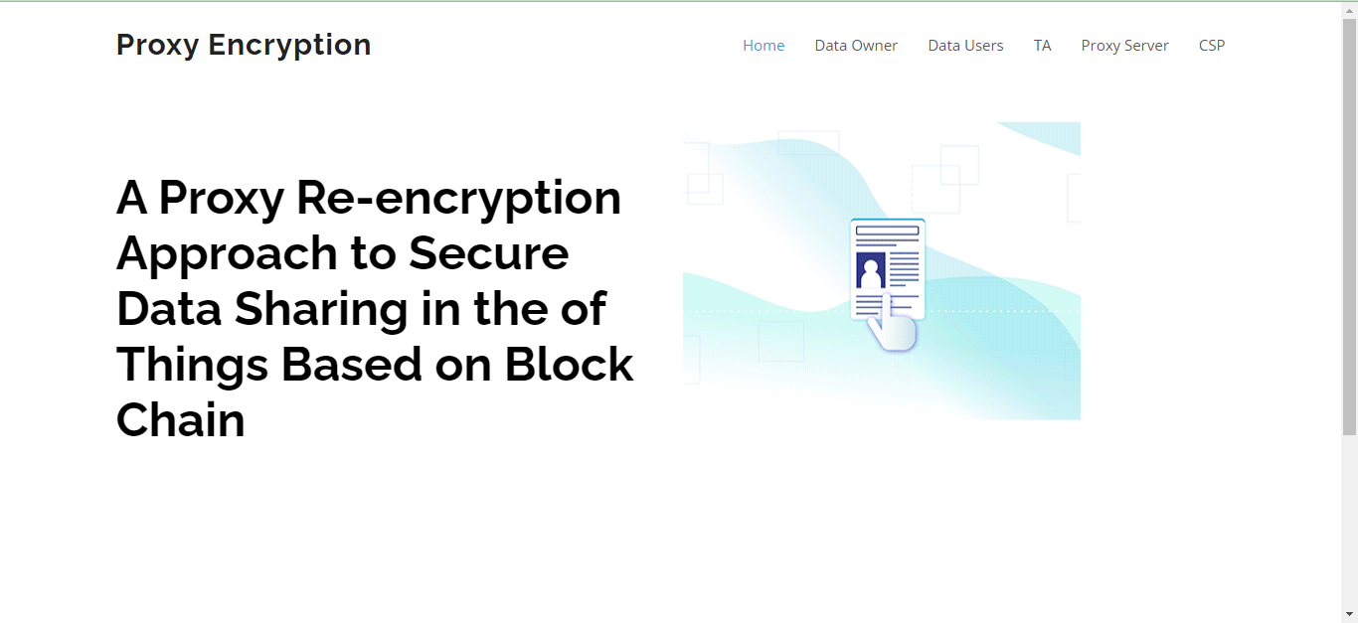
SCREENSHOT

Slide 14
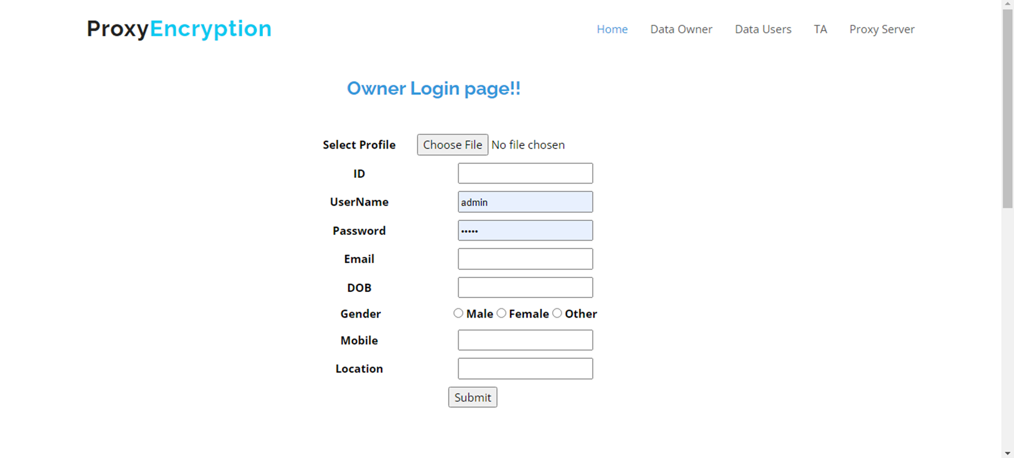
SCREENSHOT

Slide 15
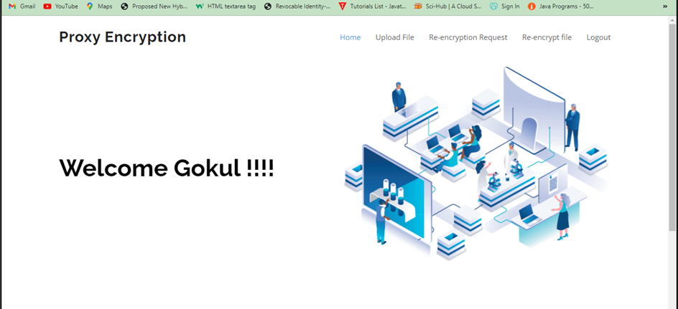
SCREENSHOT

Slide 16
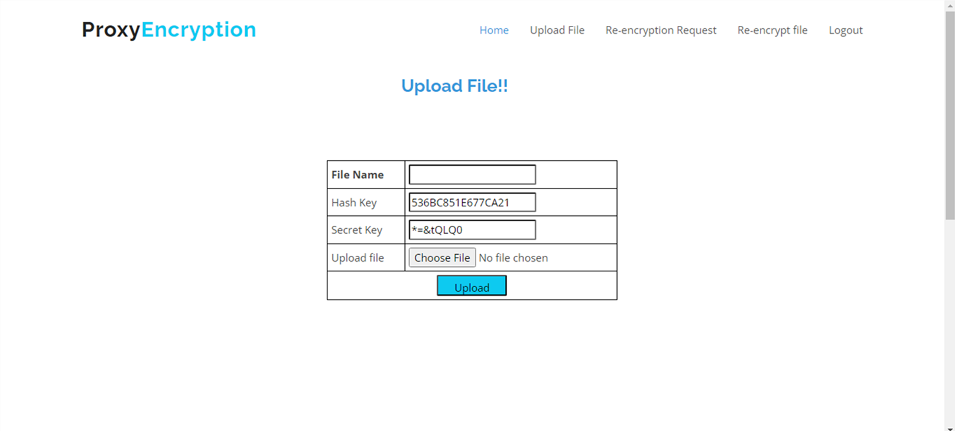
SCREENSHOT

Slide 17
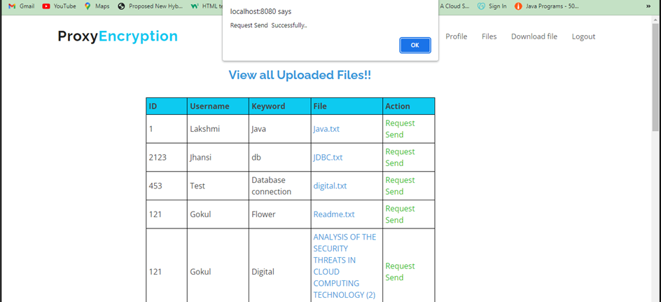
SCREENSHOT

Slide 18
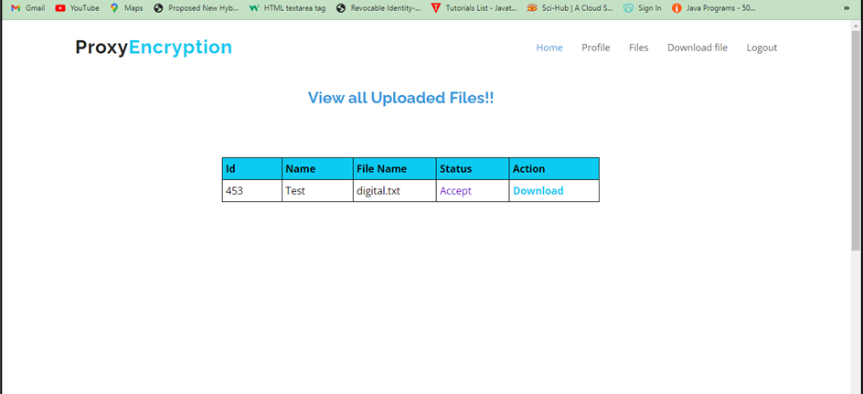
SCREENSHOT

Slide 19
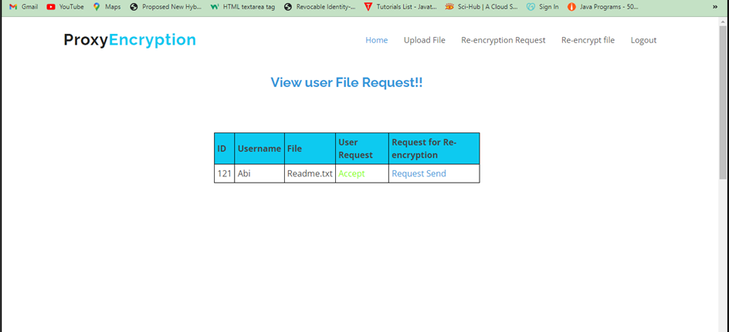
SCREENSHOT

Slide 20
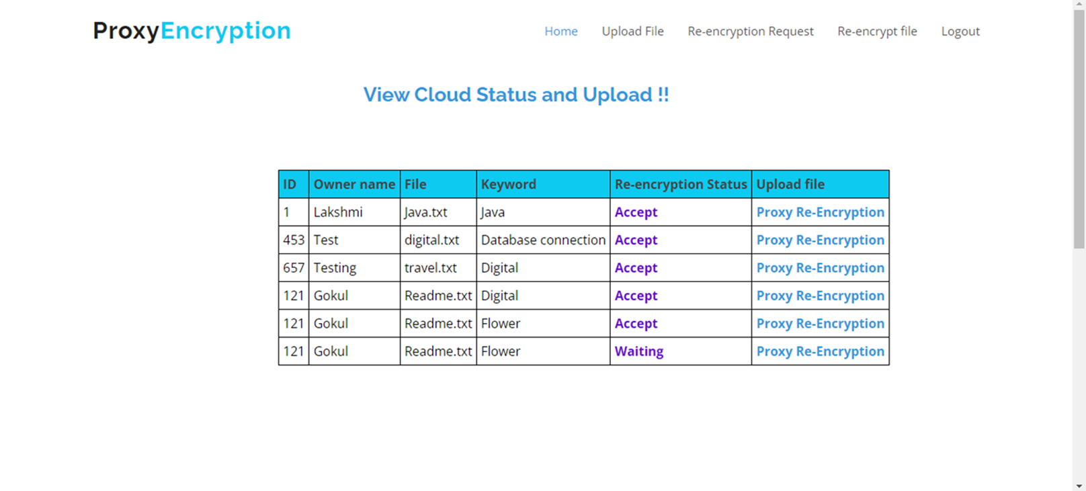
SCREENSHOT

Slide 21
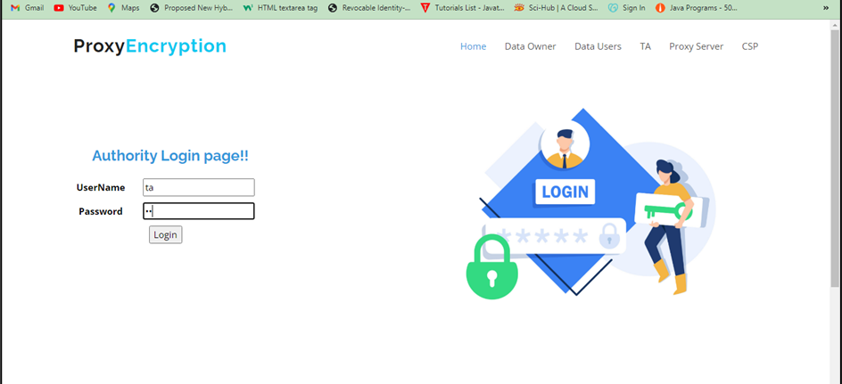
SCREENSHOT

Slide 22
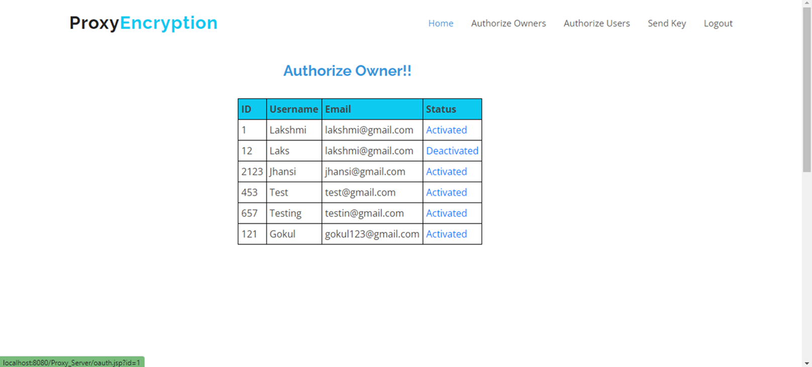
SCREENSHOT

Slide 23
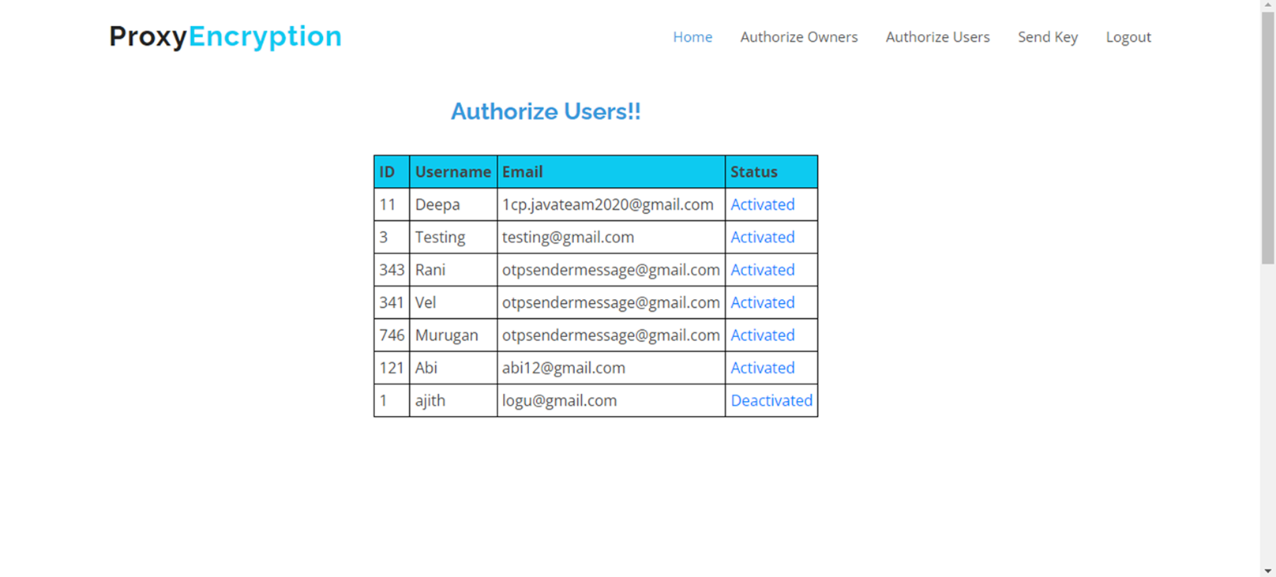
SCREENSHOT

Slide 24
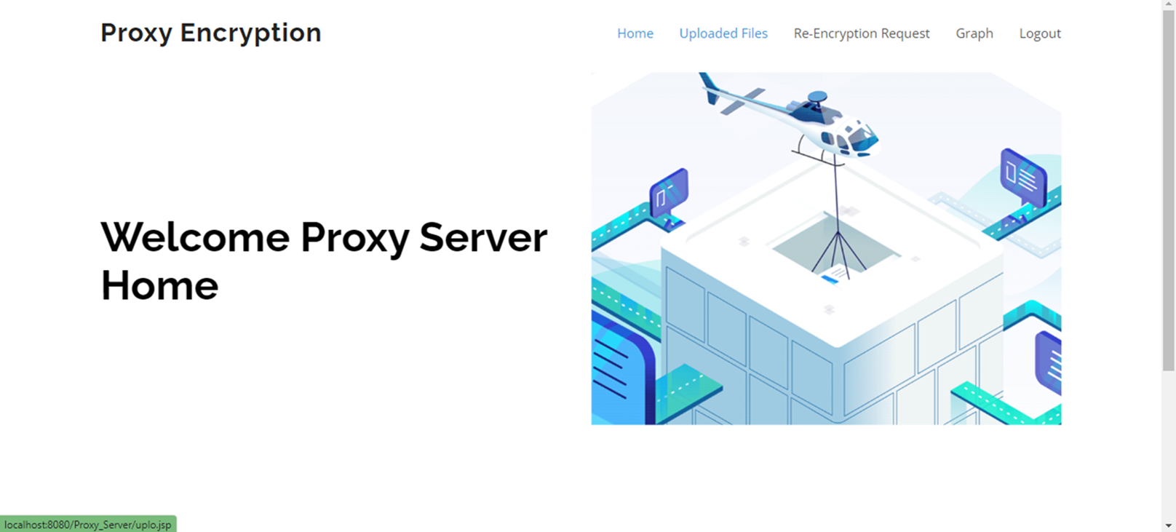
SCREENSHOT

Slide 25
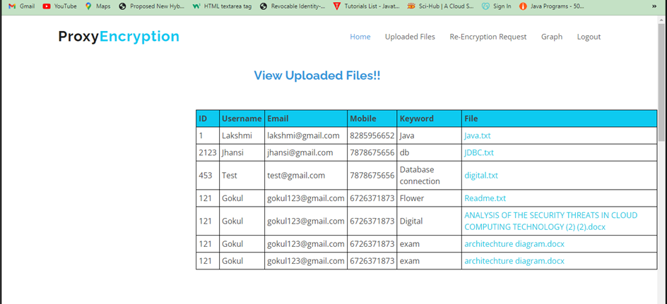
SCREENSHOT

Slide 26
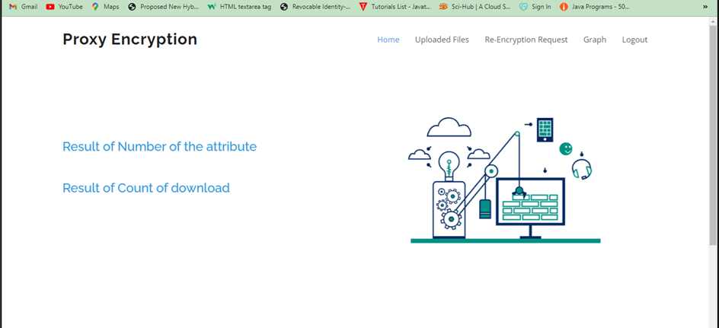
SCREENSHOT

Slide 27
Hardware and software requirements
System : Pentium i3 processor
Hard Disk : 500GB(least required)
Ram : 2GB (least required)
Operating System : Windows 10 (least required)
Language : Java
Tool : NetBeans 8.2
Database : MySQL

Slide 28
Future enhancement
Seamless Security:
Future IoT data sharing will be both secure and effortless.
Advanced Tech Integration:
Enhanced blockchain and proxy re-encryption for faster sharing.
Tailored Solutions:
New hardware/software for secure IoT data exchange.
Key Focus Areas:
Scalability, interoperability, user-friendliness for broad adoption.

Slide 29
Conclusion
Blockchain and proxy re-encryption offer a secure, decentralized solution for IoT data sharing amidst growing device connections and data volumes. Prioritizing privacy and security is crucial, and these technologies provide the means to achieve it and to explore their potential for your IoT projects.

Slide 30
reference
1. Dwork, C. and N. Rothblum. (2014). "Fuzzy extractors: How to generate strong keys from biometrics and other noisy data." SIAM Journal on Computing, 38(1), 97-139.
2. Juels, A. and B. Kaliski Jr. (2007). "Pors: proofs of retrievability for large files." Proceedings of the 14th ACM conference on Computer and communications security, 584-597.

Slide 31
THANK YOU

