Slide 1
Methodology
Determine soil temperature as function of mean air temperature
Calculate permafrost thaw area as a function of surface soil temperature relative to base year
Decomposition of permafrost carbon assuming exponential decay function
Calculate emission of CO2 and CH4
Update natural emissions of CO2 and CH4
Determine corresponding temperature change/carbon price

Slide 2
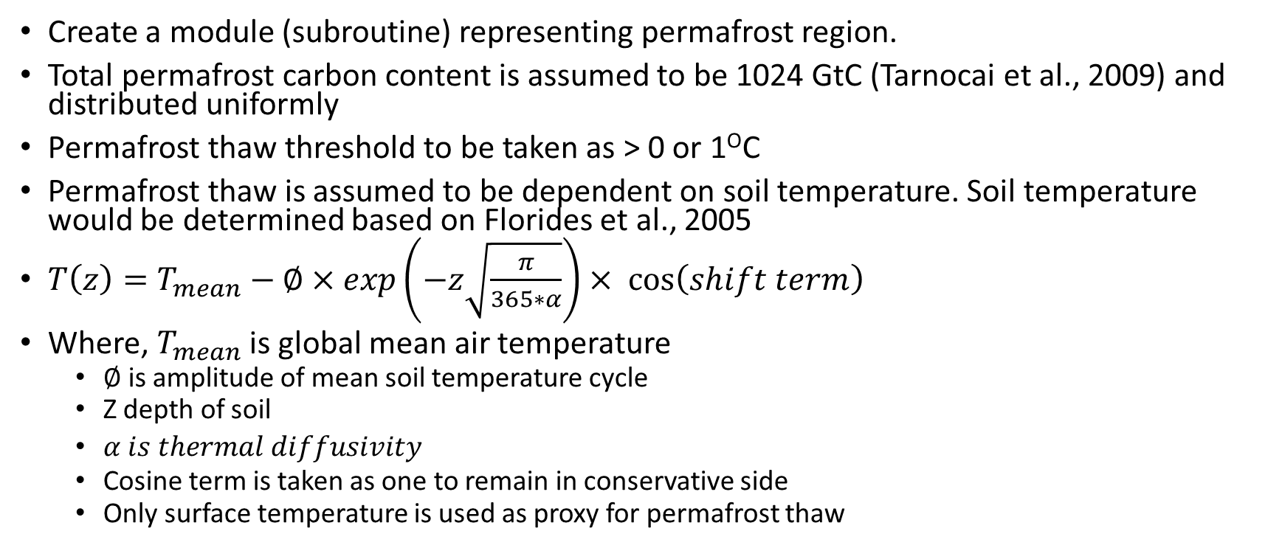
Parameter Estimation
Create a module (subroutine) representing permafrost region.
Total permafrost carbon content is assumed to be 1024 GtC (Tarnocai et al., 2009) and distributed uniformly
Permafrost thaw threshold to be taken as > 0 or 1^{O}C
Permafrost thaw is assumed to be dependent on soil temperature. Soil temperature would be determined based on Florides et al., 2005
$T\left(z\right)=T_{mean}−∅×exp\left(−z\sqrt{\frac{π}{365∗α}}\right)× \cos\left(shift term\right)$
Where, $T_{mean}$ is global mean air temperature
$∅$ is amplitude of mean soil temperature cycle
Z depth of soil
$α is thermal diffusivity$
Cosine term is taken as one to remain in conservative side
Only surface temperature is used as proxy for permafrost thaw

Slide 3
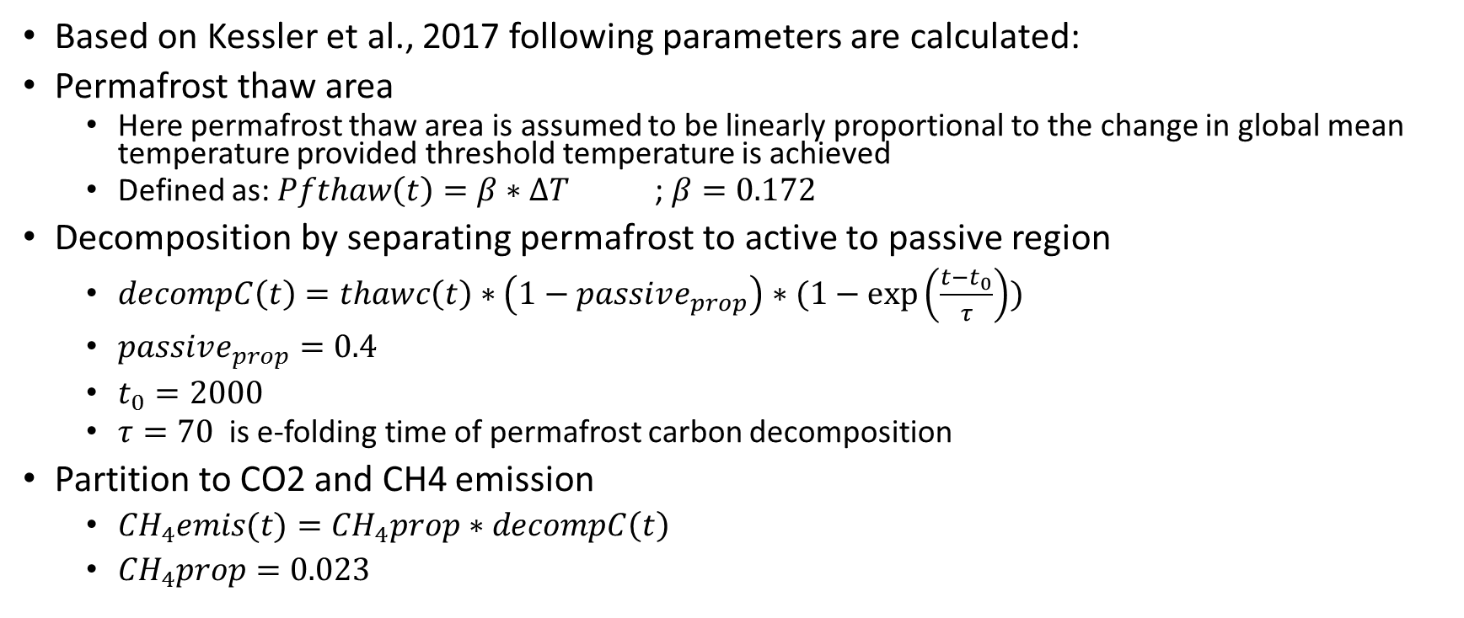
Based on Kessler et al., 2017 following parameters are calculated:
Permafrost thaw area
Here permafrost thaw area is assumed to be linearly proportional to the change in global mean temperature provided threshold temperature is achieved
Defined as: $Pfthaw\left(t\right)=β∗∆T$ ; $β=0.172$
Decomposition by separating permafrost to active to passive region
$decompC\left(t\right)=thawc\left(t\right)∗\left(1−passive_{prop}\right)∗(1−\exp\left(\frac{t−t_{0}}{τ}\right))$
$passive_{prop}=0.4$
$t_{0}=2000$
$τ=70$is e-folding time of permafrost carbon decomposition
Partition to CO2 and CH4 emission
${CH}_{4}emis(t)={CH}_{4}prop \text{∗} decompC\left(t\right)$
${CH}_{4}prop=0.023$

