Slide 1
Bluestock Mutual Fund Analytics
Bluestock Mutual Fund Analytics
Presented By: Ashik Saju

Slide 2
Project Overview
Problem statement
Mutual fund datasets contain valuable information regarding fund performance, investor behaviour, portfolio allocation, and market risk. However, raw financial data cannot directly support investment decisions.
Solution
Develop an end-to-end Mutual Fund Analytics platform that:
Automates data ingestion and cleaning
Calculates financial performance metrics
Performs advanced risk analytics
Analyses investor behaviour
Visualizes insights through Power BI dashboards
Recommends funds based on investor risk appetite

Slide 3
Project objectives
Develop an automated ETL pipeline
Clean and validate financial datasets
Store processed data in SQLite
Perform Exploratory Data Analysis (EDA)
Calculate financial performance metrics
Perform advanced risk analytics
Analyse investor behaviour
Evaluate portfolio diversification
Build an interactive Power BI dashboard
Develop a rule-based mutual fund recommendation system

Slide 4
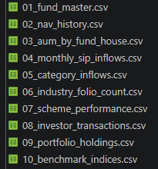
Datasets used
Fund Master
NAV History
Scheme Performance
Investor Transactions
Portfolio Holdings
Benchmark Indices
AUM by Fund House
Monthly SIP Inflows
Each dataset was cleaned, validated, and integrated using the ETL pipeline before analysis.

Slide 5
ETL Pipeline
Raw CSV Files
↓
Data Cleaning & Validation
↓
Processed CSV Files
↓
SQLite Database
↓
Python Analytics
↓
Power BI Dashboard
↓
Business Insights

Slide 6
ETL Activities
Data extraction
Missing value handling
Duplicate removal
Data validation
SQLite loading

Slide 7
Exploratory Data Analysis
The following analyses were performed:
Historical NAV Trend
Benchmark Performance Trend
Assets Under Management by Fund House
Monthly SIP Inflows
Category-wise Fund Distribution

Slide 8
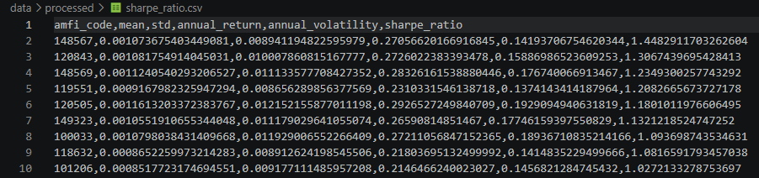
Performance Analytics
Financial metrics calculated:
CAGR
Sharpe Ratio
Sortino Ratio
Alpha
Beta
Maximum Drawdown
Tracking Error
Key Findings
Risk-adjusted performance varied significantly across schemes.
High Sharpe Ratio funds delivered superior returns relative to volatility.
Alpha and Beta provided insights into benchmark performance.

Slide 9
Advanced Analytics
Historical Value at Risk (VaR)
Conditional Value at Risk (CVaR)
Rolling 90-Day Sharpe Ratio
Investor Cohort Analysis
SIP Continuity Analysis
Portfolio Concentration (HHI)
Key Findings
VaR and CVaR quantified downside risk.
Rolling Sharpe highlighted changes in risk-adjusted performance.
Cohort and SIP analyses revealed investor behaviour trends.
HHI measured portfolio diversification.

Slide 10
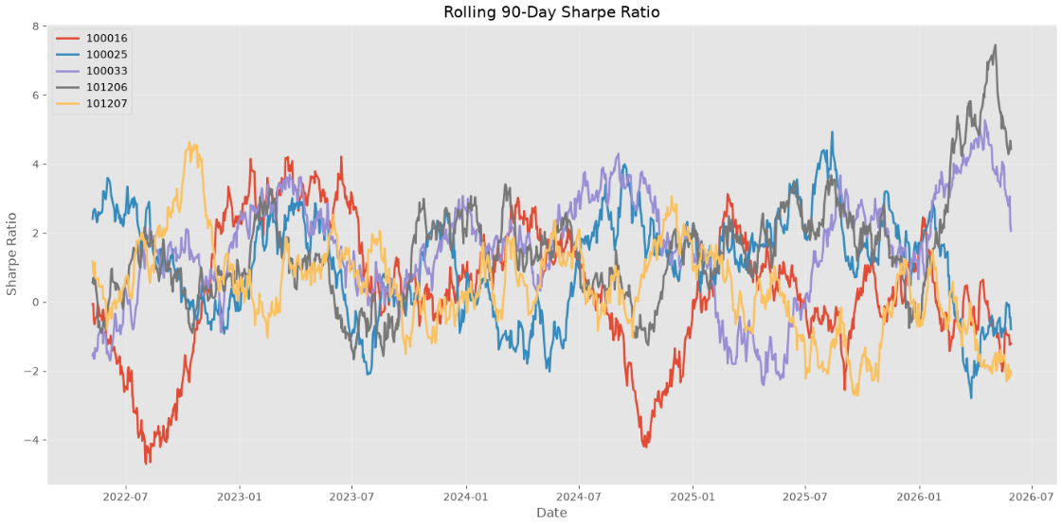
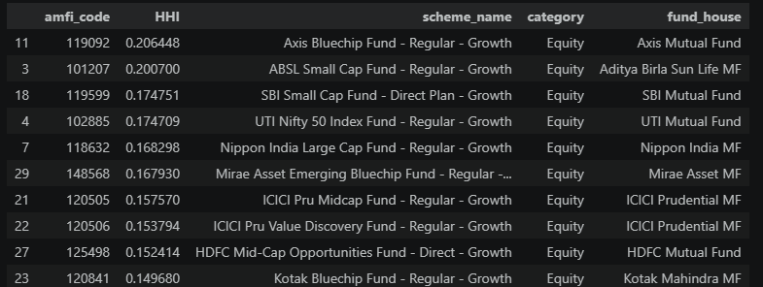

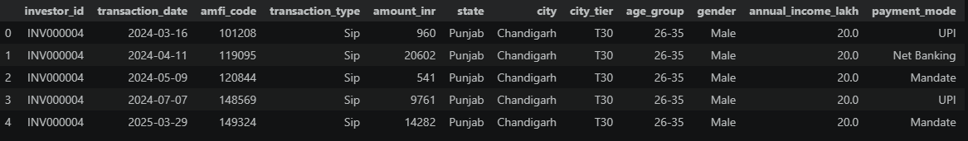

Slide 11
Mutual Fund Recommendation System
A rule-based recommendation engine was developed.
Input
Investor Risk Appetite
Low
Moderate
High
Processing
Filter funds based on risk category
Rank using Sharpe Ratio
Recommend the top-performing schemes
Output
Top three mutual fund recommendations matching the selected risk profile.

Slide 12
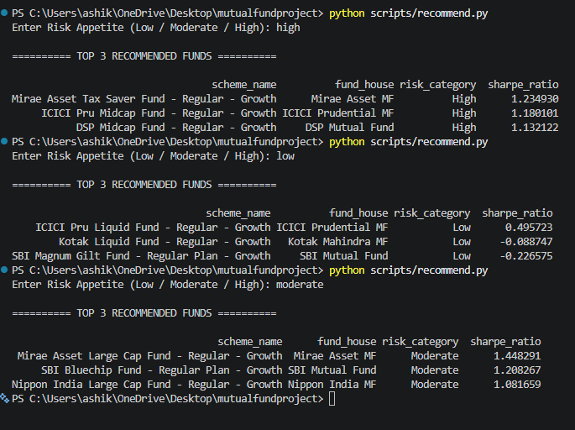

Slide 13
Interactive Power BI Dashboard
The dashboard consists of four pages:
Executive Overview
Performance Analytics
Investor Analytics
Portfolio Analytics
Features
Interactive slicers
Dynamic charts
KPIs
Drill-down analysis
Business-friendly visualizations

Slide 14
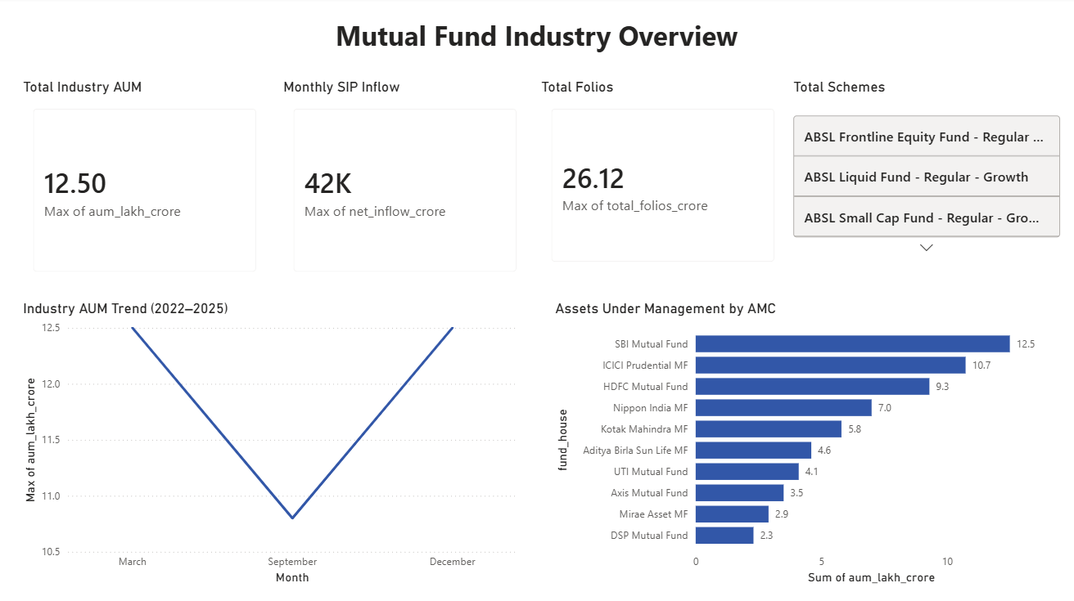
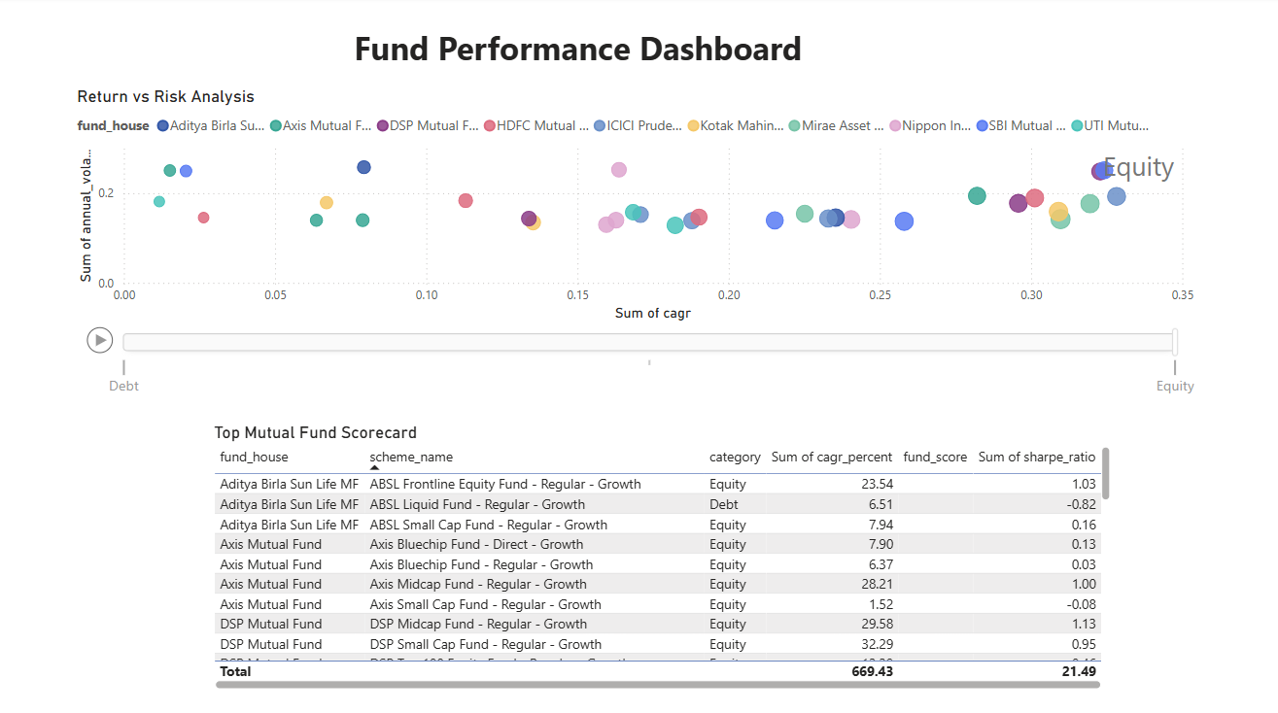
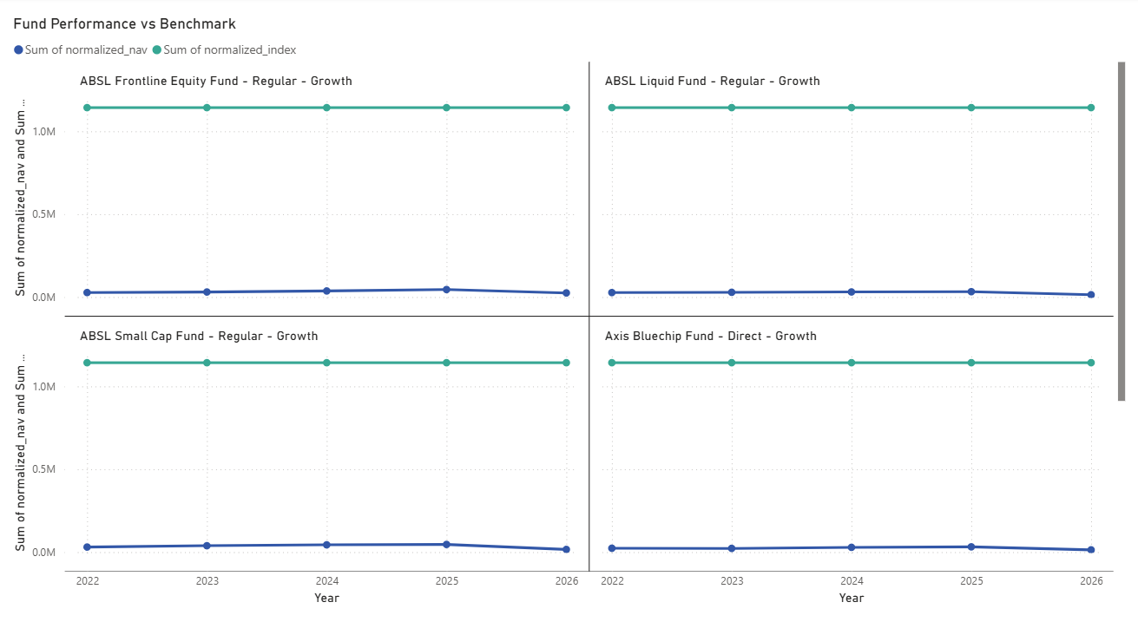
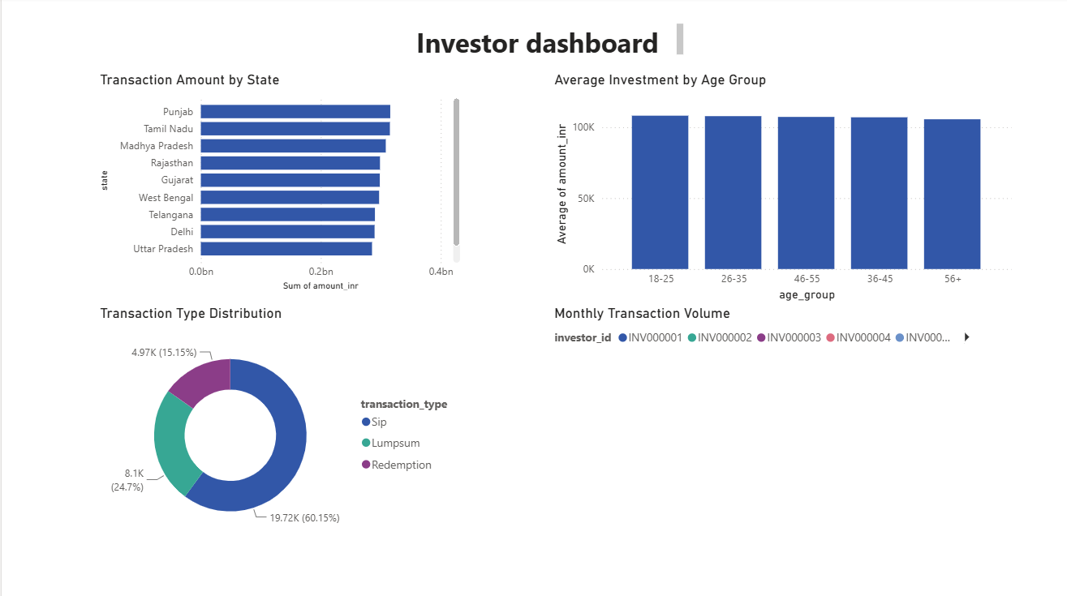

Slide 15
Findings
Funds with higher Sharpe Ratios generated better risk-adjusted returns.
Historical VaR and CVaR identified funds with greater downside exposure.
Investor cohort analysis showed increasing SIP participation among recent investors.
SIP continuity analysis identified investors at risk of discontinuing investments.
Portfolio concentration analysis highlighted diversification differences among funds.

Slide 16
Conclusion
Successfully built an end-to-end mutual fund analytics platform.
Automated ETL and data preprocessing.
Calculated financial and risk metrics.
Developed investor and portfolio analytics.
Built an interactive Power BI dashboard.
Implemented a rule-based recommendation system.

