Slide 1

BhojanCraft : AI Recipe Generator
Project Presentation
Presented by:
Ashik Chapagain
Anupam Sangam
Prabin Kandel

Slide 2
Introduction
BhojanCraft : An AI Recipe Generator is an AI-powered web application designed to generate personalized recipes, reduce food waste, and provide detailed nutritional insights.
Problem statement:
Difficulty in finding recipes based on available ingredients.
Lack of tailored nutritional information for specific dietary needs.
Food waste caused by unused ingredients.

Slide 3
Objectives
To generate AI powered recipes using machine learning models.
Provide tailored recommendations based on available ingredients and dietary preferences.
Help breaking down nutritional values for informed meal planning.

Slide 4
Key features:
Recipe generation using TensorFlow models trained on USDA/Kaggle datasets.
Nutritional insights and dietary customization.
Smart Meal Planning: Generate weekly meal plans automatically based on user preferences, ingredient availability, and nutritional goals, ensuring balanced and hassle-free cooking.
Community features: anonymous reviews and wishlist management.

Slide 5
Technical Highlights
React.js for a responsive and accessible interface.
Tailwind CSS for design and React Router for navigation.
TensorFlow for AI recipe generation and FastAPI for backend integration.
Secure authentication with JWT/Google OAuth.

Slide 6
Expected Outcome
Reduces food waste by optimizing ingredient usage.
Empowers users with healthy, personalized recipes.
Builds a community for sharing and learning.

Slide 7
Project Timeline
Gantt Chart

Slide 8
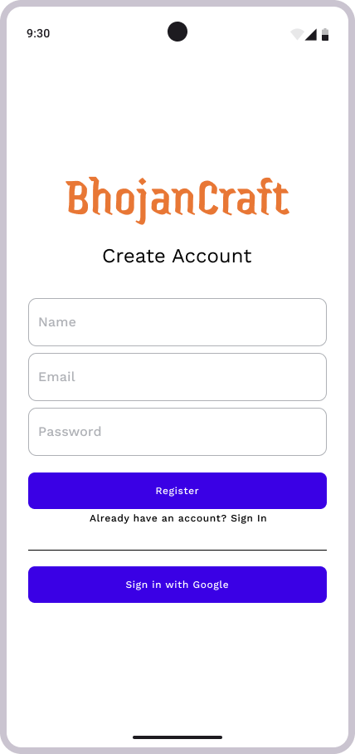
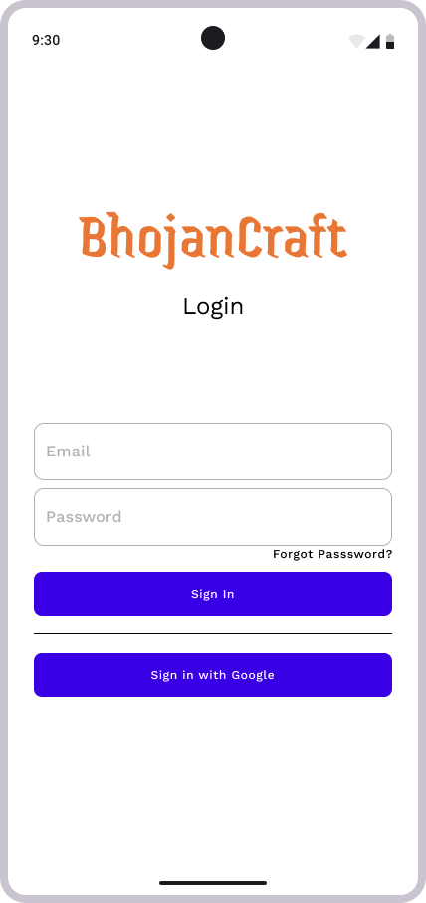
Wireframes

Slide 9
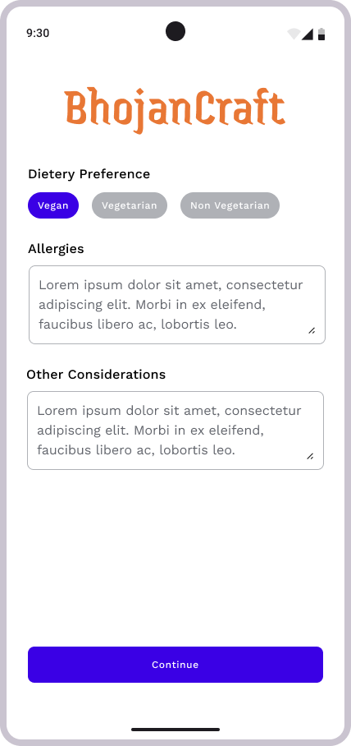
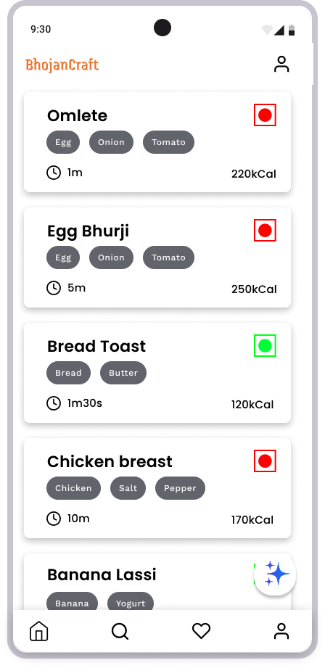
Wireframes

Slide 10
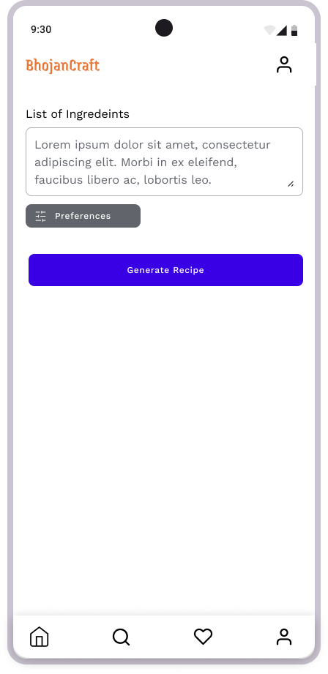
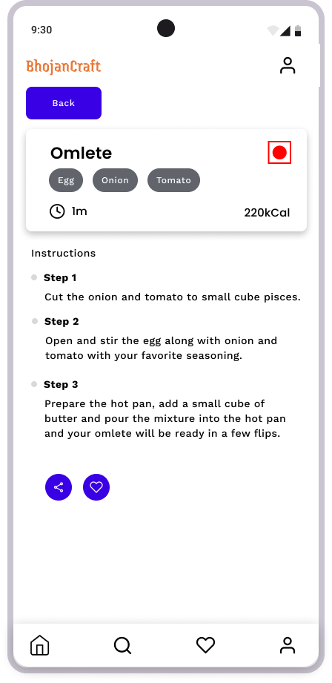
Wireframes

Slide 11
THANK YOU

