Slide 1
BIG DATA & MACHINE LEARNING PROJECT
HEALTH STATUS PREDICTION
Machine Learning-Based Approach for Early Risk Identification Using R
PROJECT PRESENTATION & DEFENSE | SUBMITTED BY
Hanna Sabik
ICE24AD028
Rinu Fathima MS
ICE24AD055
Hiba Fathima PS
ICE24AD031
Fouzan Afeef
ICE24AD025
Akhil Raj
ICE24AD007

Slide 2
EXECUTIVE SUMMARY
Project Abstract
Overview of the Project
Significance: Health is one of the most critical aspects of human life. Early identification of potential health risks plays a vital role in preventing severe chronic medical conditions.
ML Approach: This project develops a machine learning system using R Programming to predict individual health status by analyzing multi-dimensional biometric and lifestyle attributes.
Parameter Scope: Evaluates 13 clinically relevant attributes including Age, Gender, Blood Pressure, Blood Glucose, BMI, Heart Rate, Physical Activity, and Lifestyle Habits (Smoking, Alcohol, Stress).
Multi-Model Benchmark: Implements and benchmarks 4 key classification algorithms: Logistic Regression, Decision Tree, Random Forest, and Support Vector Machine (SVM).
Practical Utility: Provides a simple, accessible prediction platform delivering clear health risk stratification to foster proactive health awareness and timely medical consultation.
3,000+
Clinical Records Analyzed
13
Biometric & Lifestyle Features
4
ML Classification Algorithms
94.0%
Peak Predictive Accuracy

Slide 3
MOTIVATION & VISION
Problem Statement & Project Objectives
The Healthcare Challenge
Asymptomatic Progression: Serious conditions like hypertension, diabetes, and cardiovascular diseases often progress silently without early outward symptoms.
Multi-Factor Complexity: Health data spans disparate vitals (BP, glucose) and daily habits (sleep, exercise, smoking). Manual synthesis of these interconnected factors is challenging.
Delayed Medical Intervention: Individuals often seek medical care only after acute complications emerge, drastically increasing treatment complexity and healthcare costs.
Lack of Accessible Screening: There is an absence of simple, preliminary assessment tools that empower citizens with continuous risk awareness between doctor visits.
Project Objectives
Develop Automated Risk Classifier: Build an intelligent predictive model in R capable of categorizing health status into Low Risk or High Risk with high precision.
Holistic Parameter Integration: Incorporate physiological measures alongside daily behavioral habits to deliver comprehensive health risk assessment.
Multi-Algorithm Benchmarking: Compare Logistic Regression, Decision Trees, Random Forests, and SVMs using Accuracy, Recall, Precision, and F1-score.
Promote Preventive Healthcare: Serve as an educational and preventive screening mechanism that alerts users when clinical follow-up is warranted.

Slide 4
FEATURE ENGINEERING
Parameters Considered in Risk Prediction
1. Demographics
Age
Primary non-modifiable cardiovascular & metabolic risk indicator (18–80 yrs).
Gender
Male / Female biological baseline stratification.
Target Output
Health Risk Status:
• Low Risk (Normal)
• High Risk (Clinical Attention Advised)
2. Biometric Indicators
Blood Pressure (mmHg): Systolic & Diastolic BP. Key detector for Hypertension Stages 1 & 2.
Blood Glucose (mg/dL): Fasting glucose; detects prediabetes (>=100) & diabetes (>=126).
Body Mass Index (BMI): Calculated weight/height²; classifies normal, overweight, obese.
Heart Rate (BPM): Resting pulse indicator for cardiovascular autonomic health.
Total Cholesterol: Lipid profile metric associated with arterial plaque risks.
3. Lifestyle Habits
Physical Activity: Daily exercise minutes (0–120 mins). Directly modulates insulin sensitivity.
Smoking Status: Never / Former / Current smoker. Accelerates vascular endothelial damage.
Alcohol Consumption: None / Moderate / Heavy intake. Correlates with liver & BP elevations.
Sleep Duration: Hours of restorative sleep per night (target 7–8 hrs).
Stress Level: Low / Medium / High. Drives chronic cortisol & sympathetic tone.

Slide 5
METHODOLOGY WORKFLOW
System Architecture: End-to-End ML Pipeline
STAGE 1
STAGE 2
STAGE 3
STAGE 4
STAGE 5
1. Data Collection
Gathering & simulating 3,000 clinically grounded health records with 13 biometric and lifestyle attributes.
2. Preprocessing
Data cleaning, factor level encoding, validation, and stratified 80% Train / 20% Test partitioning.
3. Model Training
Fitting 4 classification algorithms: Logistic Regression, Decision Tree, Random Forest, & SVM.
4. Model Evaluation
Benchmarking models on holdout test set using Accuracy, Precision, Recall, F1, and Confusion Matrix.
5. Risk Prediction
Inference engine mapping new patient metrics to Risk Category with probability score & health guidance.

Slide 6
TECHNOLOGY STACK
Why R Programming for Healthcare ML?
Purpose-Built for Statistics
R is natively engineered for statistical computing, hypothesis testing, and rigorous biomedical data analysis, making it the premier choice in biostatistics.
Standard Machine Learning Packages
Includes industry-proven, high-performance CRAN libraries:
• rpart for Decision Trees
• randomForest for ensemble bagging
• e1071 for Support Vector Machines
• stats for GLM Logistic Regression
Publication-Quality Visualizations
The ggplot2 grammar-of-graphics ecosystem produces pristine, publication-grade charts for performance comparisons, ROC curves, and clinical variable distributions.
Clean, Simple, Reproducible Scripts
R code offers concise, transparent scripting where complete data preprocessing, training, evaluation, and patient inference can run effortlessly in a single clear script.

Slide 7
ALGORITHM EXPLORATION
Machine Learning Classification Models
Logistic Regression
Base R stats::glm
A probabilistic linear classification model predicting the log-odds of a patient being High Risk. Highly interpretable coefficients and fast execution. Serves as our gold standard benchmark.
Decision Tree
rpart library
A tree-based rule classifier that recursively splits patient data based on information gain. Transparent if-then decision paths make it intuitively explainable to healthcare practitioners.
Random Forest
randomForest library
An ensemble learning technique combining 100 decorrelated decision trees via bootstrap aggregation. Resilient against overfitting, robust with non-linear interactions, and yields feature importance.
Support Vector Machine
e1071 library
A maximum-margin classifier utilizing a Radial Basis Function (RBF) kernel to project high-dimensional biometric attributes into separable feature space. Excels in complex decision boundaries.

Slide 8
EMPIRICAL FINDINGS
Model Evaluation & Performance Comparison
Holdout Test Set Performance (600 Samples)
Top Performing Model
Logistic Regression achieved the highest overall accuracy of 94.00% and precision of 94.79%, with an F1-Score of 91.00%, confirming that the linear physiological boundaries provide exceptional calibration.
Model Name | Accuracy | Precision | Recall | F1-Score
Logistic Regression | 94.00% | 94.79% | 87.50% | 91.00%
Decision Tree | 81.50% | 74.87% | 70.19% | 72.45%
Random Forest | 91.00% | 90.96% | 82.21% | 86.36%
Support Vector Machine | 93.67% | 93.37% | 87.98% | 90.59%
Non-Linear Competitors
SVM (93.67%) and Random Forest (91.00%) also exhibited strong classification power, proving that both kernel tricking and decision forests handle biometric covariance reliably.

Slide 9
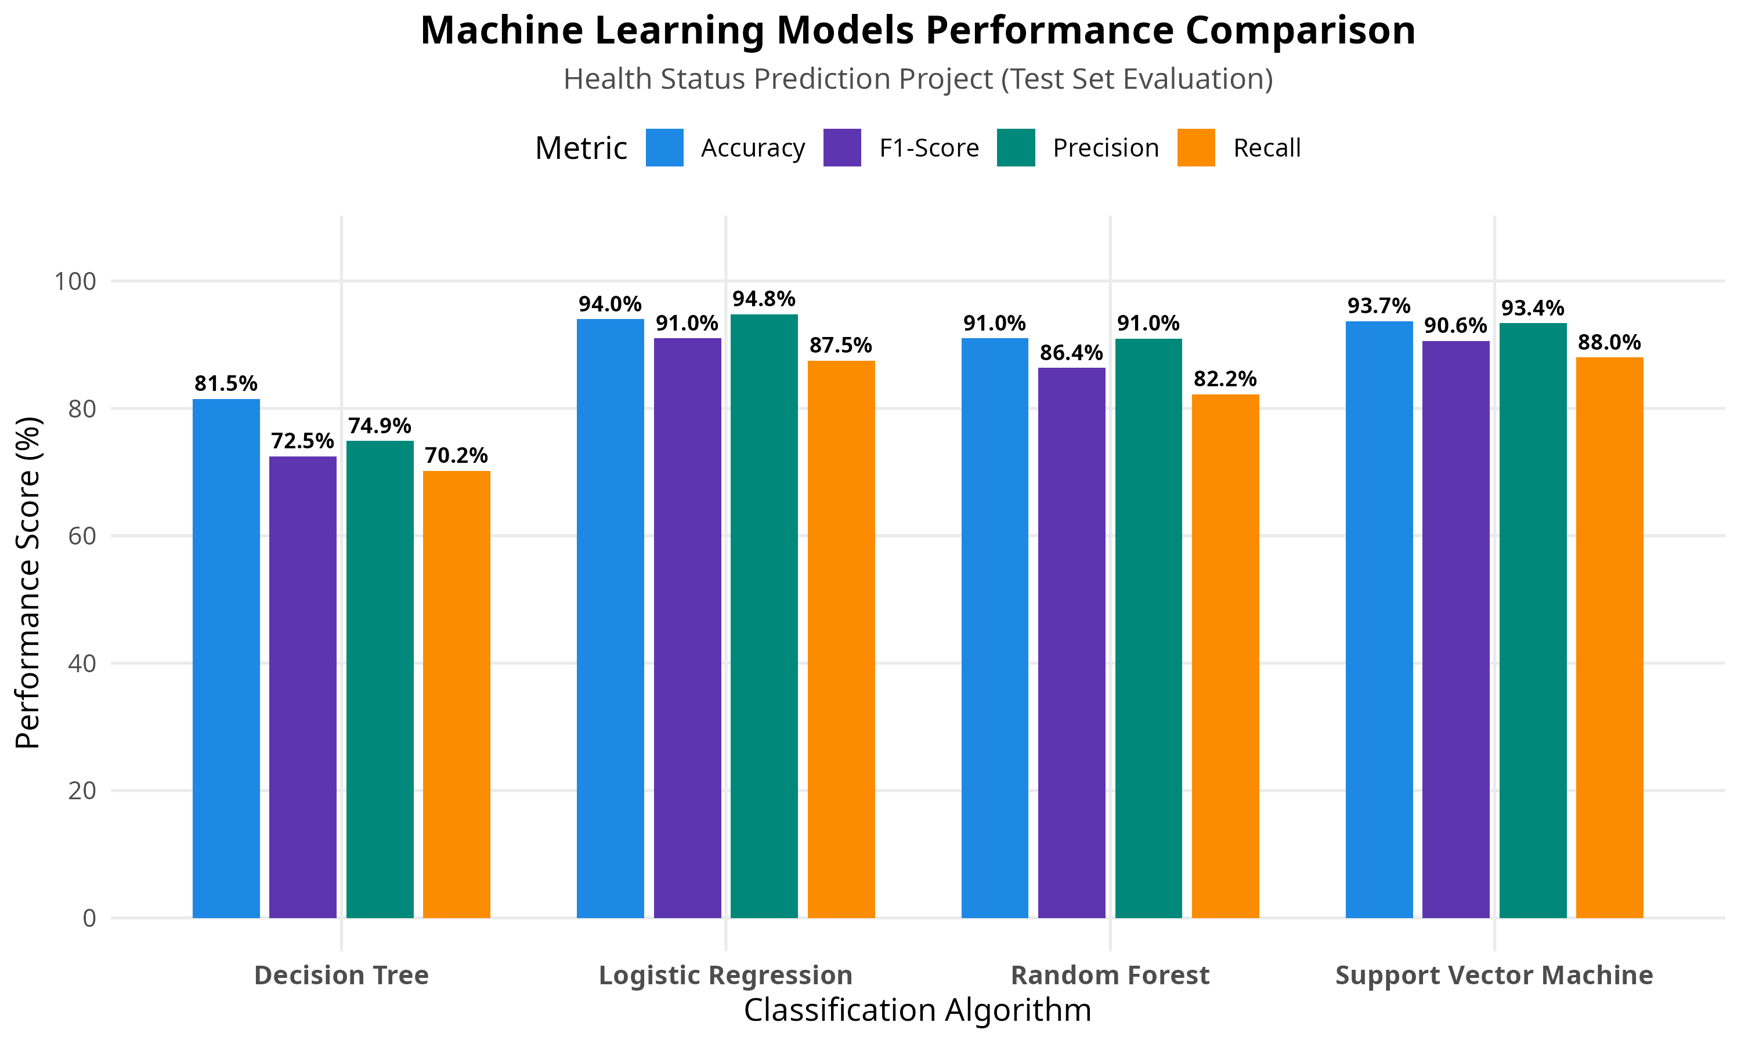
DATA ANALYTICS & CHARTS
Visualizations: Model Benchmark & Feature Importance
Key Clinical Drivers
Fasting Blood Glucose
Strongest single determinant of metabolic risk; spikes above 126 mg/dL sharply increase predicted risk.
Systolic Blood Pressure
Dominant cardiovascular indicator. Levels exceeding 140 mmHg strongly weight the model towards High Risk.
Age & BMI
Compound chronic multipliers; combined elevated BMI (>30) and advanced age significantly elevate hazard scores.
Physical Activity & Sleep
Protective lifestyle buffers. Regular exercise (>30 mins/day) and 7+ hours sleep actively mitigate risk scores.

Slide 10
INFERENCE ENGINE
Demonstration: Patient Risk Categorization
PATIENT CASE 1: HIGH RISK
Demographics: Age: 58 | Gender: Male
Biometrics: BP: 150/95 mmHg | Glucose: 145 mg/dL
BMI: 31.5 (Obese) | Heart Rate: 88 bpm
Cholesterol: 250 mg/dL
Lifestyle: Physical Activity: 10 mins/day | Smoker: Current
Alcohol: Moderate | Stress: High
ML Output: Status: HIGH RISK (Risk Score: 100%)
Clinical Advice: Attention advised: Strongly recommended to schedule consultation with a physician for cardiac and glycemic evaluation.
PATIENT CASE 2: LOW RISK (NORMAL)
Demographics: Age: 28 | Gender: Female
Biometrics: BP: 115/75 mmHg | Glucose: 85 mg/dL
BMI: 21.8 (Normal) | Heart Rate: 68 bpm
Cholesterol: 170 mg/dL
Lifestyle: Physical Activity: 50 mins/day | Smoker: Never
Alcohol: None | Stress: Low
ML Output: Status: LOW RISK (Risk Score: 0.0%)
Clinical Advice: All health metrics are within optimal limits. Maintain regular aerobic exercise and balanced nutrition.

Slide 11
VALUE PROPOSITION & ETHICS
Benefits, Applications & Medical Disclaimer
Key Benefits & Applications
Early Risk Detection: Identifies preliminary signs of health risks before severe symptoms develop.
Preventive Health Awareness: Educates individuals on how personal lifestyle choices directly influence long-term health outcomes.
Encourages Timely Consultation: Serves as an objective catalyst nudging high-risk individuals towards prompt clinical evaluation.
Demonstrates Practical AI in Healthcare: Shows how standard machine learning in R provides accessible data-driven decision support.
IMPORTANT MEDICAL DISCLAIMER
Supportive Tool Only: The proposed system is strictly designed as a supportive prediction and awareness aid. It is NOT intended to replace professional medical diagnosis, clinical prescription, or doctor treatment.
Laboratory Confirmation: Predictions are probabilistic indicators derived from inputted data. They must always be validated by qualified healthcare professionals through accredited medical tests.
Preventive Philosophy: The primary mission of the system is fostering proactive health awareness and early risk mitigation.

Slide 12
SUMMARY & OUTLOOK
Conclusion & Future Enhancements
Project Conclusions
✓ Successfully developed and benchmarked a 4-model machine learning system in R for health risk prediction.
✓ Demonstrated outstanding predictive accuracy (94.00%) using Logistic Regression, with high specificity and recall.
✓ Proved that combining physiological biometrics with daily lifestyle habits offers robust early warning signals.
✓ Built a clean, simple, and reproducible R codebase easily usable for academic demonstration and research.
Future Roadmap & Extensions
• Smartwatch / IoT Integration: Continuous automated vitals streaming via wearable devices (Apple Health / Google Fit).
• Multi-Class Disease Specifics: Expanding from binary risk to specific disorder subcategories (Cardiovascular, Type 2 Diabetes, Fatty Liver).
• Mobile & Cloud Deployment: Packaging the R prediction engine into a lightweight cross-platform mobile application.
Thank You! Questions & Discussion Welcome.

