Slide 1

Welcome

Slide 2

UIU Social Services Club (UIUSSC) is one of the leading student activity clubs of United International University (UIU), with an aim to provide assistance to underprivileged section of the society.
Establish:2011(January)
Mission: The main purpose of this club is to provide social services voluntarily to people who are deprived of basic facilities and opportunities.
Vision: Our vision is to establish such a society where there is no privilege scarcity.

Slide 3

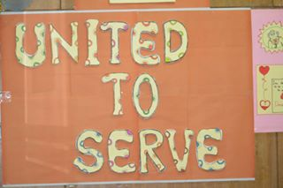
Our Slogan

Slide 4
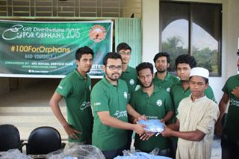
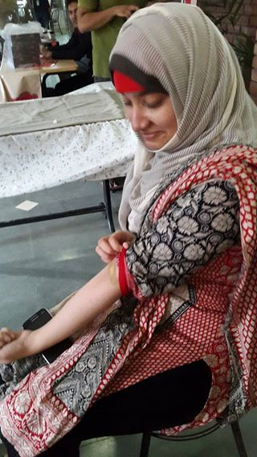
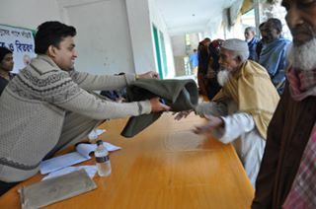
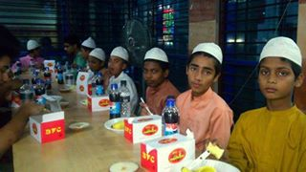
Our Activities:
Blood donation
Charitable causes
Eid clothing and gifts
Winter clothes distribution

Slide 5
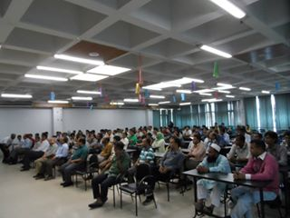
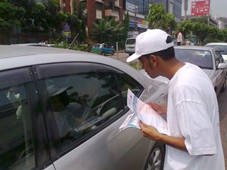
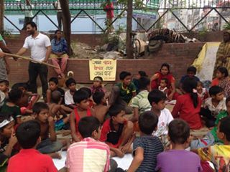
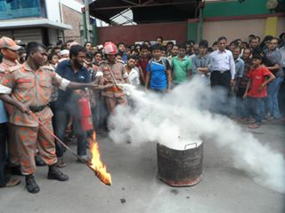
Free children education
Emergency crisis help
Social campaigns
Moral & Social seminars

Slide 6

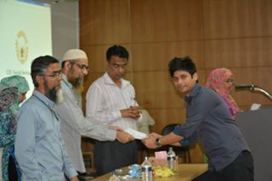
What will you get from this club?
It creates a sense of social responsibility.
UIUSSC gives you some practical experience about real life.
UIUSSC gives you a opportunity to enhance your humanity.
After every event we provide you certificates that will help in
your future career.

Slide 7
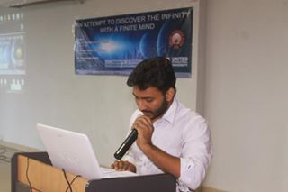
UIUSSC gives you a platform where you can build up your
leadership quality,communication skills,interpersonal skills etc.
You also get some career oriented knowledge from this club
because we maintain Chain of command.
UIUSSC provides organizing potentiality among the members.

Slide 8
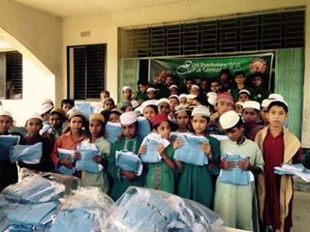
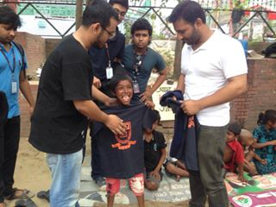
UIUSSC organizes some competitions among the members.
Last but not the least by the grace of Allah you will be the reasons of someones smile.

Slide 9
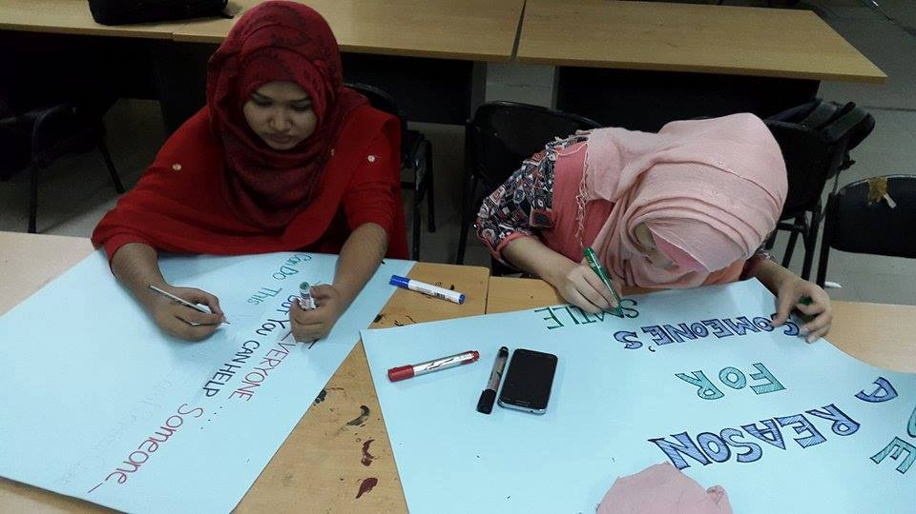
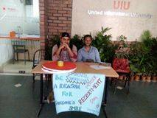
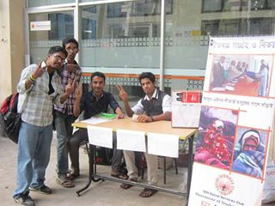
The working department of UIUSSC:
Organizing
Public relation
Online promotion for our events
Marketing
Graphics designing
H.R department
Research & Development

Slide 10

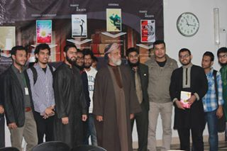
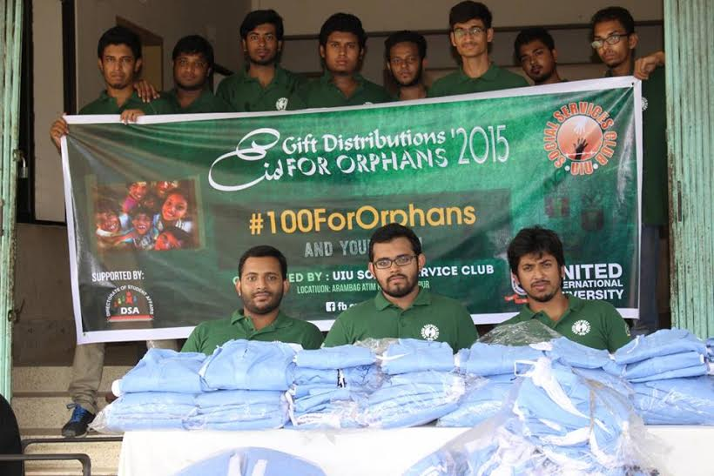
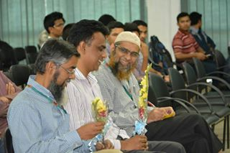
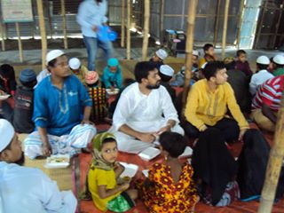
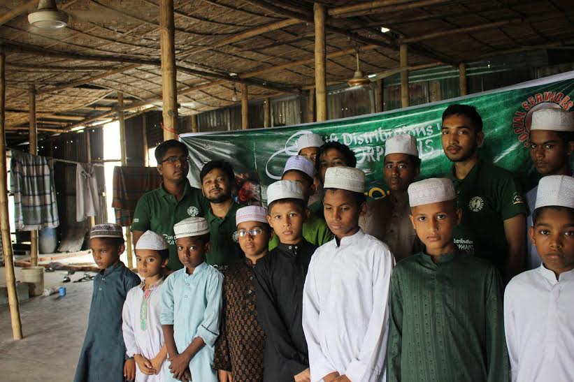
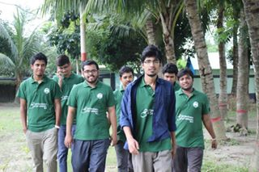
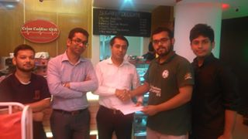
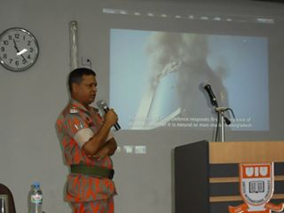
SSsdfgfhgfgff
Some memories of our past events:
MEMORIES

Slide 11
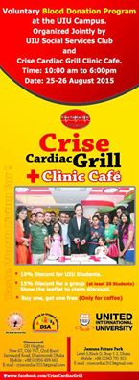

Blood Donation
Blood donation is a core programme of UIUSSC.UIUSSC tries to organize blood donation campaign in every trimester.UIUSSC has recently organized a blood donation campaign with the help of DSA & crise cardiac grill clinic cafe.
Date:25-26 August,2015
Place:UIU 1st campus
&
2nd campus
Food sponsored:
Crise cardiac grill clinic cafe

Slide 12
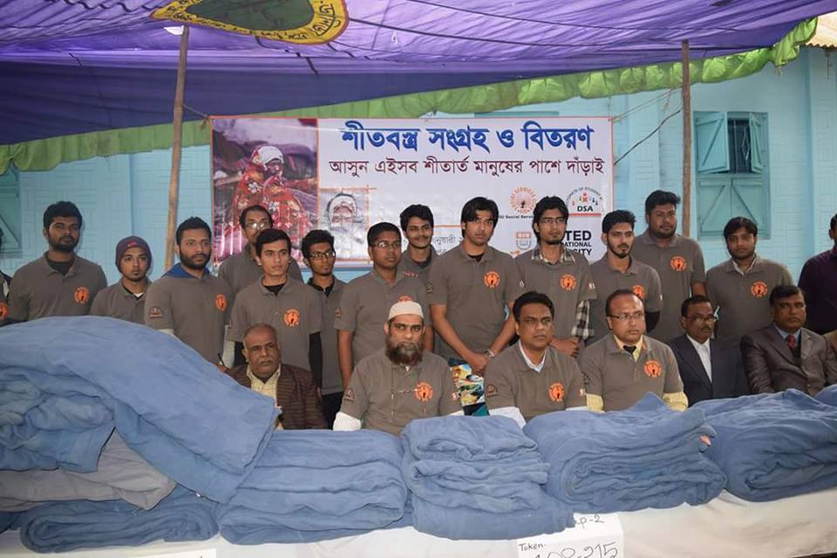
Winter Clothing distribution 2016
Winter clothing distribution is another major event of UIUSSC.This time it was bigger than ever.Team UIUSSC has distributed 520 blanket among the poor people in Kushtia.Besides it has also distributed 330 blanket,winter cloth in “Doulotpur”, “Dilpinogor” of kushtia district on 19th january,2016.Our team has also provided around 150 blankets among the physical handicaps in “Horipur”.This event was fully modereted by our honourable khwaza sir & Suman sir.
520+330+150=1000
Total distributed blankets:

Slide 13
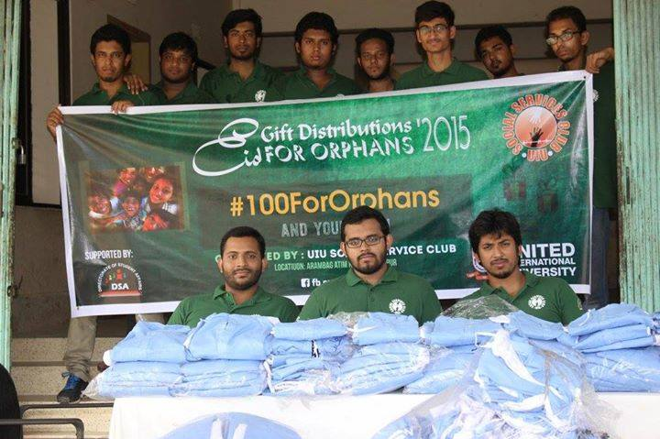
EID GIFT DISTRIBUTION FOR ORPHANS
It is one of the biggest events of UIUSSC.During Eid time,when people are busy with their trendy eid shoping that time UIUSSC distributes eid gifts among the orphans.Recently UIUSSC has distributed eid gifts among 150 orphans in Faridpur.Our team also arranged a iftar party for the orphans.

Slide 14

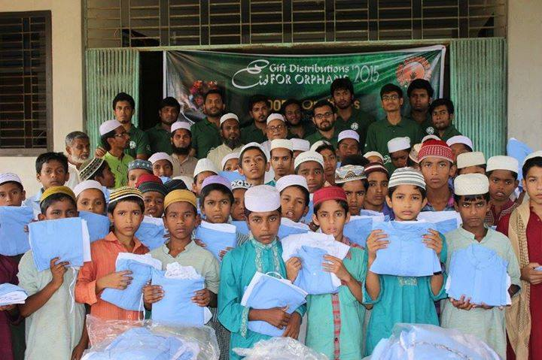
Distributed place:
Arambag atimkhana,Faridpur
Date:
8 july,2015

Slide 15

“Brains Of Society”
An Intra varsity social issues & case competition

Slide 16
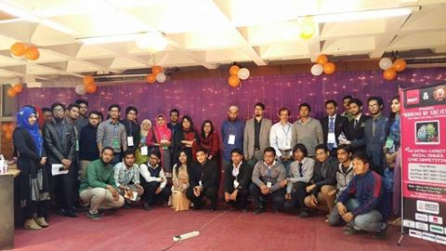
For the first time UIUSSC has organized an intra-varsity social issues & case study competition with the motto “your idea can bring the difference” where students of UIU from any department can share their innovative ideas.It was one of the most successful events of UIUSSC.It had 3 seperate rounds.Round 1 was based on general knowledge.Round 2 was a case competition & round 3 dealt with practical marketing which was field work.Final round was based on a social awareness campaign.We also provide a free workshop to the participants which was conducted by Dr. Mohammad Badruddozza who is an assistant professor & coordinator of MBA program.
Total team:32
Total participants:96

Slide 17

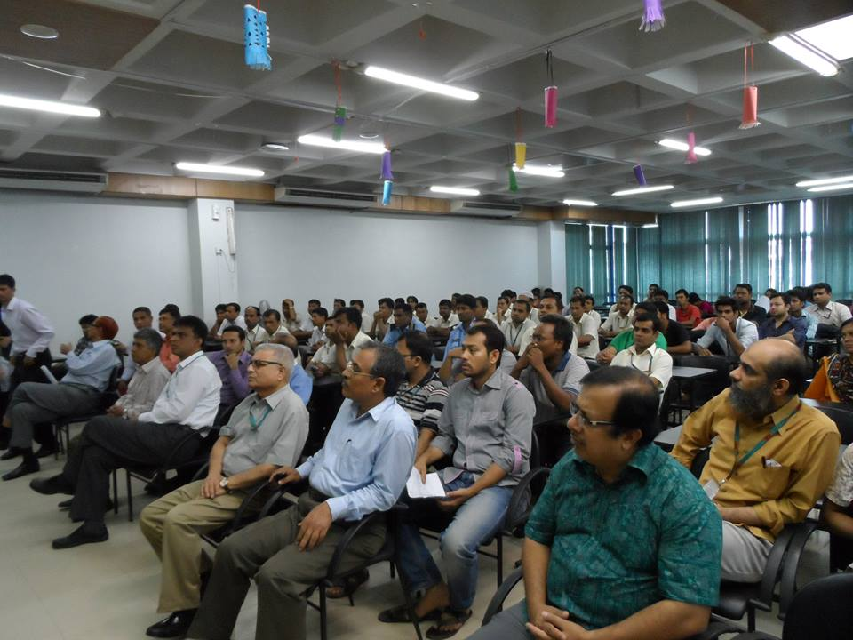
Moral And Social Seminars
Our aim is to aware people about moral and social issues that’s why we frequently arrange
Seminars.We always try to invite renowed speaker for our events. We have already arranged
Some seminars like “Purpose of life”,In pursuit of happiness”, “Food adultration”, “Lofty ambitions(The curious cases of intention)”, “A path towards corruption free society”, “Fire
drill”.

Slide 18
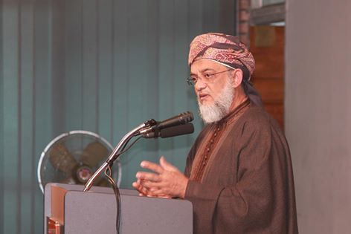
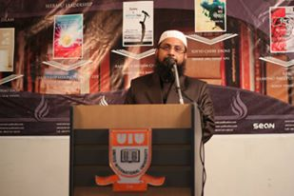
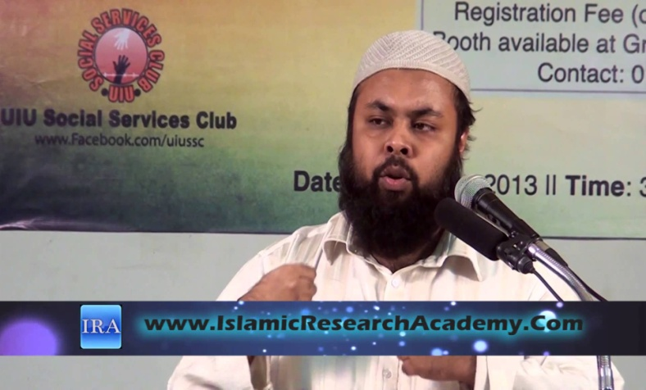
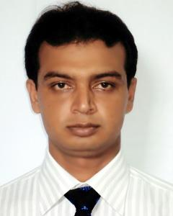
Some renowned speakers of our previous events
Mirza Yawar Baig
Dr.Mohammad Manzur-E-Elahi
Ustadh Asif Shibgat Bhuiyan
Faruq Bin Hossain Yamin

Slide 19

An Initiative by UIU SOCIAL SERVICES CLUB
UIUSSC has recently launched two new fb groups for UIU students.One is “A complete accommodation solutions for UIU students”.The purpose of this group is to let UIU students where to find a tanant,landlord & sublet.Another group is “Can We Help You?”Basically this group provides all the information about UIU like faculty,course,Clubs & Forums etc.
https://WWW.facebook.com/groups/A complete accomodation solutions for UIU students
https://WWW.facebook.com/groups/Canwehelpyou

Slide 20
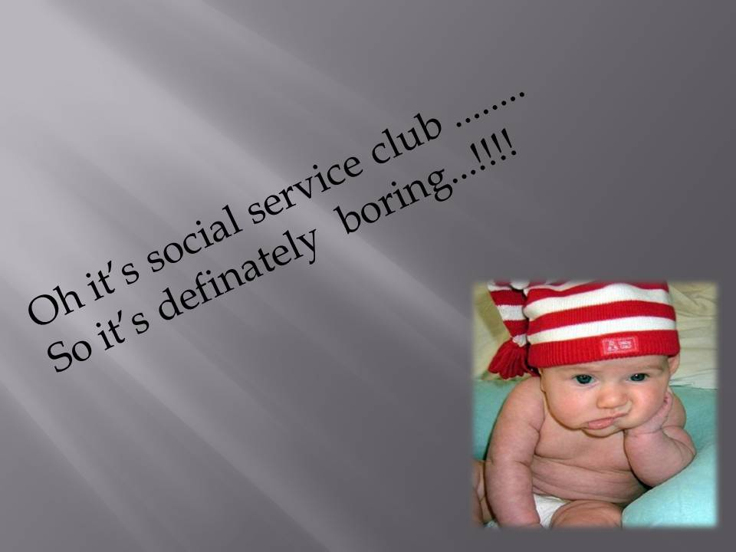

Slide 21
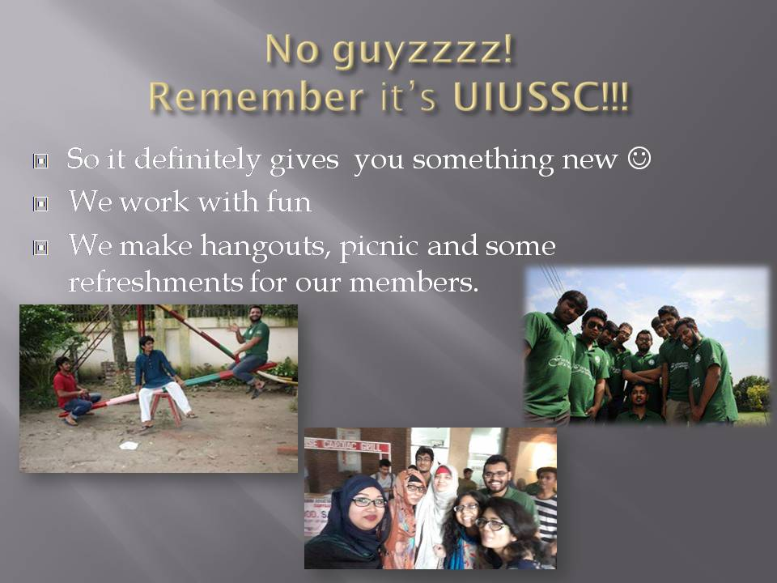

Slide 22
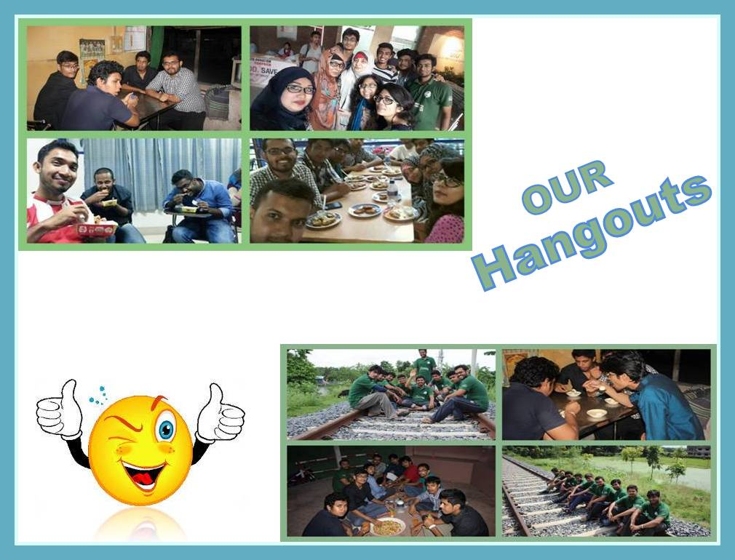

Slide 23
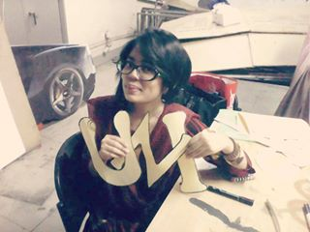
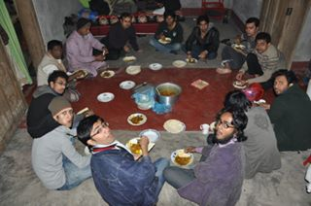
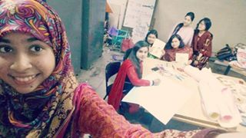
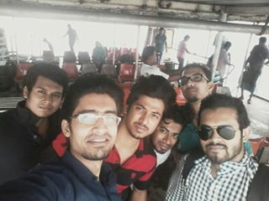
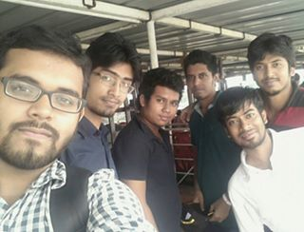
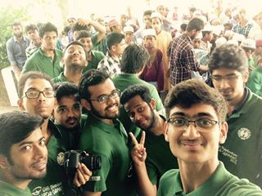
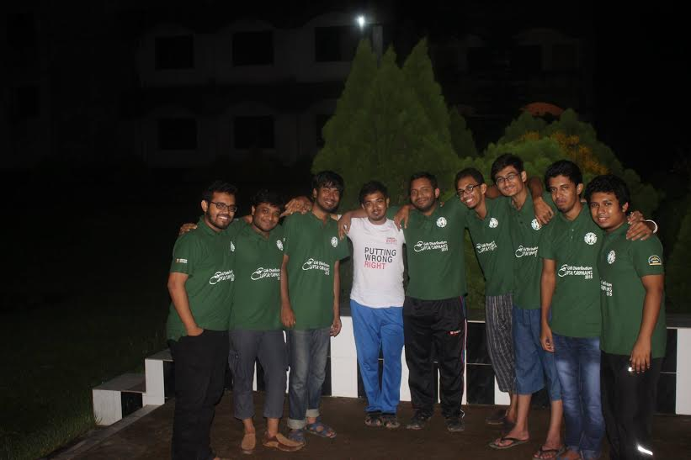
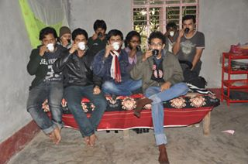
Selfie time

Slide 24
Actually It’s not a club
It’s a UIUSSC family....!

Slide 25
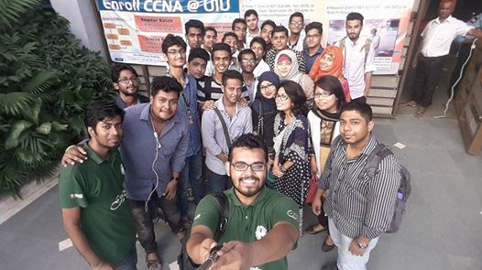
So, welcome to our
UIUSSCFAMILY

Slide 26

Thank You ...........!!!!!
Stay with us.............................!

