Slide 1

Software Engineering Lab Based on the course CSE 402
Rich Formatted Text Editing Application
to create webpages without any coding

Slide 2

Rich Formatted Text Editing Application
Presented by:
Name: ASHIKUZZAMAN| Roll: 16102020 | Reg: 4872
Supervised by:
RUBYA SHAHARIN (Assistant Professor)
Dept. of Computer Science and Engineering

Slide 3

outline
INTRODUCTION
OBJECTIVE
SYSTEM DESIGN AND DEVELOPMENT
RESULT AND DISCUSSION
LIMITATIONS
FUTURE SCOPE
CONCLUSSION
3

Slide 4

Introduction

Slide 5

Introduction
Application software.
Organic software.
Rich text editing section.
Easy use on low configuration devices.
Open source application.
Not dependent on internet connections.
Drag and drop image addition.
Multiple file formatting: doc, txt, html etc.
Basic webpage creation without coding knowledge.
5

Slide 6

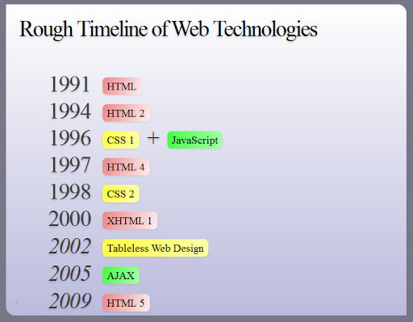
history
History of Text Editor Software: In 1970s Emacs, one of the first free and open source software projects, is another early full-screen or real-time editor, one that was ported to many systems.
History of Webpage source code:
6

Slide 7

Objective
It supports multiple font styles, font size and paragraph text alignment etc.
Basic cut, copy and paste features are available with easy access.
There is also support for drag-drop of images.
Generate doc, txt, html formats easily.
Easy use on lower configuration devices.
The most important thing is that it easily generate a basic webpage without coding.
7

Slide 8
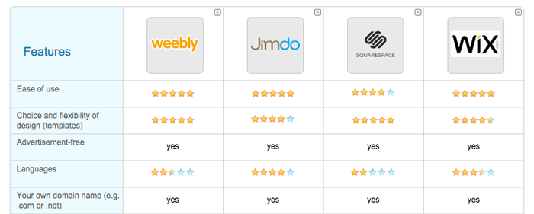
Background study
Application that developed web pages without coding
8

Slide 9

System Design and Development

Slide 10

TECHNICAL TERMS
To learn python programming.
To design and develop the GUI section with PyQt5.
To create Python bindings for C and C++ libraries with SIP.
To integrate the overall system on PyChram (IDE).
10

Slide 11
Functional requirements
HTML pages
Functional
Cross Platform
DOC, TXT, PPT
Rich text edit
11

Slide 12
Non-Functional requirements
Performance
Non-
Functional
Usability
Supportability
Reliability
12

Slide 13
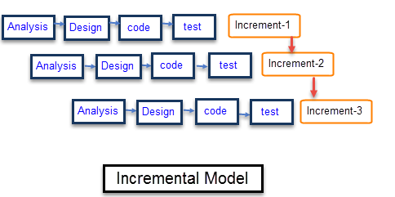
incremental model
Requirement Analysis
Design
Code
Test
13

Slide 14
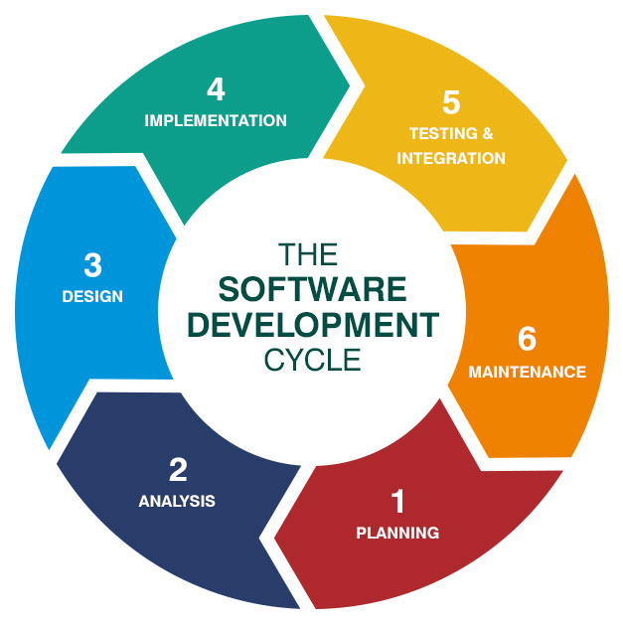
A software process model
Specification.
Design.
Validation.
Evolution.
14

Slide 15

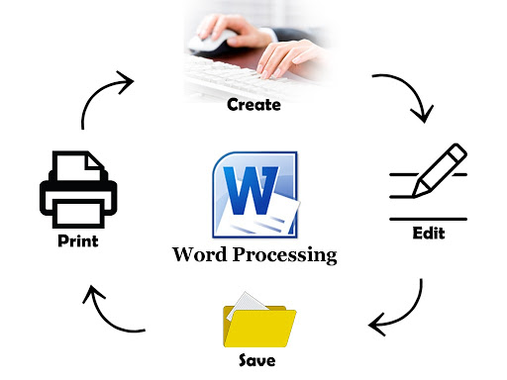
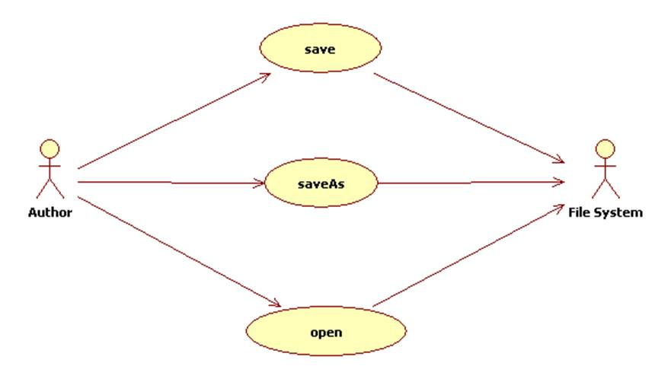
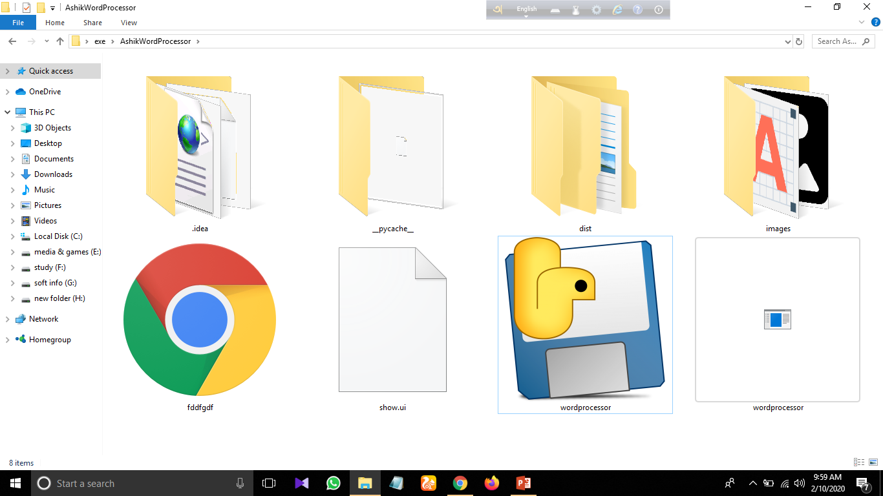
Working diagram:
15

Slide 16
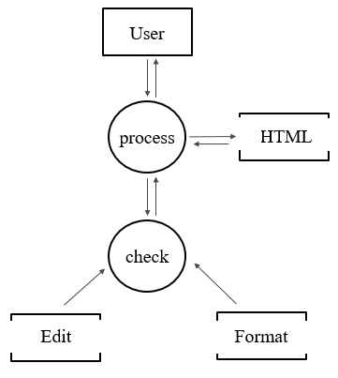
Data flow diagram:
15

Slide 17
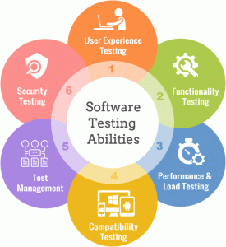
testing
Type of testing we use in our Project
Unit Testing
Module Testing
System Testing
Acceptance Testing
Alpha testing
16

Slide 18
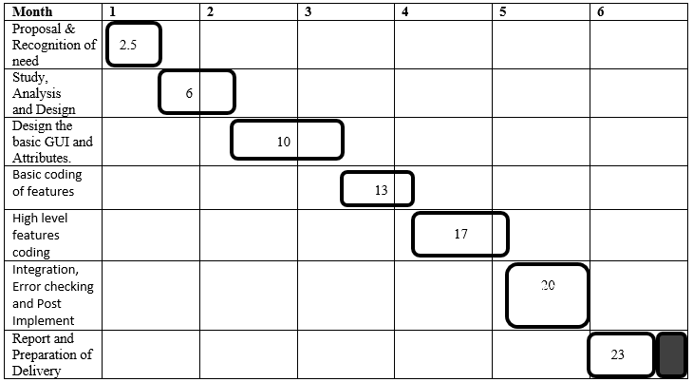
TIME SCHEDULING

Slide 19

Results and Discussions

Slide 20
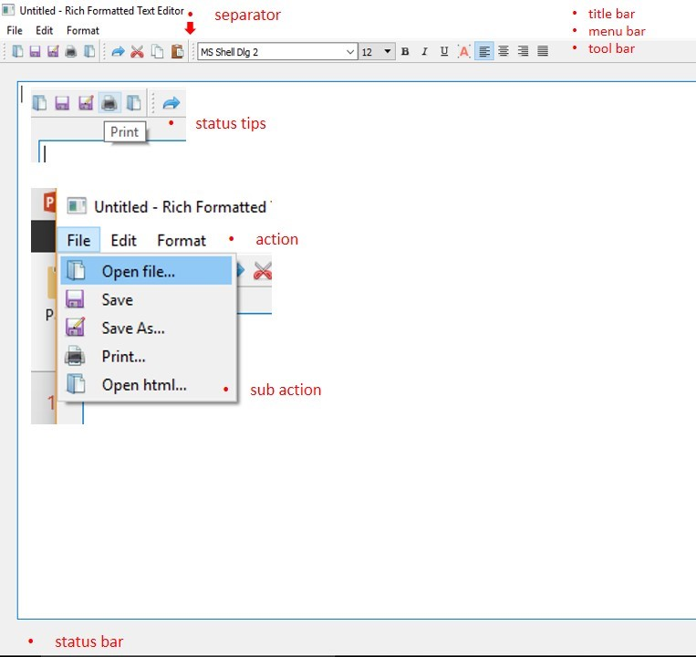
Welcome Screen
20

Slide 21
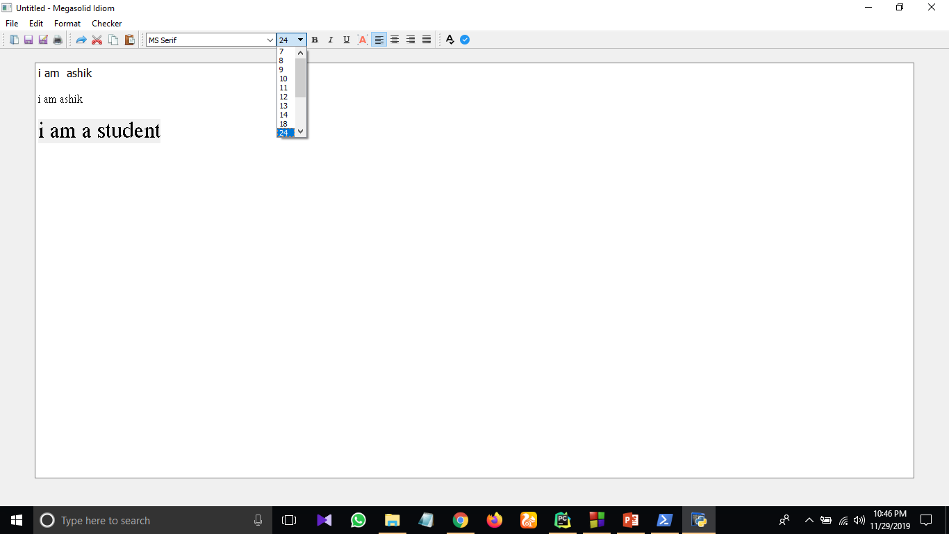
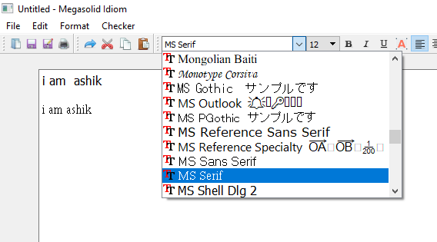
text sixe & font changing
Text Size Font changing
21

Slide 22
Text color changing
22

Slide 23
Operation under Menu
File menu Edit menu Format menu
23

Slide 24
Font and paragraph
Alignment section
Bold, italic underline
24

Slide 25
WEBPAGE
Webpage creation
25

Slide 26
WEBPAGE
Viewing source code
26

Slide 27

Limitations
Limitations of the system
1. It needs a PC.
2. It needs a processed image.
3. No much advanced features implemented.
27

Slide 28

Future Scope
We have a plane to publish this application and if we get proper funding. Our main is to target the greener learners to make them interested in web development and generate more freelancers and entrepreneurs in our country to support our remittance in future.
28

Slide 29

Conclusion
With this project, we could be able to have a helpful Application System. We hope, after completing this project we could launch the project and make sure that it works properly for the web page development. Everyone will be able to contribute to the progress of our rich formatted editing application by using this.
29

Slide 30
THE END
Rich Formatted Text Editing Application
to create webpages without any coding

