Slide 1
SHIP CLASSIFICATION USING TRIPLET CNN
Submitted by,
ABIN K JAYAN ADR18CS001
AJMAL LATHEEF ADR18CS003
ASHIL JOHNSON ADR18CS014
SIDDHARDH R NAIR ADR18CS038
Guided by,
Mrs. Manju J
Assistant Professor
Dept. of Computer Science

Slide 2
INTRODUCTION
⮚The purpose of ship classification is to identify various types of ships as accurately as possible, which is of great significance for monitoring the rights and interests of maritime traffic and improving coastal defence early warnings.
⮚With the improvement of all kinds of imaging technology, the ship classification method of imaging technology has become the mainstream method of ship target classification and recognition.

Slide 3
EXISTING SYSTEM
⮚Y. Wang and H. Liu, “A hierarchical ship detection scheme for high resolution SAR images,” IEEE Trans. Geosci. Remote Sens., vol. 50, no. 10, pp. 4173–4184, Oct. 2012
⮚The existing system classify ships from normal images using normal CNN.
⮚It uses high resolution SAR images..

Slide 4
DRAWBACKS
⮚The existing system has low accuracy.
⮚It was only able to predict ship type from high-resolution SAR images.
⮚It cannot predict ship type from a medium-resolution SAR image.

Slide 5
PROPOSED SYSTEM
⮚“Ship Classification in Medium-Resolution SAR Images via Densely Connected Triplet CNNs Integrating Fisher Discrimination Regularized Metric Learning” Jinglu He, Yinghua Wang ,Hongwei Liu, June 2020
⮚Use triplet CNN for classifying ship from satellite image.
⮚It can predict ships from medium-resolution images.

Slide 6
Classification of Ships
Cargo
Passenger
Dredging
Tanker

Slide 7
Ship Classification Criteria's
There is no fixed criteria for ship classification
The model will extract features from the input image and classify the images.
The extracting features are not known to user.
Some of the features it can considers are:
geometric features, such as ship length, ratio of length to width etc..

Slide 8
SAR
It is an active sensor that first transmits microwave signals.
Then receives back the signals that are returned, or backscattered , from the Earth's surface.
It is independent of flight altitude, weather, and has day and night imaging capability.

Slide 9
SYSTEM SPECIFICATIONS
Software Specification
❖Tool: Sublime text, Anaconda, tkinter
❖Language: Python
❖Operating System: Windows 7 or later
Hardware Specification
❖Processor: i3
❖RAM: 4GB
❖Hard Disk: 256GB or above

Slide 10
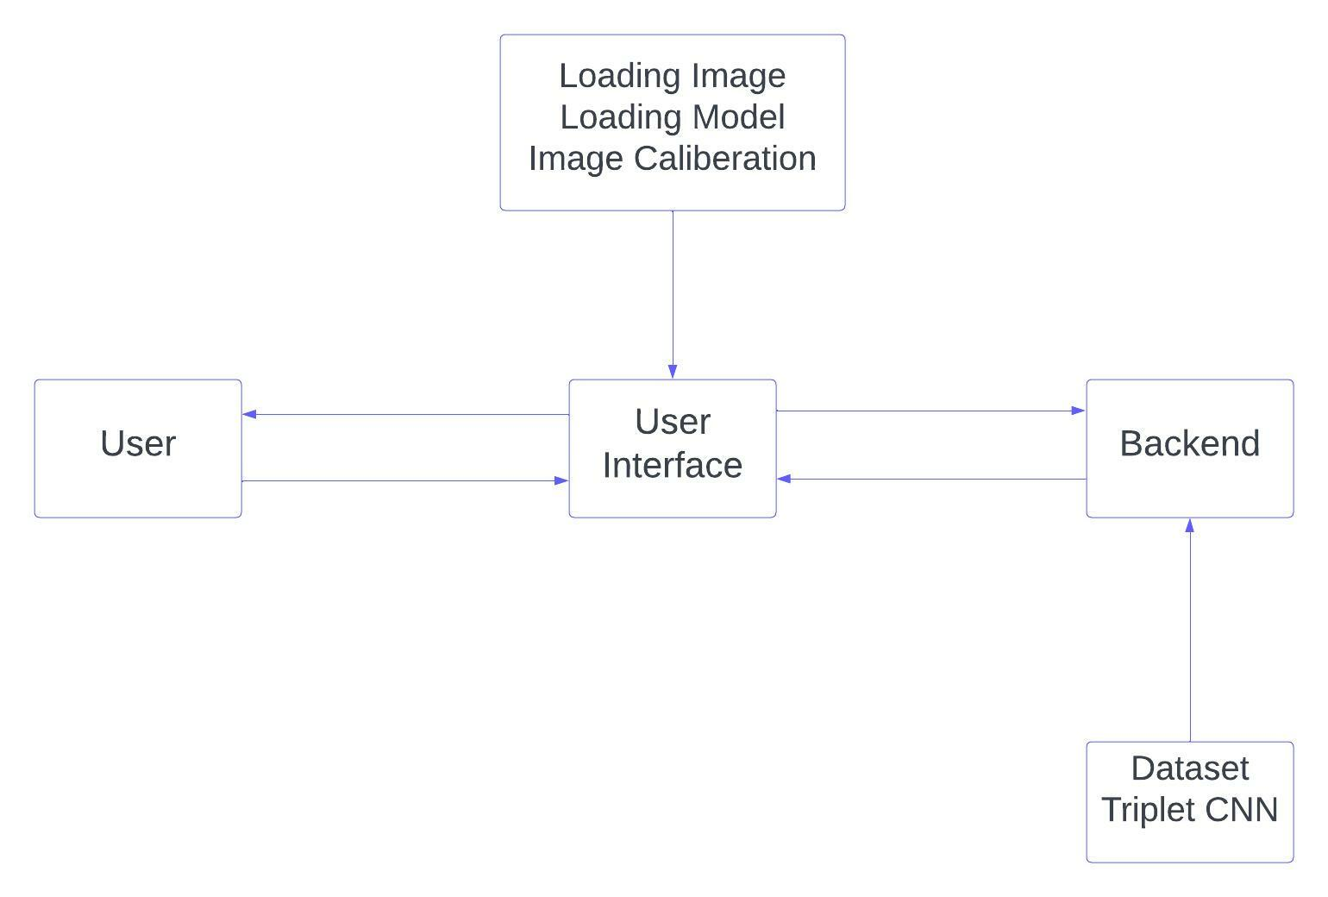
SYSTEM DESIGN

Slide 11
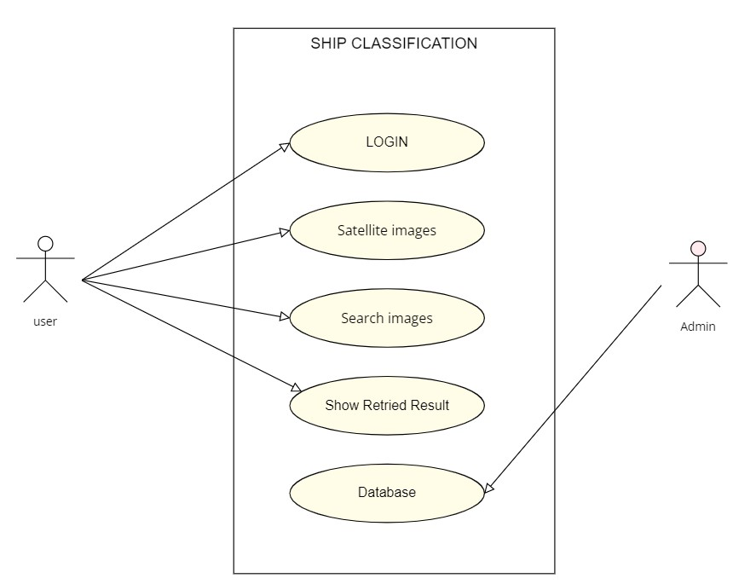
USE CASE DIAGRAM

Slide 12
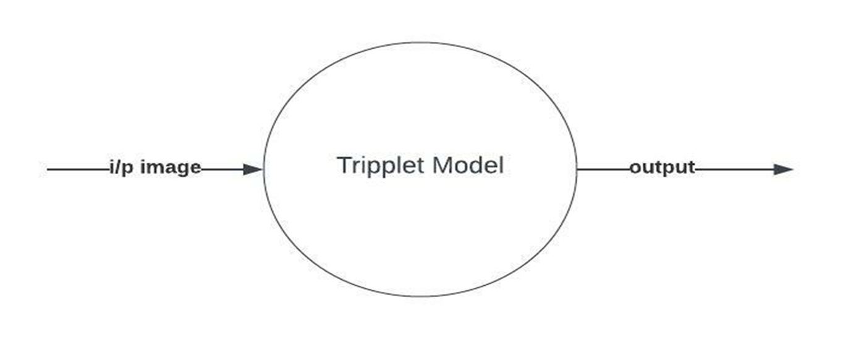
DFD-Level 0

Slide 13
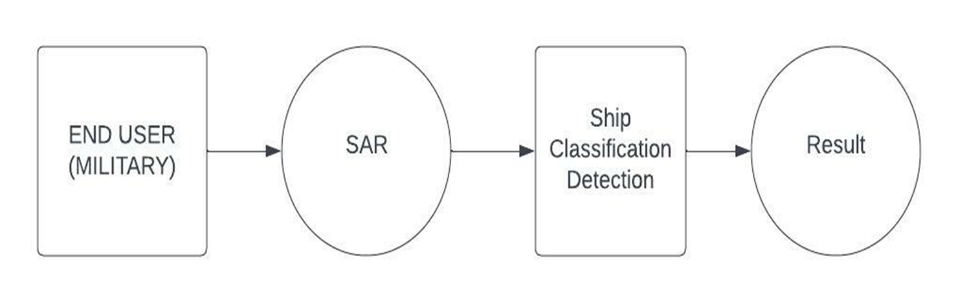
DFD-Level 1

Slide 14
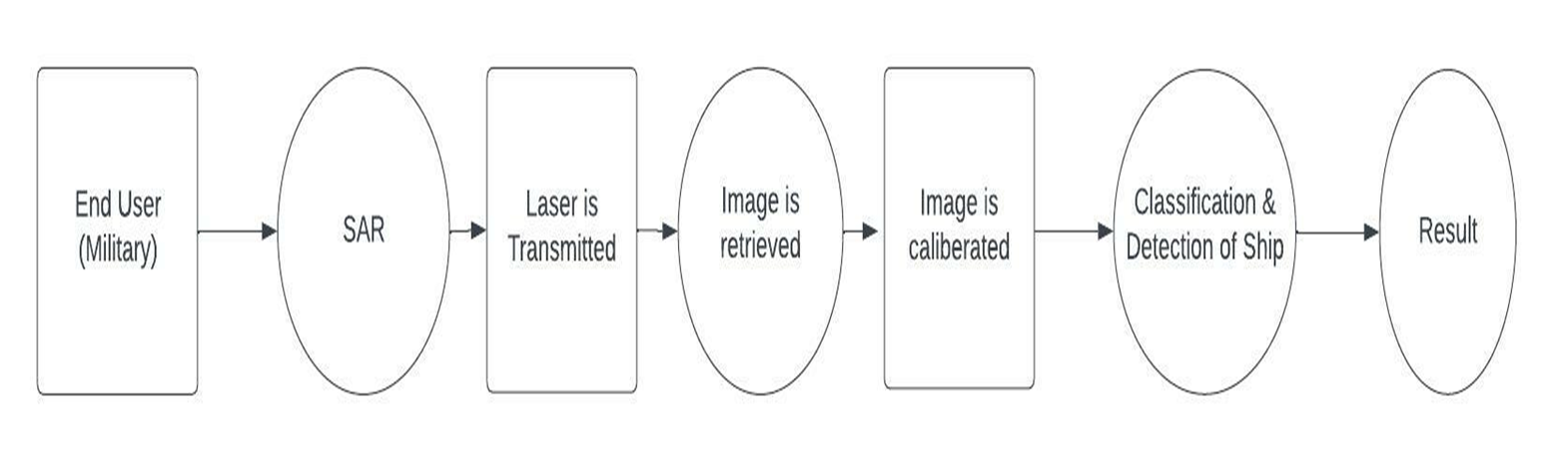
DFD-Level 2

Slide 15
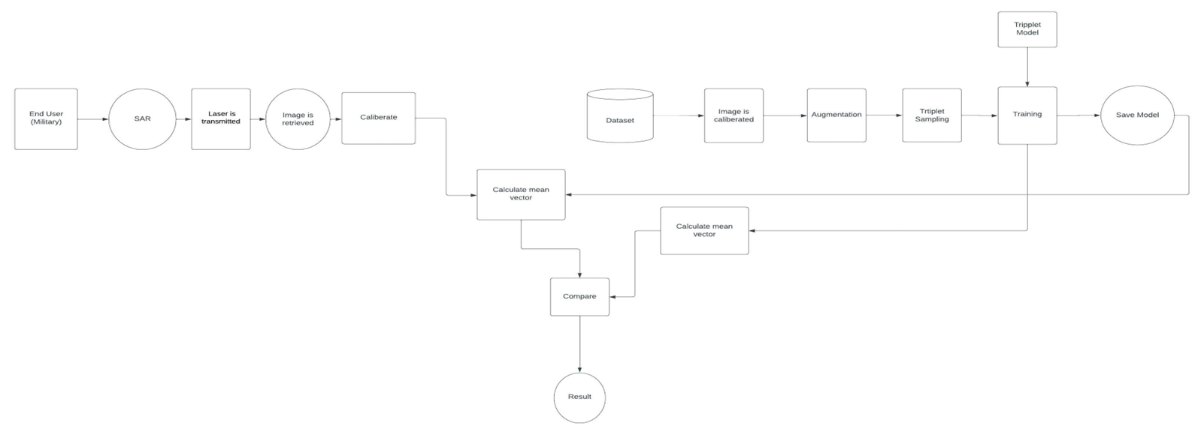
DFD-Level 3

Slide 16
MODULES
⮚ Dataset creation
⮚ Triplet sampling
⮚ Architecture creation
⮚ Training using triplet and saving model
⮚ Prediction

Slide 17
DATASET CREATION
⮚ OpenSARShip is the dataset used.
⮚ Calibrate all images using python
⮚ Edges of the images are sharpened.
Data augmentation
⮚ Horizontally and vertically flip the ship chips.
⮚ Randomly translate the ship chips with the translation .
⮚ Rotate the ship chips by 90◦, 180◦, and 270°.

Slide 18
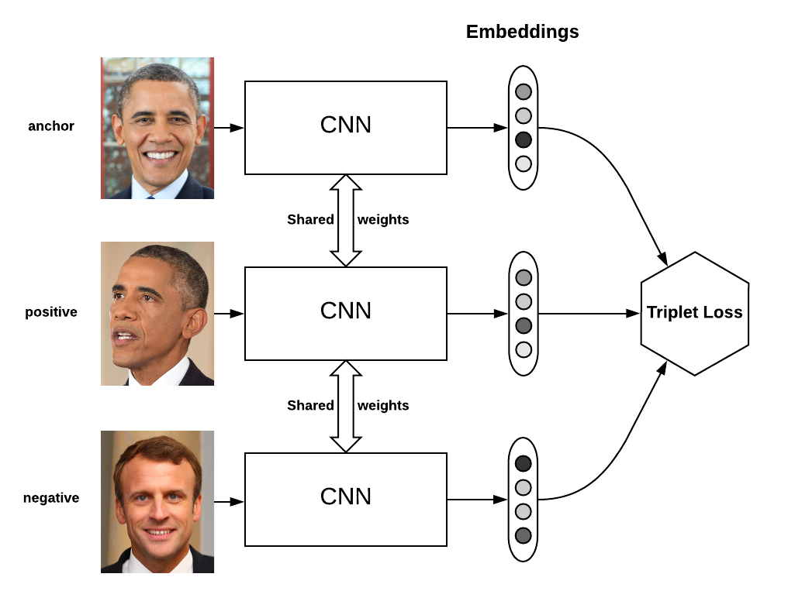
TRIPLET SAMPLING
⮚ A triplet, comprising an anchor image (x_{a}), a positive image(x_{p})from the same class as the anchor and a negative image (x_{n}) from another class, is mapped to a d-dimensional.
⮚ In the embedding space, the triplets should satisfy the following distance constraint: D(x_{a},x_{p})+α < D(x_{a}, x_{n}) ∀(x_{a}, x_{p}, x_{n})
⮚ The Euclidean distance is used to find the distance.
anchor
positive
negative

Slide 19
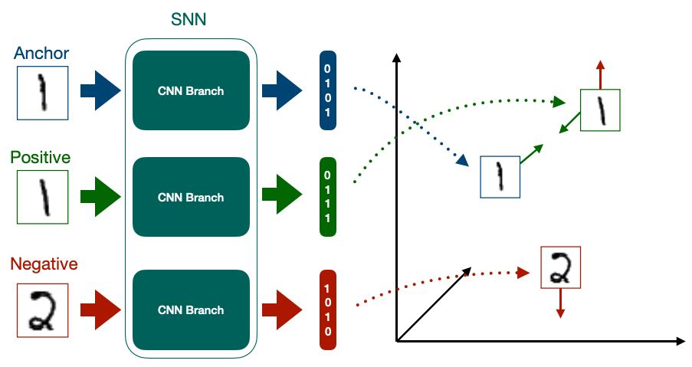
ARCHITECTURE CREATION
CNN consist of different layers:
⮚ Convolutional layer
⮚ Batch normalization layer
⮚ Pooling layer

Slide 20
TRAINING AND SAVING MODEL
⮚ Triplet CNN algorithm is used to train the dataset
⮚ Input image is entered into the 3 CNN layers
⮚ Feature extraction is done in the layers
⮚ In each training the distance between anchor image and positive image is reduced and distance between anchor image and negative is increased.
⮚ Thus the final vector is formed for each classification.

Slide 21
PREDICTION
⮚ SAR image is read as input
⮚ Input image is calibrated
⮚ Calculation of vector
⮚ Comparing the vectors
⮚ The vector with minimum Euclidian distance is considered as the resultant ship classification

Slide 22
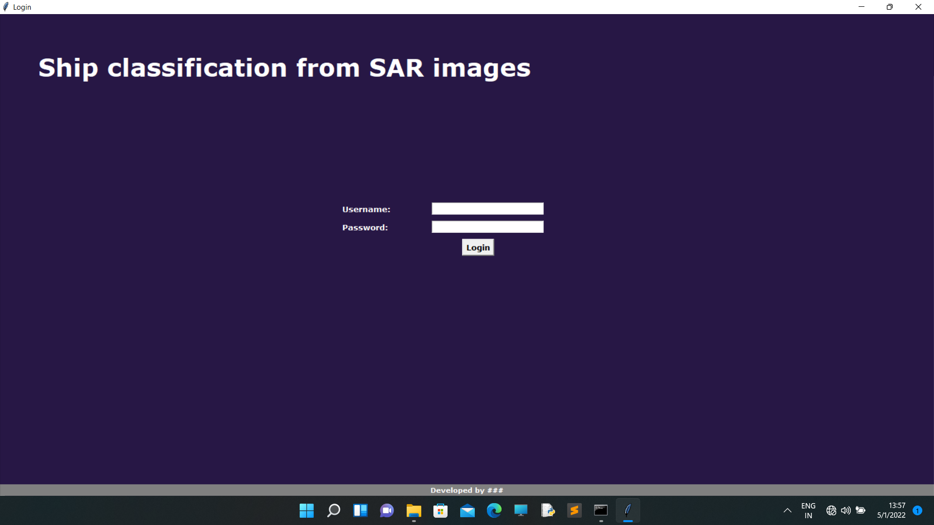
USER INTERFACE

Slide 23
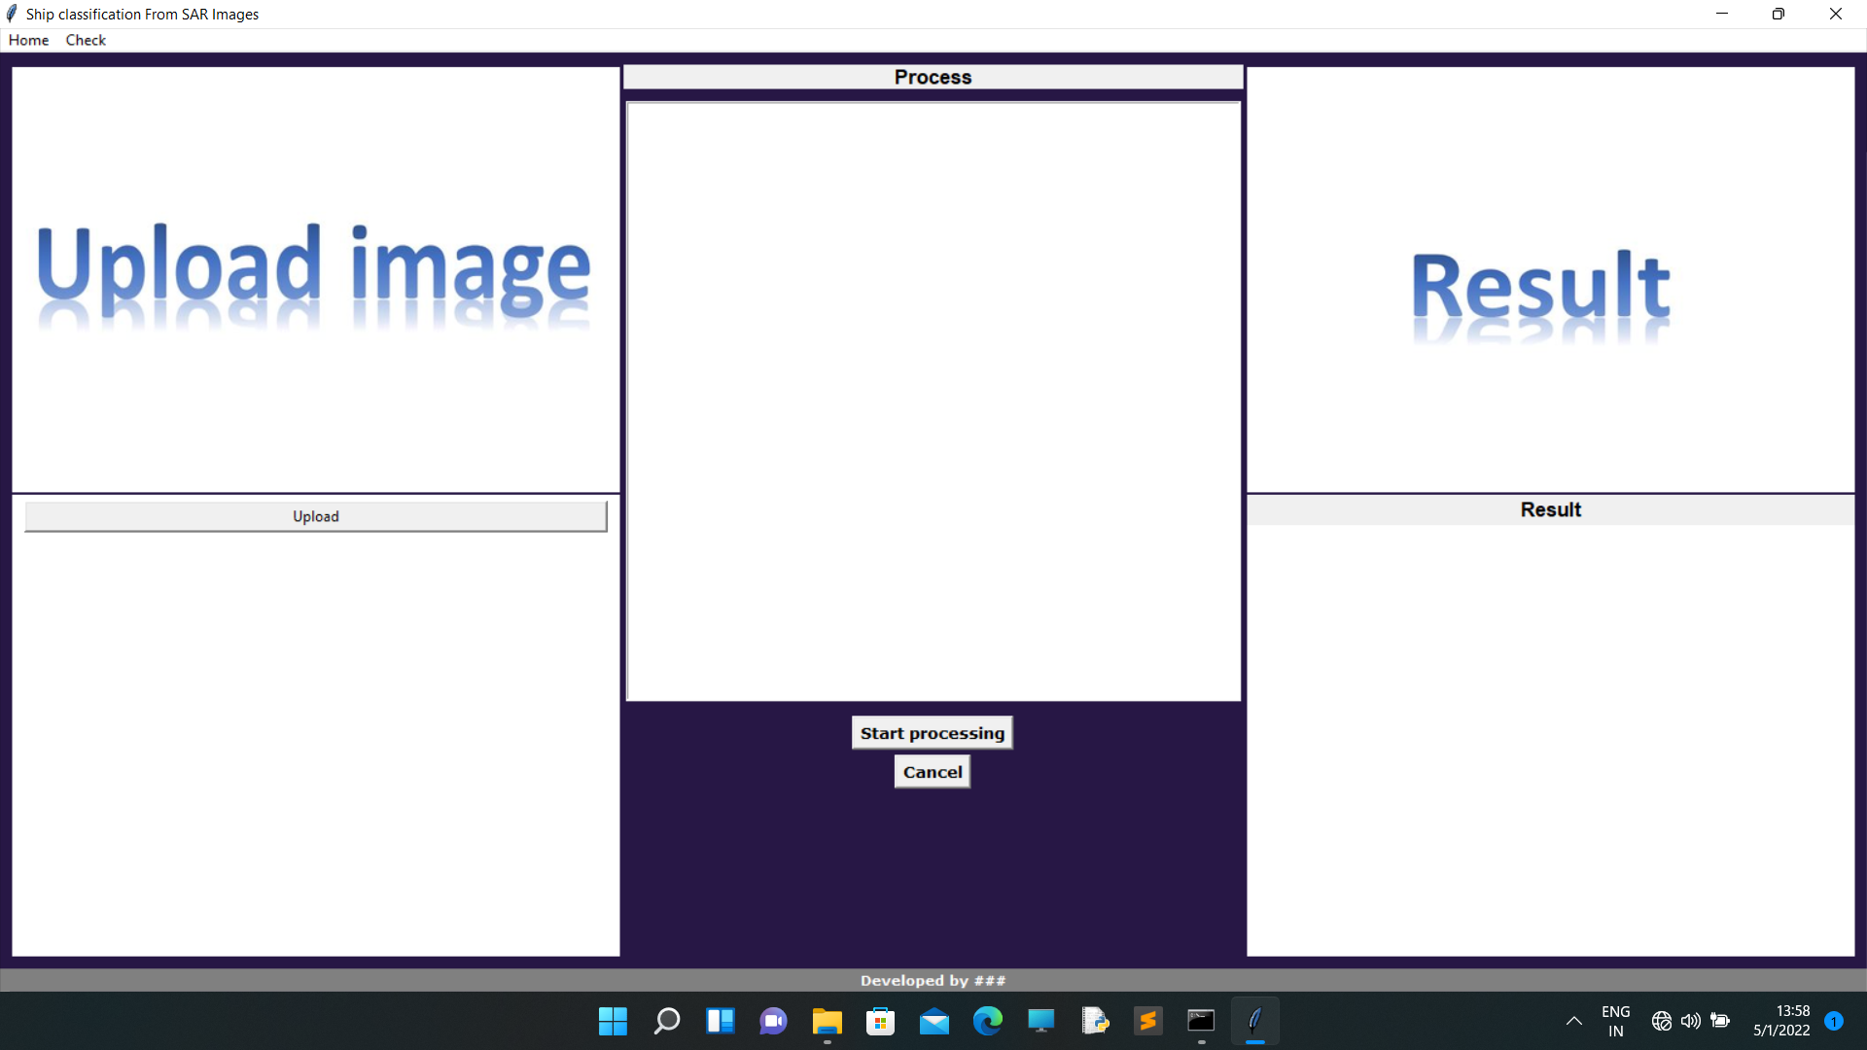

Slide 24
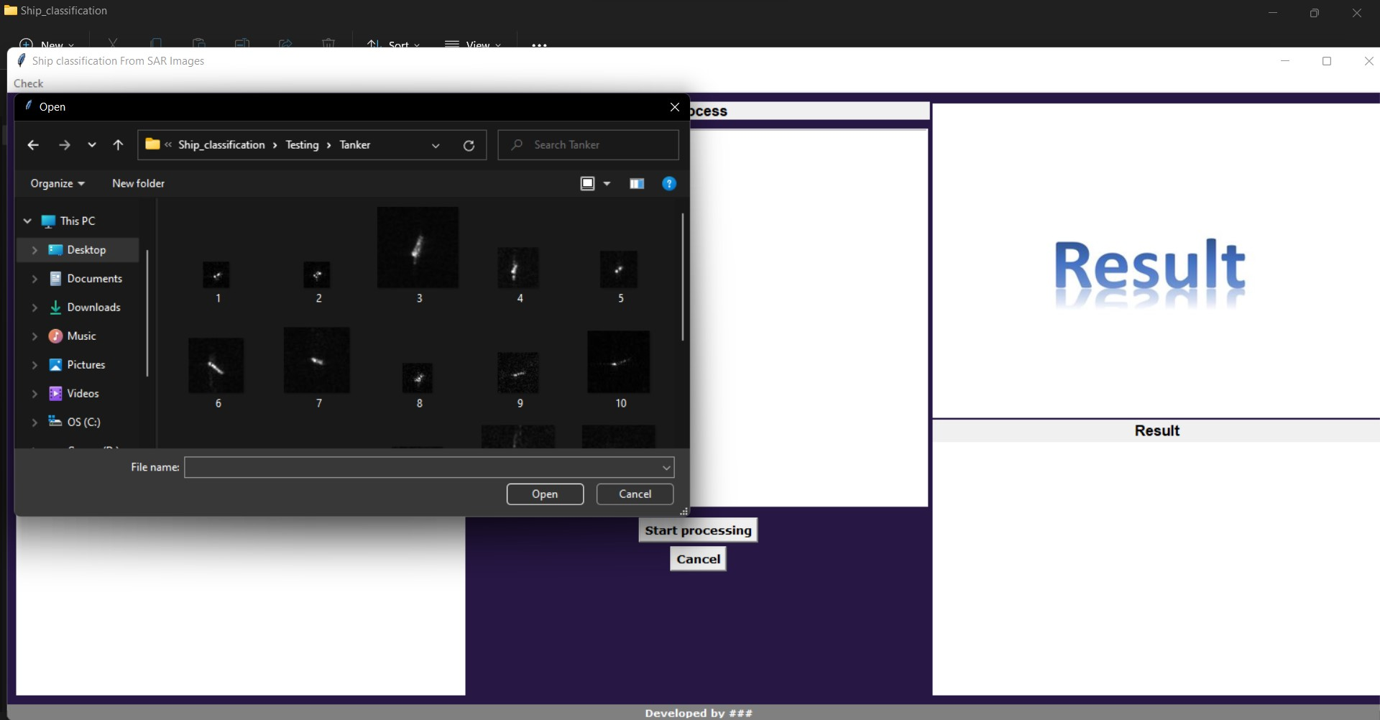

Slide 25
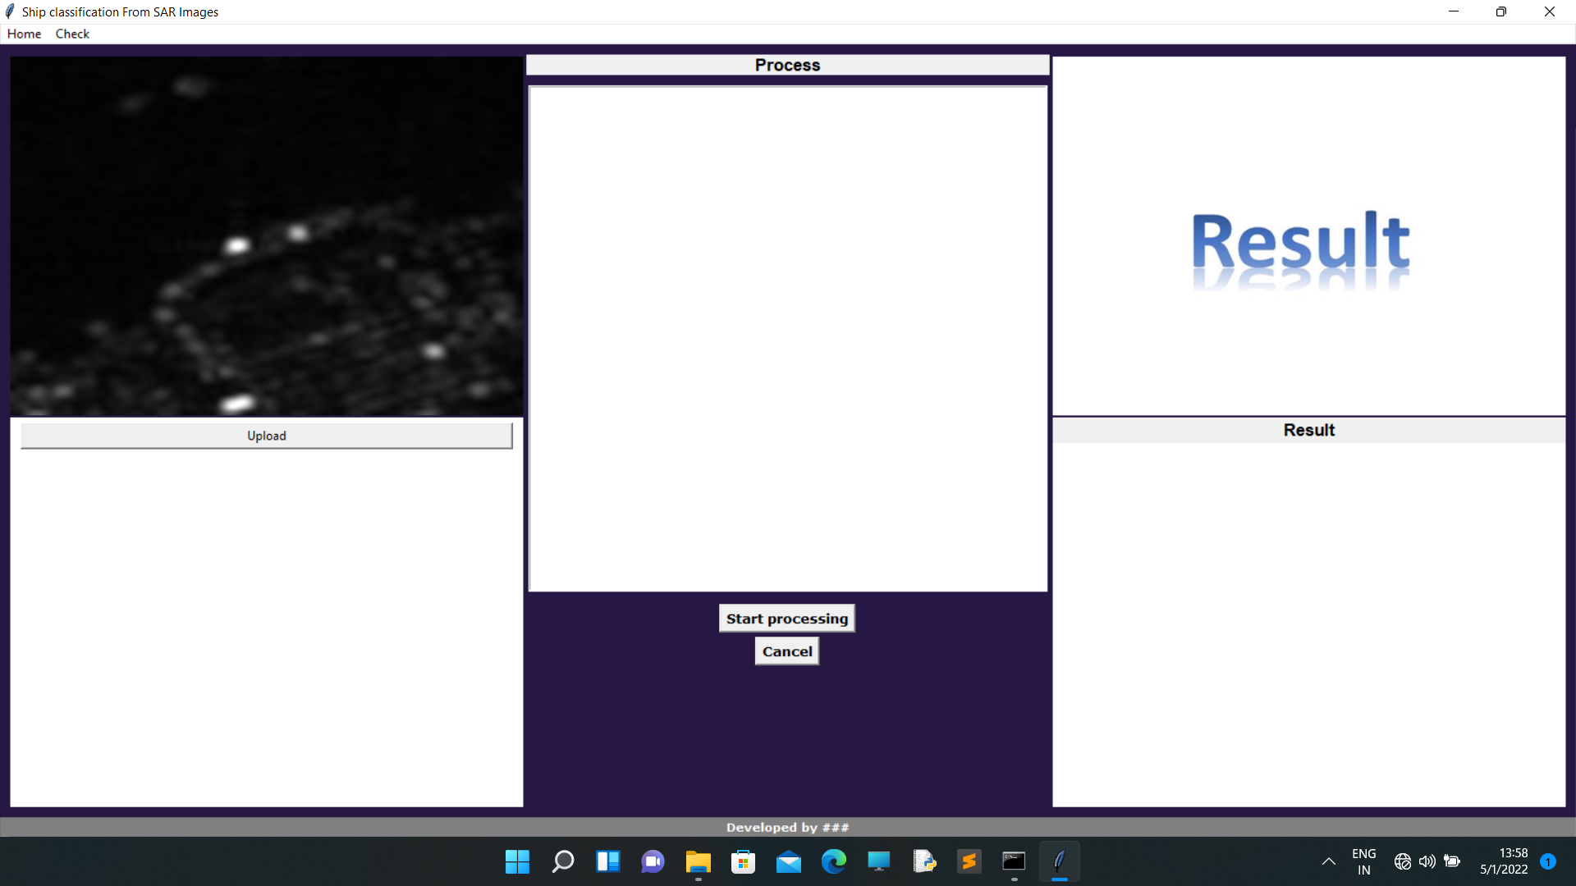

Slide 26
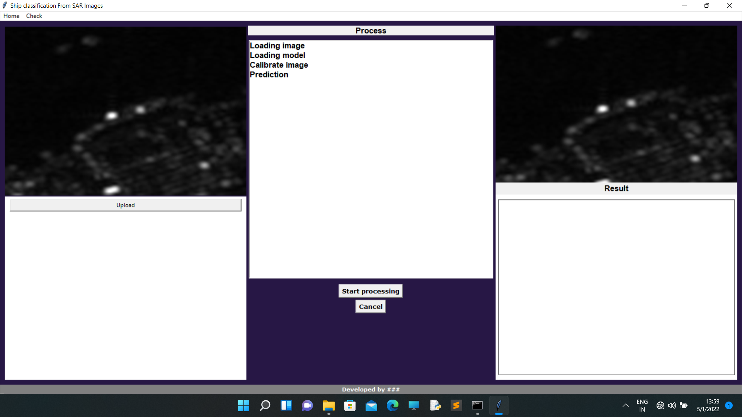

Slide 27


Slide 28
ADVANTAGES
⮚ This system is more accurate than existing systems.
⮚ It has a capability of predicting ship type from medium- resolution image
⮚ It can classify four different types of ships

Slide 29
GANTT CHART

Slide 30
FUTURE SCOPE
In the future there will be more advanced military operations.
The machine learning based satellite image classification holds a huge scope.
It can be used for rescue operations.
It can be used for finding lost ship in the sea.

Slide 31
CONCLUSION
The existing system classify ships from high-resolution SAR images using normal CNN
The proposed system improved ship classification by introducing special Triplet deep learning model.

Slide 32
REFERENCE
[1] Wang C., Zhang H., Wu F., Jiang S., Zhang B., Tang Y. A novel hierarchical ship classifier for COSMO-SkyMed sar data. IEEE Geosci. Remote Sens. Lett. 2014;11:484–488. doi: 10.1109/LGRS.2013.2268875. [CrossRef] [Google Scholar].
[2] Zhang L., Zhang L., Du B. Deep learning for remote sensing data: A technical tutorial on the state of the art. IEEE Geosci. Remote Sens. Mag. 2016;4:22–40. doi: 10.1109/MGRS.2016.2540798. [CrossRef] [Google Scholar]
[3] A. Moreira, P. Prats-Iraola, M. Younis, G. Krieger, I. Hajnsek, and K. P. Papathanassiou, “A tutorial on synthetic aperture radar,” IEEE Geosci. Remote Sens. Mag., vol. 1, no. 1, pp. 6–43, Mar. 2013.
[4] D. J. Crisp, “The state-of-the-art in ship detection in synthetic aperture radar imagery,” DSTO Inf. Sci. Lab., Edinburgh, SA, Australia, Tech. Rep. DSTO-RR-0272, 2004

Slide 33
[5] Y. Wang and H. Liu, “A hierarchical ship detection scheme for highresolution SAR images,” IEEE Trans. Geosci. Remote Sens., vol. 50, no. 10, pp. 4173–4184, Oct. 2012
[6] K. Simonyan and A. Zisserman, “Very deep convolutional networks for large-scale image recognition,” in Proc. Int. Conf. Learn. Represent., 2015, pp. 1–14.
[7] M. Wilmanski, C. Kreucher, and J. Lauer, “Modern approaches in deep learning for SAR ATR,” Proc. SPIE, vol. 9843, May 2016, Art. no. 98430N
[8] J. Ding, B. Chen, H. Liu, and M. Huang, “Convolutional neural network with data augmentation for SAR target recognition,” IEEE Geosci. Remote Sens. Lett., vol. 13, no. 3, pp. 364–368, Mar. 2016.
[9] T. Chen, K.-F. Ji, X.-W. Xing, H.-X. Zou, and H. Sun, “Ship recognition in high resolution SAR imagery based on feature selection,” in Proc. Int. Conf. Comput. Vis. Remote Sens., Xiamen, China, Dec. 2012, pp. 301–305
[10] E. Hoffer and N. Ailon, “Deep metric learning using triplet network,” in Proc. Int. Conf. Learn. Represent. Workshops, 2015, pp. 1–8.

Slide 34
THANK YOU!

