Slide 1
SHIP CLASSIFICATION USING TRIPLET CNN
Submitted by,
ABIN K JAYAN ADR18CS001
AJMAL LATHEEF ADR18CS003
ASHIL JOHNSON ADR18CS014
SIDDHARDH R NAIR ADR18CS038
Guided by,
Mrs. Manju J
Assistant Professor
Dept. of Computer Science

Slide 2
INTRODUCTION
⮚The purpose of ship classification is to identify various types of ships as accurately as possible, which is of great significance for monitoring the rights and interests of maritime traffic and improving coastal defense early warnings.
⮚With the improvement of all kinds of imaging technology, the ship classification method of imaging technology has become the mainstream method of ship target classification and recognition.

Slide 3
EXISTING SYSTEM
⮚Y. Wang and H. Liu, “A hierarchical ship detection scheme for high resolution SAR images,” IEEE Trans. Geosci. Remote Sens., vol. 50, no. 10, pp. 4173–4184, Oct. 2012
⮚The existing system classify ships from normal images using normal CNN.

Slide 4
DRAWBACKS
⮚The existing system has low accuracy.
⮚It was only able to predict ship type from satellite images.
⮚It cannot predict ship type from a SAR image.

Slide 5
PROPOSED SYSTEM
⮚“Ship Classification in Medium-Resolution SAR Images via Densely Connected Triplet CNNs Integrating Fisher Discrimination Regularized Metric Learning” Jinglu He, Yinghua Wang ,Hongwei Liu, june 2020
⮚Use tripplet CNN for classifying ship from satellite image.

Slide 6
SAR
•The medium to high resolution and wide coverage imaging ability of Synthetic Aperture Radar (SAR) systems are developed for intelligent maritime surveillance, especially for ship classification in SAR images
•SAR is independent of flight altitude, whether, and has day and night imaging capability
•Applications of SAR are numerous. Examples include topography, oceanography, glaciology, geology. SAR can also be applied for monitoring civil infrastructure stability such as bridges and also be used in environment monitoring such as oil spills, flooding, urban growth, military surveillance.

Slide 7
SYSTEM SPECIFICATIONS
Software Specification
❖Tool: Sublime text, Anaconda, tkinter
❖Language: Python
❖Operating System: Windows 7 or later
Hardware Specification
❖Processor: i3
❖RAM: 4GB
❖Hard Disk: 256GB or above

Slide 8
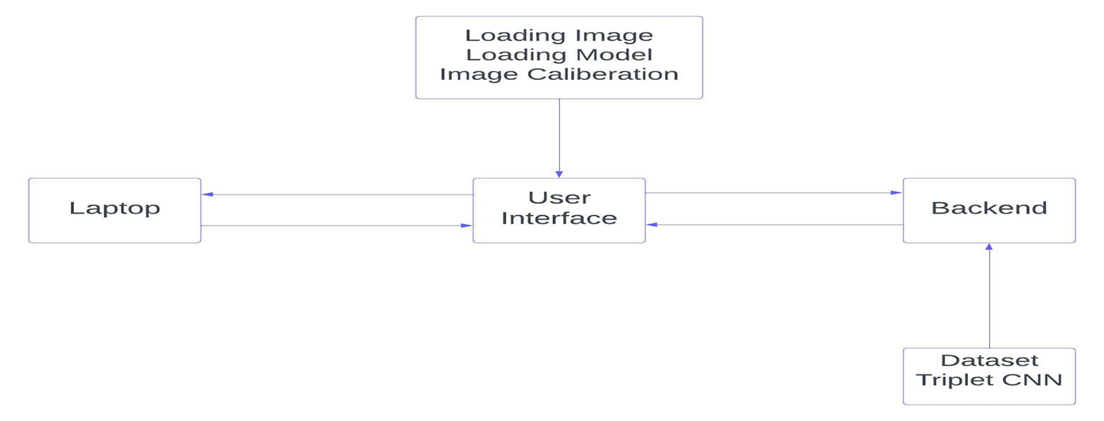
SYSTEM DESIGN

Slide 9
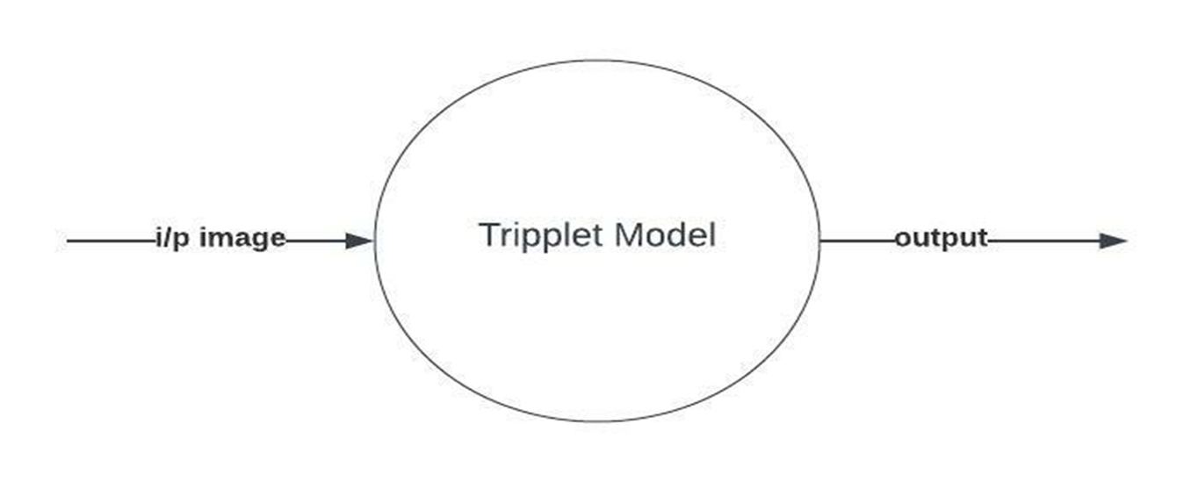
DFD-Level 0

Slide 10
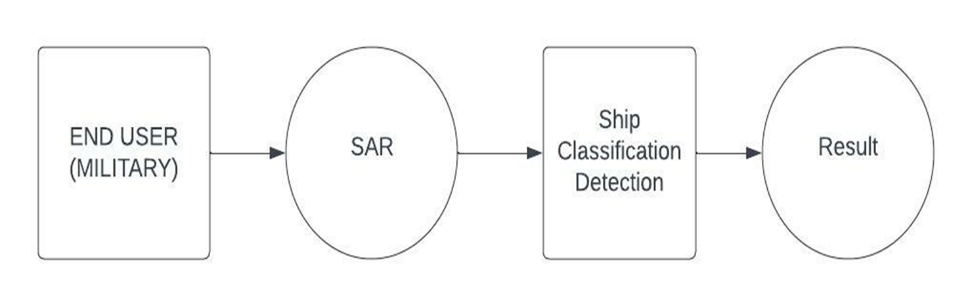
DFD-Level 1

Slide 11
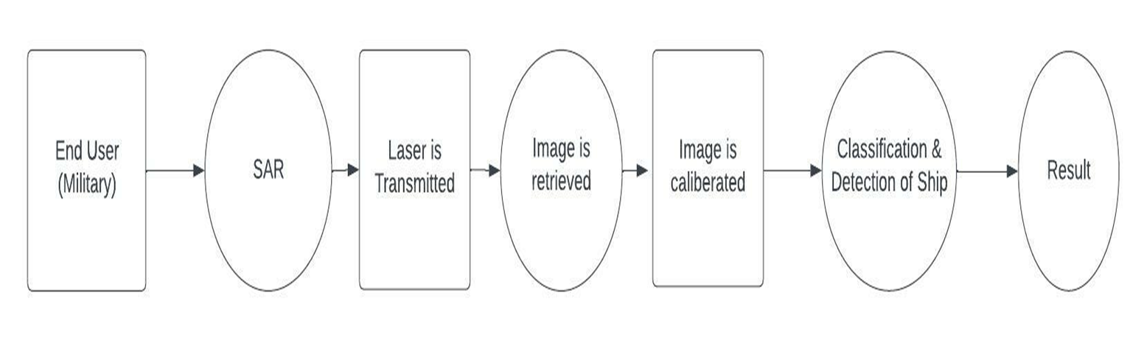
DFD-Level 2

Slide 12
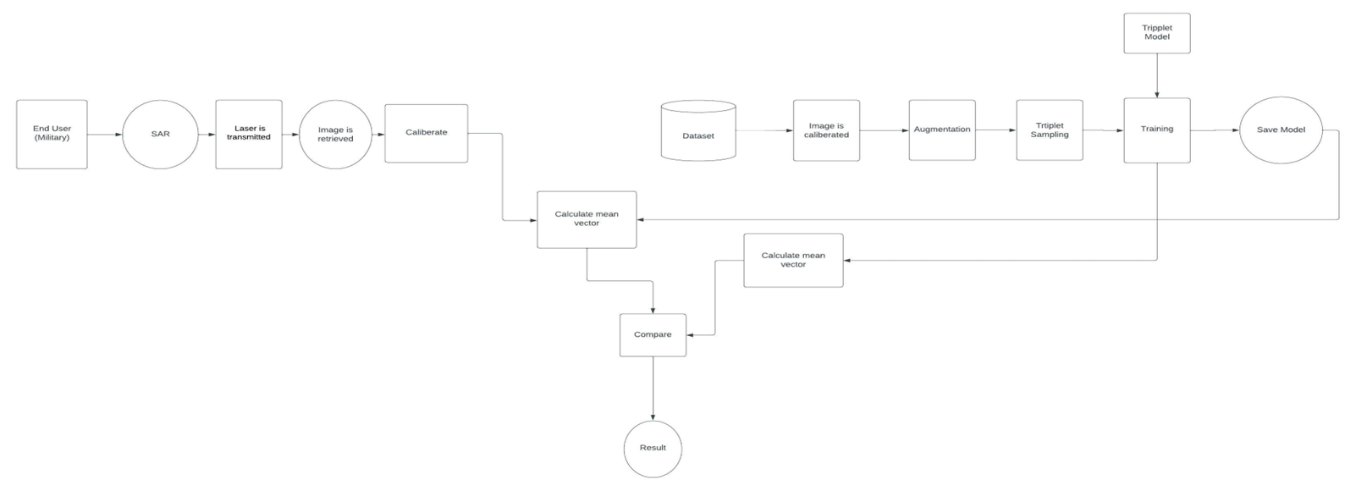
DFD-Level 3

Slide 13
Libraries
OpenCV
Pillow/PIL
NumPy
Keras

Slide 14
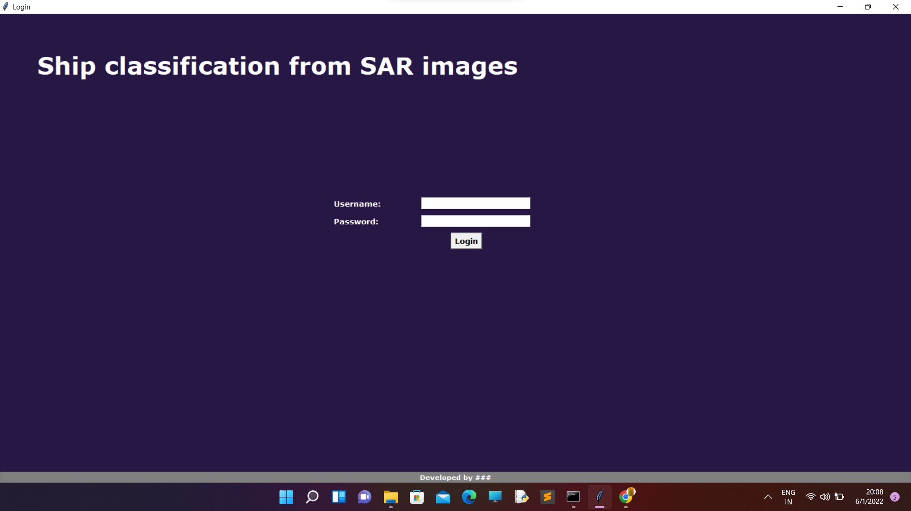
Module 1-GUI
def logcheck():
global username_var,pass_var
uname=username_var.get()
pass1=pass_var.get()
if uname=="admin" and pass1=="admin":
showcheck()
else:
messagebox.showinfo("alert","Wrong Credentials")

Slide 15
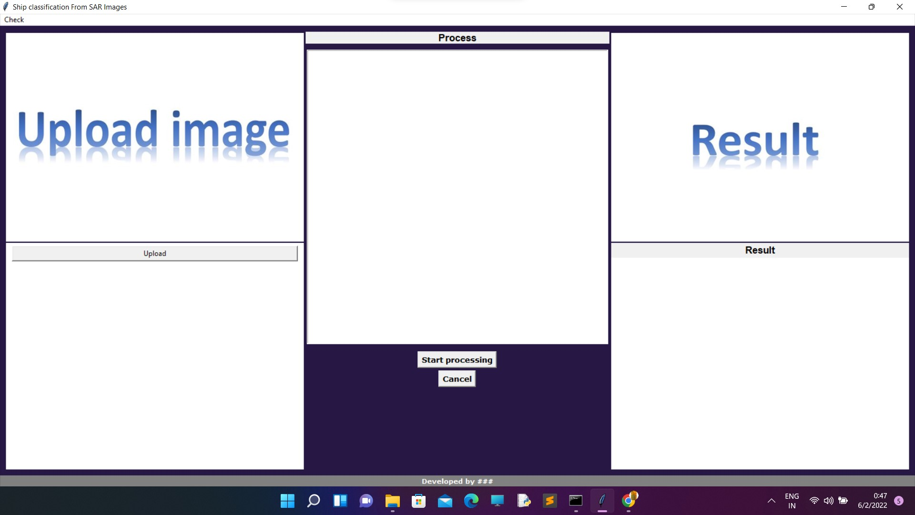

Slide 16
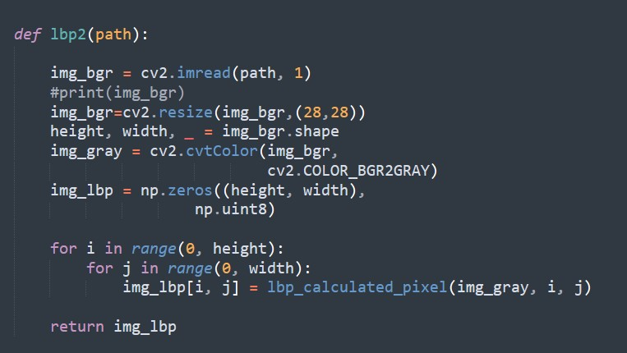
Module2- IMAGE CALIBRATION

Slide 17
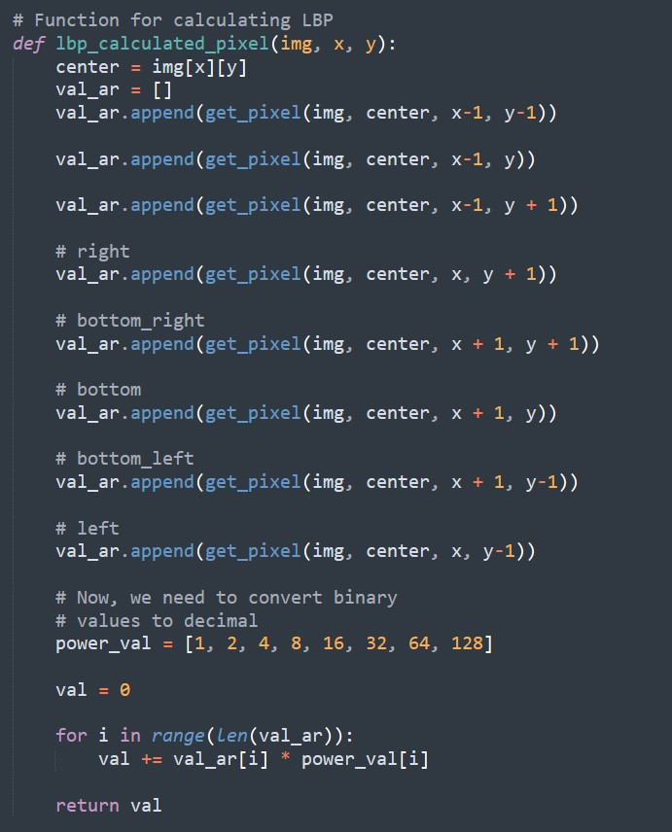

Slide 18
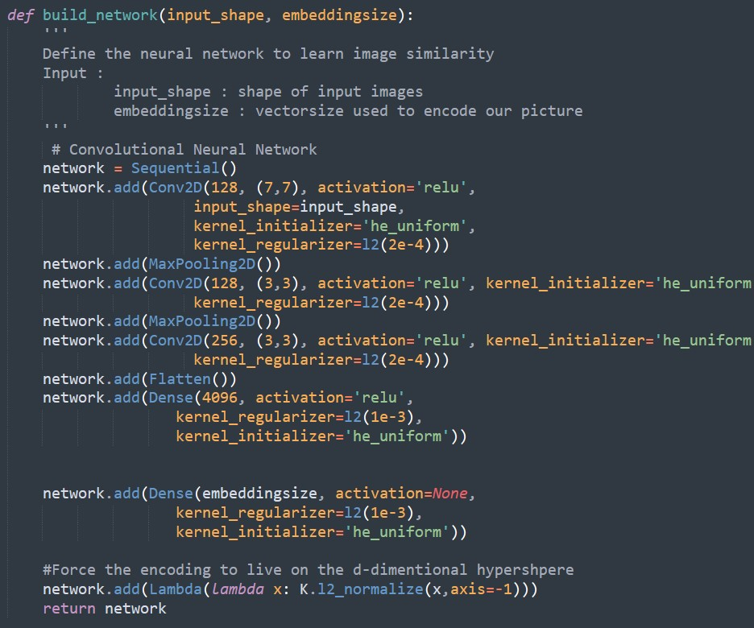
MODULE 3-ARCHITECTURE CREATION

Slide 19
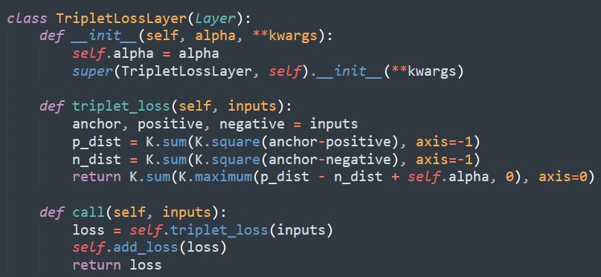

Slide 20
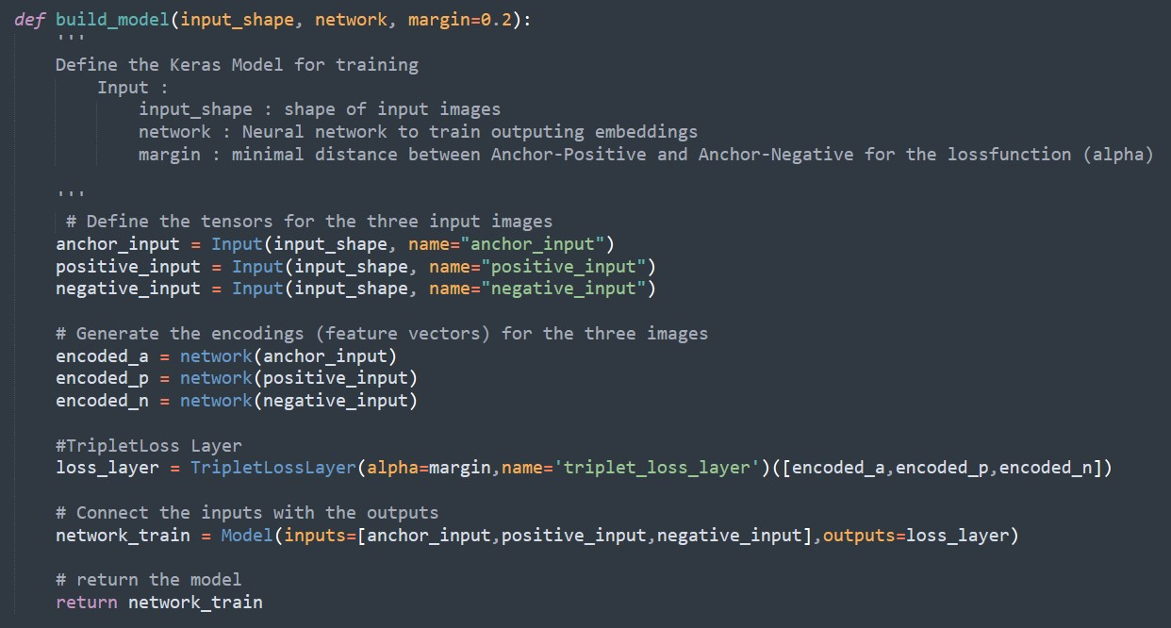

Slide 21
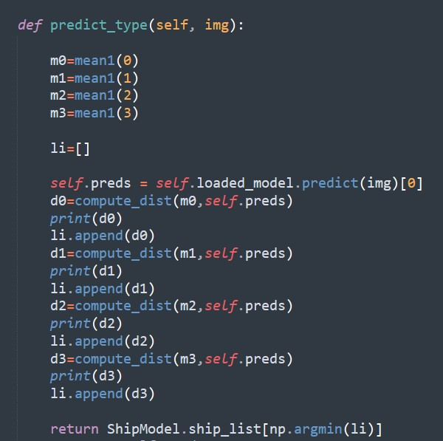
MODULE-4 PREDICTION

Slide 22
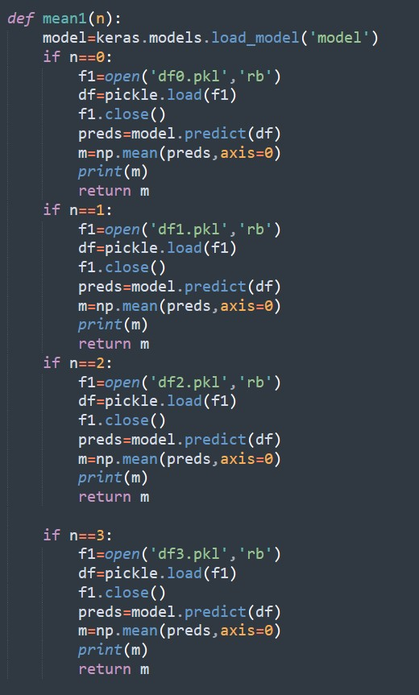


Slide 23
FUTURE SCOPE
In the future there will be more advanced military operations.
The machine learning based satellite image classification holds a huge scope.
It can be used for rescue operations.
It can be used for finding lost ship in the sea.

Slide 24
CONCLUSION
⮚The existing system classify ships from normal images using normal CNN
⮚The proposed system improved ship classification by introducing special Triplet deep learning model.

Slide 25
REFERENCE
•A. Moreira, P. Prats-Iraola, M. Younis, G. Krieger, I. Hajnsek, and K. P. Papathanassiou, “A tutorial on synthetic aperture radar,” IEEE Geosci. Remote Sens. Mag., vol. 1, no. 1, pp. 6–43, Mar. 2013.
•https://europepmc.org/article/pmc/pmc6164978#sec1-sensors-18-0292
“Deep Neural Networks Do Not Recognize Negative Images” Hossein Hosseini and Radha Poovendran ,Network Security Lab (NSL) Department of Electrical Engineering, University of Washington, Seattle, WA

Slide 26
THANK YOU!

