Slide 1
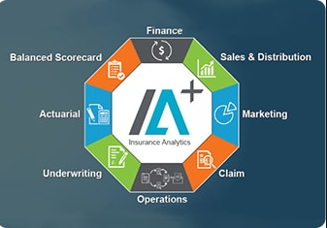
Insurance claim Underwriting

Slide 2
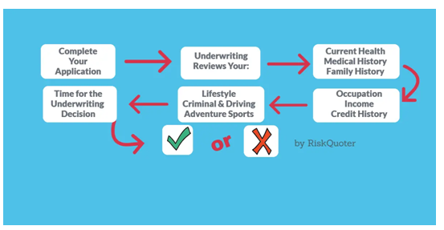
Objective and Ideology

Slide 3
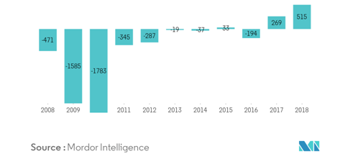
Research Rationale (1)
Insurance market for motor in the United Kingdom

Slide 4
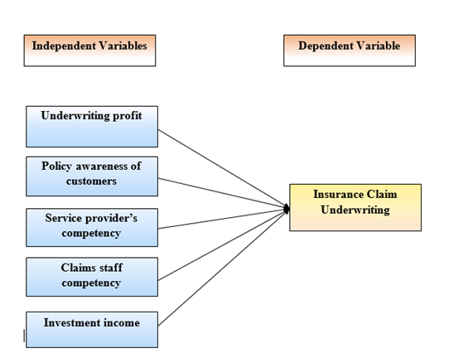
Methodology

Slide 5
Work Flow
Insurance “claim” underwriting
Underwriting profit
Policy awareness of customers
Service provider’s competency
Investment income
Claims staff competency

Slide 6
Empirical Study
Upcoding of Services
Duplicate Claims
Analyzing the claim of the individuals
·Generating a Quote
·Predicting the claim of the incident
Unnecessary Services

Slide 7
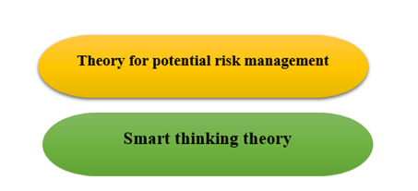
Models and theories

Slide 8
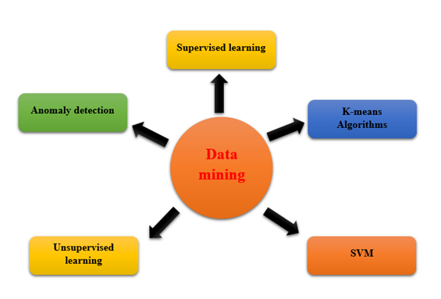
Models and theories

Slide 9
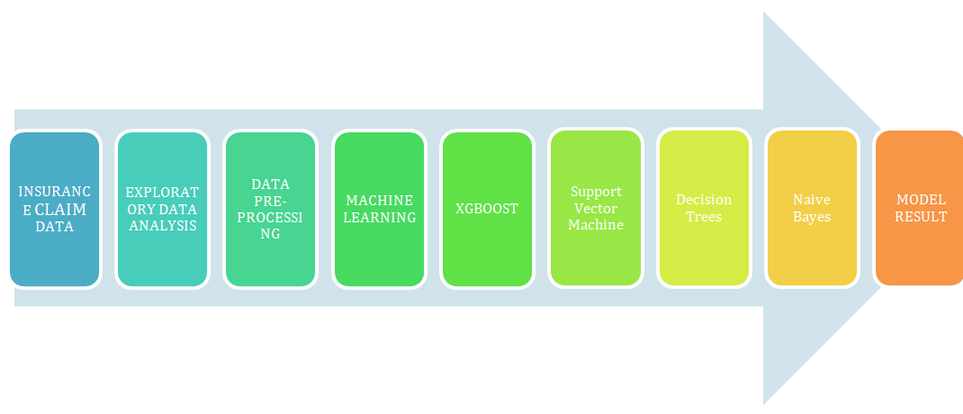
Methodology

Slide 10
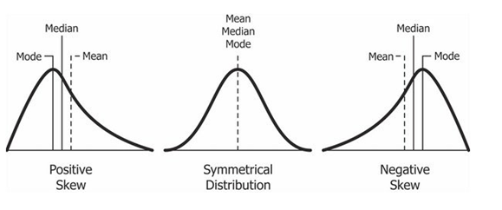
Analysis

Slide 11
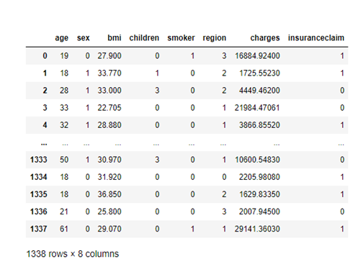
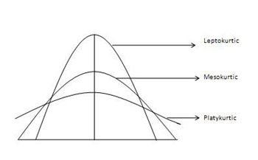
Analysis

Slide 12
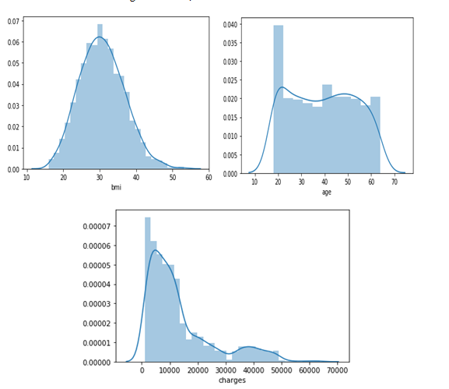
Result

Slide 13
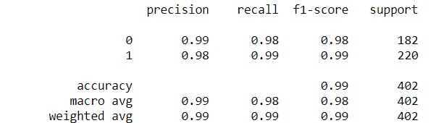
Result
Classification report of XGboost model

Slide 14
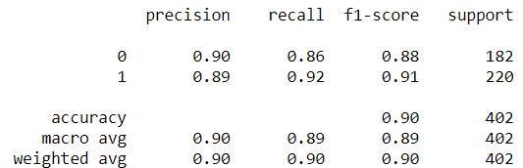
Result
Classification report of Support Vector Machine

Slide 15
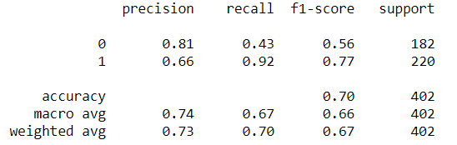
Result
Classification report of Decision Tree model

Slide 16
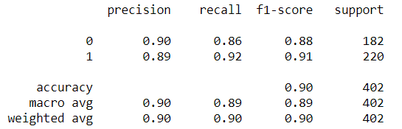
Result
Classification report of Naïve Bayes

Slide 17
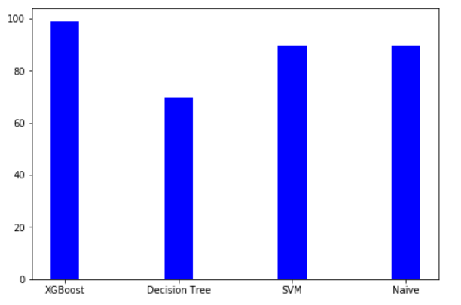
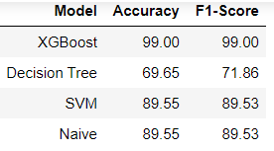
Results and Discussion
Models Performance
Models Accuracy plot

Slide 18
References
Akkor, D.G. and Ozyukse, S., 2020. The effects of new technologies on the insurance sector: a proposition for underwriting qualifications for the future. Eurasian Journal of Business and Management, 8(1), pp.36-50.
Bonissone, P.P., Messmer, R.P., Durham, W.M., Yang, D., Pavese, M. and Russell, D.M., Pacific Life Insurance Co, 2018. System for rule-based insurance underwriting suitable for use by an automated system. U.S. Patent Application 15/836,689.
Denning, R.O., Moin, M.M. and Perschy, D.L., Hartford Fire Insurance Co, 2020. System and method for proactive underwriting using social data.U.S. Patent 10,672,077.
Devereaux, R., Franck, D.S., Moritz, K., Read, S., Wheeler, D., Vaith, E., McCaw, E., Norman, C., Healy, J.J., Prasad, B. and Swain, K.L., 2017. Utilizing credit and informatic data for insurance underwriting purposes.U.S. Patent 9,818,158.

Slide 19
THANK YOU

