Slide 1
RIDE BOOKING APPLICATION
Prepared under the guidance of:
Divyansh Bhardwaj Sir
Pinky Sodhi Mam
Shruti Purohit Mam
Presented By
Ashim Aakash Roy

Slide 2
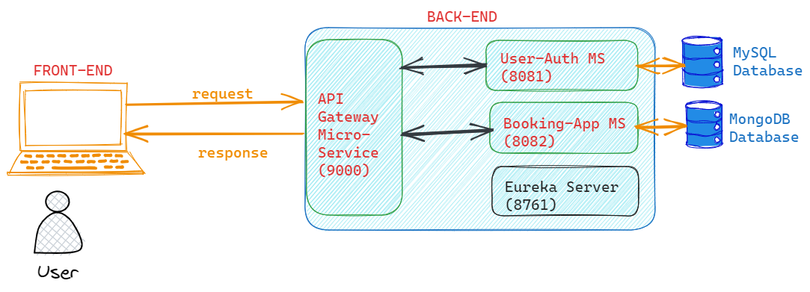
PROJECT ARCHITECTURE DIAGRAM

Slide 3





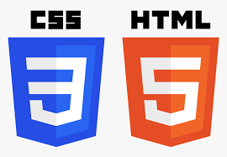






TECHNOLOGIES IMPLEMENTED
FRONT-END
BACK-END
MISCELLANEOUS

Slide 4
BACK-END MODULE
Completely written using JAVA. JDK v 17.0.8 by Amazon Coretto
Implements Spring Boot as the microservice-based web framework
Microservices implemented
1. User Authentication Microservice (runs on port number 8081)
2. Booking Application Microservice (runs on port number 8082)
3. API Gateway Microservice (runs on port number 9000)
Eureka Server (runs on port number 8761) is used for service discovery
All microservices are included as child modules to main application

Slide 5
IMPORTANT FILES
Dockerfile: It is a document containing all the commands the user requires to call on the command line to assemble an image
application.yml: It is primarily used to modify configuration parameters, such as connectivity with database, port number, eureka registry etc.
pom.xml: It is used to keep a track of project details such as group ID, artifact ID, and also all the list of dependencies required
compose.yaml: It is used to run multi-container docker application.

Slide 6
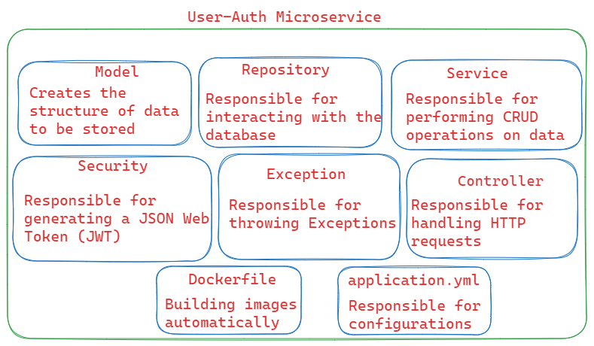
USER AUTHENTICATION
Purpose:
Allows new Users to register
Allows registered user to login
Generates a JSON Web Token (JWT), whenever a registered user logs in
User Details are stored in MySQL Database

Slide 7
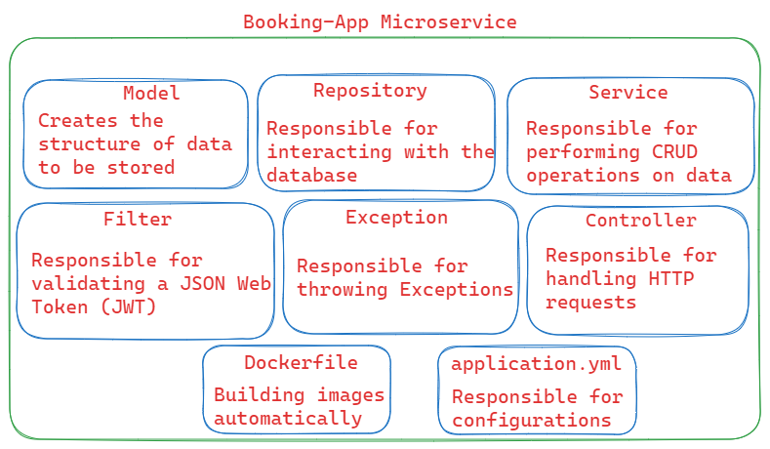
Booking application
Purpose:
Fetch user by name or email
Add a new booking for a user
Fetch one booking or list of all bookings
Update one booking details
Remove one booking or list of all bookings
Validate the generated JWT
Booking Details are stored in Mongo DB Database

Slide 8
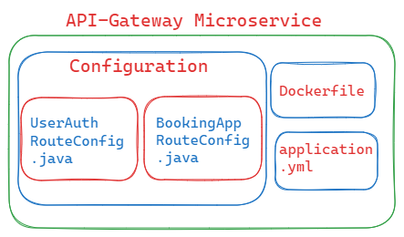
Api gateway
Purpose:
All requests pass through API Gateway
Provide a common port number for handling all requests
Configures the routes of all the micro services

Slide 9
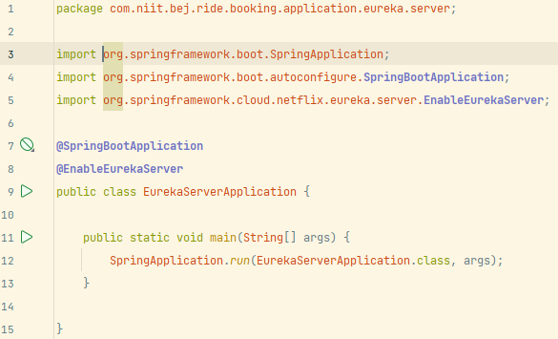
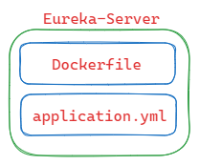
Eureka Server
Purpose:
Does not register itself as a microservice
Rather, works as service discovery
In simpler terms, keeps a track of all microservices present in the backend module.
The annotation @EnableEurekaServer is implemented.

Slide 10
FRONEND Module
Developed by using Angular, a free web based JS framework
Angular is primarily used to develop Single Page Applications (SPA)
Whenever, a new component is generated using CLI, the 4 files generated as the result are:
HTML file (it defines the skeletal appearance of webpage)
CSS file (it is used for styling of webpage for better look & feel)
TS file (it is a class file, written in TS language, contains business logic)
Testing file (self explanatory name, used for testing purposes)
One file that is updated, is the app.module.ts file, which now includes the newly created component in the declarations array.

Slide 11
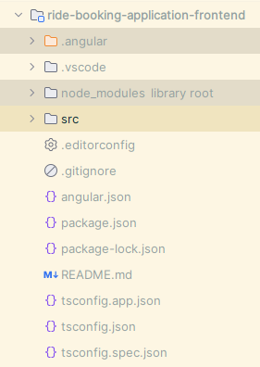
Important FILES
angular.json: Stores information about the architecture, dependencies, build and test configurations
package.json: It is a file that contains information about the project and its dependencies
tsconfig.json: It specifies the base Typescript and Angular compiler options
app.module.ts: Maintains a track of all components and imports, required in the project
app-routing.module.ts: Specifies what component to be loaded, when a specific path is entered

Slide 12
IMPORTANT ASPECTS:
Components: A component is the building block of any Angular application
A complete app is made using many components
Models: It is basically a class, written in TS syntax, which determines the structure of data that must be stored in the database
Services: It implements Dependency Injection (DI). It makes use of HttpClientModule to perform CRUD operations on database.
APIs: It stores data in JSON format, which is the most basic way to represent data.

Slide 13
IN MY PROJECT
COMPONENTS
MODELS & SERVICES
APIs
Header Component
Register Component
Login Component
Booking Component
Booking History Component
Footer Component
Models:
User Model: Fields are id, full-name, contact, email & password
Booking Model: Fields are id, pick-up-location, drop-location, vehicle-type, distance-travelled, cost-of-ride
Services:
User Service
Booking Service
1. cab-users.json
(running on port 3000)
bookings.json
(running on port 3002)

Slide 14
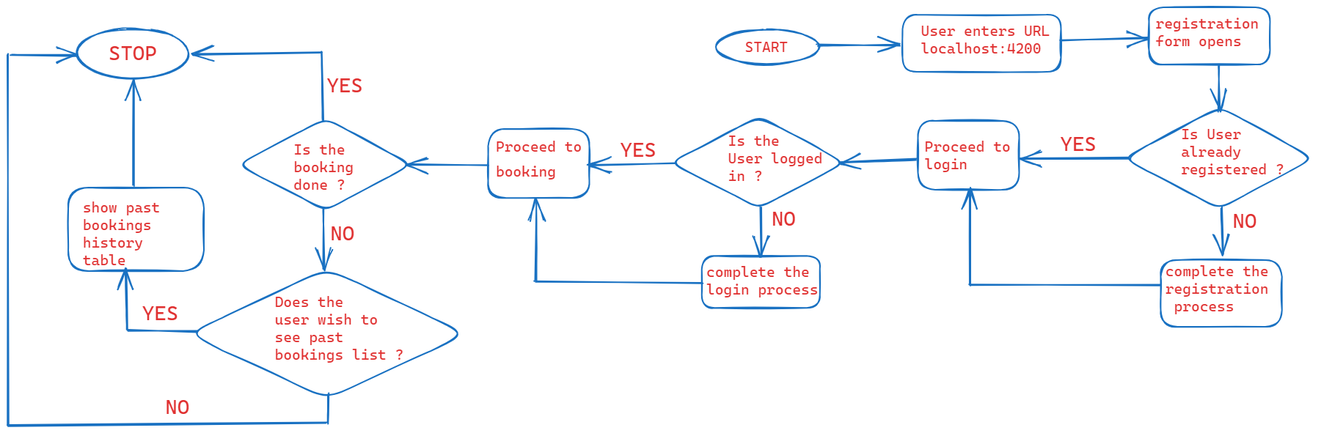
PROJECT FLOW

Slide 15
System.out.println(“Thank You”)

