Slide 1
RIDE BOOKING APPLICATION
Prepared under the guidance of:
Divyansh Bhardwaj Sir
Pinky Sodhi Mam
Shruti Purohit Mam
Presented By
Ashim Aakash Roy

Slide 2
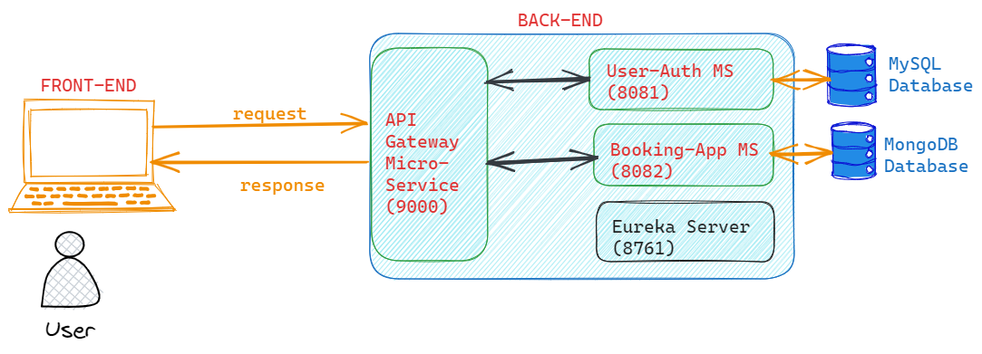
PROJECT ARCHITECTURE DIAGRAM

Slide 3












TECHNOLOGIES IMPLEMENTED
FRONT-END
BACK-END
MISCELLANEOUS

Slide 4
BACK-END MODULE
Completely written using JAVA.
JDK version 17.0.8 by Amazon Coretto
Implements Spring Boot as the open-source microservice-based web framework
Microservices implemented
1. User Authentication Microservice (runs on port number 8081)
2. Booking Application Microservice (runs on port number 8082)
3. API Gateway Microservice (runs on port number 9000)
Eureka Server (runs on port number 8761) is used for service discovery

Slide 5
USER Authentication

