Slide 1

Dynamic system development methodology(dsdm)
Deepak Vishwakarma

Slide 2
What is Dynamic Systems Development Methodology (DSDM)?
In Scrum, the focus is on creating the product. What you do after that product is created is not fully identified within the framework, as long as you create a potentially releasable product that meets the shared understanding of “Done” at the end of each iteration and deliver that product.
DSDM is intended to be more than just a framework for creating software development packages in increments. It is a full life-cycle approach with uses beyond software development projects. It includes the needed guidance to bring a product through the entire project, including the releases
DSDM has some similarities with Scrum and some very large differences. Where Scrum defines 3 core roles, DSDM defines 9 core roles and 4 supporting roles

Slide 3
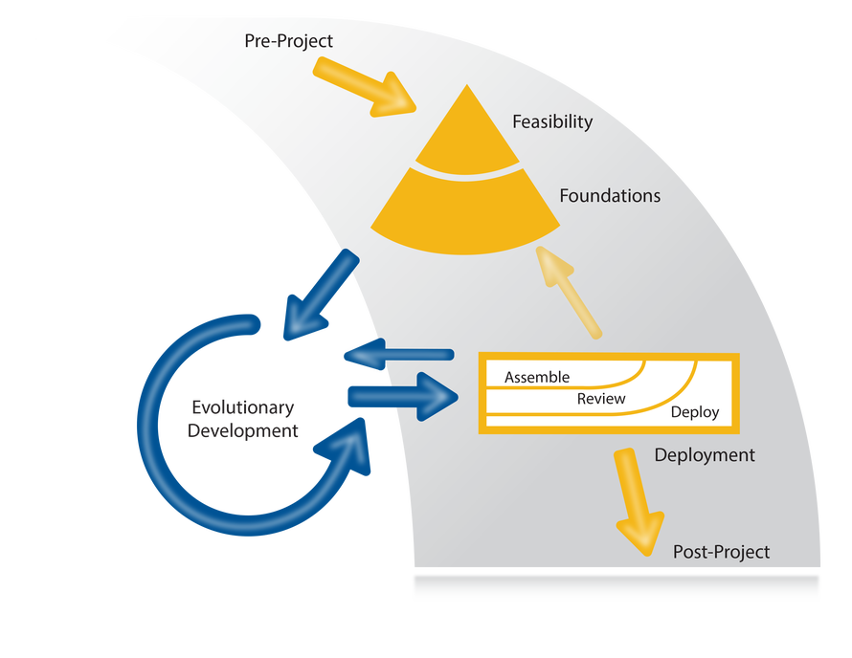
The DSDM Lifecycle

Slide 4
DSDM Phases
Pre-Project Phase
During the Pre-Project phase, you make sure projects are set up based on a clear objective. You must ensure that resources exist to begin the project’s feasibility stage. This phase would be carried out at a program or portfolio level. It is a gateway of sorts, ensuring projects are ready to begin based on the objective and business goals
Feasibility Phase
Are the projects feasible? During the feasibility phase, you want to make sure projects are technologically possible and cost-effective. You do just enough to determine if further planning is acceptable to the organization’s goals. This would be a high-level investigation of the technical requirements that would be needed for the project and solution, and whether it makes sense from a cost stand-point to continue with the project. You create rough estimates of completion time for the entire project, with a Delivery Plan to describe the Foundations Phase.

Slide 5
DSDM Phases
Foundations Phase
During Foundations you expand upon the work started in Feasibility. You create a basic understanding of the organization’s needs and how this project aligns with those needs. The idea here is to get a picture of the scope of work needed for the project and lay the foundation for defining it and estimations for completing items within the project, using ranged estimations if needed.
MoSCoW prioritization can be used to help decide where the priorities are. MoSCoW is a way of categorizing the features for the solution/product into “Must Have”, “Should Have”, “Could Have”, and “Won’t Have this time” categories

Slide 6
DSDM Phases
Evolutionary Development Phase
Now that you have built your project’s firm foundation, you should be ready to begin the iterative development cycle. The right solution should evolve over time.
Evolutionary Development makes use of timeboxing to control the iterations, with each iteration releasing a completed piece of a much larger whole. MoSCoW prioritization can be used with each timeboxed iteration to prioritize the items to be worked on (your iteration backlog).
Deployment Phase
You can either deploy the whole solution, which may make sense in some scenarios, or you can deploy small pieces of the solution with each loop through an iteration in evolutionary development.

Slide 7
DSDM Phases
Post-Project Phase
When all of your iterations are complete and you have a solution or product fully developed, your project is complete and you enter the Post-Project Phase. In this phase, you determine if the expected benefits have been actualized – keeping in mind that the benefits may accrue over time.
During Post-Project, you would also carry out a retrospective for the entire project. The idea being a way to discuss what went well during the project and what could have gone better, and to reflect upon ways to improve in future projects.

Slide 8
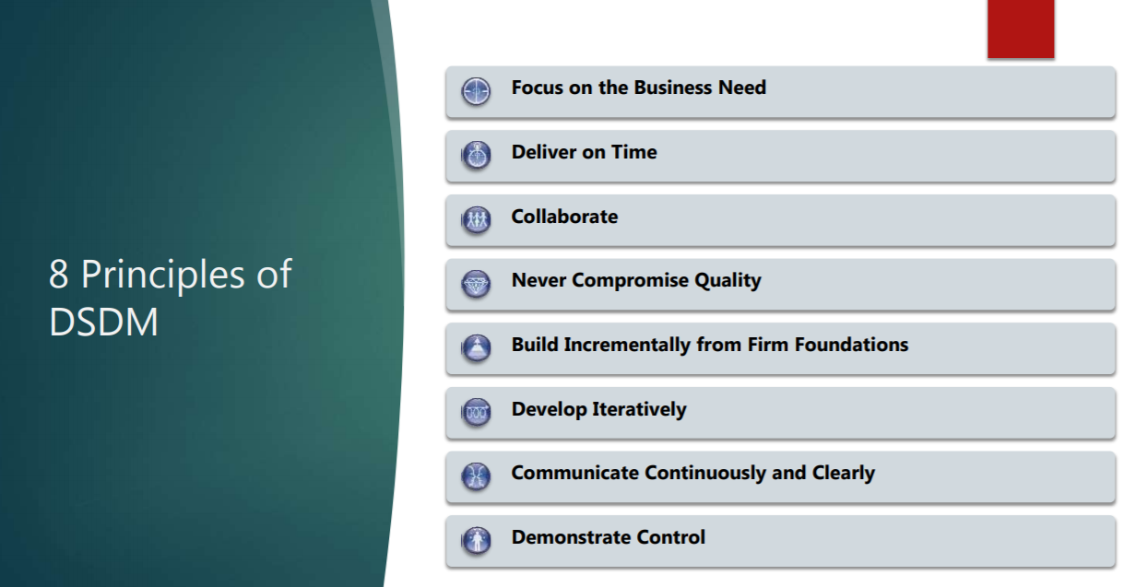
DSDM Principles

Slide 9
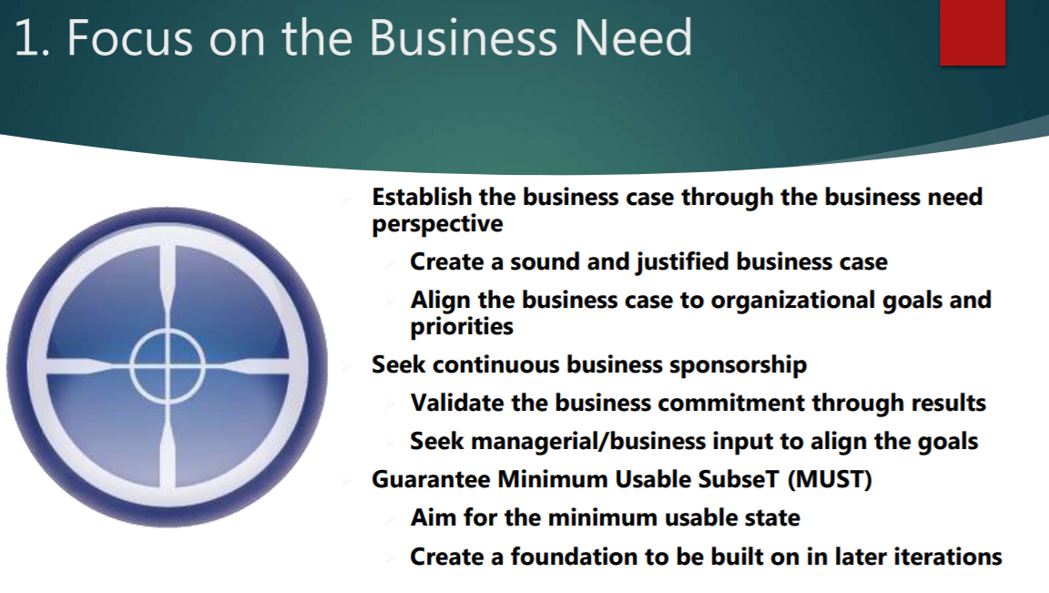
DSDM Principles

Slide 10
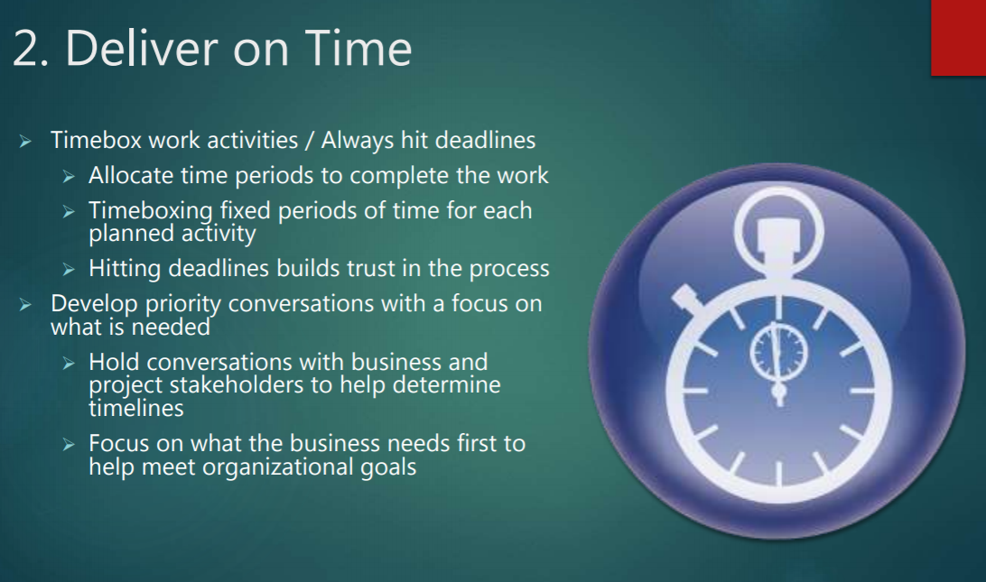
DSDM Principles

Slide 11
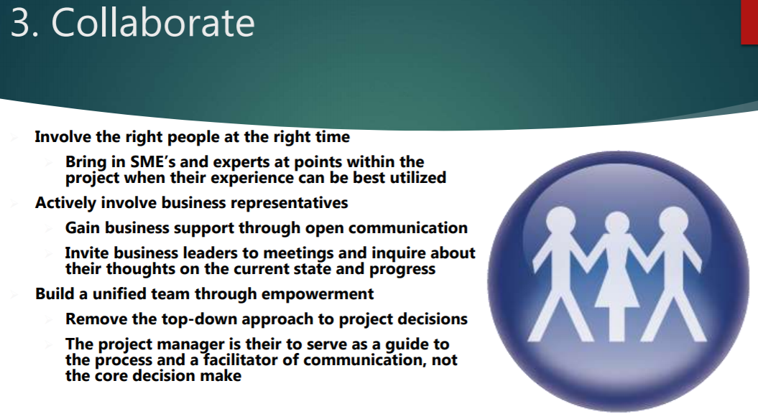
DSDM Principles

Slide 12
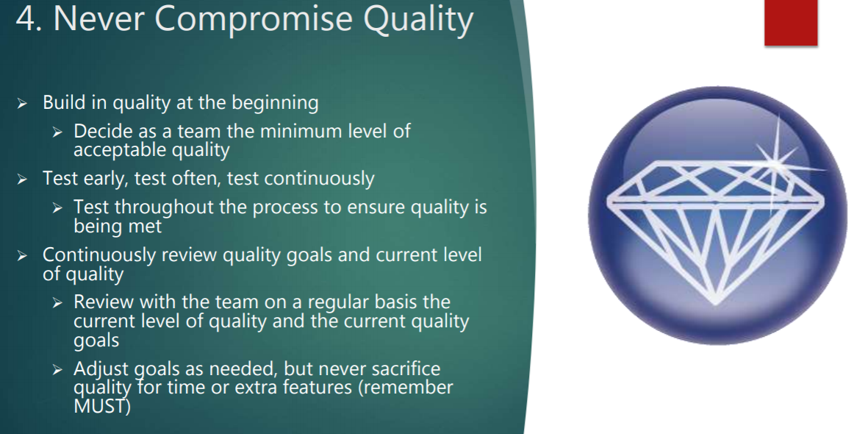
DSDM Principles

Slide 13
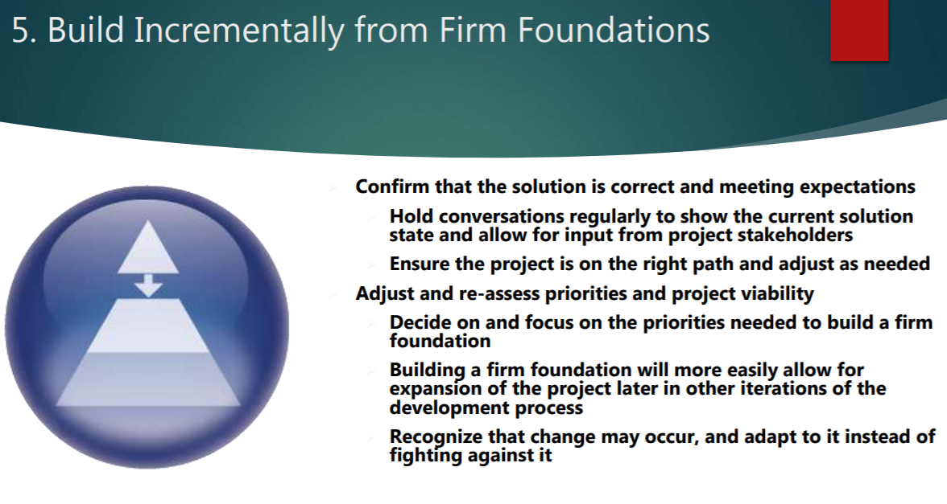
DSDM Principles

Slide 14
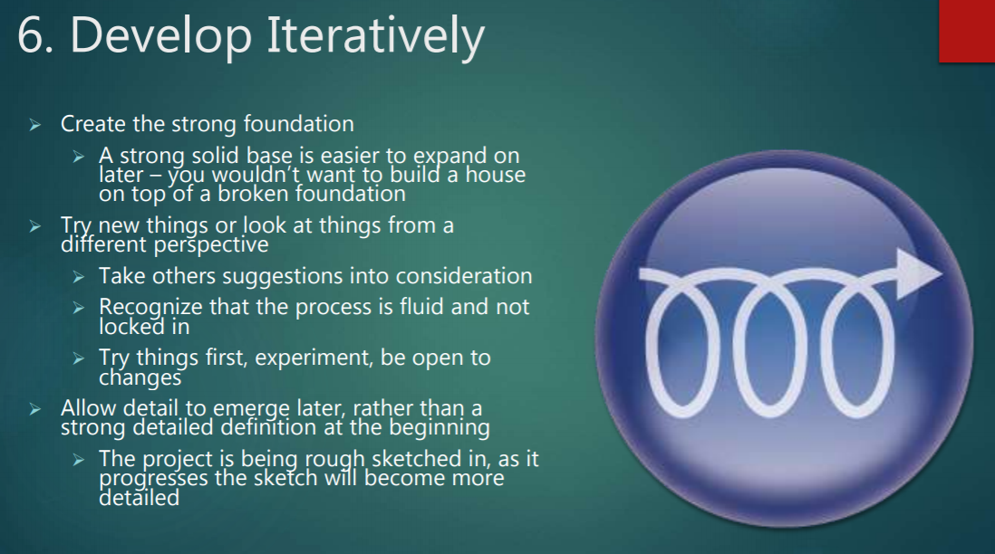
DSDM Principles

Slide 15
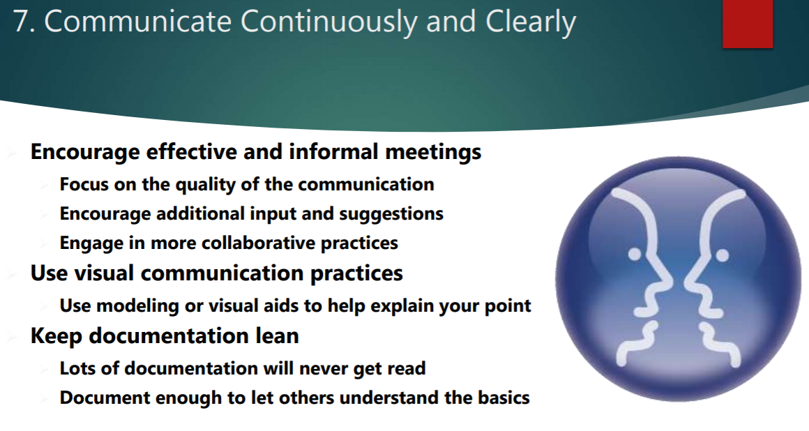
DSDM Principles

Slide 16
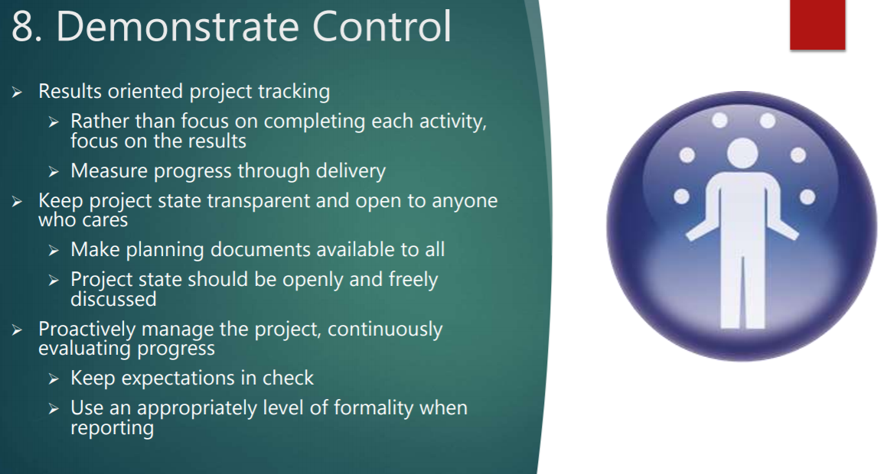
DSDM Principles

Slide 17
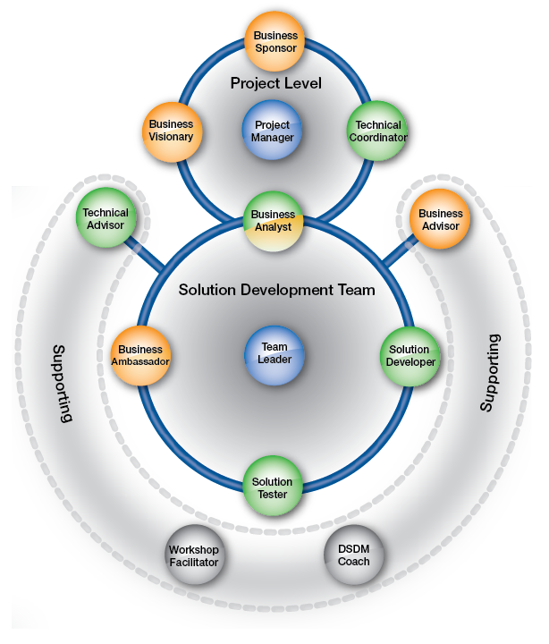
Roles in DSDM

Slide 18
Roles in DSDM
The roles within DSDM have more in common with a waterfall project than other major Agile approaches. If Agile is new, this could help provide a more comfortable transition and leave less open questions that revolve around a lighter framework.
Project Level
Business Sponsor
Business Visionary
Technical Coordinator
Project Manager
Solution Development Team Business Analyst Business Ambassador Solution Developer Solution Tester Team Leader
Supporting Technical Advisor Business Advisor Workshop Facilitator DSDM Coach

Slide 19
Roles in DSDM - Project Level
The Business Sponsor Is the senior project-level business role. He or she is the project champion and responsible for the business case and project budget. Their position should hold enough power within the organization so that they can help resolve business issues and make financial decisions.
The Business Visionary is meant to be very involved with the project, helping to create the business vision of the solution. They are required to help keep a single clear vision as the project moves forward.
The Technical Coordinator is the project’s technical authority. They work to ensure that the other technical roles work in a coordinated way. The Agile Business Consortium describes the role as providing “the glue that holds the technical aspects of the project together while advising on technical decisions and innovation.”
The Project Manager is tasked with providing an “Agile-style leadership”. This would make the Project Manager a servant-leader, not an authoritarian leader. A regular Agile Project Manager. The Project Manager should lead a self-empowered team using facilitation rather than a commanding approach to leadership.

Slide 20
Roles in DSDM - Solution Development Team (SDT)
The Business Analyst supports Project Level roles as part of the Solution Development Team. It is a relationship facilitation role, bridging gaps between the SDT and the Project Level and between the technical/solution developer roles and the business roles. They give guidance to the SDT to assist in solution development.
The Team Leader is a servant-leader for the SDT. They are tasked with ensuring goals are met and working with the team to coordinate solution development and delivery. This role will ideally be an elected role, chosen by members of the SDT, as such they may also be performing one of the other roles on the SDT.
The Business Ambassador represents the business needs within the SDT. They provide daily requirements to the team during Evolutionary Development, being the primary decision-maker for the business.

Slide 21
Roles in DSDM - Solution Development Team (SDT)
The Solution Developer translates the business requirements into a Solution Increment that meets the needs of the increment. This should be a full-time role dedicated exclusively to the project to help reduce risk and waste.
The Solution Tester is tasked with making sure the solution works, testing to the decided standards

Slide 22
Roles in DSDM - Support
The Business Advisor’s role is to help ensure the testing of the solution meets the business needs. They may be a Subject Matter Expert and/or a future user of the solution, or they may provide regulation and legal advice.
The Technical Advisor provides technical support for the solution. They may be responsible for operational changes, assisting with the release, or ongoing maintenance of the solution.
The Workshop Facilitator will manage the workshop process. They are responsible for organizing meetings that achieve a workshop objective.
The DSDM Coach is responsible for helping the team understand the DSDM approach. They are there to ensure that DSDM is followed and to help those outside the team understand the process. They provide the details of DSDM.

Slide 23
Reference and bibliography
https://www.agilebusiness.org/page/ProjectFramework_07_RolesResponsibilities
https://www.agilebusiness.org/page/ProjectFramework_10_MoSCoWPrioritisation
https://www.agilebusiness.org/content/introduction-0
https://www.agilebusiness.org/

