Slide 1

Kanban development
Deepak Vishwakarma

Slide 2
KANBAN
Kanban means “Visual Card” in Japanese.
Kanban is a method applying just-in-time delivery while not overloading the team members.
In Kanban, the process, from definition of a task to its delivery to the customer, is displayed for stakeholders to see.
Team members pull work from a queue when they have excess capacity.

Slide 3
Core of Kanban
Kanban Development is an approach to incremental, evolutionary process and systems change for organizations.
Teams practicing other methodologies can use Kanban to improve their existing processes.
Kanban has 2 core concepts:
Visualize the work
Limit the work in process

Slide 4
Visualizing the Work
Kanban teams use Kanban Boards to represent the work and workflow.
After visualizing the work, the stakeholders will be able to monitor the flow of work.
The bottlenecks in the flow are realized by the stakeholders.

Slide 5
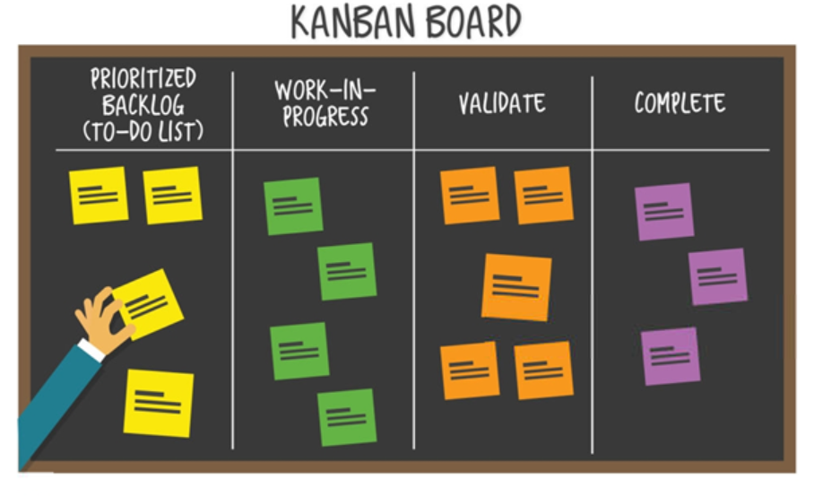
Visualizing the Work - Board

Slide 6
Limiting Work-in-Progress
Kanban limits work-in-progress to realize the bottlenecks, to stimulate collaboration, and to continuously improve the system.
By focusing on flow, Kanban emphasizes finishing work over starting new work.
Limiting the amount of work-in-progress prevents overproduction.
When there are too much unfinished work, stakeholders re-direct their attention to finishing and collaborate for unfinished work.

Slide 7
Guidelines of Kanban
Kanban has 9 guidelines:
4 basic principles
5 core properties.
The principles motivate you how you should think, whereas the properties motivate you how you should do.

Slide 8
4 Basic Principles
Start with Existing Process
Agree to Pursue Incremental, Evolutionary Change
Respect the Current Process, Roles, Responsibilities and Titles
Leadership at all Levels

Slide 9
5 Core Properties
Visualize the Workflow
Limit Work-in-Progress
Measure and Manage Flow
Make Process Policies Explicit
Search and Apply Improvement Opportunities

Slide 10
Kanban Development Lifecycle
Kanban Software Development is the application of Kanban principles to software development.
Steps
Flexibility in Planning
Minimizing Cycle Time
Efficiency Through Focus
Making Metrics Visual
Moving Toward Continuous Delivery

Slide 11
Benefits of Kanban
Kanban delivers features faster by shortening cycle times.
Kanban is responsive to change.
Where priorities change very frequently, Kanban is ideal.
Kanban can be started with a few changes in the environment.
Kanban reduces waste in the system.

Slide 12
Reference and bibliography
https://medium.com/swlh/being-agile-kanban-vs-scrum-ef4a8b6f892d

