Slide 1
CYBER GYAN VIRTUAL INTERNSHIP PROGRAM Centre for Development of Advanced Computing (CDAC), Noida
Submitted By:
Tanisha Prakash
Project Trainee, (May-June) 2024

Slide 2
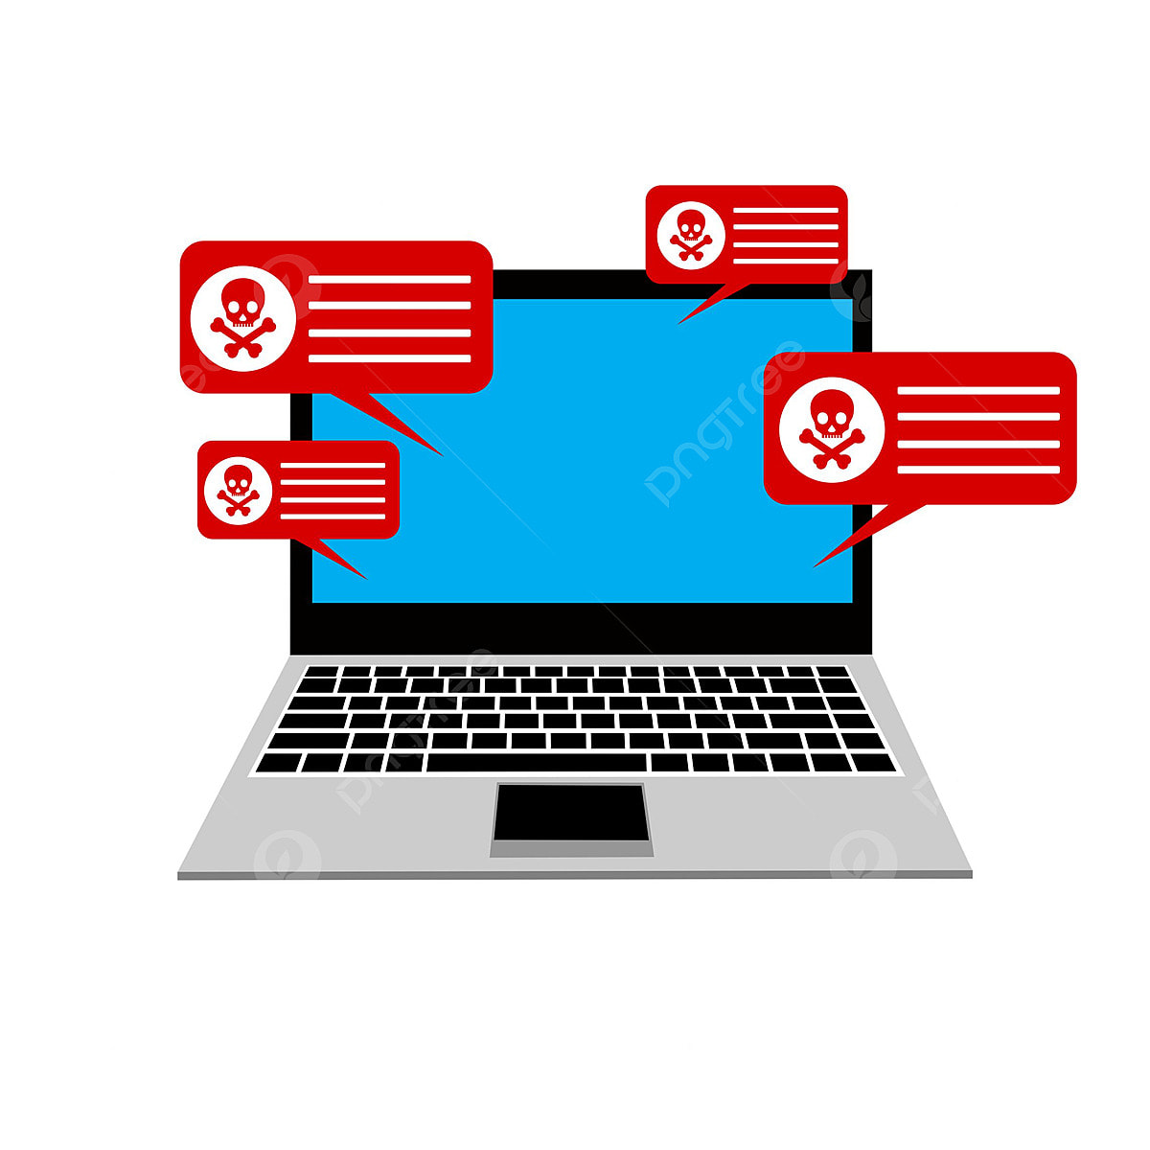
TOPIC NAME
BUILDING A RANSOMWARE SIMULATOR

Slide 3

PROBLEM STATEMENT
Building a Ransomware Simulator: Design, build & encrypts a test file and displays a ransom message on VM. The project aims to develop a program that mimics the behaviour of ransomware, but without causing any actual harm. The program will simulate the encryption process, displaying a ransom note, and potentially disabling functionalities to test security measures and user awareness.

Slide 4
TECHNOLOGY/TOOLS TO BE USED
Creating a ransomware simulator involves using various tools and technologies to mimic the behaviour of real ransomware while ensuring no actual harm is caused to the user's data. Here are some tools and technologies used in this project:
Programming language:
- Python is used due to its simplicity and powerful libraries for file manipulation, encryption, and GUI development.
Frameworks and Libraries:
- Cryptography library: PyCryptodome (Python library) provides cryptographic functions including encryption and decryption.
-File Manipulation Libraries: os and shutil (Python library) are used for file and directory operations like renaming and moving files.
-GUI Development: Tkinter (Python library)
-Image Processing: Pillow (Python library) is used to add image processing capabilities.
Tools:
-Development Environment: Visual Studio Code

Slide 5
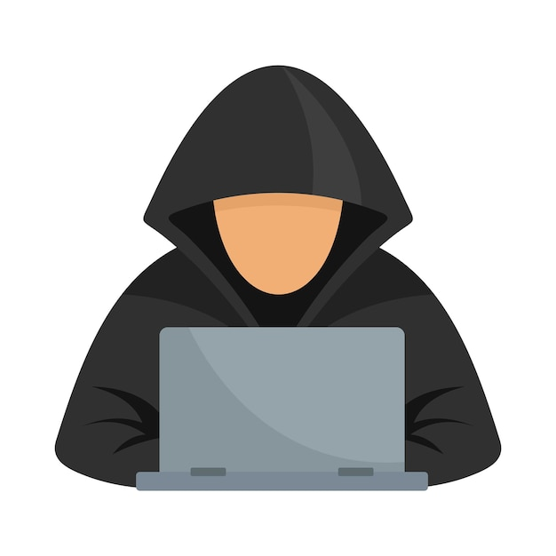
WHAT IS RANSOMWARE?
Ransomware is malware that employs encryption to hold a victim’s information at ransom. A user or organization’s critical data is encrypted so that they cannot access files, databases, or applications. A ransom is then demanded to provide access.
Ransomware is often designed to spread across a network and target database and file servers, and can thus quickly paralyze an entire organization.
It is a growing threat, generating billions of dollars in payments to cybercriminals and inflicting significant damage and expenses for businesses and governmental organizations.

Slide 6
TYPES OF RANSOMWARE
The most common types of ransomware include:
Crypto Ransomware or Encryptors : Encyrptors are one of the most well-known and damaging variants. This type encrypts the files and data within a system, making the content inaccessible without a decryption key.
Lockers : Lockers completely lock you out of your system, so your files and applications are inaccessible. A lock screen displays the ransom demand, possibly with a countdown clock to increase urgency and drive victims to act.
Scareware : Scareware is fake software that claims to have detected a virus or other issue on your computer and directs you to pay to resolve the problem. Some types of scareware lock the computer, while others simply flood the screen with pop-up alerts without actually damaging files.
Doxware or Leakware : Leakware threatens to distribute sensitive personal or company information online, and many people panic and pay the ransom to prevent private data from falling into the wrong hands or entering the public domain. One variation is police-themed ransomware, which claims to be law enforcement and warns that illegal online activity has been detected, but jail time can be avoided by paying a fine.
RaaS (Ransomware as a Service) : Raas refers to malware hosted anonymously by a “professional” hacker that handles all aspects of the attack, from distributing ransomware to collecting payments and restoring access, in return for a cut of the loot.

Slide 7
RANSOMWARE ATTACK SIMULATION
The typical workflow of a ransomware attack is described below:
Initial Infection:
Victim Acquires Ransomware: The process begins when the victim unknowingly acquires ransomware through various methods such as email attachments, exploit kits, or malicious links. This can occur via phishing emails, drive-by downloads, or other forms of social engineering attacks.
Contacting Command-and-Control (C&C) Server:
Ransomware Contacts Attacker’s C&C Server: Once the ransomware is executed on the victim's machine, it initiates communication with the attacker's Command-and-Control (C&C) server. This server acts as the control hub for the ransomware.
Downloading Public Key: The ransomware downloads a public key from the C&C server. This key will be used to encrypt the victim's data.
Data Encryption and Ransom Note:
Data Encryption: Using the downloaded public key, the ransomware begins encrypting files on the victim's system, rendering them inaccessible without the corresponding private key.
Ransom Note: After the data is encrypted, the ransomware displays a ransom note on the victim's screen. This note provides instructions on how to pay the ransom (typically in cryptocurrency like Bitcoin) in order to receive the private key needed to decrypt the data.
Ransom Payment and Decryption:
Ransom Payment: The victim is instructed to pay the ransom amount to a specified cryptocurrency wallet.
Private Key Delivery: After the ransom is paid, the attacker sends the private key to the victim. This key can be used to decrypt the encrypted data, restoring access to the victim’s files.

Slide 8
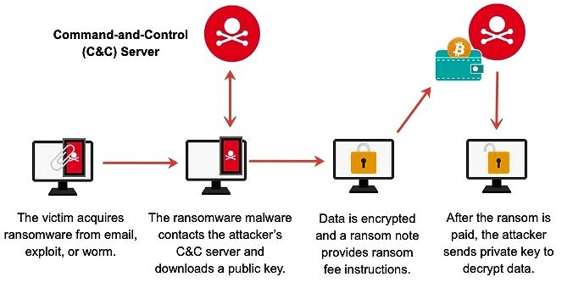

Slide 9
WHY RANSOMWARE ATTACKS ARE SPREADING?
Ransomware attacks and their variants are rapidly evolving to counter preventive technologies for several reasons:
Easy availability of malware kits that can be used to create new malware samples on demand
Use of known good generic interpreters to create cross-platform ransomware (for example, Ransom32 uses Node.js with a JavaScript payload).
Use of new techniques, such as encrypting the complete disk instead of selected files.
Today’s thieves don’t even have to be tech savvy. Ransomware marketplaces have sprouted up online, offering malware strains for any would-be cybercrook and generating extra profit for the malware authors, who often ask for a cut in the ransom proceeds.

Slide 10
HOW TO PREVENT RANSOMWARE ATTACKS?
Back Up Your Data: Regularly back up your files to the cloud and an external hard drive. If infected, you can restore your system from these backups.
Secure Your Backups: Ensure backups are not accessible from the systems they are backing up to prevent ransomware from encrypting or deleting them.
Use Security Software: Protect all devices with comprehensive security software and keep it updated to patch vulnerabilities.
Practice Safe Surfing: Be cautious with emails, texts, and downloads. Only interact with trusted sources to avoid social engineering attacks.
Use Secure Networks: Avoid public Wi-Fi. Use a VPN for secure internet connections wherever you are.
Stay Informed: Keep up with the latest ransomware threats and available decryption tools.
Implement Security Awareness: Regularly train and test your organization on security practices to avoid phishing and social engineering attacks.

Slide 11
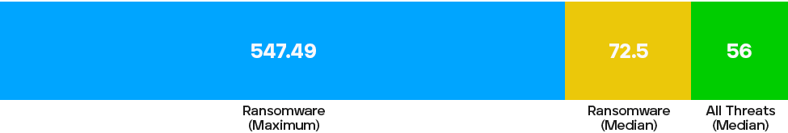
Median Dwell Time for Ransomware Attacks (in Days)
The median dwell time for ransomware attacks is 72.75 days, in comparison to all threats at 56 days (including ransomware).

Slide 12
THANKYOU

