Slide 1

Software Engineering Damir Dobric / Andreas Pech
Presentation on
ML-25-26-05-Python-Code-Tool-Interpreter-for-Chart-Creation
Team Name: FileForge
Date: 29/03/2026
Md Sohel Rana Matriculation Number: 1428128 sohel.rana@stud.fra-uas.de | Md Ashiqur Rahman Matriculation Number: 1393169 md.rahman3@stud.fra-uas.de
M.Eng. Information Technology WS25-26 / Damir Dobric & Andreas Pech / Module Software Engineering

Slide 2
AGENDA
Project Overview
System Architecture
01
Overall basic discussion on the challenges and the solution.
02
How the pieces fit together from request to rendered chart.
Security Pipeline
Orchestration Layer
03
Discussion on how secure the generated code.
04
The system maintains a secure orchestration layer.
Technology Stack
Performance Measure
05
List of technologies we have used to build the project.
06
How good this systems works.
Codebase Review
Conclusion
07
Review the real codebase and run the project.
08
Summary of the project.
M.Eng. Information Technology WS25-26 / Damir Dobric & Andreas Pech / Module Software Engineering

Slide 3
PROJECT OVERVIEW
The Challenge
Writing code to generate chart from scratch takes time and doing it repeatedly is tedious. As well as people from different background doesn’t have idea about coding. LLMs can write the code but running untrusted AI output directly is a real security risk, and there was no good middle ground.
Our Solution
We built a conversational agent on top of LLM and the Microsoft Agent Framework. You describe the chart you want, and the system takes care of the rest. Writing the script, checking it for safety, running it in isolation, and getting smarter each time something goes wrong.
M.Eng. Information Technology WS25-26/ Damir Dobric & Andreas Pech/ Module Software Engineering

Slide 4
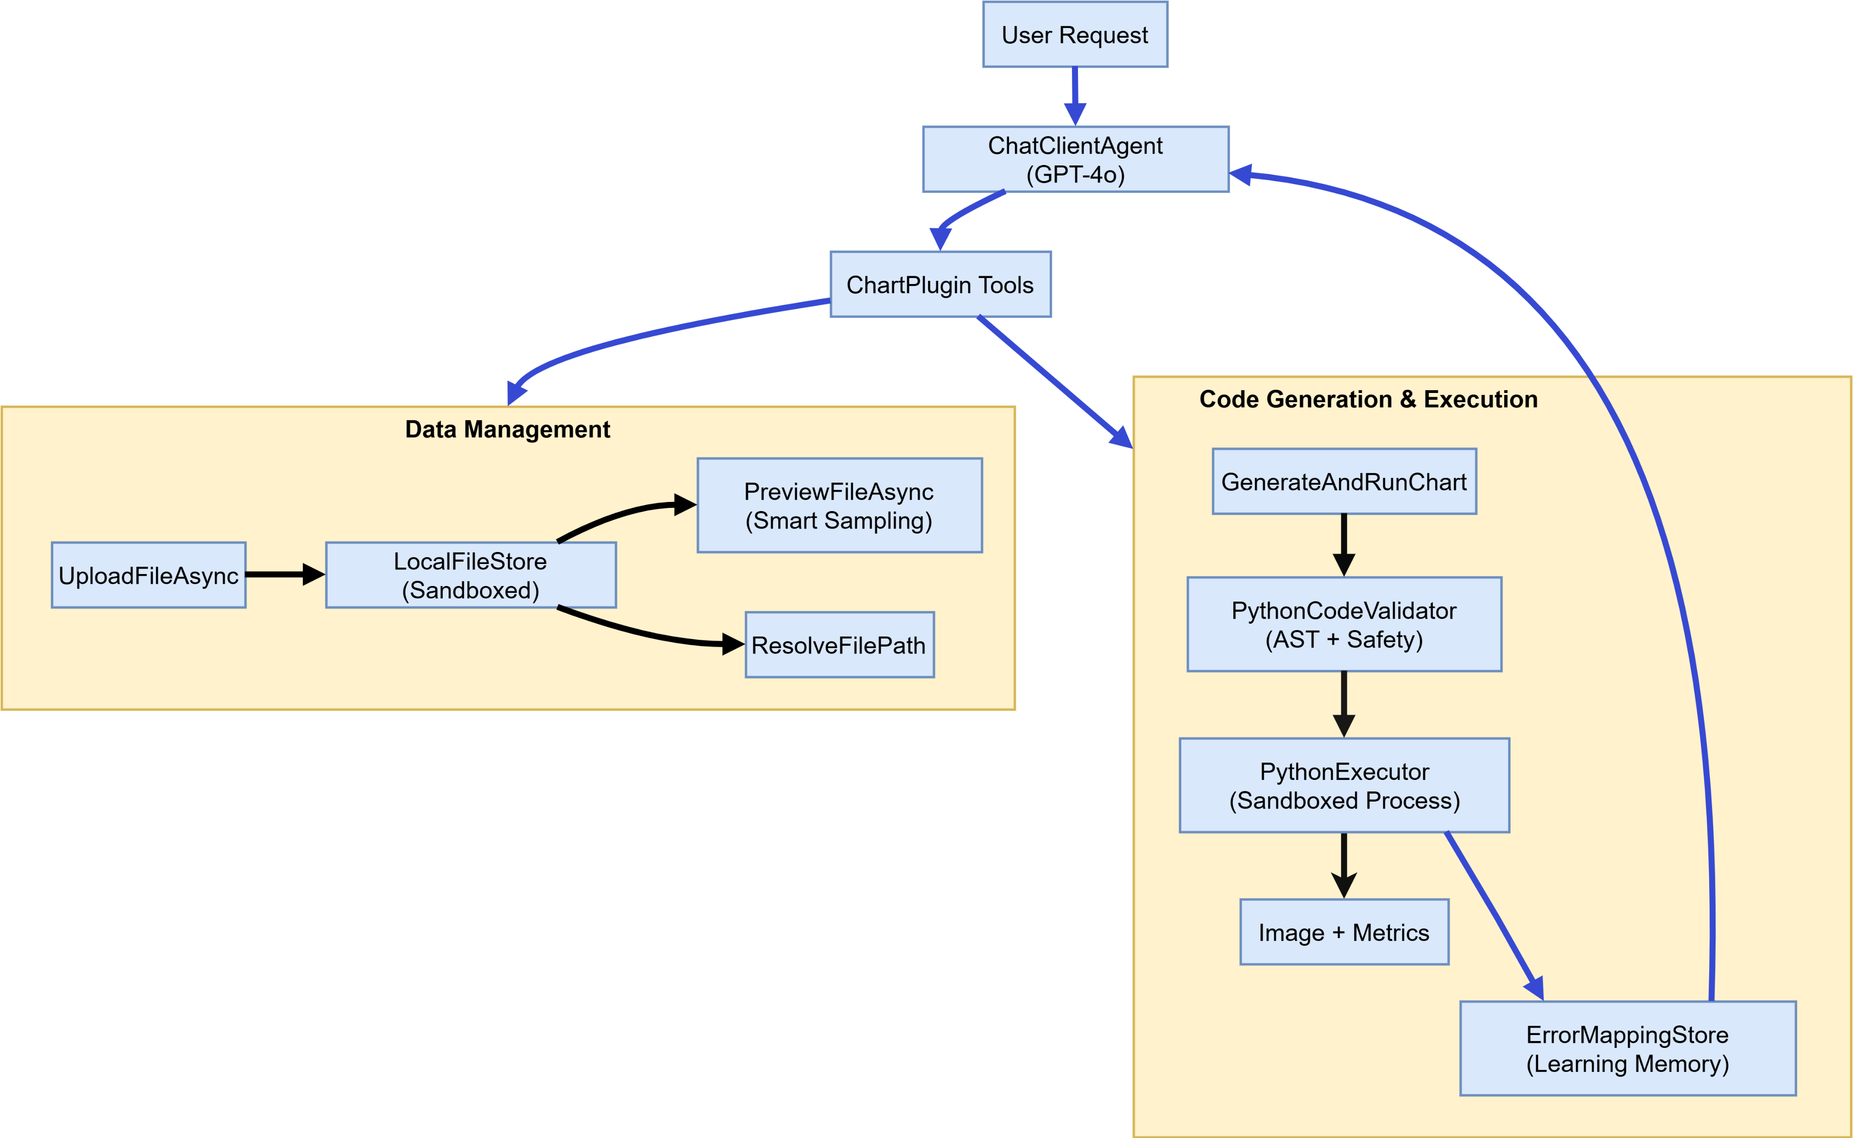
SYSTEM ARCHITECTURE
M.Eng. Information Technology WS25-26/ Damir Dobric & Andreas Pech/ Module Software Engineering

Slide 5
SYSTEM ARCHITECTURE
Data Management
UploadFileAsync stores files in an isolated sandbox folder
PreviewFileAsync reads schema without loading the whole file
DatasetAnalyzer infers column types and value ranges
PathSafety blocks traversal attacks and name injection
Code Generation
GPT-4o authors the full matplotlib script from the schema
PythonCodeValidator screens code before it ever runs
PythonExecutor launches the script in a child process
ChartManifest logs every run with timing and memory use
Error Mapping
ErrorMappingStore classifies failures into 6 categories
Each failure gets summarized and prepended to the next call
Prevents repeating column-name and type errors already seen
The agent gets better with every run — no retraining needed
M.Eng. Information Technology WS25-26/ Damir Dobric & Andreas Pech/ Module Software Engineering

Slide 6
SYSTEM ARCHITECTURE
ERRORMAPPING STORE - 6 Error Categories
ColumnNotFound
TypeError
SyntaxError
ImportError
RuntimeError
ValidationError
M.Eng. Information Technology WS25-26/ Damir Dobric & Andreas Pech/ Module Software Engineering

Slide 7
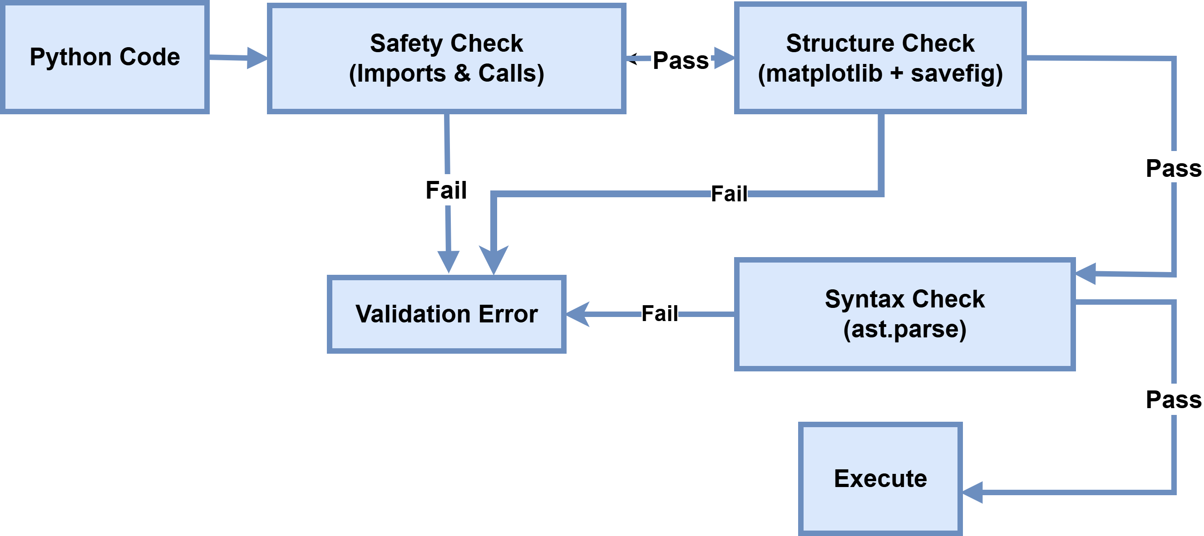
SECURITY PIPELINE
01
Safety Check
Blocks dangerous imports (`os`, `subprocess`) and functions (`eval`, `exec`)
02
Structure Check
Ensures `matplotlib` uses the background `Agg` engine and saves the file correctly.
03
Syntax Check
Validates structure via Python Abstract Syntax Tree (AST) parsing.
04
Execution Sandbox
Runs the script in an isolated directory with forced Memory Limits and Network Blocking
M.Eng. Information Technology WS25-26/ Damir Dobric & Andreas Pech/ Module Software Engineering

Slide 8
ORCHESTRATION LAYER
Core:
C# 13 / .NET 10 hosting a ChatClientAgent (GPT-4o).
Agent Tools:
7 callable tools (Upload, Preview, Read, Execute) exposed via `ChartPlugin`.
Data Flow:
Natural Language ➔ Tool Selection ➔ Code Generation ➔ Validation ➔ Sandboxed Execution.
M.Eng. Information Technology WS25-26/ Damir Dobric & Andreas Pech/ Module Software Engineering

Slide 9
ORCHESTRATION LAYER
AGENT TOOLS
01
UploadFileAsync
05
ResolveFilePath
Moves a local file into the sandboxed workspace and assigns it a safe alias
Resolves an alias to its full file-system path for use inside Python scripts
02
ListFiles
06
ListGeneratedCharts
Returns the current file inventory, with optional keyword filtering
Lists every chart produced so far, with execution time and memory figures
03
DeleteFiles
07
GenerateAndRunChart
Clears one or more files from the workspace by name or pattern
Runs the generated script through three validation checks, then executes it in isolation
04
PreviewFileAsync
Reads schema, row count, column types, and value ranges without loading the whole file
M.Eng. Information Technology WS25-26/ Damir Dobric & Andreas Pech/ Module Software Engineering

Slide 10
ORCHESTRATION LAYER
DATA FLOW
Natural Language
Tool Selection
Code Generation
Validation
Sandbox Execution
M.Eng. Information Technology WS25-26/ Damir Dobric & Andreas Pech/ Module Software Engineering

Slide 11
TECHNOLOGY STACK
Runtime
AL / LLM
Python
Testing
Storage
.NET 10 SDK
OpenAI GPT-4o
matplotlib
MS Test
Local filesystem
C# 13
Microsoft.Extensions.AI
pandas
Moq 4.20
IStorageStore (extensible)
Microsoft.Agents.AI
numpy
42 unit tests
Python ≥ 3.8
M.Eng. Information Technology WS25-26/ Damir Dobric & Andreas Pech/ Module Software Engineering

Slide 12
MEASURED PERFORMANCE
Scenario | File Size | Execution Time | Peak Memory
Simple inline data chart | N/A | 800-1200ms | 35-50 MB
CSV (<1 MB) | 500 KB | 1200-1800ms | 60-80 MB
CSV (10 MB) | 10 MB | 2500-3500ms | 150-200 MB
CSV (100 MB, sampled) | 100 MB | 4000-6000ms | 300-400 MB
Multi-chart (3 charts) | 1 MB each | 4000-6000ms | 100-150 MB
M.Eng. Information Technology WS25-26/ Damir Dobric & Andreas Pech/ Module Software Engineering

Slide 13
CODE BASE REVIEW & RUN & USE
M.Eng. Information Technology WS25-26/ Damir Dobric & Andreas Pech/ Module Software Engineering

Slide 14
CONCLUSION
Summary of Achievements
Successfully combined LLM based code generation with secure local data processing
Built a resilient agent capable of handling diverse and massive datasets without crashing.
Delivered a clean, extensible, and thoroughly tested codebase perfectly aligned with the course objectives.
Future Work
Persistent Cross-Session Learning: Persist ErrorMappingStore entries to a SQLite database. The agent accumulates error patterns over its full operational lifetime rather than resetting on each new session.
Cloud Object Storage Integration: Implement the Storage interface for Cloud. Enables datasets that exceed local disk capacity or reside in organizational data lakes.
Extended Visualization Libraries: Delivering interactive charts and a broader range of professional visualization types.
M.Eng. Information Technology WS25-26/ Damir Dobric & Andreas Pech/ Module Software Engineering

Slide 15
Thank You
M.Eng. Information Technology WS25-26/ Damir Dobric & Andreas Pech/ Module Software Engineering

