Slide 1

Project 2 Regression Analysis
Group Member
Dalia Heitham Yousif (3019136)
Ishrat Jahan (3001900)
Md Mozahidul Islam (3022958)
Ashiq Hasan (3023634)
Frei verwendbar
Notes:
Hello Everyone, As a group we took the project 2 (Regression Analysis) as our work .Here is a small presentation of what we did ,hope you like it. Thanks

Slide 2
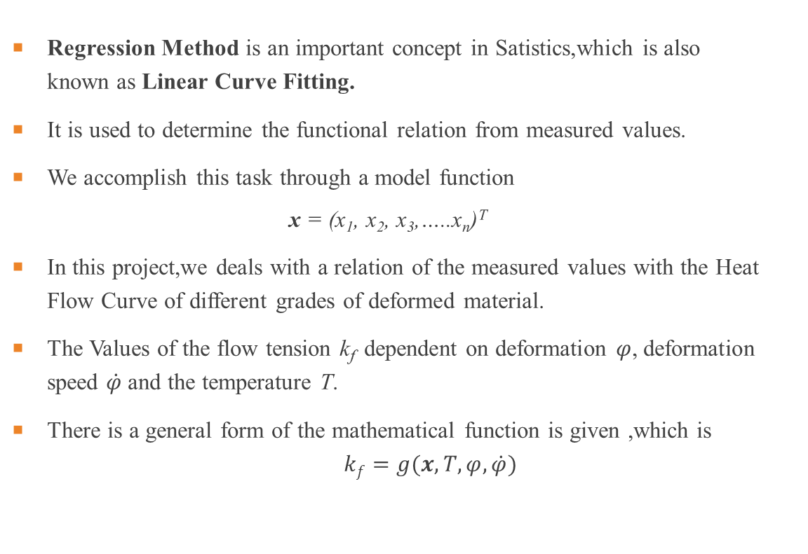
Introduction
Regression Method is an important concept in Satistics,which is also known as Linear Curve Fitting.
It is used to determine the functional relation from measured values.
We accomplish this task through a model function
$$\text{x} \text{= (}\text{x}\text{1}\text{, }\text{x}\text{2}\text{, }\text{x}\text{3}\text{,…..}\text{xn}\text{)}\text{T}$$
In this project,we deals with a relation of the measured values with the Heat Flow Curve of different grades of deformed material.
The Values of the flow tension k_{f} dependent on deformation $φ$, deformation speed $\dot{φ}$and the temperature T.
There is a general form of the mathematical function is given ,which is $kf=g(x,T,φ,\dot{φ})$

Slide 3
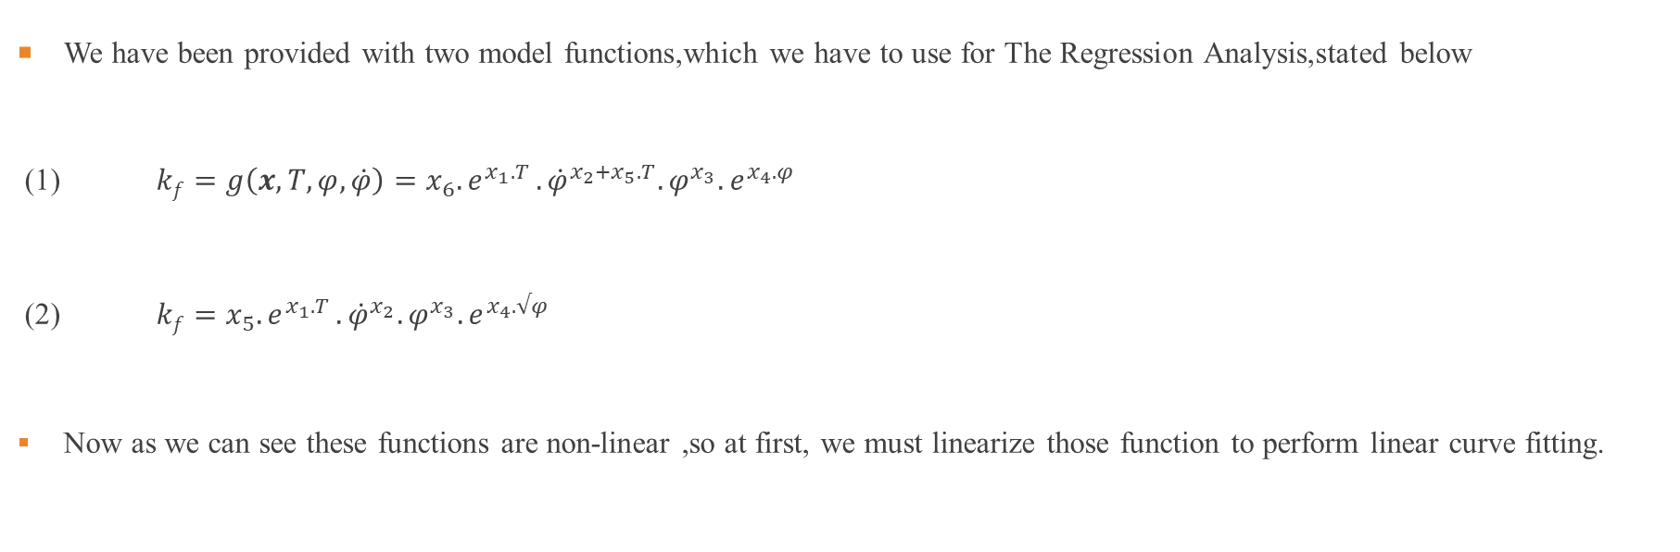
Given Non-Linear Model functions
We have been provided with two model functions,which we have to use for The Regression Analysis,stated below
(1) $kf=g\left(x,T,φ,\dot{φ}\right)=x_{6}{.e}^{x_{1}.T}.{\dot{φ}}^{x_{2}+x_{5}.T}.φ^{x_{3}}.e^{x_{4}.φ}$
(2) $kf=x_{5}{.e}^{x_{1}.T}.{\dot{φ}}^{x_{2}}.φ^{x_{3}}.e^{x_{4}.√φ}$
Now as we can see these functions are non-linear ,so at first, we must linearize those function to perform linear curve fitting.

Slide 4
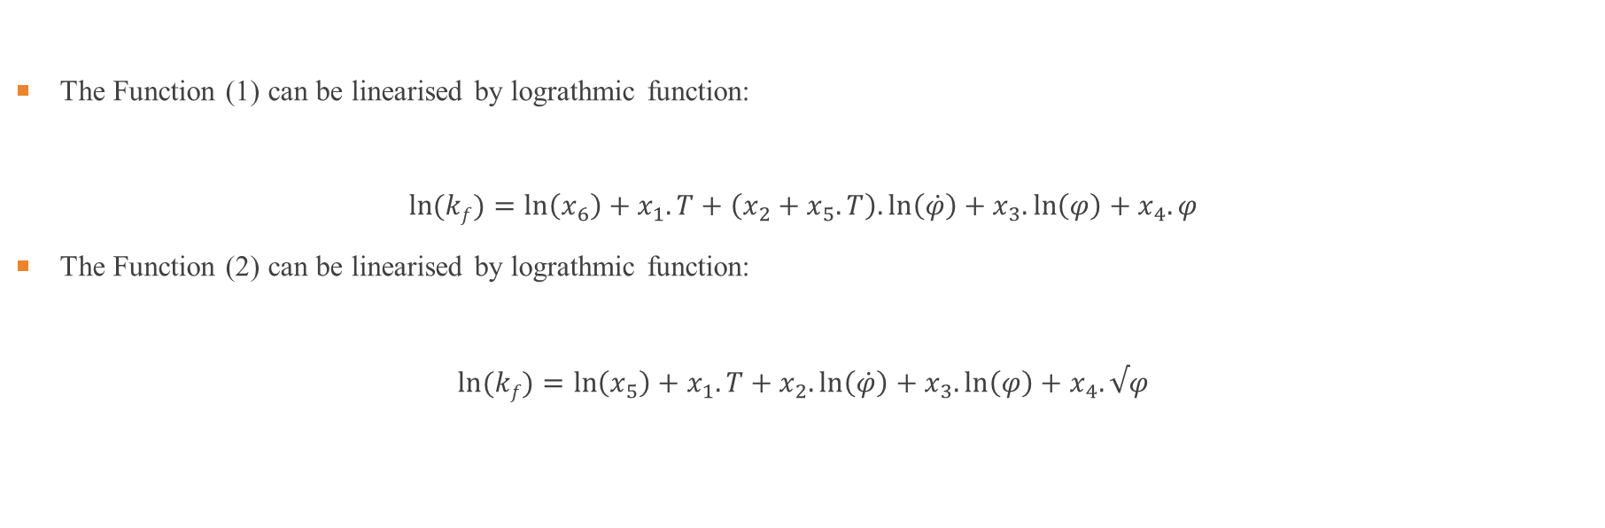
Linearisation of Model functions
The Function (1) can be linearised by lograthmic function:
$$\ln{(kf)}=\ln\left(x_{6}\right)+x_{1}.T+\left(x_{2}+x_{5}.T\right).\ln\left(\dot{φ}\right)+x_{3}.\ln\left(φ\right)+x_{4}.φ$$
The Function (2) can be linearised by lograthmic function:
$$\ln{(kf)}=\ln\left(x_{5}\right)+x_{1}.T+x_{2}.\ln\left(\dot{φ}\right)+x_{3}.\ln\left(φ\right)+x_{4}.√φ$$

Slide 5
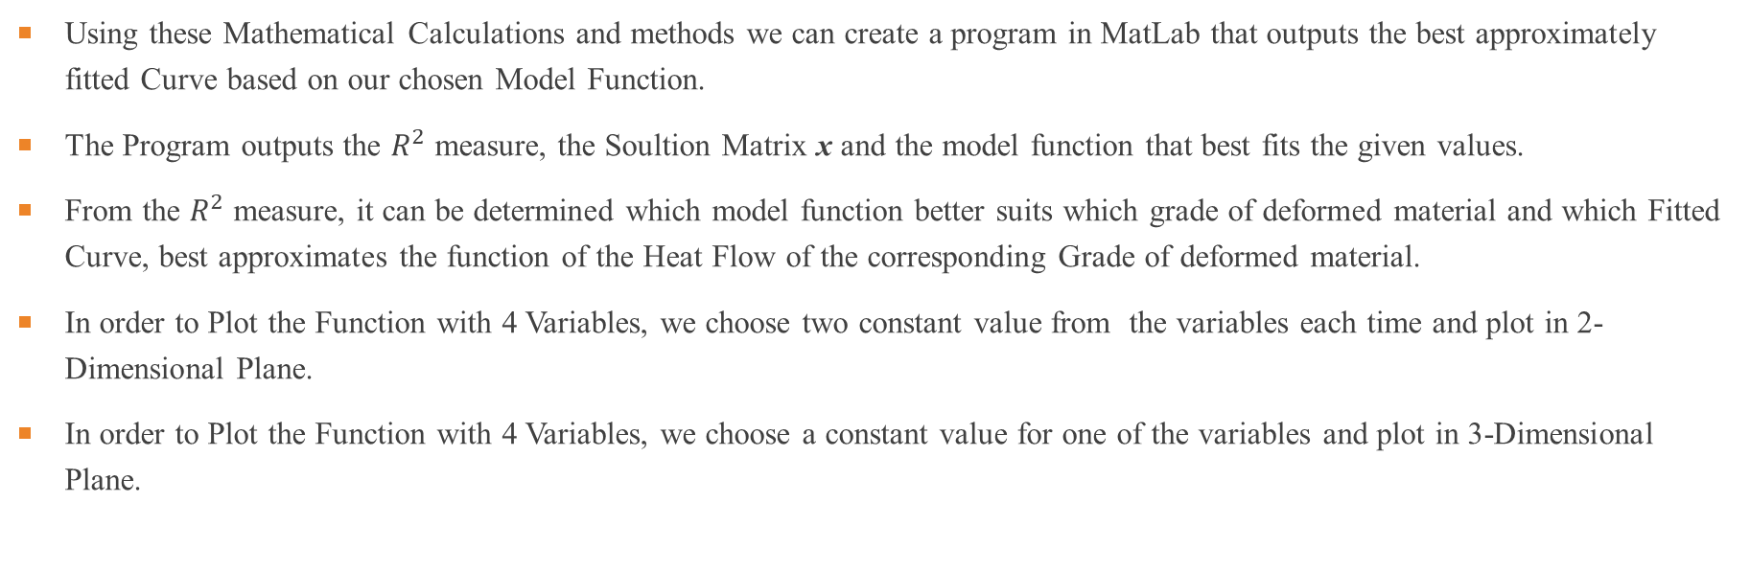
Matlab
Using these Mathematical Calculations and methods we can create a program in MatLab that outputs the best approximately fitted Curve based on our chosen Model Function.
The Program outputs the $R^{2}$ measure, the Soultion Matrix x and the model function that best fits the given values.
From the $R^{2}$ measure, it can be determined which model function better suits which grade of deformed material and which Fitted Curve, best approximates the function of the Heat Flow of the corresponding Grade of deformed material.
In order to Plot the Function with 4 Variables, we choose two constant value from the variables each time and plot in 2-Dimensional Plane.
In order to Plot the Function with 4 Variables, we choose a constant value for one of the variables and plot in 3-Dimensional Plane.

Slide 6
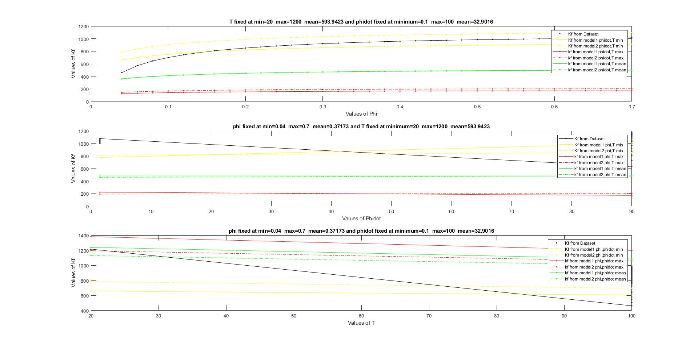

Graphical Results-100Cr6 (2D)
Here is the graphical result of measured values for the 100Cr6 in 2-Dimension.
The black lines is for the $kf$ from database ,all straight line is for Model 1 and all dotted line is for model 2.The yellow line is when variable are fixed at min ,red is when variable are fixed at max and green when variable are fixed at mean.
We determined 3 graph where first one T and phidot were fixed ,second one phi and T were fixed and the third one phi and phitdot were fixed.

Slide 7
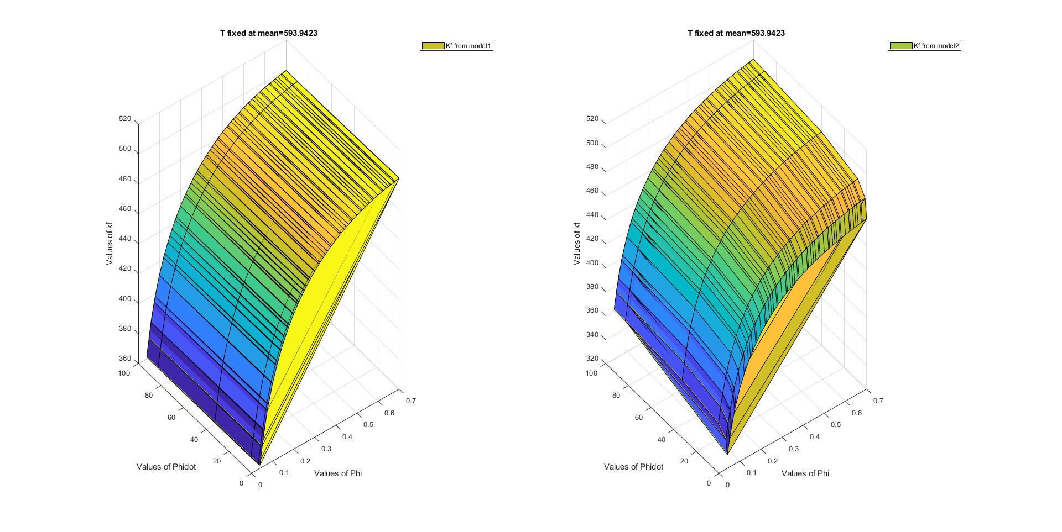
Graphical Results-100Cr6 (3D) T MEAN
Here is the graphical result of measured values for the 100Cr6 in 3-Dimension.
We measured the value while T fixed at mean.
In the left side we got the graph for model 1 and right side for model 2.

Slide 8
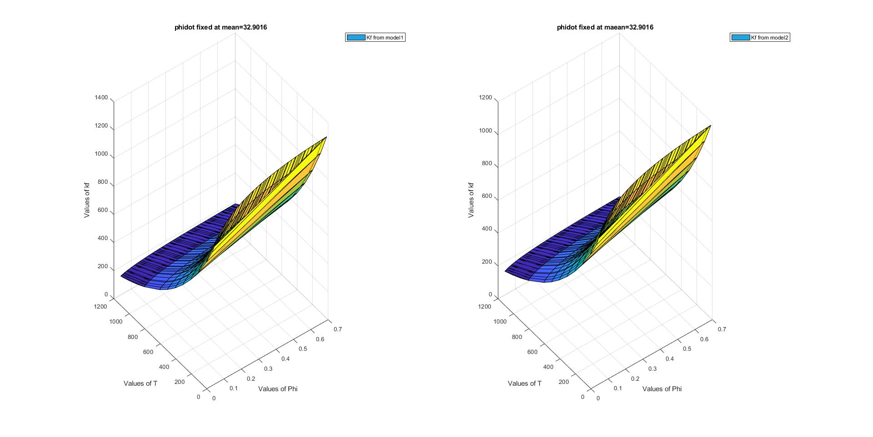
Graphical Results-100Cr6 (3D) phidot mean
Here is the graphical result of measured values for the 100Cr6 in 3-Dimension.
We measured the value while PHIDOT fixed at mean.
In the left side we got the graph for model 1 and right side for model 2.

Slide 9
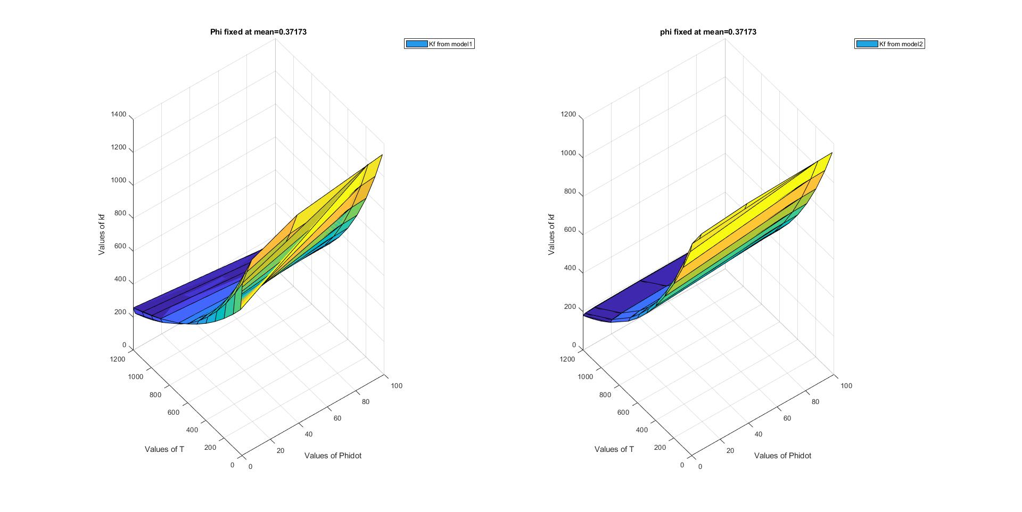
Graphical Results-100Cr6 (3D) phi Mean
Here is the graphical result of measured values for the 100Cr6 in 3-Dimension.
We measured the value while PHI fixed at mean.
In the left side we got the graph for model 1 and right side for model 2.

Slide 10


Results-100Cr6
Model 1
Model 2
RSquared: 0.6145
Transformed parameters for the non linear model function:
x1 = -0.0013
x2 = 0.0623
x3 = 0.1520
x4 = -0.1681
x5 = -0.0001
x6 = exp( 7.1509)=1275.25
$$kf=g\left(x,T,φ,\dot{φ}\right)=(1275.25){.e}^{(−0.0013).T}.{\dot{φ}}^{(0.0623+(−0.0001)).T}.φ^{(0.1520)}.e^{(−0.1681).φ}$$
RSquared: 0.6003
Transformed parameters for the non linear model function:
x1 = -0.0015
x2 = 0.0125
x3 = 0.2023
x4 = -0.3873
x5 = exp(7.4531)=1725.20
$$kf=(1725.20{).e}^{(−0.0015).T}.{\dot{φ}}^{(0.0125)}.φ^{(0.2023)}.e^{(−0.3873).√φ}$$

Slide 11
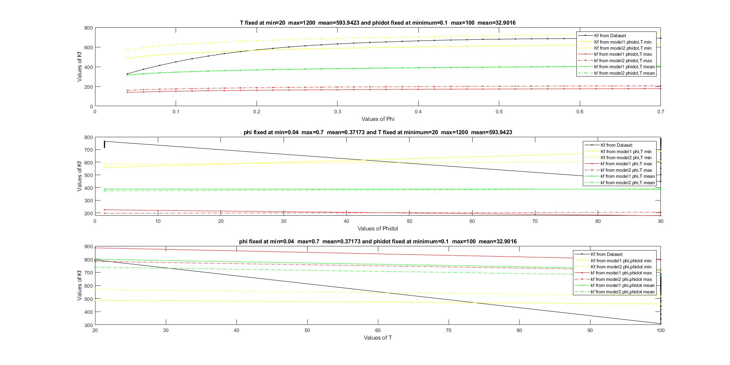

Graphical Results-C15 (2D)
Here is the graphical result of measured values for the C15 in 2-Dimension.
The black lines is for the $kf$ from database ,all straight line is for Model 1 and all dotted line is for model 2.The yellow line is when variable are fixed at min ,red is when variable are fixed at max and green when variable are fixed at mean.
We determined 3 graph where first one T and phidot were fixed ,second one phi and T were fixed and the third one phi and phitdot were fixed.

Slide 12
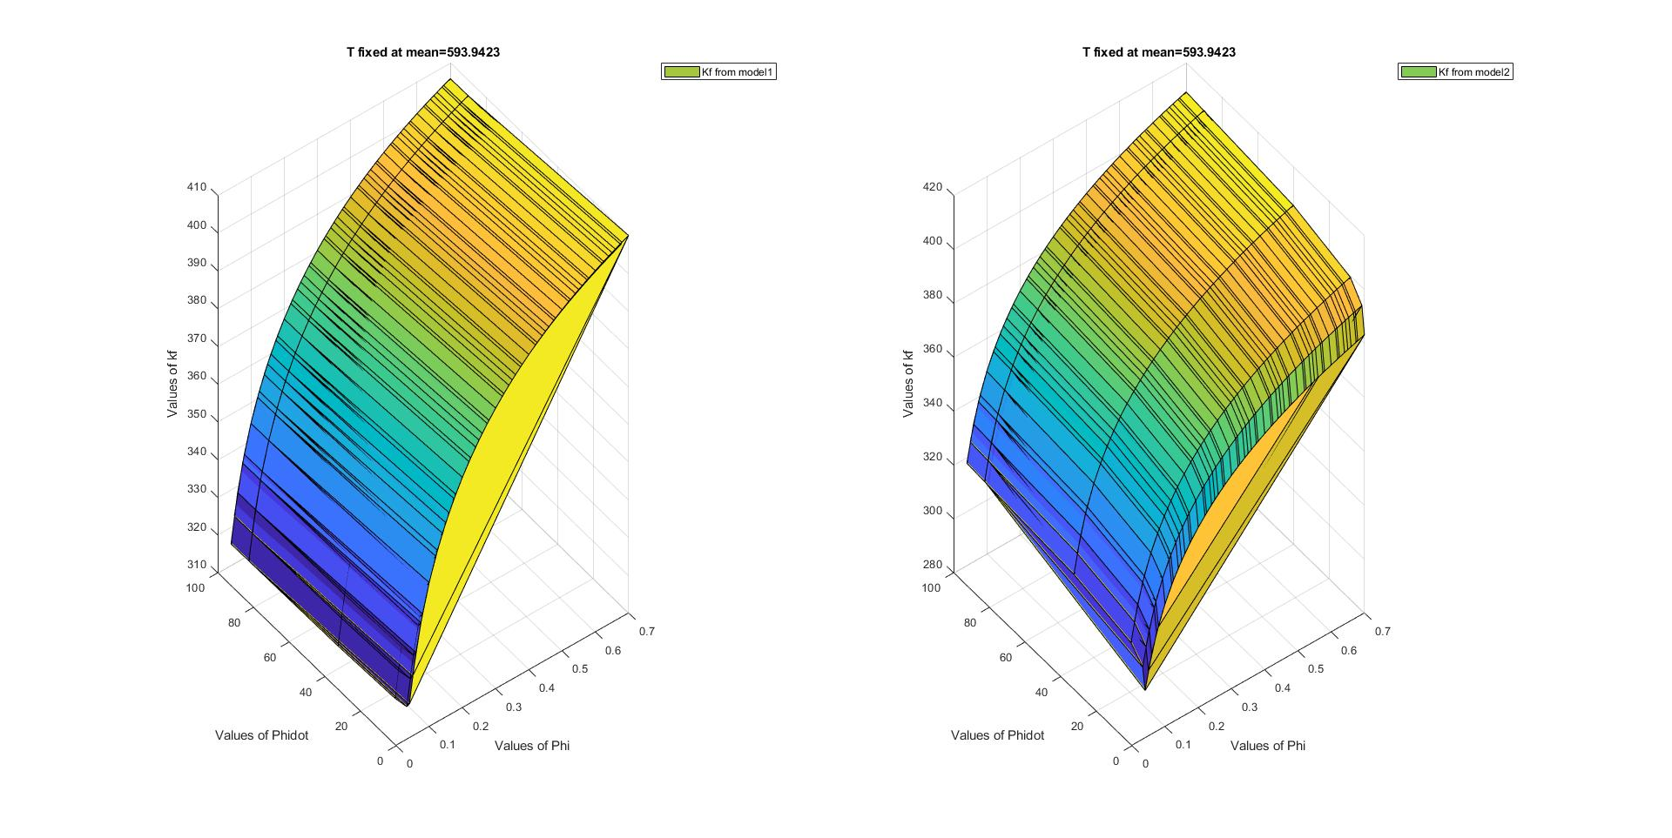
Graphical Results-C15 (3D) T MEAN
Here is the graphical result of measured values for the C15 in 3-Dimension.
We measured the value while T fixed at mean.
In the left side we got the graph for model 1 and right side for model 2.

Slide 13
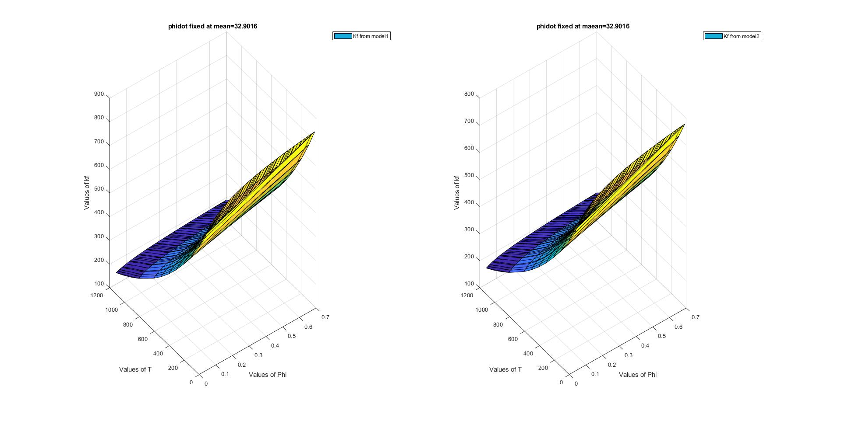
Graphical Results-C15 (3D) phidot mean
Here is the graphical result of measured values for the C15 in 3-Dimension.
We measured the value while phidot fixed at mean.
In the left side we got the graph for model 1 and right side for model 2.

Slide 14
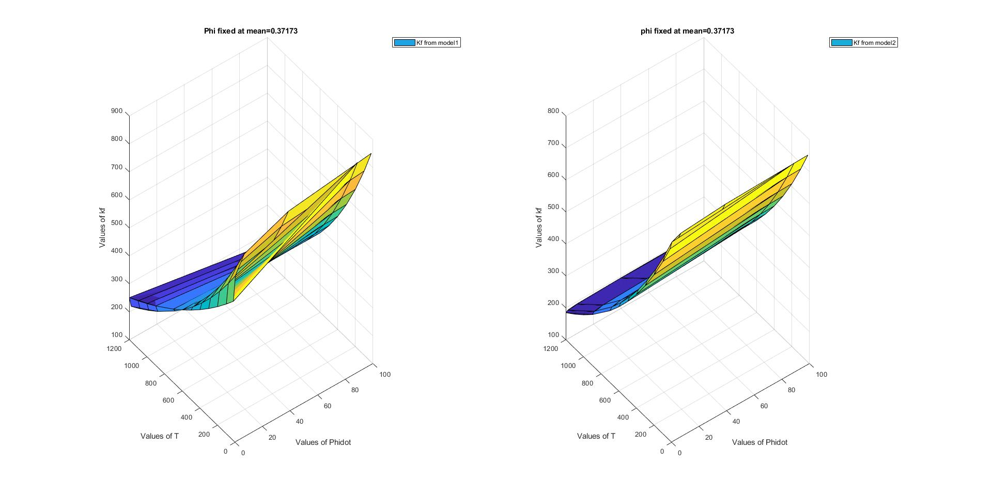
Graphical Results-C15 (3D) Phi Mean
Here is the graphical result of measured values for the C15 in 3-Dimension.
We measured the value while phi fixed at mean.
In the left side we got the graph for model 1 and right side for model 2.

Slide 15


Results-C15
Model 1
Model 2
RSquared: 0.4425
Transformed parameters for the non linear model function:
x1 = -0.0009
x2 = 0.0520
x3 = 0.0987
x4 = -0.0476
x5 = -0.0001
x6 = exp(6.6426)=767.087
$$kf=g\left(x,T,φ,\dot{φ}\right)=(\text{767.087}){.e}^{(−0.0009).T}.{\dot{φ}}^{(0.0520+(−0.0001)).T}.φ^{(0.0987)}.e^{(−0.0476).φ}$$
RSquared: 0.4294
Transformed parameters for the non linear model function:
x1 = -0.0011
x2 = 0.0095
x3 = 0.1106
x4 = -0.1008
x5 = exp(6.7652)=867.14
$$kf=(867.14{).e}^{(−0.0011).T}.{\dot{φ}}^{(0.0095)}.φ^{(0.1106)}.e^{(−0.1008).√φ}$$

Slide 16
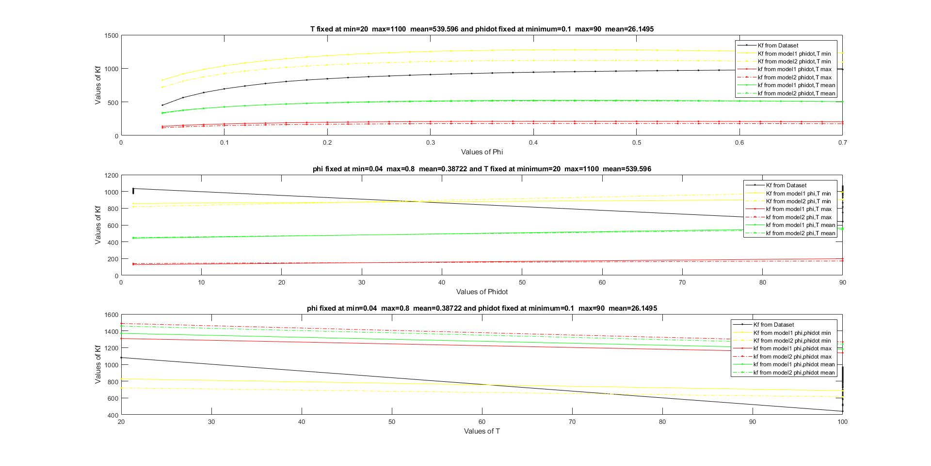

Graphical Results- C60 (2D)
Here is the graphical result of measured values for the C60 in 2-Dimension.
The black lines is for the $kf$ from database ,red for $kf$ from model 1 and green for $kf$ from model 2.
We determined 3 graph while T and phidot were fixed at minimum, maximum and mean.

Slide 17
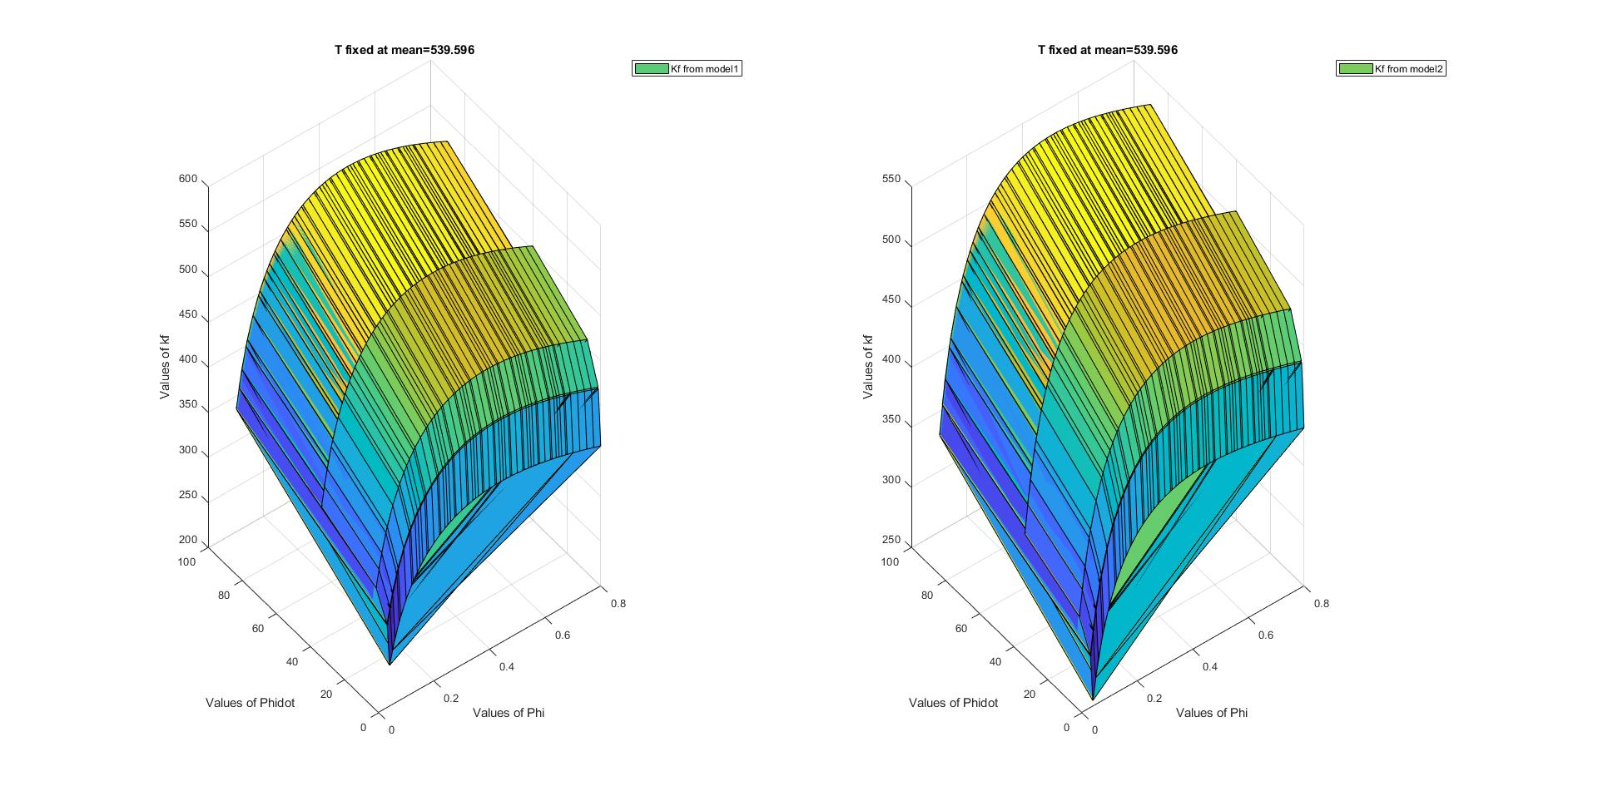
Graphical Results-C60 (3D) T MEAN
Here is the graphical result of measured values for the C60 in 3-Dimension.
We measured the value while T fixed at mean.
In the left side we got the graph for model 1 and right side for model 2.

Slide 18
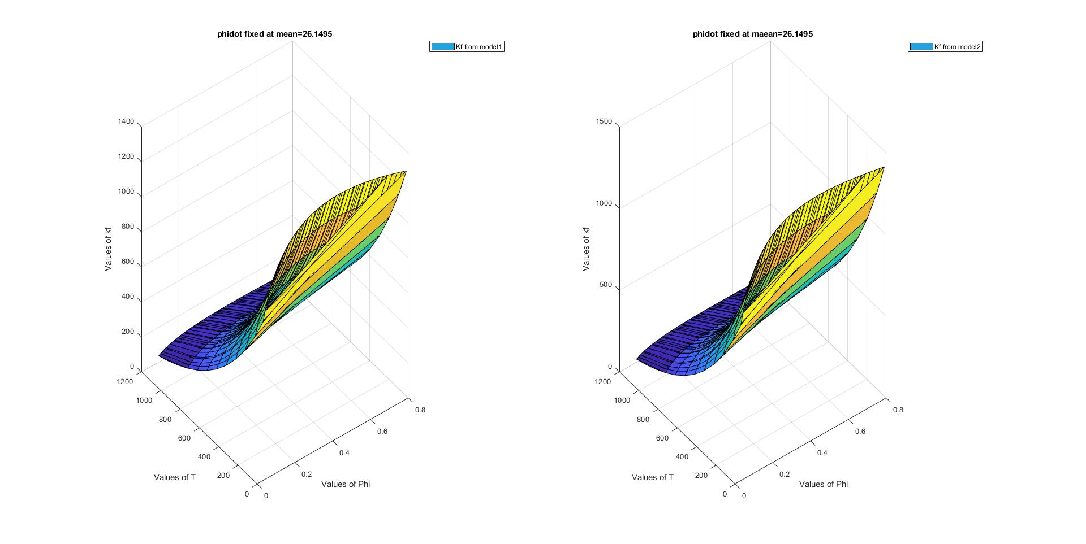
Graphical Results-C60 (3D) PHIDOT MEAN
Here is the graphical result of measured values for the C60 in 3-Dimension.
We measured the value while phidot fixed at mean.
In the left side we got the graph for model 1 and right side for model 2.

Slide 19
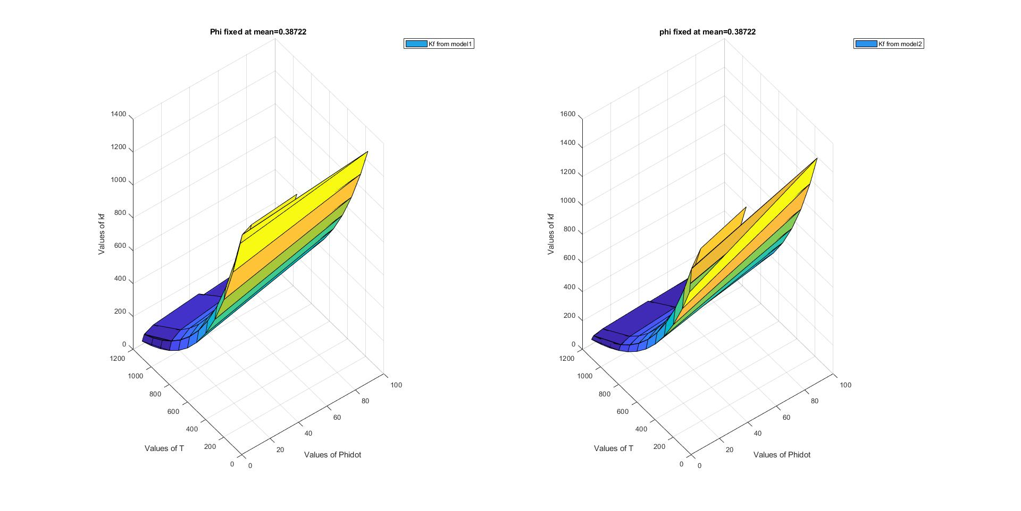
Graphical Results-C60 (3D) PHI MEAN
Here is the graphical result of measured values for the C60 in 3-Dimension.
We measured the value while phi fixed at mean.
In the left side we got the graph for model 1 and right side for model 2.

Slide 20


Results-C60
Model 1
Model 2
RSquared: 0.8981
Transformed parameters for the non linear model function:
x1 = -0.0021
x2 = 0.0114
x3 = 0.2918
x4 = -0.6639
x5 = 0.0001
x6 = exp(7.7565)=2336.71
$$kf=g\left(x,T,φ,\dot{φ}\right)=(\text{2336.71}){.e}^{(−0.0021).T}.{\dot{φ}}^{(0.0114+(0.0001)).T}.φ^{(0.2918)}.e^{(−0.6639).φ}$$
RSquared: 0.8907
Transformed parameters for the non linear model function:
x1 = -0.0020
x2 = 0.0475
x3 = 0.4362
x4 = -1.3008
x5 = exp(8.3921)=4412.07
$$kf=(\text{4412.07}{).e}^{(−0.0020).T}.{\dot{φ}}^{(0.0475)}.φ^{(0.4362)}.e^{(−1.3008).√φ}$$

Slide 21
COnclusion
Here is the comparison between two models while all the variable fixed at mean, min and max.
Model 1
Model 2
T | PHIDOT | PHI | $$R^{2}$$
T | PHIDOT | PHI | $$R^{2}$$
 | 100Cr6 | 593.9423 | 32.9016 | 0.37173 | 0.6145
MEAN | C15 | 593.9423 | 32.9016 | 0.37173 | 0.4425
 | C60 | 593.596 | 26.1495 | 0.38722 | 0.8981
 | 100Cr6 | 593.9423 | 32.9016 | 0.37173 | 0.6003
MEAN | C15 | 593.9423 | 32.9016 | 0.37173 | 0.4294
 | C60 | 593.596 | 26.1495 | 0.38722 | 0.8907
 | 100Cr6 | 20 | 0.1 | 0.04 | 0.6145
MIN | C15 | 20 | 0.1 | 0.04 | 0.4425
 | C60 | 20 | 0.1 | 0.04 | 0.8981
 | 100Cr6 | 20 | 0.1 | 0.04 | 0.6003
MIN | C15 | 20 | 0.1 | 0.04 | 0.4294
 | C60 | 20 | 0.1 | 0.04 | 0.8907
 | 100Cr6 | 1200 | 100 | 0.7 | 0.6145
MAX | C15 | 1200 | 100 | 0.7 | 0.4425
 | C60 | 1100 | 90 | 0.8 | 0.8981
 | 100Cr6 | 1200 | 100 | 0.7 | 0.6003
MAX | C15 | 1200 | 100 | 0.7 | 0.4294
 | C60 | 1100 | 90 | 0.8 | 0.8907

