Slide 1
BLOOD BANK MANAGEMENT

Slide 2
Submitted By
Batch -: E-76
Group-B
Members:
Md Ashiqur Rahman | Roll-25
Ripan Baidy | Roll-27
Shajedul Haque | Roll-17
Abdul Kadir | Roll -29
Amit Deb | Roll - 21
Mahfuja Khatun | Roll - 13
Submitted To
Md. Habibullah Belali
Asst. Professor
Department of CSE
Dhaka International University

Slide 3
Index
Introduction
Feature of this project
Tools and Technology
Screenshot of project features
Challenges / Limitation
Conclusion

Slide 4
Introduction
We are developed a system where anyone can search a blood donor with specific blood group, location, or phone no. This application also able to manage blood donor information.

Slide 5
Feature of this project
Store blood donor information.
Update donor information
Search by name, blood group, location and mobile no.
Remove donor information

Slide 6
Tools/Technology which we used
IDE: VS Code
Frontend: HTML, CSS
Backend: PHP
Database: mySQL

Slide 7
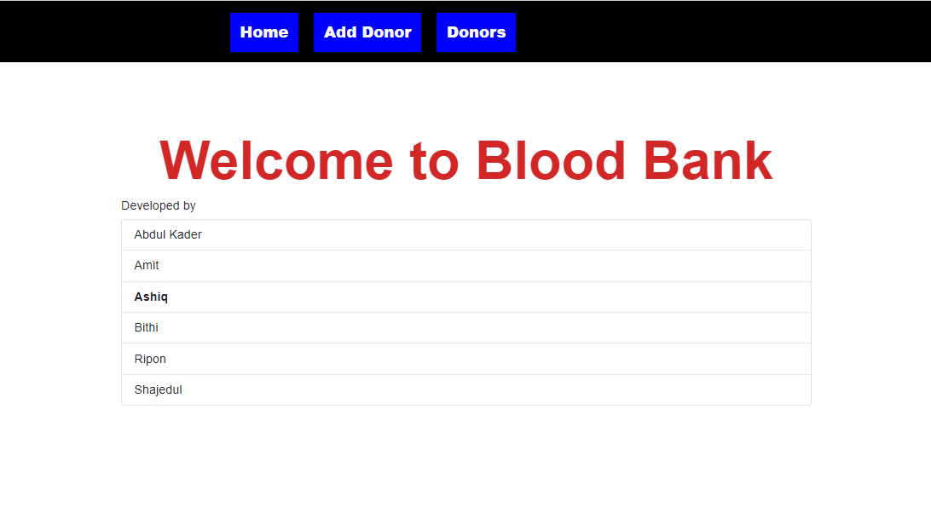
Screenshot
Home Page: Description: This page for show home page information

Slide 8
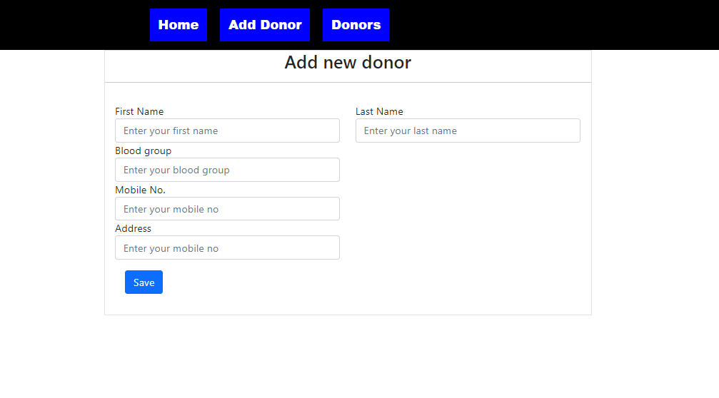
Screenshot
Description: This is blood donor registration save/edit form.

Slide 9
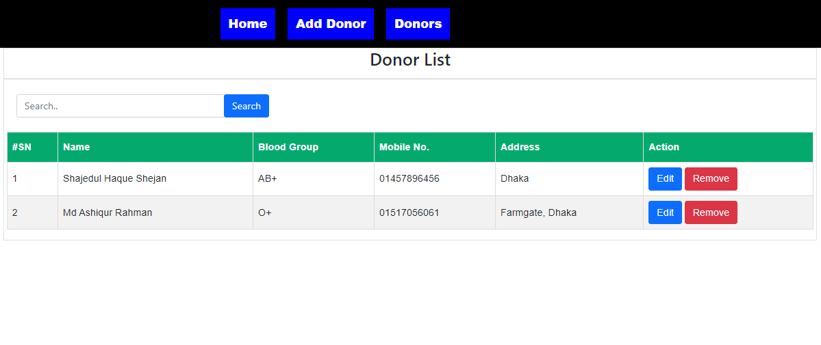
Screenshot
Description: This page show Donor list, In this page we also can can search a blood donor

Slide 10
Challenges
Learning PHP
Implement SQL query with php
Limitation
Form validation not implemented
Input field is not user friendly

Slide 11
Conclusion
We learn a lot by doing this project. We implement our database knowledge practically. After doing this project we realize why we need to learn database knowledge. This learning was really enjoyable to us.

Slide 12


