Slide 1
Extended Euclidean Algorithm & Calculate Private key Exponent
Project 1
Presented By
Md Ashiqul AMIN

Slide 2
Introduction:
Extended Euclidean algorithm is an extension to the Euclidean algorithm
Euclidean algorithm is an algorithm that produces the greatest common divisor of two integers. It was described by Euclid as early as in 300 BC
The extended Euclidean algorithm was published by the English mathematician Nicholas Saunderson,[1] who attributed it to Roger Cotes as a method for computing continued fractions efficiently.[2]
Calculate GCD of a and b
In addition, calculate coefficients of Bézout's identity denoted by x and y
ax+by=gcd(a,b)
Ref:
Saunderson, Nicholas (1740). The Elements of Algebra in Ten Books
Tattersall, J. J. (2005). Elementary Number Theory in Nine Chapters. Cambridge: Cambridge University Press. ISBN 978-0-521-85014-8., pp. 72–76.

Slide 3
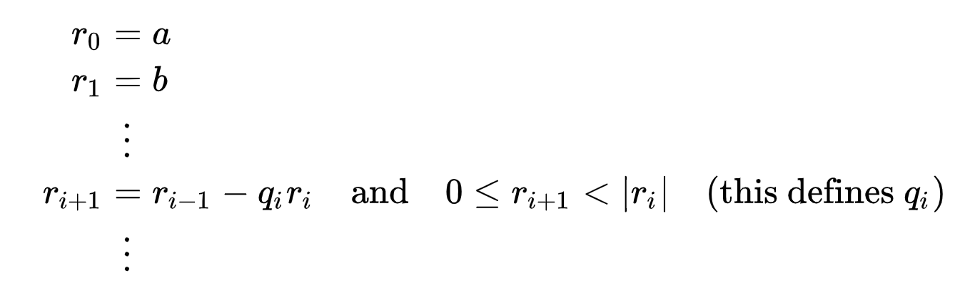
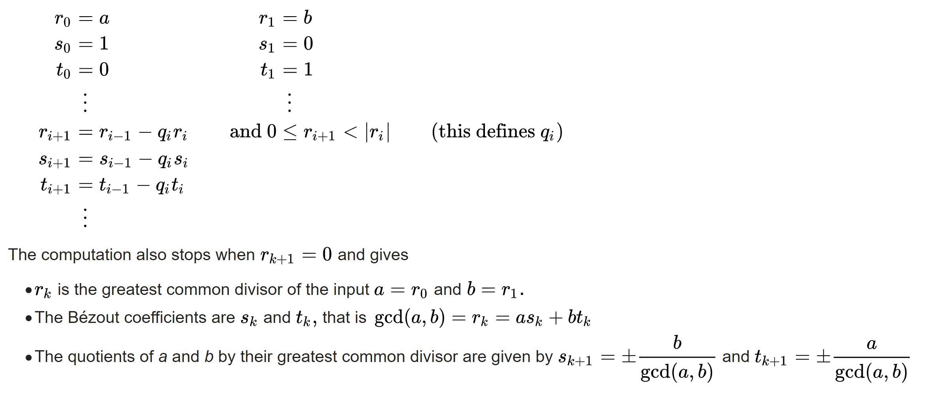
Algorithm
Euclidian Algorithm
Extended Euclidian Algorithm

Slide 4
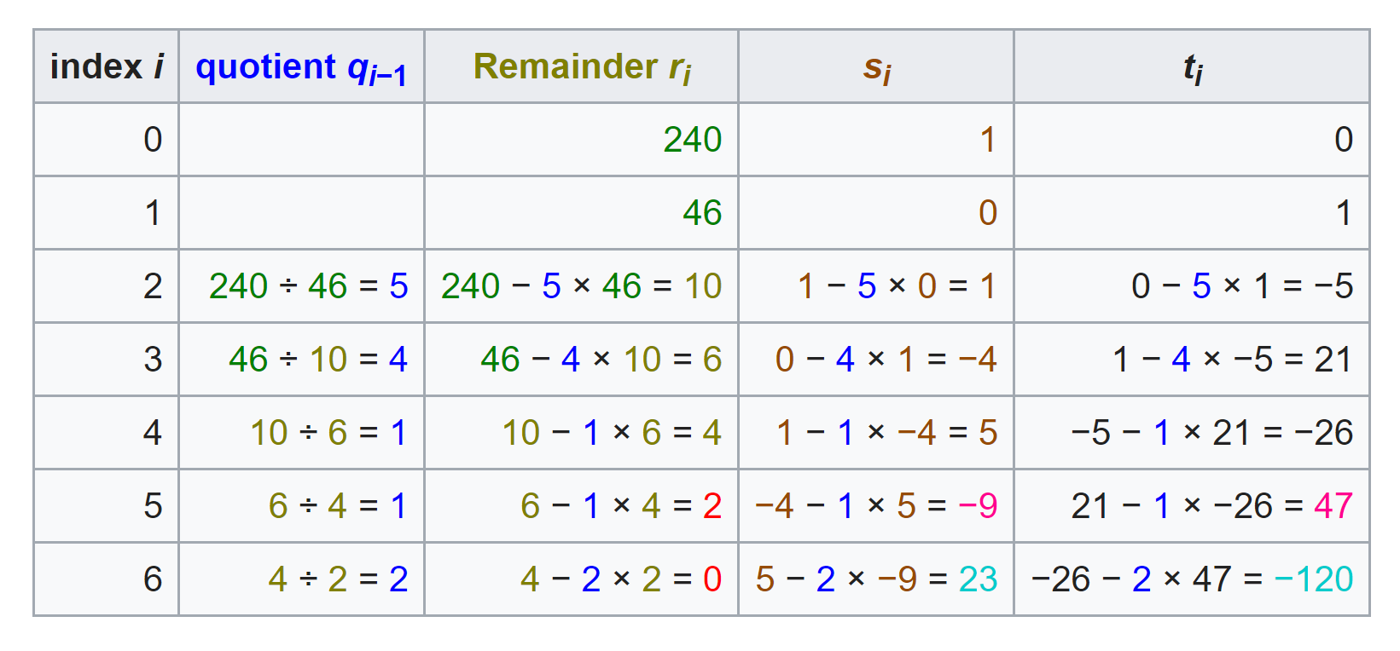
Example:
Here x= s and y=t
Euclidean algorithm proceeds with input 240 and 46
a = 240, b =46
last non zero entry, 2. So GCD is 2
Bézout coefficients appear in the last two entries of the second-to-last row
−9 × 240 + 47 × 46 = 2

Slide 5

Application
Modular multiplicative Inverse to Calculate Key Exponent in RSA
Steps:
gcd(a,b) =1
Here a=e and b=φ(n)
gcd(e,φ(n))=1,
e=public key, φ(n)= totient
Equation ex+φ(n)y=1 or es+φ(n)t=1
1<e<φ(n)
ed≡1(modφ(n))
d≡$e^{−1}$(modφ(n))

Slide 6
Questions?
Email: ma3359@nau.EDU

