Slide 1

Clustering of Transactional data
Identifying customer behavior using Transactional Data

Slide 2

Business Perspective
Grouping of customers by finding similarity between them to impose targeted marketing which should help create business strategies for better outcome and maximum profit.
Target Audience: Business stakeholders of Dime Community Bank and Strategy planning team.

Slide 3
Technical approach to the business case
Data Cleaning
Data Exploratory Analysis
Feature Engineering
Separated the data into two levels: Account level and Transactional level
Application of unsupervised learning to learn possible customer patterns

Slide 4
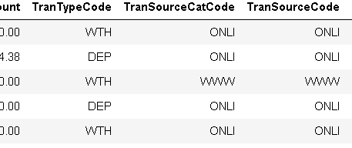

Data Exploration
Extracting the data from the SQL server database.
To start off we are using the data of one month and did the analysis followed by unsupervised learning.
The dataset contain 14 columns and 56975 rows.

Slide 5
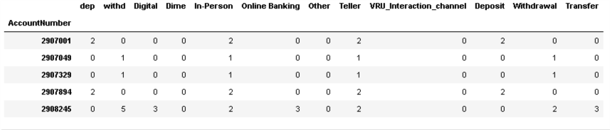
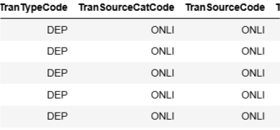
Analysis of data in ‘Transactional’ level and ‘Account’ level
Transactional Level
Account Level
Data set define according to transactional history
Aggregated transactional history of customer w.r.t account number

Slide 6
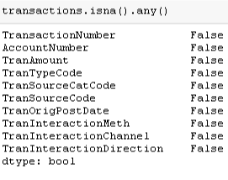
Feature Engineering: Account/Transactional Level
Removed few columns from the data which are of not use. TranTypeDesc, TellerCIF, TranSourceDesc
There were null values only in TellerCIF column, hence we removed that column.
In TranAmount column we get to know the amount which has being deposited or withdraw. Separating deposit and withdrawal amount by creating 2 different columns

Slide 7
Feature Engineering - Transactional Level
Day of the month column
Day of the week column
Scores column according to amount of transaction

Slide 8
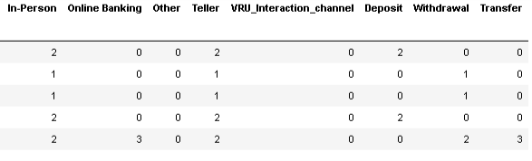
Feature Engineering – Account level
Created a pivot table with count of each type of category for any column

Slide 9
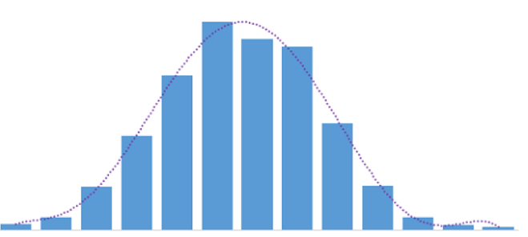
Distribution of the data

Slide 10
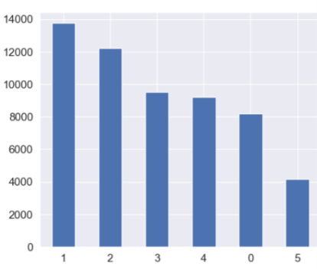
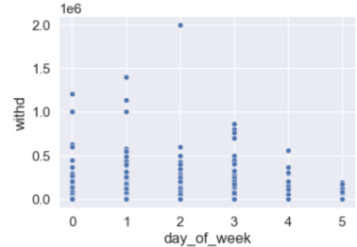
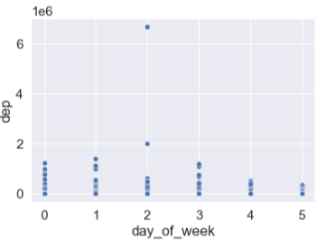
Transactional pattern according to the day of the week
Data Visualization

Slide 11
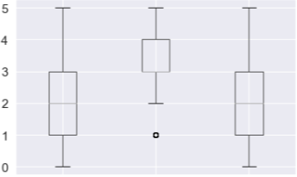
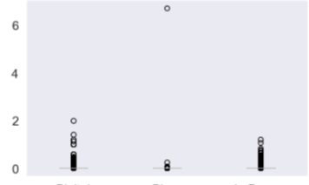
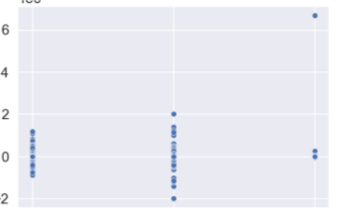
Modes of Transactions

Slide 12
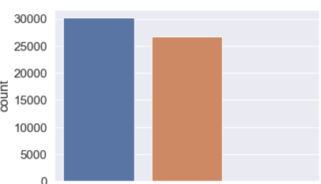
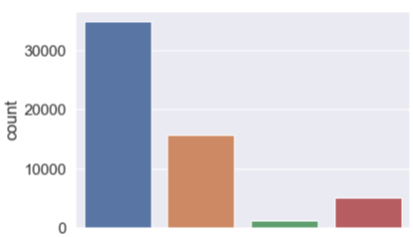
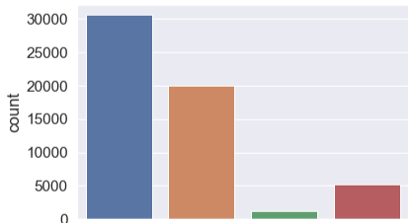
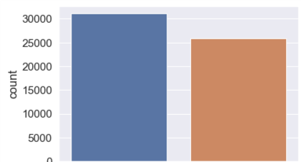
Transactional Methods

Slide 13
Account Level – Data Preprocessing
Creating a pivot table from all the columns and its categories
Grouping of all the columns w.r.t unique account number
Feature Selection through variance threshold method (sklearn)
Retaining only the important features and indexing the dataset

Slide 14
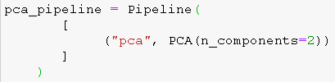
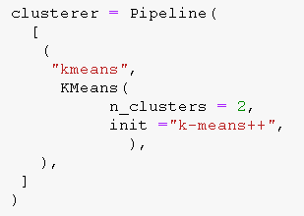
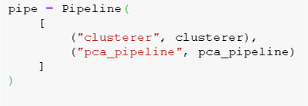
Pipeline for PCA and Kmeans
Pipeline is the process of automating machine learning workflows.
Created pipelines for the steps involved in pca and kmeans to use it recursively whenever required

Slide 15
Account Level Clustering – K-means
Optimal number of clusters reckoned for clustering through elbow graph and silhouette score is 2 for Kmeans clustering
Initiated the model with parameters as init=
k-means++, random_state=0
Saved the clustering output in a variable and added back to the original dataset for visualization of the clusters.

Slide 16
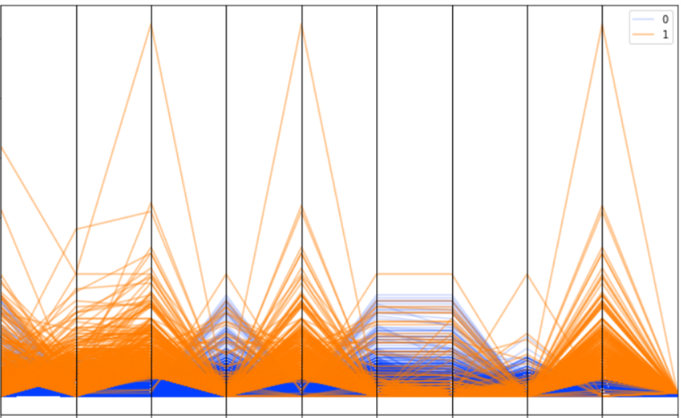
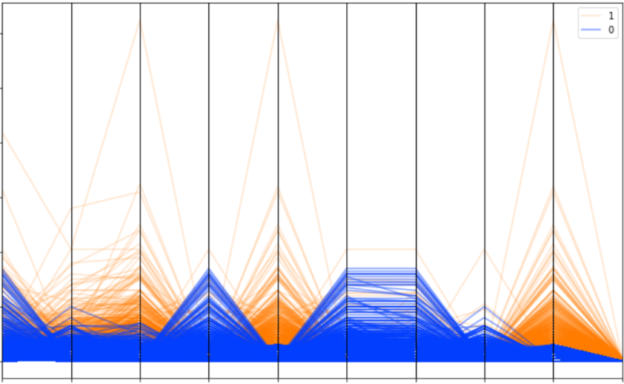
Parallel Coordinate Plot
This Plot explains the distribution of clusters in the data

Slide 17
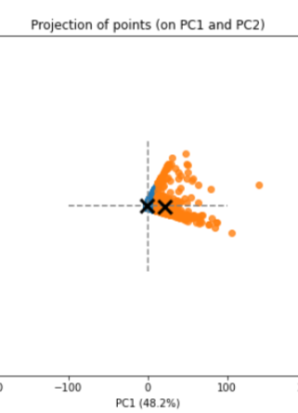
Principal Component Analysis – Account Level
Used PCA to reduce our data to 2 dimensions for better understanding
Parameter used n_components = 2
Bipolar graphs show the centroid of two clusters

Slide 18
Account level clustering – DB Scan
The Optimal Value For Epsilon (EPS) was found to be 0.065 from the radius graph
Taking size of the dataset into consideration min_sample parameter was set to 4000
Numbers of clusters reckoned were 2
The visualization derived for relations among the columns as expected

Slide 19
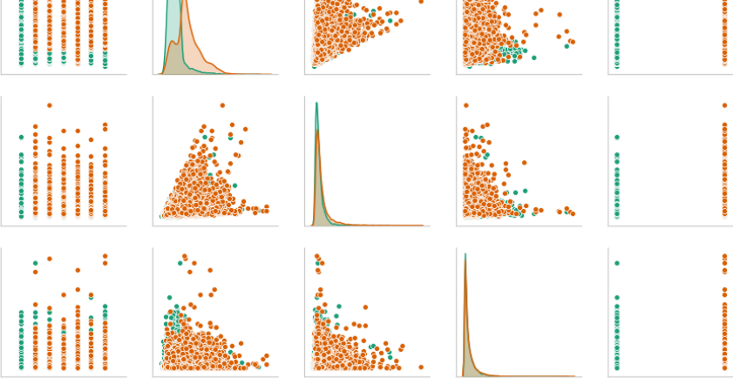

Slide 20
Transactional Level – Data Preprocessing
Removing Outliers from the numerical columns and storing the output in a new variable in dataset
Removed all the unnecessary columns
Normalization of the dataset w.r.t mean
Removing all the null values from the new dataframe

Slide 21
Transactional Level Clustering - K modes
Used score column into consideration instead of the Transaction related numerical columns
Converted day of the week and day of the month into categorical and all the columns as string type
Applied Labelencoder() on the whole dataset
Found the optimal number of K between 2 and 3
Saved clustering output in a variable and added back in the original dataframe for visualization

Slide 22
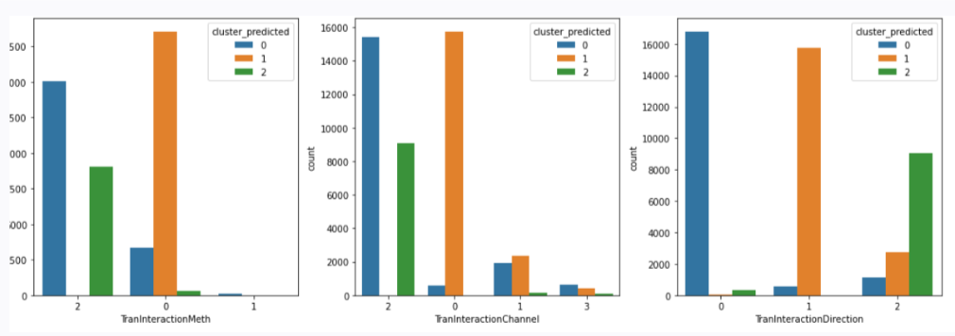
K modes Clustering – Visualization

Slide 23
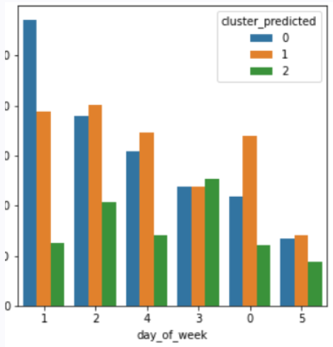
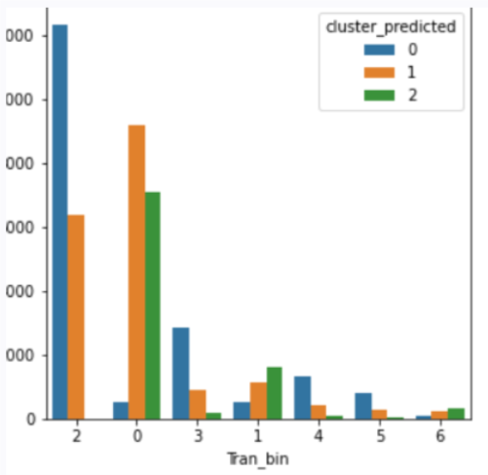
K modes Clustering – Visualization

Slide 24
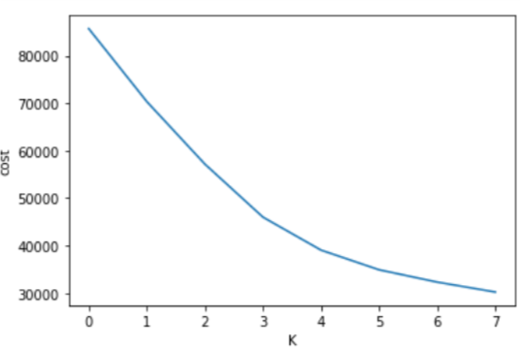
Transactional Level – K-prototype
Used the categorical and numerical columns as it is while normalizing all three numerical columns together
Converted dataframe into an array
Found optimal number of K is 2 by initializing Haung and Cao parameters
Saved clustering output in a variable and added back in the original dataframe for visualization

Slide 25
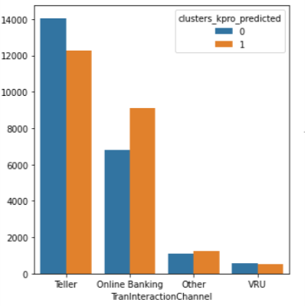
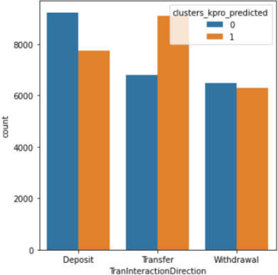
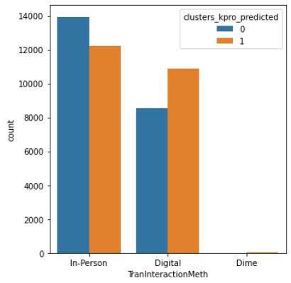
K-Prototype Visualization

Slide 26
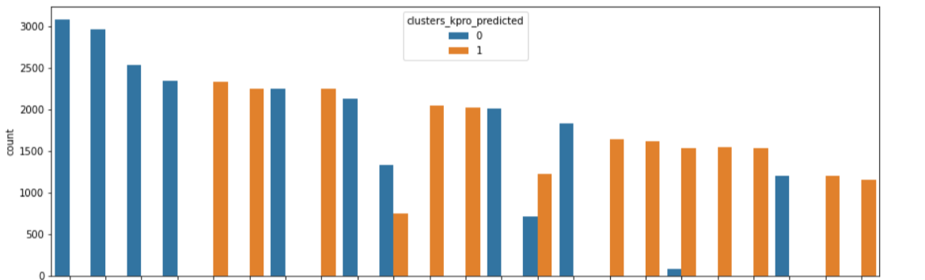
K-Prototype Visualization

Slide 27

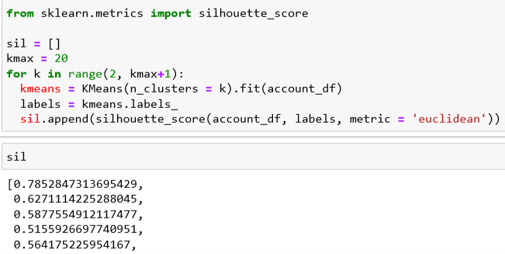
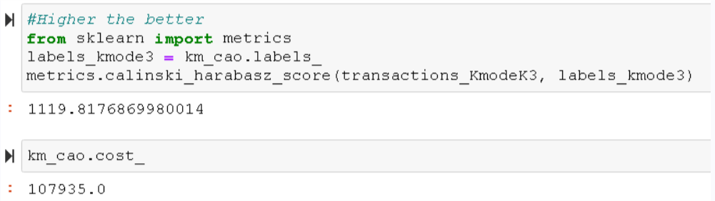
CONCLUSION
Post application of different types of clustering and checking in accordance with various statistical attributes in account level the representation of 2 clusters through K means and in transactional level representation of 3 clusters trough K modes was found to be most meaningful in terms of business and various statistical attributes.
To endorse the alignment between business and technical perspective the calinski harabasz score and cost is also found out in k mode and k prototype models for optimal numbers of k value.
In conclusion, from the whole project the strategies and optimization of existing modes of business’s decisions could made as data driven ones.

