Slide 1
IBM Coursera Advance Data Science Capstone
by
Ashiqur Rahman Khan
Github: https://github.com/ashiqurrahmankhan21st/CapstoneProject

Slide 2
Table of Content
Data Set https://www.kaggle.com/goyalshalini93/car-data
Use Case
Solution to the Use Case
Architectural Choice
Data Quality assessment, Data Pre-processing and Feature Engineering
Model Performance Indicator
Model Algorithm

Slide 3
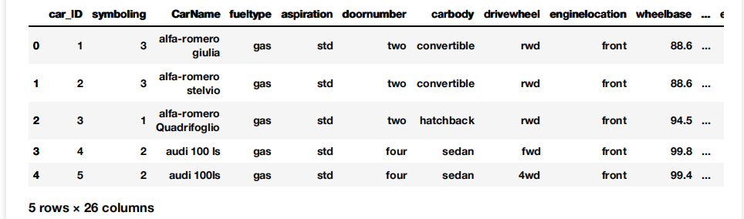
DataSet
DataSet Shape:
column - 26
row - 203
Data types:
float64 - 8, int64 - 8, object - 10
data.head()

Slide 4
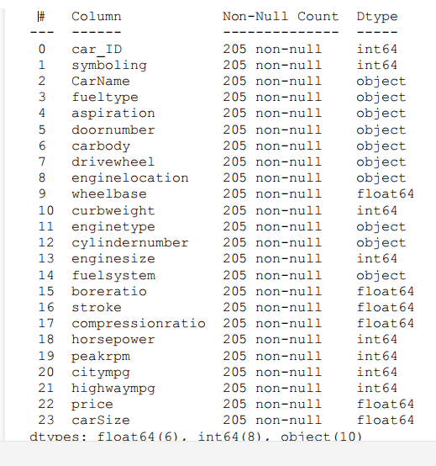
Features
data.info()
as data will be labeled
based on the car volume.
that's why calculating the
car volume.
#cars volume assigned in carSize column:
df['carSize'] = df['carlength']
* df['carwidth']
* df['carheight']

Slide 5
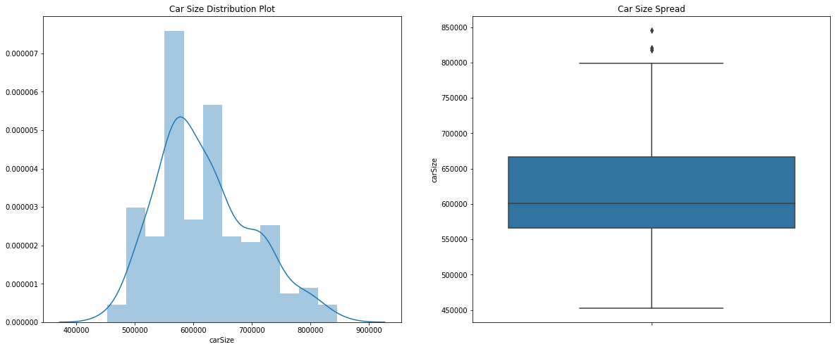
Visualization
Cars Volume/Size Column

Slide 6
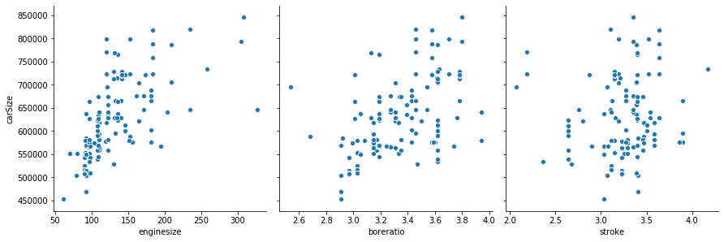
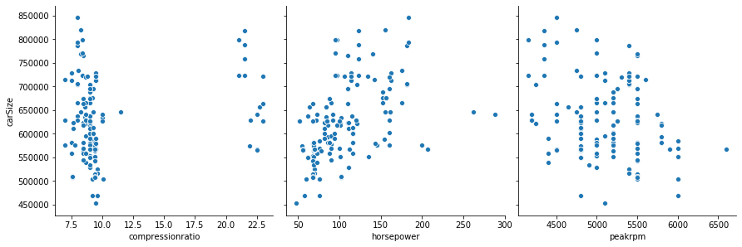
carSize vs other features

Slide 7
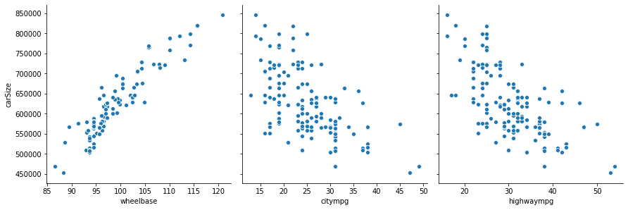
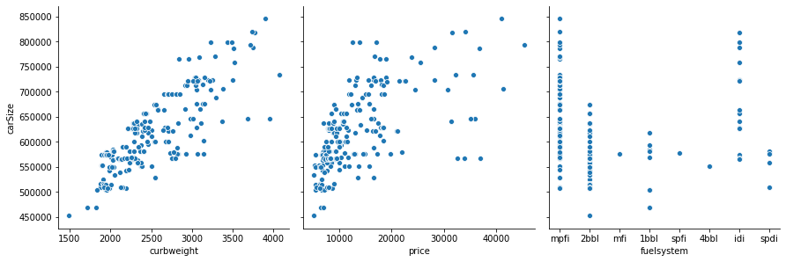
carSize vs other features

Slide 8
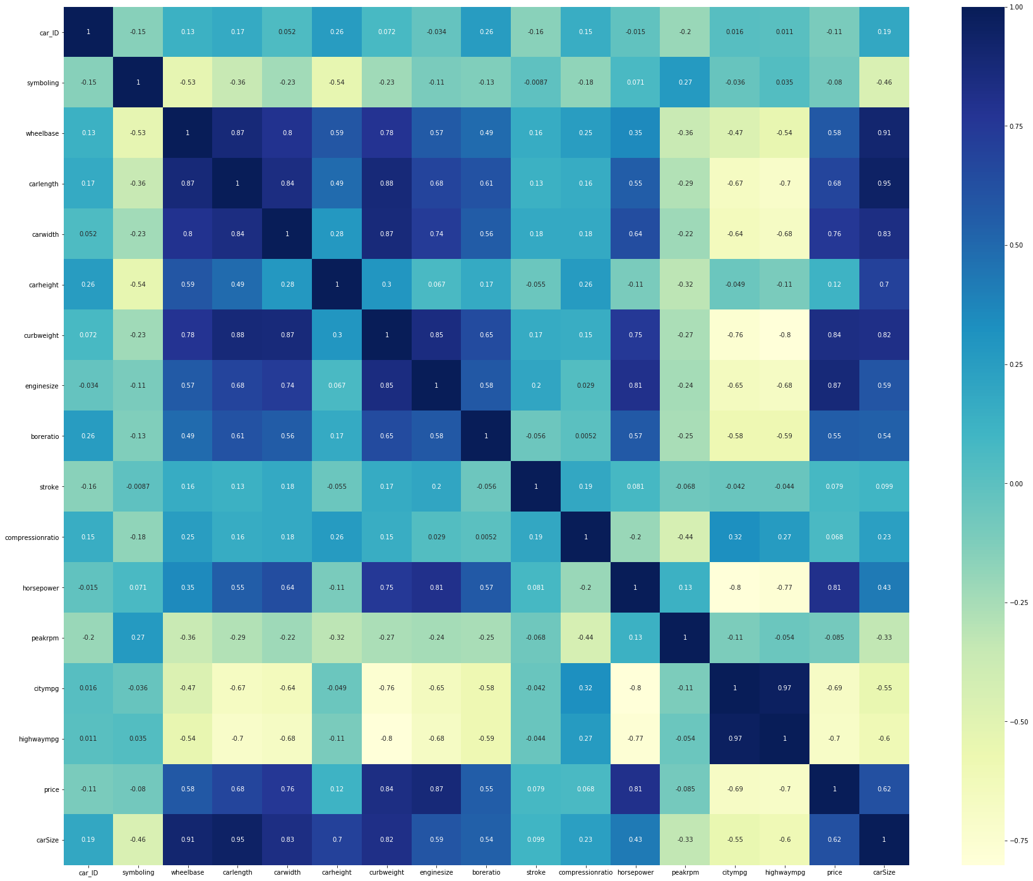
Correlation Matrics
highly correlated
features
1 > x >= 0.5
wheelbase
curbweight
enginesize
boreratio
price

Slide 9
Use Case
in this project a car dataset is used with many car’s features
in a car inventory or car showroom cars can be arranged in any manner.
if the cars are arranged in a random way or without any analysis then it will be inefficient inventory arrangement and very messy.

Slide 10
Solution to the Use Case
different cars have different feature measures
as car inventory management is all about space management so significant features should be the main focus which affects the car size
here each car volume/size was measured
then pair wise correlation was measured to identify the significant features for further calculations

Slide 11
Solution to the Use Case
then highly correlated features were identified which do affect the Car Size. these are:
wheelbase
curbweight
enginesize
boreratio
price
then labels were assigned to the data
then by applying some Machine Learning Algorithms/models best result can be achieved

Slide 12
Architectural Choice
Environment :
Jupyter Notebook
Frameworks :
Apache Spark (pyspark)

Slide 13
Models
MultiClass Classification - A, B & C :
1. LogisticRegression
2. RandomForestClassifier
3. DecisionTreeClassifier
Binary Classification - A & B :
1. LinearSVC
2. GBTClassifier
3. RandomForestClassifier

Slide 14
Data Quality assessment
as we saw there is no null value in the dataset and the carSize feature has 2 outliers only and some there were some features had positive correlation with the carSize so the Data Quality is good enough.

Slide 15
Data Pre-processing
As it is a classification problem label must be assigned to the dataset against each row.
as it is a space related problem so we must assign class based on car volume/size.
so ABC analysis was done based on carSize (car volume) column and each row got a class A,B or C,
for binary classification model only A and B class was assigned.

Slide 16
Feature Engineering
Based on the correlation matrices, 5 features were selected which have correlation with carSize grater than 0.5 and less than 1.0
then Class column was assigned as label column and that 5 columns as feature columns.

Slide 17
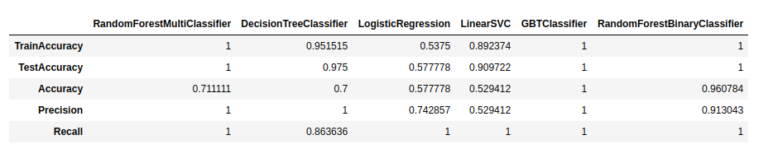
Model Performance Indicator
Model Performance Indicators
Accuracy
Precision
Recall

Slide 18
Model Algorithm
Based on the Model Performance Indicators
DecisionTreeClassifier Algorithm should be selected as the Model Algorithm.

