Slide 1

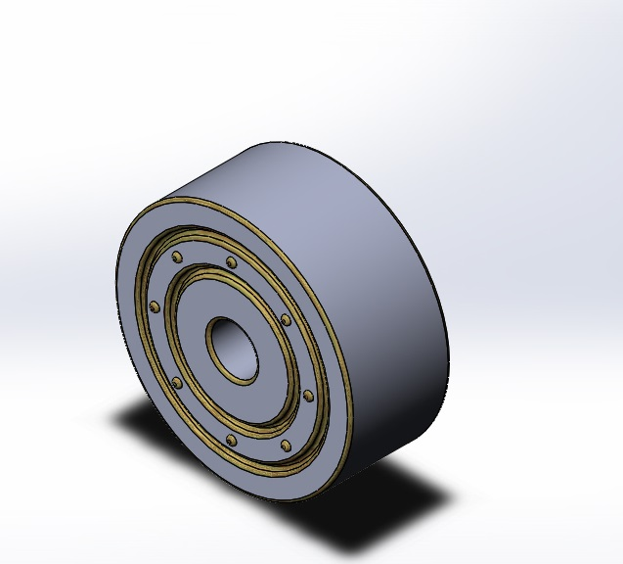
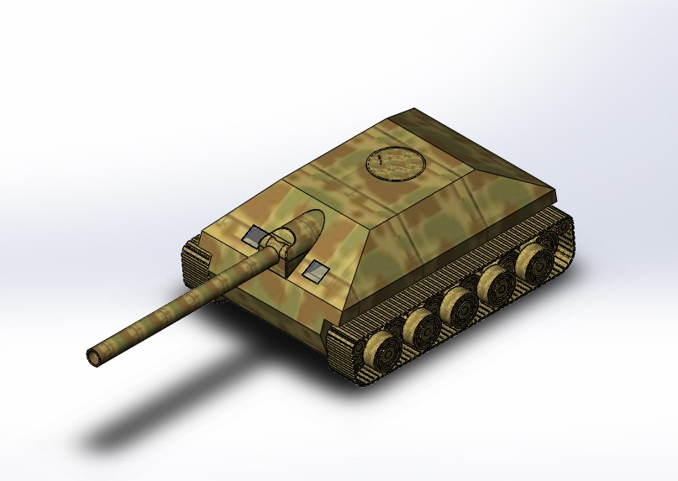
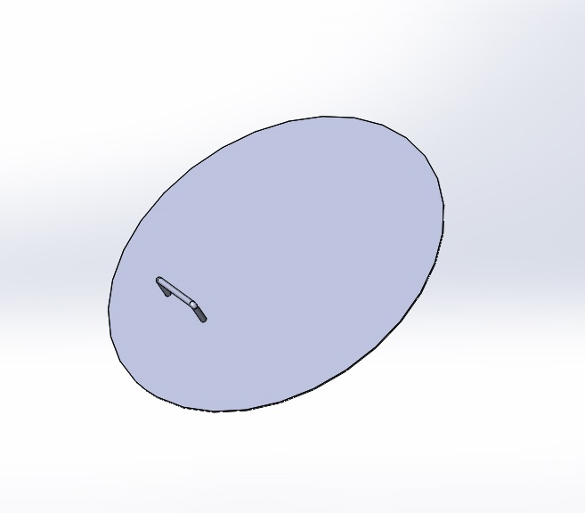
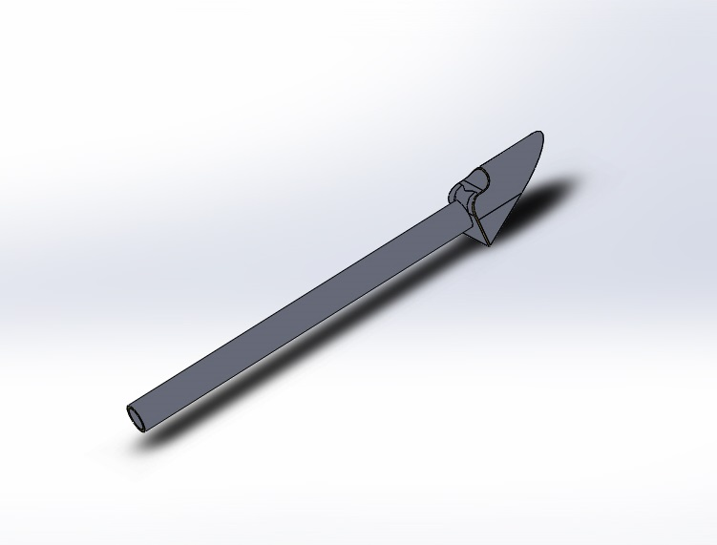
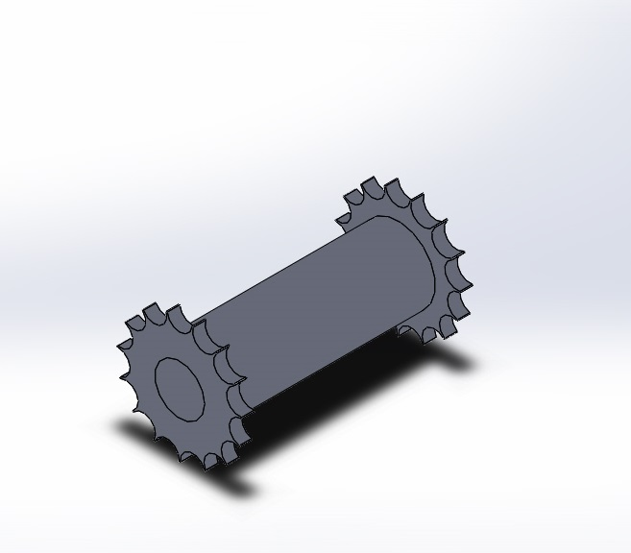
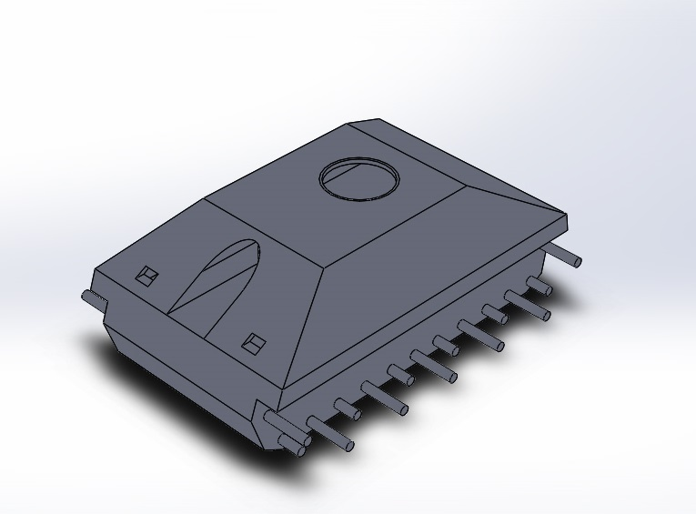
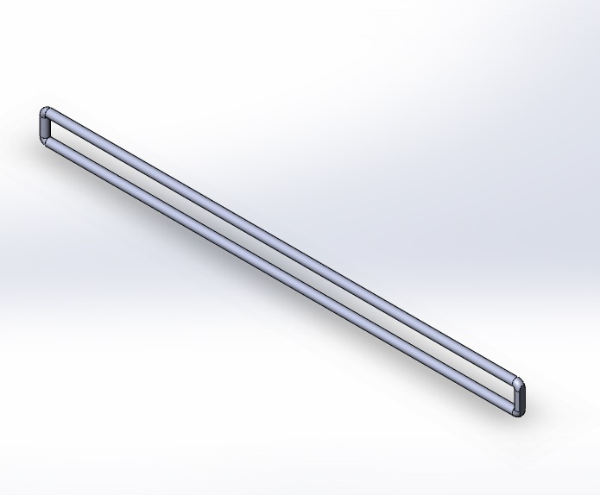
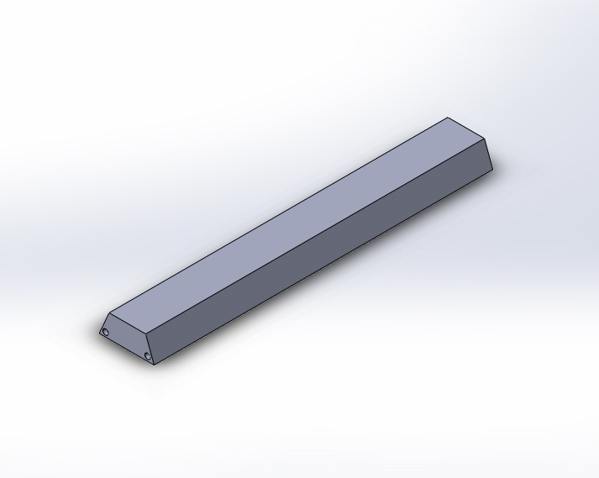
An Engineering Drawing of “German Tank Destroyer E - 25”
In Solidworks
Submitted By :
Ashiqur Rahman Khan
ID: 201736004
Major Operations:
Extrude Boss
Swept Boss
Cut Extrude
Shell
Circular Pattern
Mirror Component
Chain Component pattern
Revolve Cut
Fillet
Mate
Belt Mate
Width mate
Steps:
Drew the Body part
Drew Wheel & Gear wheel
Fire Pipe was made by Boss Extrude and Shell
Chain components were made
Using Assembly Component Belt & Chain Component Pattern the Belt was made
Finally all part file were assemble in a assembly file.

