Slide 1

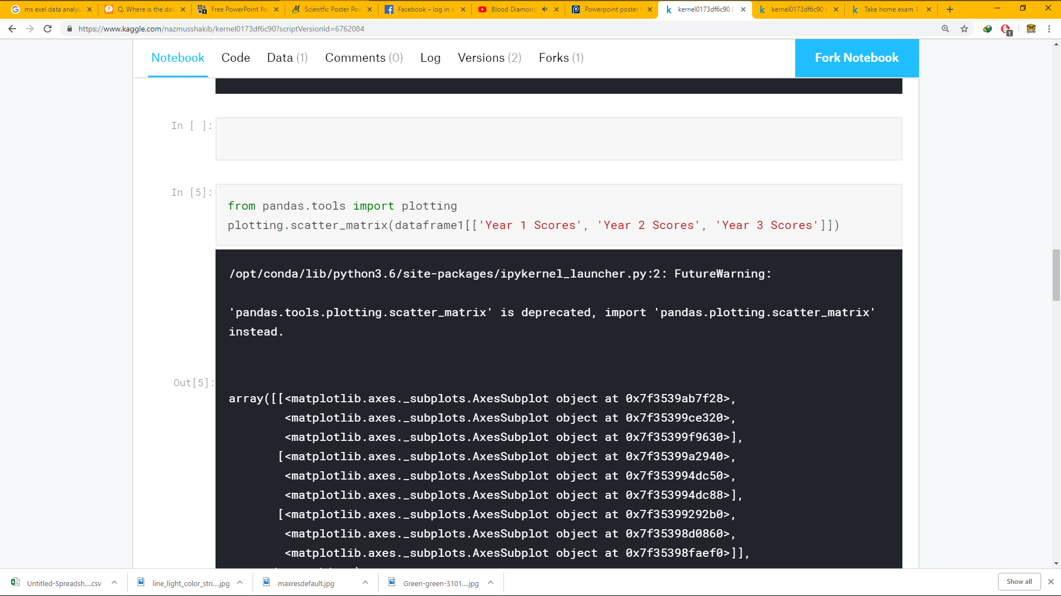
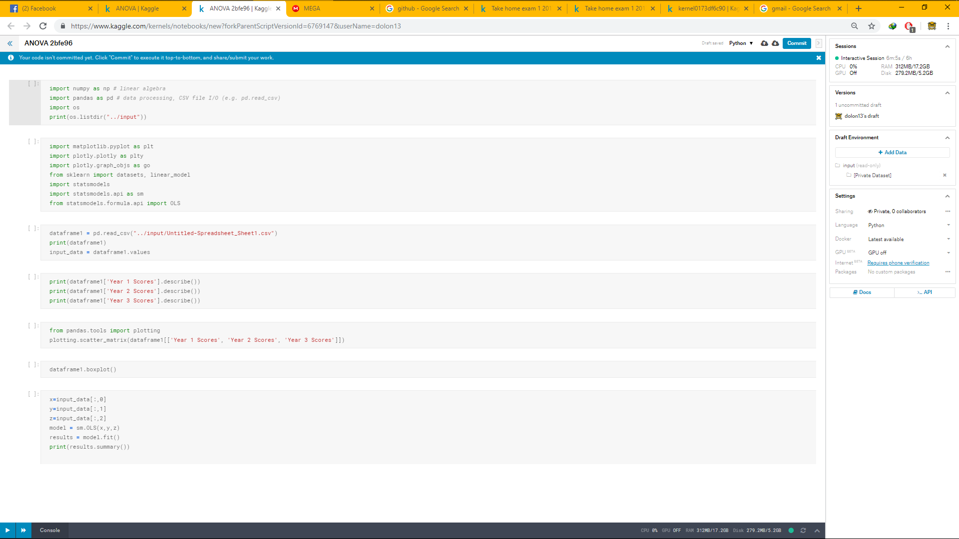
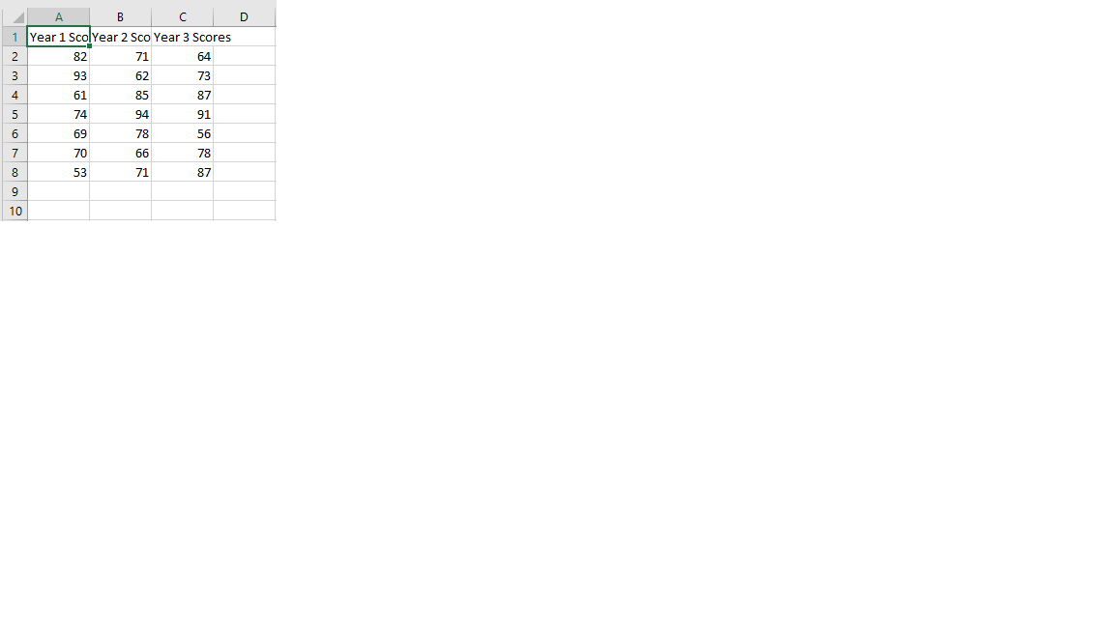
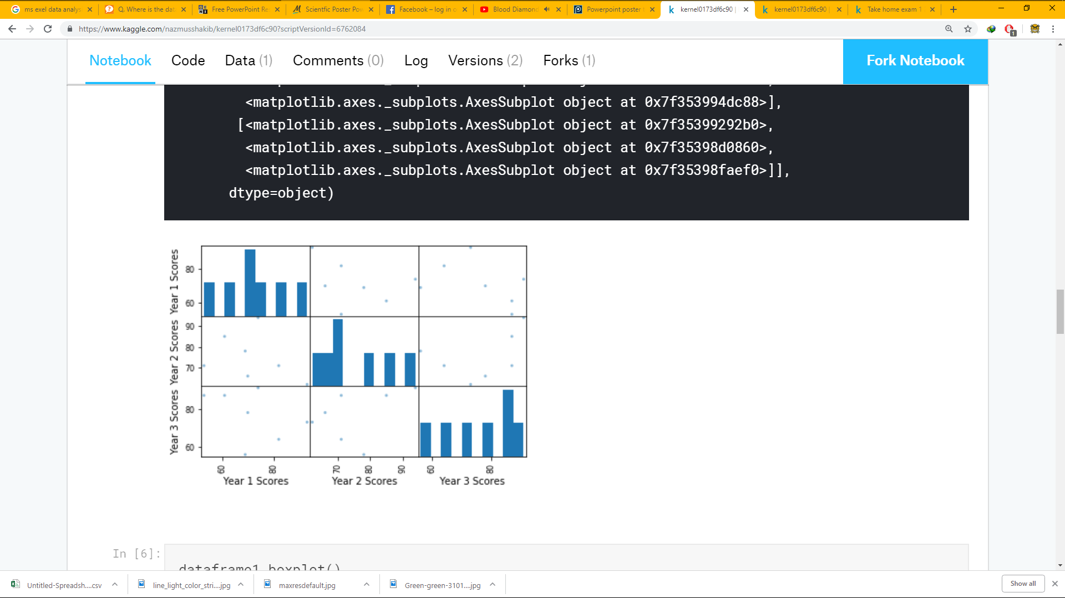
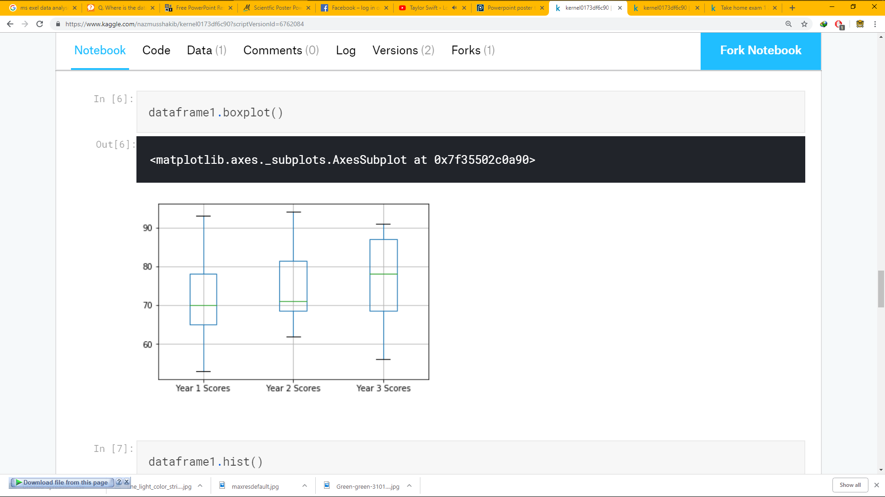
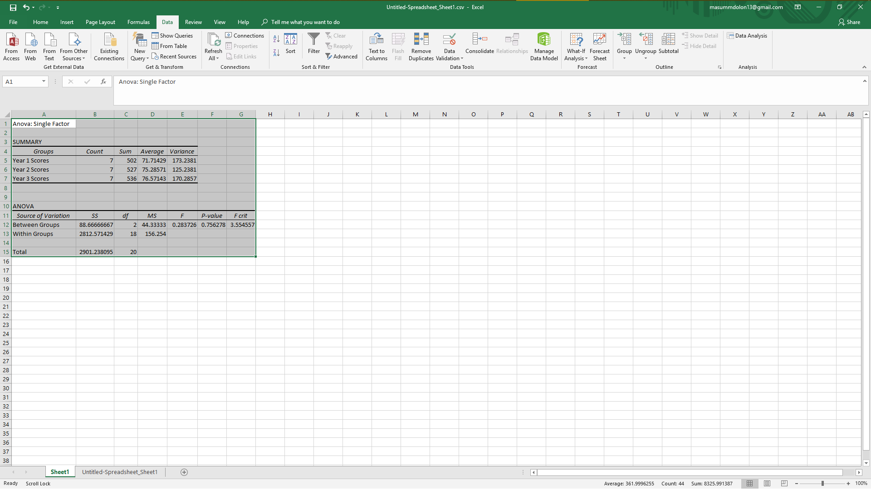
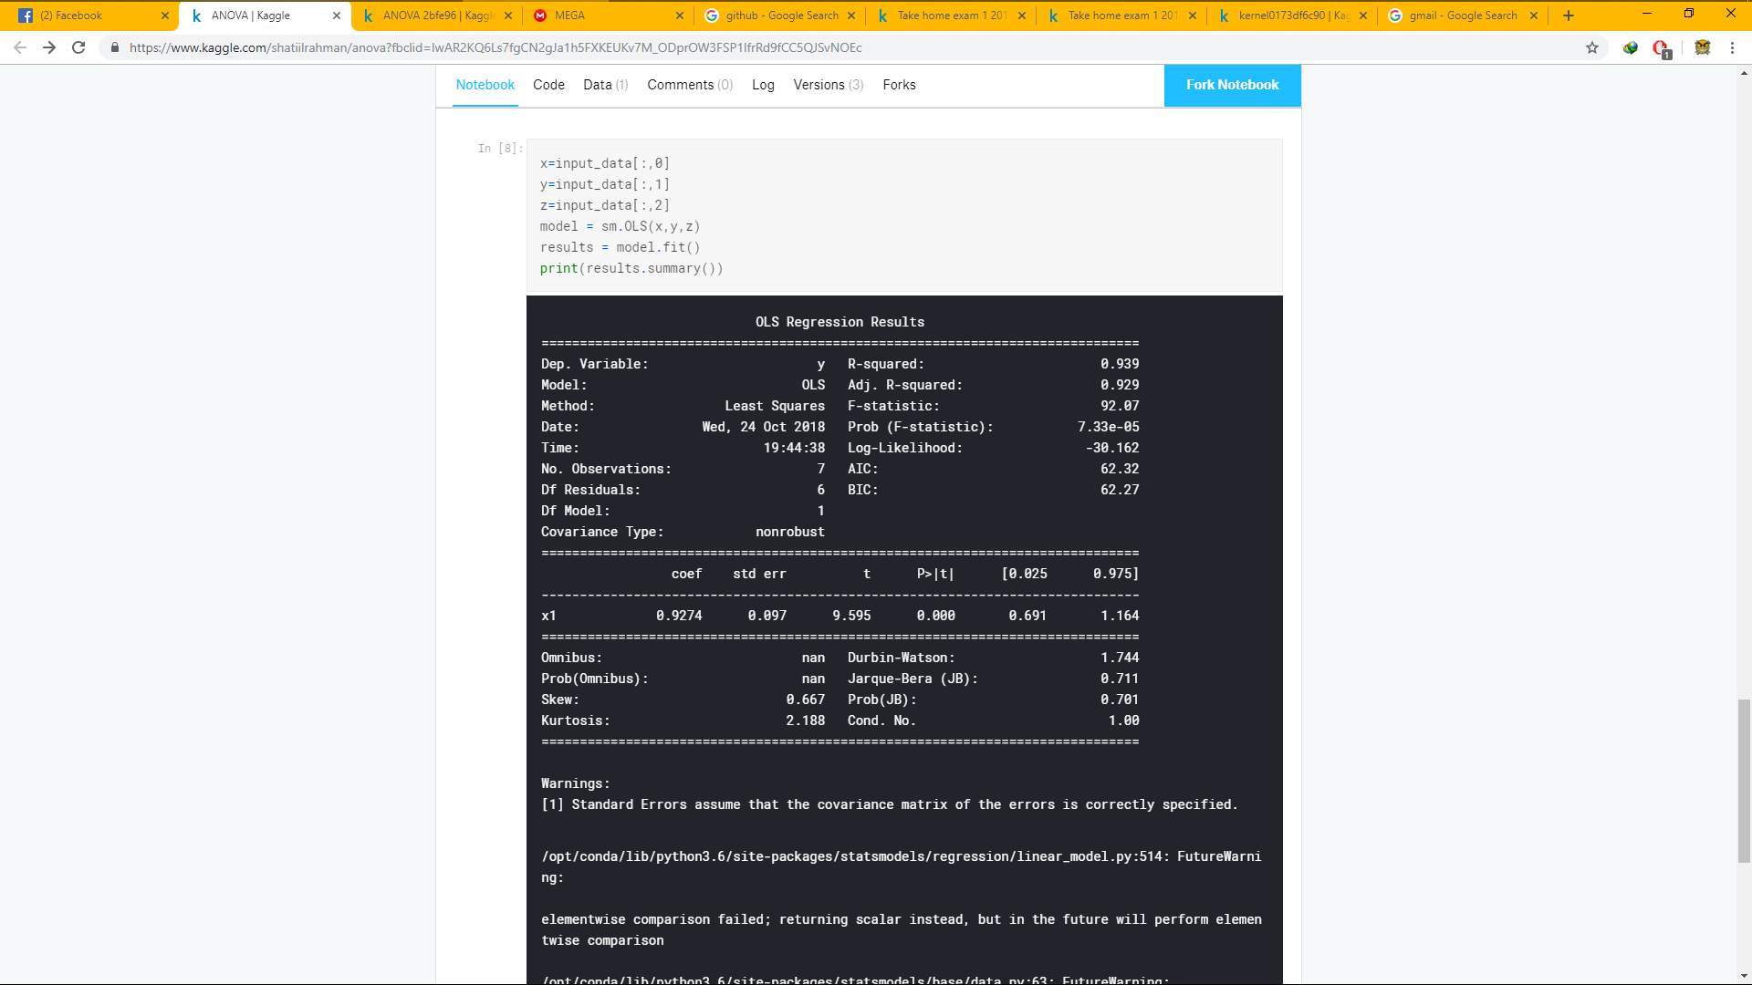
MILITARY INSTITUTE OF SCIENCE AND TECHNOLOGY
PYTHON IN INDUSTRIAL ENGINEERING
SUMMARY
SCATTER MATRIX
PYTHON CODE
DATASET
This is a dataset of a student’s test scores of 3 years. There are scores of 7 courses per year. Box plot, anova, scatter matrix, histogram was plotted in by the use of pogramming language python. Microsoft Exel and www.kaggle.com was used for the operations.
BOX PLOT
SUBMISSION
ANOVA
OLS REGRESSION
Submitted to-
Asst. Prof. Tanmoy Das
Dept. of IPE, MIST
Submitted by,
Ashiqur Rahman Khan- 201736004
Masum Mushfiq Dolon- 201736011
Mustakim Khonodokar Bappy- 201736026
Mohammad Nazmus Shakib- 201736029
Probability and Statistics(IPE-205)
IPE-02

