Slide 1

Automatic Polyps Segmentation Using Residual Attention U-Net
Team members:
Ruksat Khan Shayoni
S M Asif Hossain
Ashiqur Rahman
Rubina Islam Reya
Supervisor
Hossain Md. Shakhawat, Ph.D.
Assistant Professor Department of Computer Science
Faculty of Science & Technology
American International University-Bangladesh
1

Slide 2
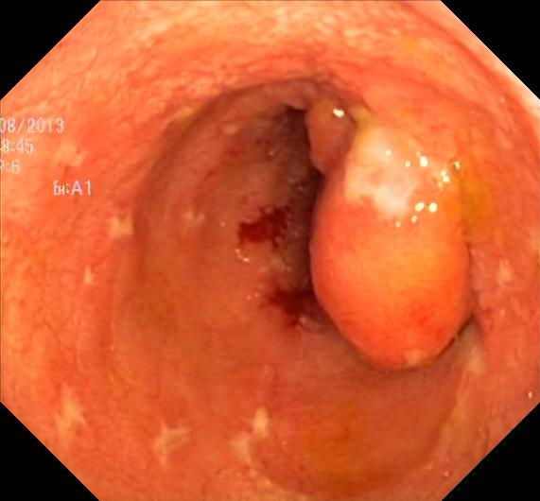
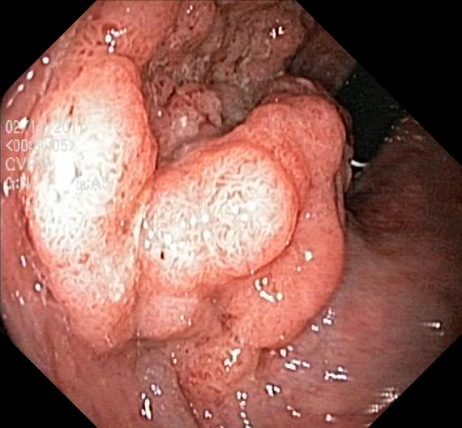
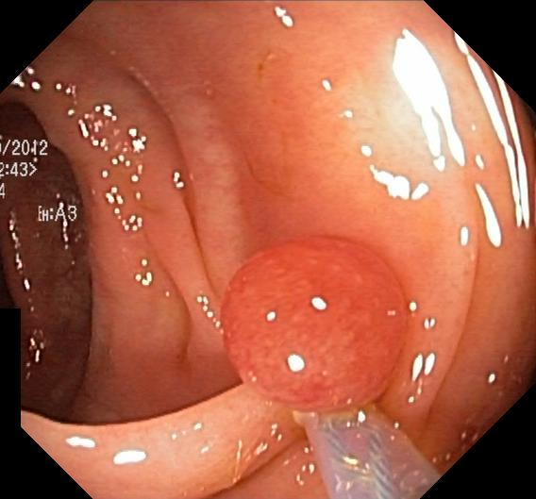
What is Polyps?
A polyp is a projecting growth of tissue from a surface in the body, usually a mucous membrane. Here, we will be focusing on polyps that form on the mucosal wall of the gastrointestinal tract.
Figure 01- Polyps in gastrointestinal tract
2

Slide 3
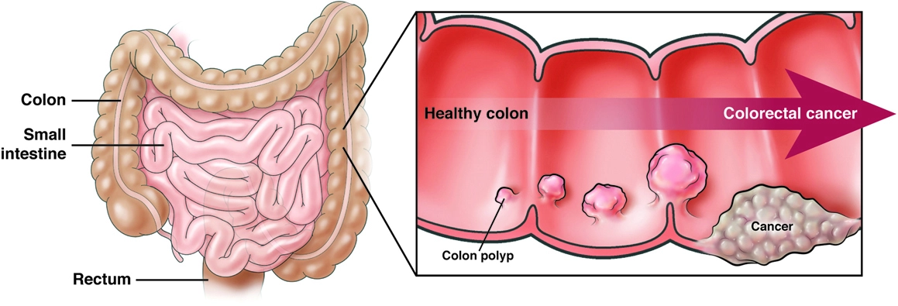
Why is Polyps Segmentation Needed?
Early-stage Polyps segmentation is necessary to avoid future cancer.
Figure 02- Colorectal Cancer
3

Slide 4
Motivation & Goals
Our goal is to achieve more efficient detection for Polyps Segmentation using HyperKvasir dataset based on the Endotect Challenge ¹.
¹https://endotect.com/
4

Slide 5
Significance of the Research
Can provide detailed boundary information for clinical analysis.
Less possibilities of error in detection
Faster process
Low cost design solutions
Automated Detection
Saves time of the medical experts
5

Slide 6
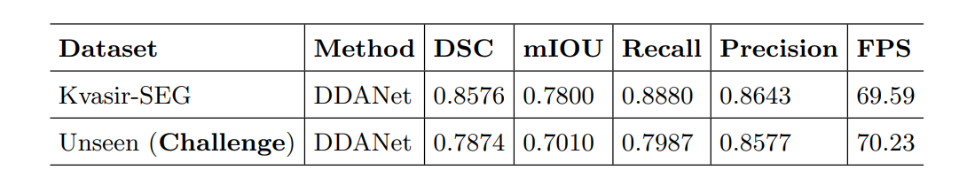
Limitation of Existing Automatic System
Model- Dual Decoder Attention Network (DDANet)²
Result -
Limitations:
Challenge in detection remained within some polyps (for example, flat or sessile)
It used greyscale image reconstruction after segmentation
The evaluation parameters as in the Dice Coefficient (DSC), mean Intersection over Union (mIoU), Recall, Precision, and FPS were quite well but still under 90%
²https://paperswithcode.com/paper/ddanet-dual-decoder-attention-network-for
6

Slide 7
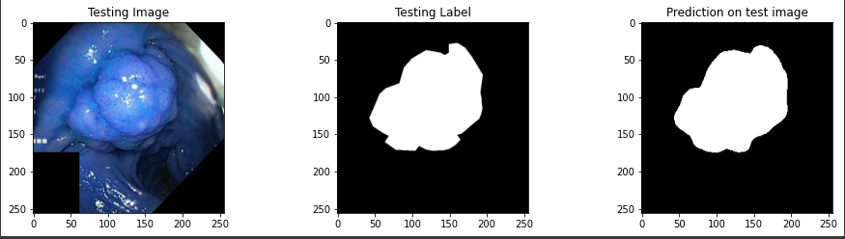
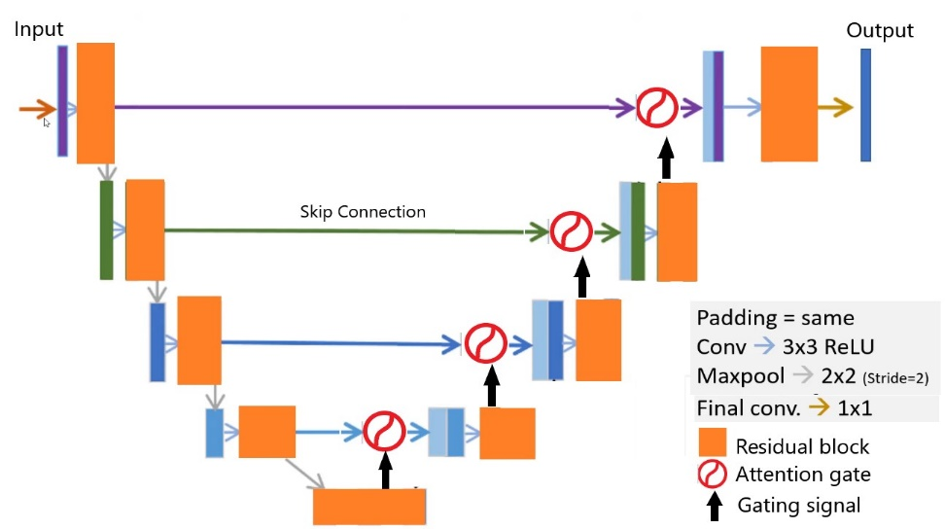
Proposed Method
Model- Residual Attention U-Net (RAUNet)
Input Image
Segmented
Output Image
RAU-Net
7

Slide 8
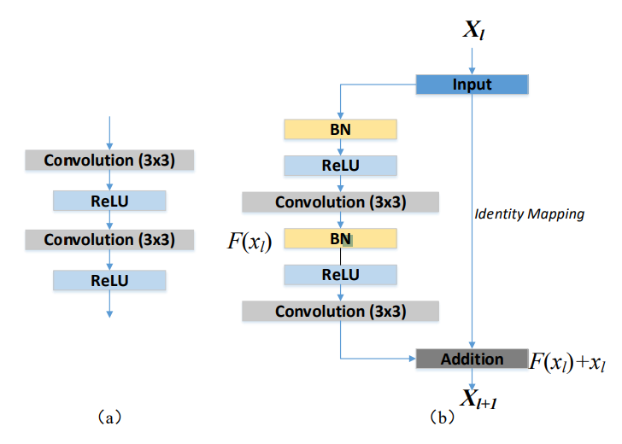
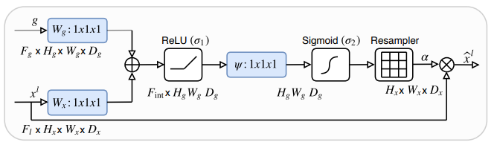
Residual Attention U-Net Architecture
Residual Learning ³
Residual learning utilizes identity mapping and
drives the new layers to learn something
new and different. Also handling the Vanishing
gradient problem in deep networks.
Attention Mechanism ⁴
Attention mechanism guides the model's attention
to learn to focus on target structures, while suppressing feature activation in irrelevant areas.
Gradients originating from background regions are down weighted, and target’s pixels weights are amplified.
A schematic of the attention gate
Residual Block
³https://arxiv.org/abs/1512.03385 ⁴https://arxiv.org/abs/1804.03999
8

Slide 9
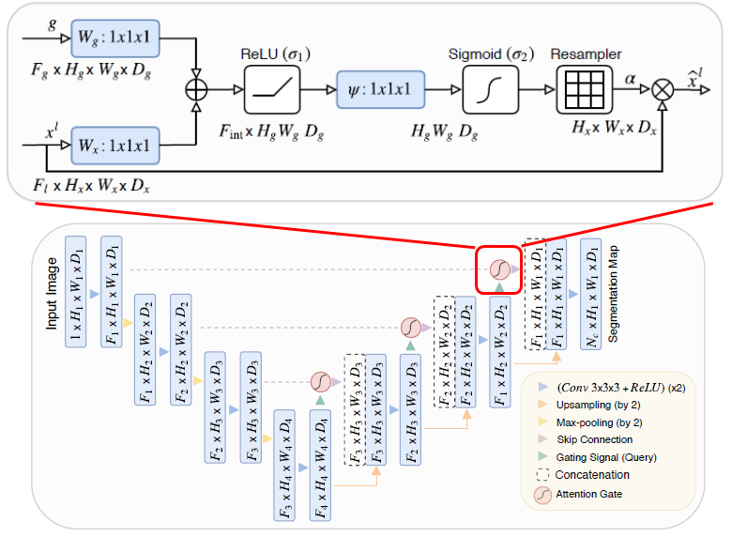
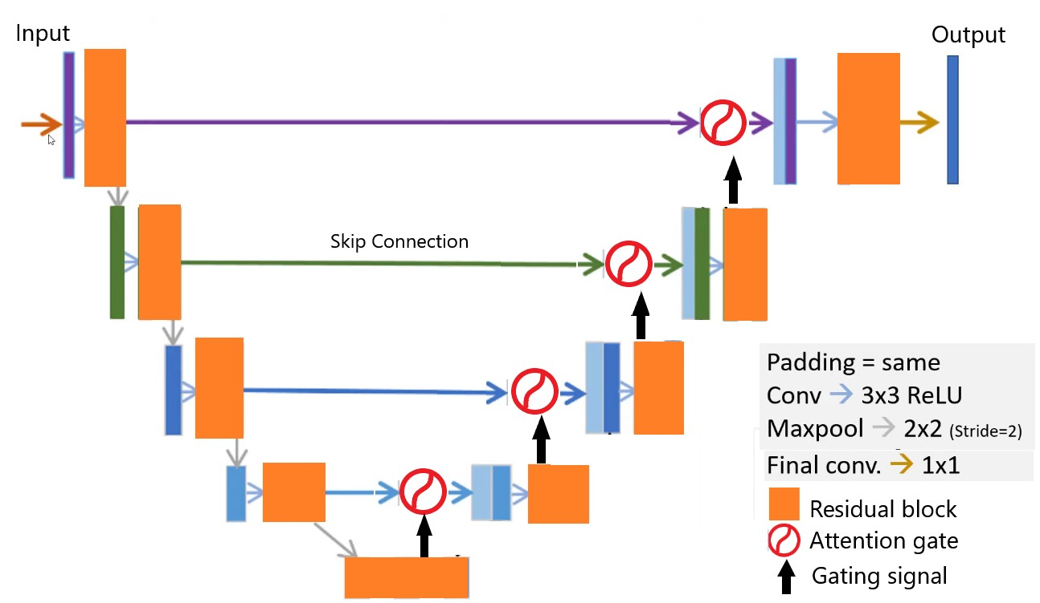
Residual Attention U-Net Architecture: Comparison with Traditional U-Net
In contrast to traditional U-Net ⁵:
The plain convolution blocks are replaced by Residual blocks, improving classification performance
Attention Gate assigned at the skip connection, enhances relevant feature representation
Figure : Proposed RAUNet architecture.
9
⁵https://arxiv.org/abs/1505.04597

Slide 10
Results: Datasets & Hyper-parameter
Hyperkvasir Training Dataset
(1000 images)
900 Training Images
100 Validation Image
Training Parameters
Input Image shape | 256, 256, 3
Output Image shape | 256, 256, 1
Average Learning rate | 0.002
Loss function | Binary Focal Loss (Gamma =2)
Optimizers | Adam
Batch size | 12
Epochs | 380
Convolution Filter size | 3x3
Max-pooling & Up-sampling kernel size | 2x2
Filters [Down-sampling] | 64, 128, 256, 512, 1024
Filters [Up-sampling] | 512, 256, 128, 64
Final layer activation | Sigmoid
Dropout | None
Endotect Challenge
Testing Dataset
(200 images)
Resources & Implemented Code : https://github.com/ashiqurrahmanovy/Thesis-G89-resources
10

Slide 11
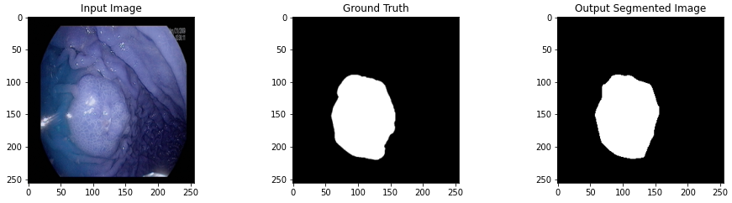
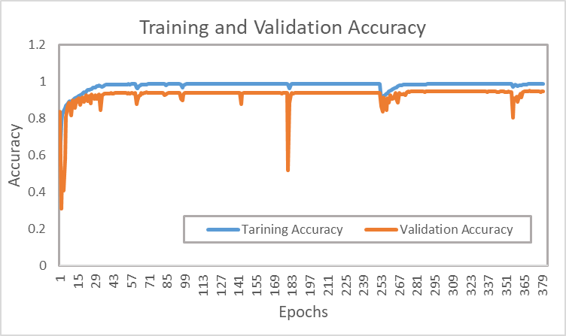
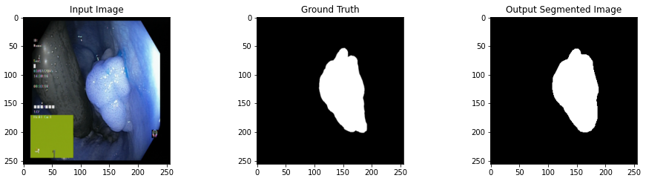
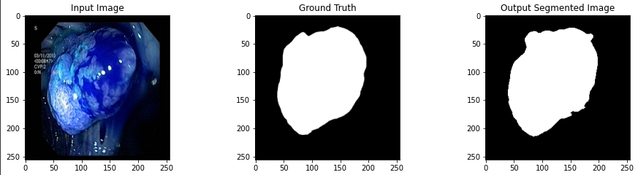
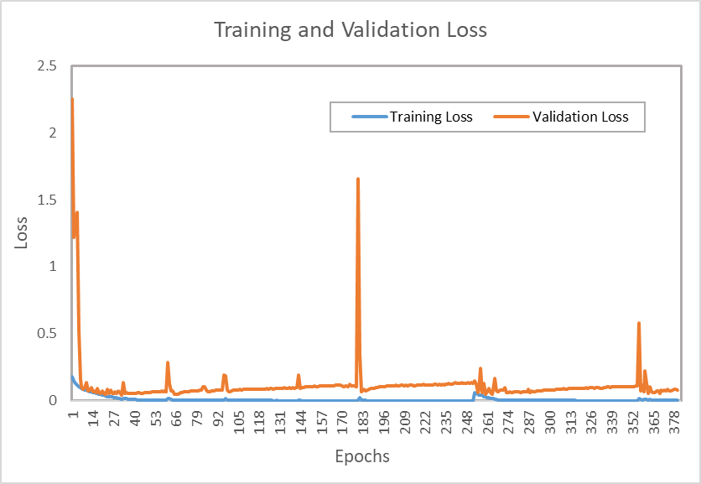
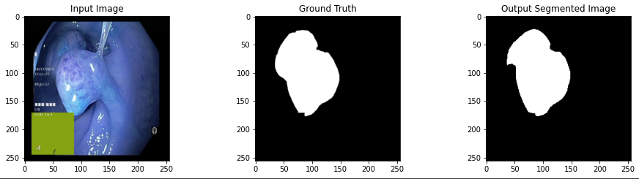
Results: Evaluation of proposed method
11

Slide 12
Results: Comparison of proposed method
 | DICE score (challenge) | Accuracy | Mean IOU | Precision | Recall | F1 score
Validation dataset (10% of Hyperkvasir) | 0.864 | 0.948 | 0.853 | 0.897 | 0.869 | 0.862
Our score on Endotect test dataset (challenge) | 0.830 | 0.947 | 0.830 | 0.859 | 0.857 | 0.835
DDANet score on Endotect test dataset (challenge) | 0.7874 | 0.7010 | 0.7987 | 0.8643 | 0.8577 | -
Our model has achieved 4% (approx.) more Dice-coefficient Score than DDANet’s.
Our model also has 94% (approx.) accuracy, and above 80% score on other evaluation metrics.
12

Slide 13
Summary
We have achieved our goal to model a network with the highest score on Endotect Polyps Segmentation challenge.
We have been successful to improve the accuracy
Our Dice-coefficient Score of 0.830 on the challenge dataset makes RAUNet the highest-ranked model on this challenge.
For our future work, we aim to reach a dice coefficient score higher more than 90% approximately. We will improve our model further, and also work on different other networks and datasets.
13

Slide 14
Thank you
Any question?
14

