Slide 1
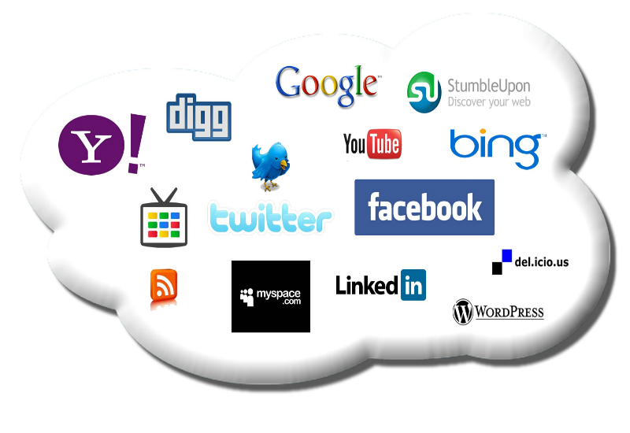
A Social Compute Cloud: Allocating and Sharing
Infrastructure Resources via Social Networks

Slide 2
Authors
Simon Caton, Member, IEEE
Christian Haas, Member, IEEE
Kyle Chard, Member, IEEE
Kris Bubendorfer, Member, IEEE
Omer F. Rana, Member, IEEE

Slide 3
Published In :
Magazine :
Services Computing, IEEE Transactions on
(Volume:7, Issue:3)
Date of Publication :
July-Sept. 2014
ISSN :
1939-1374
DOI :
10.1109/TSC.2014.2303091

Slide 4

Presented By :
Name :
Md. Ashiquzzaman
Roll :
1107039
Course Name :
Technical Writing & Seminar
Course No. :
CSE 4120
Department of Computer Science
&
Engineering, KUET, Khulna - 9203.

Slide 5
Topics
Introduction
A Social Compute Cloud
Overview
Challenges
Architecture of Social Cloud Platform
Social Adapters and User Preferences
Implementation
Evolution
Discussion
Conclusions and Future Work

Slide 6
Introduction
Popularity and Usefulness of Cloud Computing
Ability to reduce overheads and costs for consumers by leveraging economies of scale to provide infrastructure, platforms and software as services.
Existing Service providers and their Methodology
Ex: EC2, Google Cloud, Windows Azure

Slide 7
Introduction
Key issues: Notions of Trust and Accountability between resource consumers and providers
Trust and accountability encapsulate several different aspects such as security, privacy, ethical practices, transparency, protection of rights, and issues concerning compensation. Addressing these concerns is a significant undertaking, and consequentially, many international research programs have emerged
Alternative approach: A Social Cloud with preference based approach
Using social Media like Facebook, twitter, WhatsApp
Examples
More than 1 billions of Facebook user. If 0.5% users donate their unused resource than it can be larges super computer.

Slide 8
A Social Compute Cloud
Is designed to enable access to elastic compute capabilities provided through resources contributed by socially connected peers.
Is a form of community cloud as the resources are owned, provided and consumed by members of a social community. Through this cloud infrastructure consumers are able to execute programs on virtualized resources.
In this model, providers host sandboxed lightweight virtual machines (VM) on which consumers can execute applications, potentially in parallel, on their computing resources.

Slide 9
Challenges
A social compute cloud needs to traverse network address translations (NAT)
Handle non-static IP addresses (especially in the case of mobile users) and accommodate best effort notions of quality of service
Requires adequate security and sandboxing mechanisms to protect resources from potentially malicious or incompetent users and also to protect user applications from potentially malicious resources.
Leveraging social structures to facilitate the sharing of compute resources within a social network

Slide 10
Architecture of Social Cloud Platform
Like any cloud model, a platform is required to coordinate and facilitate its basic functionality (user management, resource allocation, etc.)
Below Fig. 1 shows the high level architecture for a social compute cloud and its key components
A social clearing house is an institutionalized microeconomic system that defines how supply is allocated to demand
A social clearing house is the central point in the system where all information concerning users, their sharing preferences, and their resource supply and demand is kept.
A middleware to provide the basic resource fabrics, resource virtualization and sandboxing mechanisms for provisioning and consuming resources

Slide 11
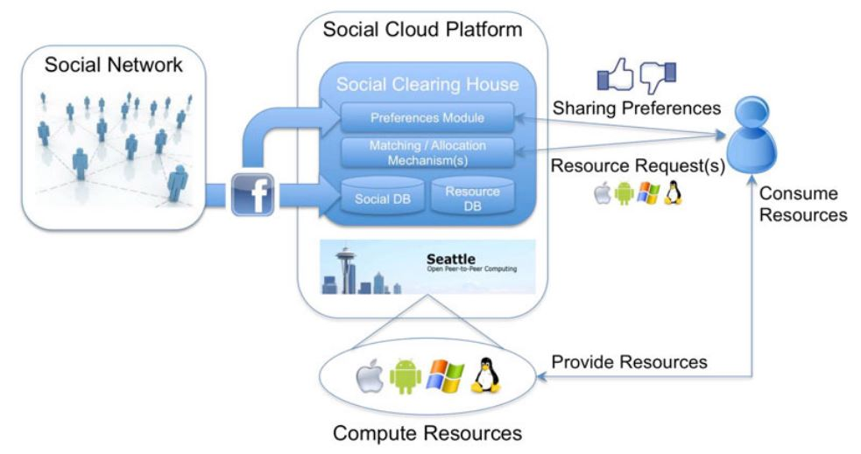
Architecture of Social Cloud Platform
Fig. 1. A social compute cloud and its core components.

Slide 12
Social Adapters and User Preferences
To facilitate social sharing, and the construction of sharing preferences, a social cloud requires access to users social networks.
Here proposed using a social adapter, rather than implementing the platform as a social network application
There need bidirectional approval to establishment of a digital social tie as one user initiates and the second user must confirm the request in order for the link to be established.
How to interpret the user’s social ties for the purposes of allocation. There proposed three methods by authors:
Ask users to rank their friends
Leverage methods from social network analysis
Use social network and interaction theories to construct a social sharing and interaction model

Slide 13
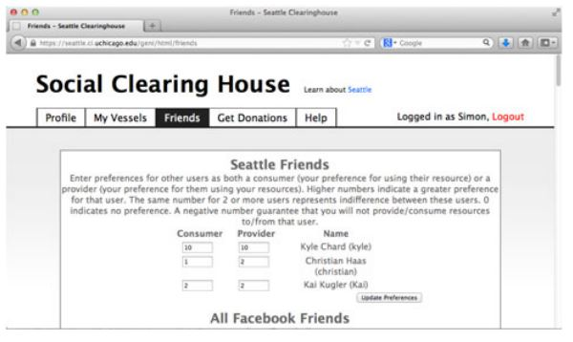
Implementation
Implementation of a social compute cloud builds upon Seattle, an open source peer-to-peer (P2P) computing platform. Seattle was chosen as the basis for this implementation due to its lightweight virtualization middleware, which use to enable application execution on contributed resources, and its extensible clearing house model which can be extend to enable social allocation via preference matching algorithms.
Fig. 2. The user preference interface of Seattle

Slide 14
Implementation
Social Network Integration
In order to access users’ profile information and relationships, the social clearing house requires access to a user’s Facebook profile.
To do so, there need a Facebook application for the social clearing house that requests
access to profile information, friends and friend lists of registered users. The Facebook application is integrated with the clearing house with OAuth2 protocol and get required information.

Slide 15
Implementation
Preference Assignment
There used a simple numerical preference matching interface that enables users to define their preference For a friend as both a consumer and a provider. The higher the value the greater the users’ preference for their friend. A value of 0 indicates no preference and a negative value indicates unwillingness to interact with that friend. Assigning the same value to multiple friends indicates indifference between them. When preferences are assigned they are stored in the application database and are used to generate the overall preference model for allocation involving the user.

Slide 16
Implementation
Social Resource Allocation
Seattle is based on the principle of best effort and random
allocation. But to get best effort solution authors take matching algorithm. The commonly used matching algorithms are
Deferred-acceptance (DA)
Welfare-optimal (WO)
Genetic algorithm (GA)
GATA - combination of a GA with a threshold acceptance (TA)

Slide 17
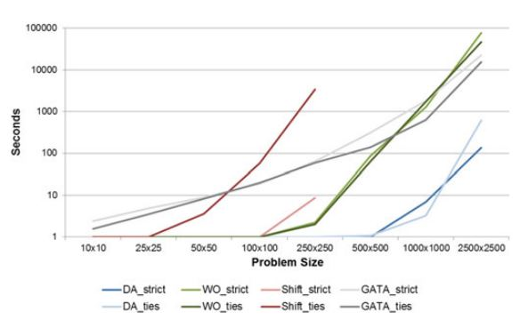
EVALUATION
Allocation Algorithm Runtime Analysis
Fig. 4. Algorithm runtimes with different problem sizes.

Slide 18
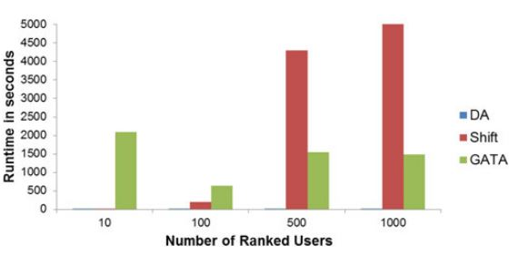
EVALUATION
Allocation Algorithm Runtime Analysis
Fig. 5. Runtimes for different numbers of ranked users, for 1,000 users per side.

Slide 19
Discussion
The social compute cloud facilitates preference-based sharing of computational infrastructure using several different preference matching algorithms. Our results show the qualities of the algorithms and the tradeoffs that arise from factors like runtime, allocation mode, and allocation quality. DA is the most time-efficient algorithm to obtain a stable allocation and using algorithms such as GATA is preferable for smaller settings or when there are no time constraints, whereas using fast algorithms such as DA might be better if allocations need to be made more frequently. Another issue with the matching algorithms considered in this paper is that they currently support only one-to-one matching's but some tweaking extend the algorithms to handle these cases.

Slide 20
Conclusions
In this paper, we have presented a social compute cloud: a platform that enables the sharing of infrastructure resources between friends via digitally encoded social relationships. Using our implementation, users are able to execute programs on virtualized resources provided by their friends. To construct a social compute cloud, we have extended Seattle to access users’ social networks, allow users to elicit sharing preferences, and utilize matching algorithms to enable preference-based socially-aware resource allocation.

Slide 21
References :
[1] M. Armbrust et al., “A View of Cloud Computing,”Comm. ACM,
vol. 53, no. 4, pp. 50-58, 2010.
[2] F. Gens, “New IDC IT Cloud Services Survey: Top Benefits and
Challenges,” IDC exchange, http://blogs.idc.com/ie/?p=730,
2009.
[3] D. Bradshaw, G. Folco, G. Cattaneo, and M. Kolding,
“Quantitative Estimates of the Demand for Cloud Computing in
Europe and the Likely Barriers to Up-Take,” http://ec.europa.
eu/information_society/activities/cloudcomputing/docs/quantitative_estimates.pdf, July 2012.
[4] K. Chard, S. Caton, O. Rana, and K. Bubendorfer, “Social Cloud:
Cloud Computing in Social Networks,”Proc. IEEE Third Int’l Conf.
Cloud Computing (CLOUD), pp. 99-106, 2010.
[5] K. Chard, K. Bubendorfer, S. Caton, and O. Rana, “Social
Cloud Computing: A Vision for Socially Motivated Resource
Sharing,”IEEE Trans. Services Computing,vol.5,no.4,pp.551-563, Jan. 2012

Slide 22
Thank you , all…

