Slide 1
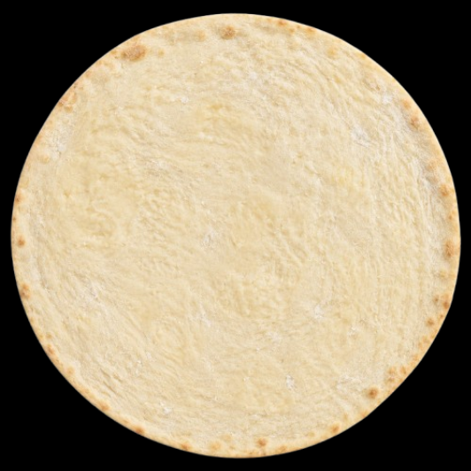
▸ THE FUTURE OF DINING
Welcome to
Pizza 3.14 π
Smart Tabletop Pizza Ordering System
Final Year Project — BS Computer Science
Academic Year 2025–2026

Slide 2
▸ PROJECT INTRODUCTION
02
Introduction
University
National University of Technology
Supervisor
Ma'am Kainaat Zafar
Project Title
Pizza 3.14 — Interactive Tabletop
Ordering & Kitchen Management System
Group Members
1
Ali Ashir
F22605023
2
Shiza Khizar
F22605038
3
Muhammad Saad
F22605031
4
Brekhna Afridi
F22605049

Slide 3
▸ PRESENTATION OUTLINE
03
Agenda
What we will cover in this pitch
01
Problem Statement
02
Proposed Solution
03
Key Features
04
System Architecture
05
Technology Stack
06
Modules & User Flows
07
Blockchain styled Feedback
08
Results & Future Work

Slide 4
▸ 01 — OVERVIEW
04
Project Overview
A full-stack tabletop dining experience that turns pizza ordering into an immersive, real-time ritual.
1
User Roles
Customer · Kitchen · Admin
2
Order Stages
NEW → PREPARING → BAKING → READY → SERVED
3
Layer Types
Base · Sauce · Cheese · Toppings
4
Combinations
Visual builder with live nutrition & pricing

Slide 5
▸ 02 — THE PROBLEM
05
Problem Statement
Traditional restaurant ordering fails customers and kitchens alike.
Static, lifeless menus
Verbal miscommunication
No live preview
No interactivity or visual engagement at the table.
Waiter relay introduces wrong toppings and sizes.
Customers cannot see their pizza before it arrives.
Hidden pricing & nutrition
Chaotic kitchen workflow
Hidden order status
No real-time calories or cost while customizing.
Paper tickets and shouted orders during peak hours.
Customers wait in the dark — anxiety grows.

Slide 6
▸ 03 — OUR SOLUTION
06
Proposed Solution
Pizza 3.14 unifies visual ordering, real-time kitchen sync, and tamper-evident feedback in one dark-glass tabletop experience — built for the modern restaurant.
Orbit-ring pizza builder — Drag ingredients onto a live canvas with GSAP animations and real food photography.
Live nutrition & billing — Calories, macros, and price update instantly on every layer change.
Socket.io real-time sync — Kitchen Kanban and customer table stay in sync without page refresh.
Waiting engagement — Tic-tac-toe and pizza trivia while orders are prepared.
SHA-256 feedback chain — Append-only blockchain-style ledger — verifiable by admin.

Slide 7
▸ 04 — KEY FEATURES
07
Key Features
Six features. One revolution.
Visual Pizza Builder
Drag ingredients from an orbit ring. Layered canvas with BASE → SAUCE → CHEESE → TOPPINGS.
Live Nutrition & Pricing
Calories, protein, fats, carbs, and bill total update on every selection.
Real-time Kitchen Kanban
Socket.io push: NEW → PREPARING → BAKING → READY → SERVED. Zero refresh.

Slide 8
▸ 04 — KEY FEATURES
08
Live Order Tracking
Customers watch status toasts and progress bar from the table.
Blockchain Feedback
SHA-256 hash chain: each review links to the previous block. Admin verifies integrity.
Most Famous Combo
Surfaces top-ordered combinations from real order data.

Slide 9
▸ 05 — THE EXPERIENCE
09
How It Works
Five steps — from seat to satisfaction.
01
02
03
04
05
Sit
Build
Order
Watch
Verify
Table greets you with menu & combo banner
Orbit ring → canvas. Live nutrition & price
One tap — kitchen sees it instantly
Live status: NEW through READY
Tamper-evident feedback after SERVED

Slide 10
▸ 06 — ARCHITECTURE
10
System Architecture
Three clients · one Next.js server · PostgreSQL
Presentation
Customer Table | Kitchen Kanban | Admin Dashboard
Application
Next.js 14 App Router · API Routes · Socket.io Server · Auth Middleware
Data
Prisma ORM → PostgreSQL (Supabase)
Socket.io Rooms: kitchen | table-{tableId}

Slide 11
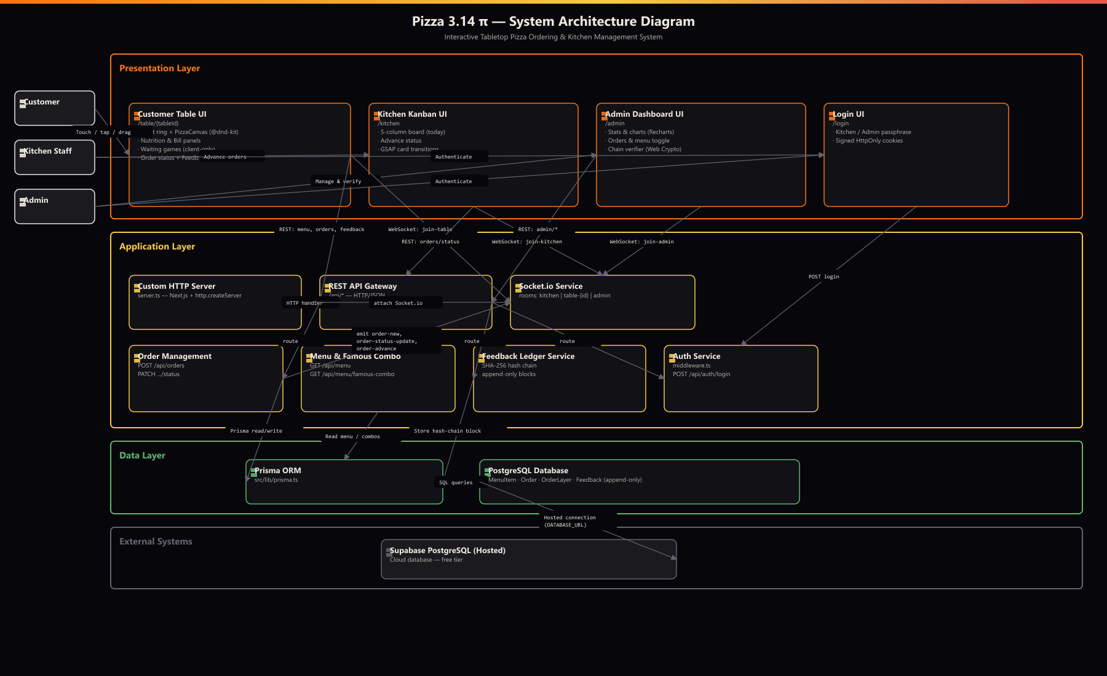
▸ 06 — ARCHITECTURE
10

Slide 12
▸ 07 — TECHNOLOGY
11
Technology Stack
Modern, production-grade tools chosen for speed and reliability.
Frontend
Backend
Next.js 14 (App Router)
React 18 · TypeScript
Tailwind CSS · GSAP
@dnd-kit (touch drag)
Next.js API Routes
Custom Node server + Socket.io
Prisma ORM
SHA-256 hash (Node crypto)
Database
Deploy & Tools
PostgreSQL (Supabase)
MenuItem · Order · OrderLayer
Feedback (append-only chain)
Railway
Demo passphrase auth
Recharts (admin analytics)

Slide 13
▸ 08 — DATA MODEL
12
Database Design
Relational schema with strict layer ordering and immutable feedback.
MenuItem
Ingredients: name, layerType, price, nutrition, imageUrl, isAvailable
Order
tableId, status, totalPrice, totalCals, timestamps
OrderLayer
Links order ↔ menu item; server assigns zIndex for render stack
Feedback
contentHash, prevHash, blockHash, timestamp — NEVER updated/deleted
OrderStatus: NEW → PREPARING → BAKING → READY → SERVED

Slide 14
▸ 09 — MODULES
13
User Roles & Modules
Three personas — one connected ecosystem.
Customer
/table/{id} · Public
Orbit builder · live bill · order · games · feedback
Kitchen
/kitchen · Passphrase
Today's Kanban · advance status · Socket.io live board
Admin
/admin · Passphrase
Stats · orders · menu toggle · chain verifier

Slide 15
▸ 10 — CUSTOMER MODULE
14
Customer Table Experience
Black-glass full-screen tabletop — no browser chrome.
Most Famous Combo banner auto-populates top orders (dismissible)
Ingredient orbit ring around central pizza canvas
Left panel: live nutrition (calories, protein, fat, carbs)
Right panel: itemized bill + Place Order (requires exactly one BASE)
Waiting mode: orbit fades → Tic-Tac-Toe + Pizza Trivia
GSAP animations: fly-in layers, celebration on SERVED
Table Layout
┌ Combo Banner ─────────────┐
│ Nutrition │ Canvas │ Bill │
│ │ Orbit │ │
│ │ Games* │ │
└───────────────────────────┘
*after order placed

Slide 16
▸ 11 — KITCHEN MODULE
15
New orders appear instantly — no refresh
Advance → moves one status step; emits to customer table
SERVED column is read-only (no further advance)
GSAP animates cards between columns
Kitchen Kanban Board
Today's orders only — live via Socket.io.
NEW
PREPARING
BAKING
READY
SERVED

Slide 17
▸ 12 — INNOVATION
16
Blockchain-Style Feedback Ledger
Tamper-evident reviews — verifiable in the admin panel.
contentHash = SHA256(rawText)
prevHash = previous blockHash (or "0")
timestamp = ISO 8601 UTC
blockHash = SHA256(prevHash + timestamp + contentHash)
Append-only: Feedback rows are never updated or deleted
Prisma $transaction prevents prevHash race conditions
Gated on order.status === SERVED (one review per order)
Admin "Verify Chain" re-computes hashes client-side (Web Crypto)
Shows VALID or BROKEN per block — full transparency

Slide 18
▸ 13 — OUTCOMES
17
Project Outcomes
What we delivered in this FYP implementation.
End-to-end tabletop ordering with photorealistic layered pizza canvas
Bi-directional real-time sync (Socket.io) between kitchen and customer
Live nutrition and pricing engine — no surprise bills
Engagement layer (games) reducing perceived wait time
Cryptographic feedback integrity without external blockchain APIs
Responsive dark UI matching premium landing-page design system
REST API + documented routes for orders, menu, feedback, admin stats

Slide 19
▸ 14 — ROADMAP
18
Future Scope
Post enhancements for production deployment.
Production Auth
OAuth / role-based access replacing demo passphrases
Multi-branch
Franchise support with per-location menus and analytics
Payments
Integrated checkout (Stripe / local gateways)
Mobile Native
Dedicated waiter / manager apps
AI Recommendations
Personalized combos from order history
IoT Integration
Smart table sensors + kitchen display systems

Slide 20
▸ THANK YOU
Thank You
Pizza 3.14 π
Questions & Discussion
National University of Technology
Supervisor: Ma'am Kainaat Zafar
Ali Ashir · Shiza Khizar · Muhammad Saad · Brekhna Afridi

