Slide 1


Design and Development of a Real-time Process Monitoring, Scheduling and Performance Analysis System
Csa0403 – OPERATING SYSTEMS
Presented by,
Paneesha B (192472206)
Prithiyanka shree M (192521144)
Vishali P (192524313)
Ashira Bridget Susan S (192524316)
Lasyasree K (192511140)
Under the Guidance of,
Dr. Charlyn Pushpa Latha G

Slide 2

Introduction
A real-time system for tracking, scheduling, and evaluating running processes.
Continuously monitors process states, CPU usage, waiting time, and execution behavior.
Applies scheduling strategies to improve resource utilization and responsiveness.
Converts raw process data into meaningful performance insights.

Slide 3

Problem Statement
Traditional process monitoring often provides static or delayed performance information.
Poor scheduling decisions can increase waiting time and response time.
Manual analysis makes it difficult to identify process bottlenecks quickly.
A unified system is needed to monitor, schedule, and analyze processes dynamically.

Slide 4
Literature Survey
S. No. | Author(s) & Year | Methodology / Technology | Key Findings | Research Gap
1 | Lakshman et al. (2027) | Reviewed IoT-based smart library architecture using RFID, sensors, and cloud technologies. | IoT improves book tracking, inventory management, and library automation. | Lacks practical implementation and security evaluation.
2 | Limkar et al. (2025) | Developed a smart library system using RFID, barcode scanning, and IoT. | Reduces manual work and improves library operations. | Does not include AI-based analytics or predictive features.
3 | Cheung et al. (2025) | Qualitative study on IoT-enabled academic library services. | IoT enhances user experience, resource utilization, and service efficiency. | Limited to qualitative analysis and a specific regional context.
4 | Naikar & Paul (2025) | Reviewed future smart library technologies including AI, IoT, and cloud computing. | Smart libraries offer intelligent and user-centric services. | No implementation or performance validation provided.

Slide 5

Objectives
Monitor process execution and system resource usage in real time.
Implement and compare multiple CPU scheduling techniques.
Calculate waiting time, turnaround time, response time, and CPU utilization.
Detect performance variations and potential bottlenecks.
Present results through clear reports and visual performance indicators.

Slide 6

Existing System
Monitor process execution and system resource usage in real time.
Implement and compare multiple CPU scheduling techniques.
Calculate waiting time, turnaround time, response time, and CPU utilization.
Detect performance variations and potential bottlenecks.
Present results through clear reports and visual performance indicators.

Slide 7

Proposed System
Process monitoring and scheduling are commonly handled as separate activities.
Scheduling algorithms are usually evaluated using predefined datasets.
Performance analysis often requires manual calculation.
Limited integration between live process status and scheduling decisions.
Difficult to obtain a complete performance overview from a single interface.

Slide 8
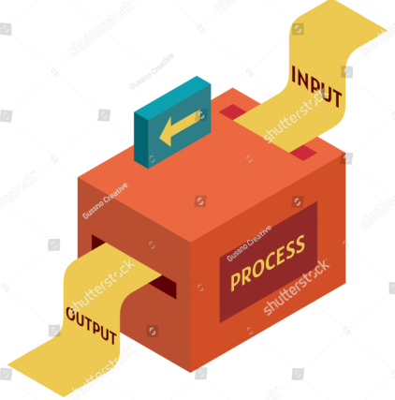
Module 1: Process Input & Monitoring
Accepts process details such as Process ID, arrival time, burst time, and priority.
Maintains the current state of every process.
Tracks transitions such as Ready, Running, and Completed.
Continuously updates process execution information.

Slide 9

Module 2: Scheduling Engine
Implements selected CPU scheduling algorithms.
Determines the next process based on scheduling criteria.
Handles process queues and execution order.
Supports comparison between different scheduling strategies.
Highlights how scheduling decisions affect overall performance.

Slide 10

Module 3: Real-Time Performance Tracking
Records execution metrics while processes are being simulated.
Calculates waiting, turnaround, and response times.
Monitors CPU utilization and scheduling efficiency.
Identifies processes experiencing excessive delays.
Provides continuously updated performance indicators.

Slide 11

Module 4: Analysis & Comparison
Compares scheduling algorithms using common performance metrics.
Identifies the algorithm producing better execution efficiency.
Detects bottlenecks and inefficient process behavior.
Converts collected data into comparative performance insights.
Supports data-driven evaluation of scheduling decisions.

Slide 12

Module 5: Reports & Visualization
Displays process status and scheduling results in an organized dashboard.
Generates tables and charts for performance comparison.
Presents key metrics using easily understandable indicators.
Produces summarized reports for further analysis.
Enables quick interpretation of system behavior.

Slide 13

Advantages
Provides centralized process monitoring and scheduling.
Reduces manual performance calculations.
Enables quick identification of process delays.
Makes scheduling algorithms easier to compare and understand.
Improves visibility into CPU and process performance.

Slide 14

Limitations
Primarily operates as a simulation-based system.
Results depend on the accuracy of input process parameters.
May not represent all complexities of modern operating systems.
Advanced real-time scheduling policies may require additional implementation.
Large-scale process environments may require stronger optimization.

Slide 15

Real-World Applications
Operating System Process Management – evaluating CPU scheduling behavior.
Data Centers – analyzing workload distribution and resource usage.
Cloud Computing – studying process allocation and execution efficiency.
Embedded Systems – monitoring time-sensitive tasks.
Performance Testing – identifying execution bottlenecks in computing workloads.

Slide 16

Future Enhancements
Integrate live operating-system process data instead of simulated inputs.
Add intelligent scheduling using workload-based decision-making.
Introduce predictive analytics for detecting future bottlenecks.
Develop remote monitoring through a web-based dashboard.
Extend the system for multi-core and distributed environments.

Slide 17

Conclusion
The system provides an integrated approach to process monitoring, scheduling, and performance analysis.
Real-time tracking improves visibility into process execution.
Scheduling comparison helps identify more efficient execution strategies.
Automated analytics simplify performance evaluation.
The proposed framework can serve as a foundation for smarter and adaptive process management systems.

Slide 18
THANK YOU!

