Slide 1

Rule-Based Enterprise Workflow Optimization for Identifying and Reducing Task Bottlenecks Using Functions and Dynamic Memory Allocation
Csa0201 – c programming
Presented by,
Ashira Bridget Susan S – 192524316
Priyavarsheni M V - 192524428
Guided by,
Dr. Charlyn Pushpa Latha G

Slide 2

Introduction
Modern enterprises handle hundreds of workflow tasks daily across multiple departments.
Delays in task completion can reduce operational efficiency and productivity.
Identifying workflow bottlenecks early helps organizations improve resource utilization.
This project implements a rule-based workflow optimization framework using the C programming language.
Functions and dynamic memory allocation are utilized to efficiently manage and analyze workflow data.

Slide 3
Literature Survey
Authors & Year | Title | Key Contribution | Relevance to Project | Authors & Year
Yu & Yao (2026) | Agents and Workflows | Explores intelligent agents and workflow management using large language models for task execution and automation. | Provides the conceptual foundation for agent-based workflow optimization and intelligent task management. | Yu & Yao (2026)
Shoba et al. (2026) | Hierarchical ML Ensemble Engine for Dynamic Project Management Optimization and Resource Intelligence | Proposes an ML ensemble framework for optimizing project management and resource allocation dynamically. | Demonstrates techniques for improving resource utilization and workflow efficiency in enterprise environments. | Shoba et al. (2026)
Kosińska et al. (2025) | Rule-based Execution of Management Actions in Cloud-native Environments | Introduces a rule-based approach for automating management actions in cloud-native systems. | Supports the use of constraint-based and rule-driven mechanisms for workflow execution and bottleneck reduction. | Kosińska et al. (2026)
Yandamuri (2024) | AI-Enabled Workflow Automation and Predictive Analytics for Enterprise Operations Management | Presents AI-driven workflow automation integrated with predictive analytics for enterprise operations. | Highlights the role of AI in predicting performance trends and enhancing operational decision-making. | Yandamuri (2026)

Slide 4

Problem Statement
Enterprise workflows often experience delays due to inefficient task execution.
Manual monitoring of large task datasets is time-consuming and error-prone.
Bottlenecks are difficult to identify without systematic analysis.
Organizations require a lightweight and explainable solution to detect workflow inefficiencies.
There is a need for a rule-driven system that can identify, classify, and HELP reduce task bottlenecks.

Slide 5

Objectives
Analyze workflow tasks and identify delayed activities.
Detect bottlenecks using predefined business rules.
Classify bottlenecks into minor, moderate, and severe categories.
Recommend suitable workflow management strategies.
Simulate optimization and measure performance improvement.
Generate analytical reports for workflow evaluation.

Slide 6

Existing System
Workflow monitoring is largely manual.
Delays are identified only after operational issues occur.
Limited visibility into department-wise performance.
Lack of structured bottleneck classification mechanisms.
Decision-making depends heavily on human observation.
Difficult to scale for large datasets.

Slide 7
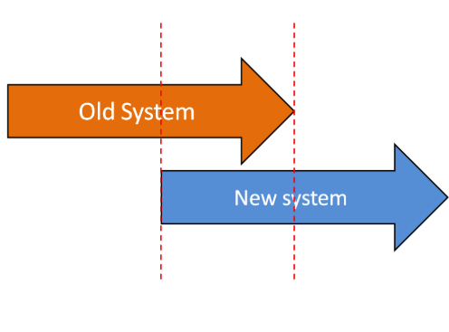
Proposed System
A rule-based enterprise workflow optimization framework.
Automatically analyzes workflow datasets.
Detects bottlenecks based on task delays.
Assigns workflow management methods using business rules.
Simulates optimization outcomes to estimate performance gains.
Generates department-wise and task-wise analytical reports.
Uses dynamic memory allocation for scalable data handling.

Slide 8


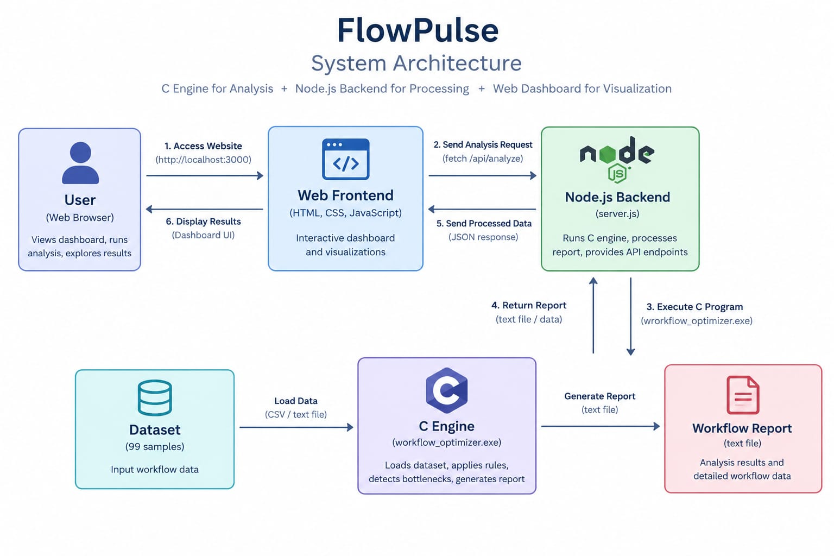
System Architecture

Slide 9
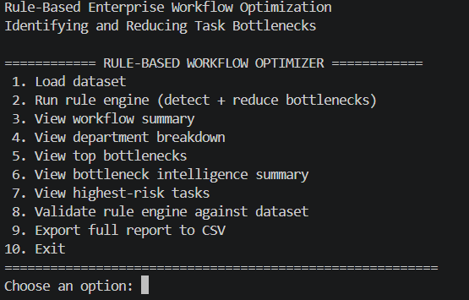
Module 1 – Intelligent Workflow Analysis Engine
FUNCTIONS PERFORMED
Loads workflow dataset from CSV files.
Dynamically allocates memory for workflow records.
Calculates the difference between estimated and actual completion times.
Detects delayed tasks automatically.
Classifies delays into:
  Minor delay
  Moderate delay
  Severe delay
Determines workflow efficiency status.
OUTCOME
Provides accurate identification of workflow bottlenecks and operational inefficiencies.

Slide 10
Module 2 – Optimization & Decision Support Engine
FUNCTIONS PERFORMED
Evaluates task priority levels.
Assigns workflow management methods:
  Optimized
  Hybrid
  Manual
Simulates post-optimization task execution.
Calculates expected performance improvement.
Generates workflow summaries and departmental reports.
Validates rule-engine accuracy against the dataset.
OUTCOME
Supports decision-making and recommends strategies to reduce workflow delays.

Slide 11
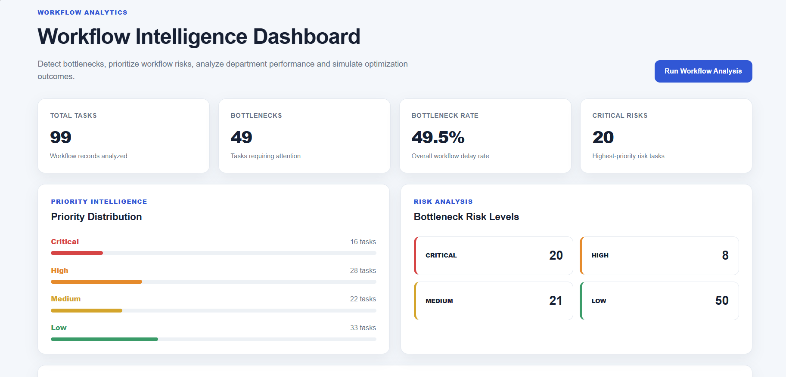

Slide 12
Advantages & Limitations
Advantages
Simple and easy to understand.
Fully explainable rule-based decisions.
No machine learning dependency.
Fast execution with low computational overhead.
Dynamic memory improves scalability.
Generates accurate workflow reports.
Achieved 100% validation accuracy on the dataset.
Limitations
Performance depends on predefined rules.
Rules must be updated when business processes change.
Cannot automatically learn from new patterns.
Limited adaptability compared to advanced AI systems.

Slide 13

Future Scope
Integration with real-time workflow monitoring systems.
Development of graphical dashboards for visualization.
Hybrid integration with machine learning models.
Cloud-based workflow analytics platform.
Automated resource allocation recommendations.
Real-time bottleneck alerts and notifications.
Support for larger enterprise datasets and distributed systems.

Slide 14
Conclusion
A rule-based enterprise workflow optimization framework was successfully developed.
The system effectively identifies and categorizes workflow bottlenecks.
Dynamic memory allocation enables efficient management of workflow records.
Optimization rules help improve task execution strategies.
Department-wise and workflow-wide insights support better decision-making.
The project demonstrates how rule-based intelligence can enhance enterprise workflow efficiency in a transparent and cost-effective manner.

Slide 15
THANK YOU!

