Slide 1
SAP-FI
A comprehensive overview.
Notes:
Entered text
SAP-FI

Slide 2
Introduction
Financial Accounting is designed to collect the transactional data that provides a foundation for preparing the standard portfolio of reports.
In general, these reports are primarily, but not exclusively, directed at external parties.
Standard reports include: • Balance Sheet
• Income Statement
• Statement of Cash Flows

Slide 3
SAP-FI is a module within the SAP ERP (Systems, Applications and Products Enterprise Resource Planning) system, focusing on financial accounting processes.
It is used by organizations to manage their financial transactions, reporting, and analysis.
SAP-FI integrates with other SAP modules such as SAP-MM (Materials Management) and SAP-SD (Sales and Distribution) to provide end-to-end financial management.

Slide 4
Key Features and Functionality of SAP-FI
General Ledger (G/L)
Accounts Payable (FI-AP)
Accounts Receivable (FI-AR)
Asset Accounting (AA)
Bank Accounting (BA)
Cash Management (CM)
Financial Reporting

Slide 5
General Ledger (G/L)
The General Ledger in SAP-FI serves as the central repository for financial transactions, providing a comprehensive and accurate view of an organization's financial position.
It allows businesses to define and maintain their chart of accounts, record journal entries, and generate financial reports like balance sheets and income statements.
Integration with other SAP modules enables real-time updates, improved data accuracy, and streamlined financial processes.
The GL supports period-end and year-end closing activities, ensuring compliance and facilitating the generation of financial statements.
Additionally, the GL provides extensive reporting and analysis capabilities, allowing businesses to gain insights into their financial performance, identify trends, and make informed strategic decisions.

Slide 6
Accounts Payable (FI-AP)
FI-AP in SAP-FI manages vendor-related financial transactions, including invoice processing, payment management, and reconciliation.
It automates invoice verification, supports various payment methods, and integrates with the General Ledger for accurate financial postings.
FI-AP provides reporting and analysis capabilities for better cash flow management and vendor relationship management.
It streamlines processes, reduces manual effort, and improves efficiency in managing payables.
The system supports various payment methods, such as checks, electronic funds transfer (EFT), and automatic payment programs, ensuring timely and accurate payments to vendors.

Slide 7
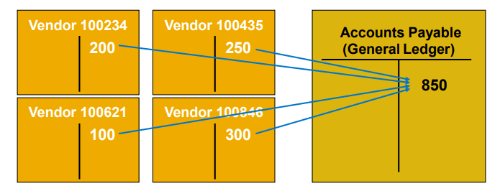

Slide 8
Accounts Receivable (FI-AR)
FI-AR in SAP-FI handles the organization's customer-related financial transactions, including invoicing, receipt processing, and revenue recognition.
It automates customer invoicing, tracks receivables, and supports various payment methods for efficient cash collection.
FI-AR integrates with the General Ledger for accurate financial postings and provides reporting and analysis capabilities for monitoring receivables and cash flow.
It streamlines processes, improves cash flow management, and enhances customer relationship management.
AR offers comprehensive reporting capabilities, such as aged receivables analysis, open item analysis, and customer account statements, providing insights into outstanding receivables and cash flow management.

Slide 9
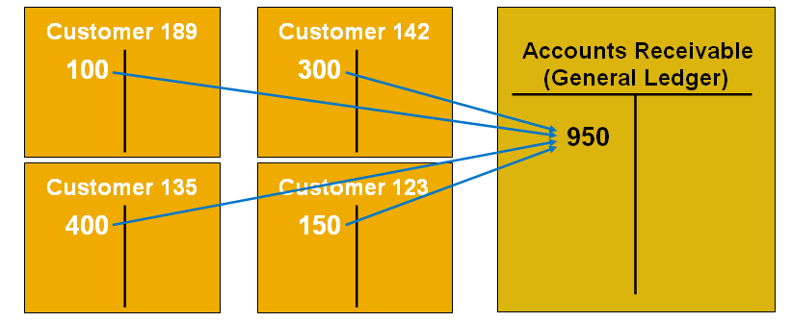

Slide 10
Asset Accounting (AA)
AA in SAP-FI manages fixed assets throughout their lifecycle, including acquisition, depreciation, retirement, and valuation.
It enables businesses to record and track assets, define depreciation methods, and ensure compliance with accounting standards.
AA automates depreciation calculations, integrates with other modules, and provides reporting for asset monitoring and analysis.
It streamlines asset accounting processes, reduces manual effort, and ensures accurate financial reporting of fixed assets.
AA provides reporting capabilities, including asset balance reports, asset history sheets, and asset value analysis, allowing businesses to monitor and analyze their asset portfolio.
It also supports asset master data management, allowing businesses to maintain detailed information about each asset, including location, maintenance history, and acquisition details.

Slide 11
Bank Accounting (BA)
BA in SAP-FI manages financial transactions related to banks, including bank master data, reconciliation, and electronic bank statement processing.
It enables businesses to maintain bank details, reconcile financial records, and process electronic bank statements.
BA integrates with the General Ledger, automates bank transactions, and provides reporting on bank balances and cash flows.
It streamlines bank accounting processes, reduces manual effort, and ensures accurate financial management of bank transactions.
BA offers reporting capabilities, including bank account statements, cash position reports, and bank reconciliation reports, providing insights into cash flows and bank balances.

Slide 12
Cash Management (CM)
CM in SAP-FI optimizes cash flows and liquidity through cash positioning, forecasting, and liquidity management.
It provides real-time monitoring of cash positions, supports cash forecasting, and integrates with other modules.
CM streamlines cash-related transactions, offers reporting on cash flows and liquidity, and improves cash management efficiency.
It offers reporting capabilities, including cash flow statements, liquidity analysis, and cash position reports, providing insights into cash availability and financial risk management.

Slide 13
Financial Reporting
Financial Reporting in SAP-FI generates accurate financial statements like balance sheets, income statements, and cash flow statements.
It provides real-time access to financial data for timely decision-making and compliance with accounting standards.
The reporting system supports customization, analysis features, and drill-down capabilities for deeper insights.
The reporting functionality can be integrated with other modules and external systems for data consolidation and comprehensive reporting.
With its user-friendly interfaces and advanced reporting tools, SAP-FI enables efficient and user-friendly financial reporting processes.

Slide 14
FI Master Data
Customer and Vendor Master Data
Customer and vendor account balances are maintained in FI through fully integrated accounts receivable and accounts payable sub-ledgers.
Financial postings for customers and vendors are made directly to their respective individual accounts and accompanied by a concurrent automatic posting to the General Ledger.

Slide 15
FI Reporting
Balance Sheet : • Presentation of an organization’s Assets, Liabilities, and Equity at a point in time. • Assets: What the company owns • Liabilities: What the company owes • Equity: The difference between Assets and Liabilities • Assets - Liabilities = Equity
Income Statement :
• Presentation of an organization’s revenues and expenses for a given period of time (e.g. monthly, quarterly, or yearly). • Revenues, in a simple sense, are inflows of cash as a result of selling activities or the disposal of company assets. • Expenses, in a simple sense, are outflows of cash or the creation of liabilities to support company operations. • Revenues - Expenses = Net Income

Slide 16
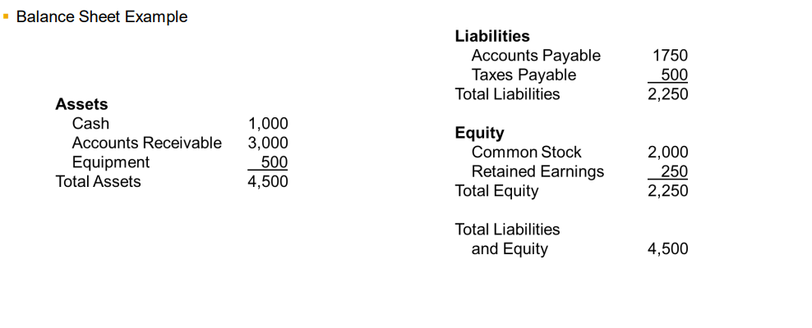

Slide 17
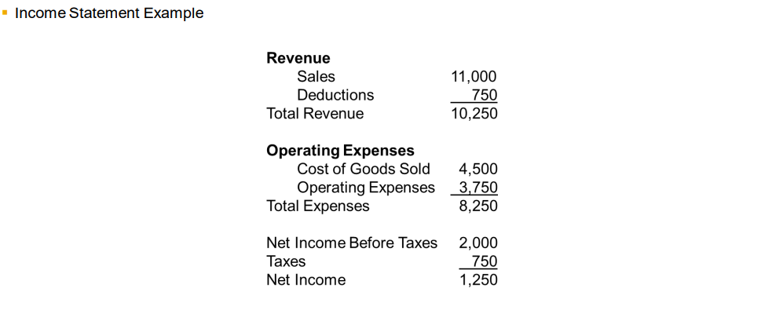

Slide 18
SAP Document Principle
Each business transaction impacting FI writes data to the SAP database creating a uniquely numbered electronic document.
The document number can be used to recall the transaction at a later date.
It contains, for example, such critical and necessary information as: • Responsible person • Date and time of the transaction • Commercial content
Once written to the SAP database, a financial document (one impacting the financial position of the company) can not be deleted from the database.
It can be changed to some degree.
The SAP document principle provides a solid and important framework for a strong internal control system – a requirement of law for companies that operate in most countries in the world.

Slide 19
Integration of SAP-FI with other SAP modules
Integration with SAP-MM (Materials Management)
Integration with SAP-SD (Sales and Distribution)
Integration with Controlling (CO)

Slide 20
Integration with SAP-MM (Materials Management)
Procure-to-Pay Process: SAP-FI integrates with SAP-MM to facilitate financial postings related to procurement processes. When a purchase order is created in SAP-MM, it can trigger the creation of accounting documents in SAP-FI.
Goods Receipt: When goods are received in the warehouse and a goods receipt is recorded in SAP-MM, it triggers the financial postings in SAP-FI, updating inventory values and generating corresponding accounting entries.
Invoice Verification: SAP-FI receives invoice verification data from SAP-MM, enabling the automatic posting of vendor invoices and initiating the payment process.

Slide 21
Integration with SAP-SD (Sales and Distribution)
Order-to-Cash Process: SAP-FI integrates with SAP-SD to streamline financial processes related to sales and distribution. When a sales order is created in SAP-SD, it can trigger financial postings in SAP-FI.
Revenue Recognition: SAP-FI receives revenue data from SAP-SD, ensuring accurate recognition of revenue based on sales orders and delivery status.
Billing: SAP-FI generates customer invoices based on billing data from SAP-SD, and these invoices are posted in the FI module for accounts receivable management and revenue reporting.

Slide 22
Integration with Controlling (CO)
Cost and Revenue Transfer: SAP-FI and the Controlling (CO) module are closely integrated to transfer cost and revenue information between the modules. This integration allows for management accounting and cost controlling purposes.
Cost Centre Accounting: SAP-FI sends cost centre-related financial data to CO, which enables detailed cost analysis, budgeting, and variance reporting.
Profit Centre Accounting: SAP-FI provides financial data to CO for profit centre reporting, allowing organizations to analyse profitability at the individual profit centre level.

Slide 23
Benefits of SAP-FI

Slide 24
Improved Financial Control
Accurate Financial Data: SAP-FI ensures the integrity and accuracy of financial data by automating financial transactions and reducing manual errors.
Compliance with Accounting Standards: SAP-FI helps organizations adhere to accounting standards and regulatory requirements by enforcing proper accounting practices and generating compliant financial statements.
Reduced Financial Risk: The system provides checks and controls to minimize financial risk, such as segregation of duties, approval workflows, and audit trails.

Slide 25
Streamlined Processes
Automation: SAP-FI automates financial processes such as invoice processing, payment processing, and bank reconciliation, reducing manual effort and increasing efficiency.
Process Integration: The integration of SAP-FI with other SAP modules ensures seamless flow of data and eliminates the need for duplicate data entry or reconciliation across different systems.
Workflow Management: SAP-FI allows the creation of workflow rules and approval processes, streamlining financial operations and improving process efficiency.

Slide 26
Real-time Reporting and Analysis
Timely and Accurate Information: SAP-FI provides real-time access to financial data, enabling stakeholders to make informed decisions based on up-to-date information.
Financial Reports: The system offers a wide range of predefined financial reports such as balance sheets, income statements, cash flow statements, and trial balances. These reports can be customized and generated at any time.
Analytical Capabilities: SAP-FI allows for in-depth financial analysis by providing tools for data exploration, ad-hoc reporting, and data visualization. This supports financial planning, forecasting, and performance monitoring.

Slide 27
Enhanced Audit Trail
Transactional Traceability: SAP-FI maintains a detailed audit trail of financial transactions, recording the who, what, when, and why of each transaction. This helps in tracking and investigating any discrepancies or anomalies.
Document Management: The system stores and organizes financial documents, such as vendor invoices and customer receipts, providing easy access for audit purposes and ensuring compliance with document retention policies.
Internal Controls: SAP-FI offers robust internal control mechanisms, such as authorization checks, segregation of duties, and document validations, to support a strong control environment.

Slide 28
Integration with External Systems
Bank Integration: SAP-FI can be integrated with external banking systems, enabling electronic bank statement processing, automatic bank reconciliation, and electronic payments, which improves cash management and reduces manual reconciliation efforts.
Third-Party Systems Integration: SAP-FI can exchange data with external systems like procurement platforms or tax systems, ensuring data consistency and reducing data entry efforts.
Data Exchange Standards: SAP-FI supports industry-standard data exchange formats such as EDI (Electronic Data Interchange) or XML (eXtensible Markup Language), allowing seamless integration with partners or customers.

Slide 29
Case Studies

Slide 30
Nestlé
Challenge: Nestle had multiple production facilities spread across different locations, resulting in complex financial processes and decentralized accounting practices.
The lack of a unified financial system made it challenging to obtain accurate financial information and streamline reporting processes.
Solution: The company implemented SAP-FI to centralize financial operations and gain better control over their financial processes.
They configured a standardized chart of accounts and established integration with SAP-MM for seamless procurement-to-payment processes.
Benefits:
Improved Financial Control: The implementation of SAP-FI provided a centralized view of financial transactions, resulting in better financial control and compliance.
Streamlined Processes: The automation of invoice processing and payment management reduced manual effort, resulting in increased efficiency and reduced processing time.
Accurate Financial Reporting: SAP-FI enabled real-time access to financial data, allowing the company to generate accurate financial reports promptly.
Cost Savings: The streamlined processes and enhanced control mechanisms led to cost savings by reducing duplicate payments and minimizing manual errors.

Slide 31
Company: Siemens AG
Industry: Manufacturing
Benefits:
Improved financial reporting accuracy and timeliness.
Streamlined financial processes, reducing manual effort.
Enhanced visibility into financial performance.
Company: Adidas Group
Industry: Retail/Apparel
Benefits:
Integrated financial processes with sales and distribution activities.
Efficient revenue recognition and cash flow management.
Enhanced financial control and compliance.
Company: General Electric (GE)
Industry: Industrial Conglomerate
Benefits:
Standardized financial processes across diverse business units.
Improved financial control and compliance with accounting standards.
Real-time financial reporting for informed decision-making.

Slide 32
Conclusion
In conclusion, SAP-FI offers organizations a robust financial management solution that streamlines operations, enhances financial control, and enables informed decision-making. Through its integration with other SAP modules and real-time reporting capabilities, SAP-FI empowers organizations to achieve improved accuracy, efficiency, and compliance. Successful implementation requires careful planning, configuration, and training. The case studies presented demonstrate the tangible benefits experienced in industries such as manufacturing, retail, and healthcare. By leveraging SAP-FI, organizations can optimize financial processes, drive cost savings, and enhance overall business performance.
Thanks you.

