Slide 1
MEDIA INTELLIGENCE DASHBOARD
Vibecheck Cinema
TMDB + YouTube Data Pipeline
Movie data caching • sentiment analysis • resilient discovery
Browser
Pipeline
TMDB + YouTube
VIBECHECK CINEMA • TMDB + YOUTUBE DATA PIPELINE
01

Slide 2
RATIONALE
Why This Pipeline Exists
01
Unified Discovery
02
Unstructured Data
Users need a single interface for movie metadata and audience signals across multiple sources.
YouTube comments are high-volume and unstructured; the pipeline must extract a clear sentiment signal.
03
API Efficiency
04
Resilience
Direct provider calls for every visitor increase latency and consume TMDB/YouTube quotas.
A persistent cache decouples the user experience from temporary upstream API failures.
VIBECHECK CINEMA • TMDB + YOUTUBE DATA PIPELINE
02

Slide 3
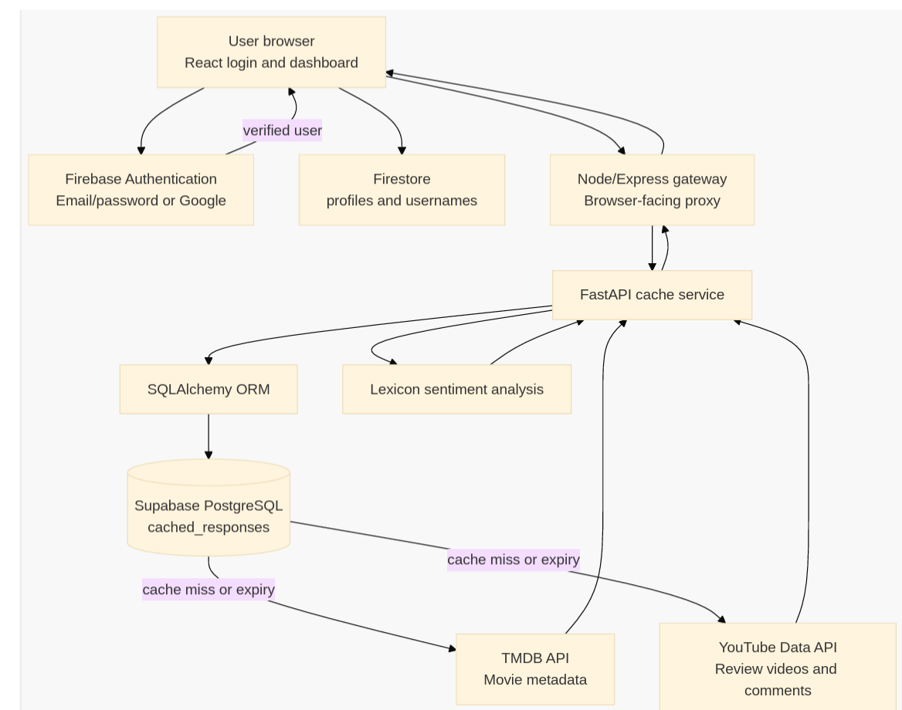
ARCHITECTURE
System Flow at a Glance
Browser → Gateway → Cache Service → PostgreSQL (SQLAlchemy ORM). TMDB metadata is lazily refetched on cache miss or expiry; YouTube review data is fetched live from the cache service on every request and never stored.
VIBECHECK CINEMA • TMDB + YOUTUBE DATA PIPELINE
03

Slide 4
DATA PATH · TMDB
TMDB Movie-Data Path
Metadata Collection
CACHE KEY GENERATION
Endpoints: Popular, Now Playing, Upcoming, Top Rated, Search, Details
# Search Key
Normalization: Raw JSON mapped to a clean schema — ID, Title, Overview, Poster URL, Rating
search:batman:page=1
Details: Extended fetch adds Credits (Director, Cast) and Videos (Trailers)
# List Key
list:popular:page=1
Stable cache keys drive every PostgreSQL lookup — same request, same key, same row.
# Details Key
movie:27205:details
Keys are stable strings used for PostgreSQL lookups.
VIBECHECK CINEMA • TMDB + YOUTUBE DATA PIPELINE
04

Slide 5
CACHE STRATEGY
Refresh Intervals & Timestamp Formula
Data Category | Refresh Interval | Fetch Logic
Movie Lists (Popular, etc.) | 6 Hours | TMDB called after 6h or on cache miss.
Search Results | 12 Hours | Repeated searches reuse stored JSON.
Movie Details | 30 Days | Metadata changes slowly; long-term cache.
expires_at = current_utc_time + selected_ttl
Lazy Refresh: The cache is not refreshed by a timer. The next request after expiry triggers a fresh API call.
Only TMDB responses are cached. YouTube review data has no TTL row — it is fetched live on every request and never written to PostgreSQL.
VIBECHECK CINEMA • TMDB + YOUTUBE DATA PIPELINE
05

Slide 6
DATA PATH · YOUTUBE
YouTube Review-Data Path
01
02
03
Video Search
Comment Collection
Live Scoring
Search for up to 5 relevant English review videos using the query: “{title} movie review.”
Request up to 40 top-level comments per video via the commentThreads endpoint.
Comments go straight to the lexicon scorer and back to the user — nothing is written to the cache table.
RESILIENT FETCHING
If YouTube collection fails, TMDB metadata is still returned with a recorded source error.
VIBECHECK CINEMA • TMDB + YOUTUBE DATA PIPELINE
06

Slide 7
SENTIMENT ENGINE
From Comments to a Movie Signal
Lexicon-Based Scoring
Verdict Thresholds
A transparent algorithm counts predefined positive and negative words in review sentences.
≥ 50%
Mostly Positive
ASPECTS SCORED
Acting
Story
Visuals
Music
Pacing
< 50%
Mostly Negative
Limits: does not handle sarcasm, negation, or complex context (non-ML approach).
0
No Data / Not Scored
VIBECHECK CINEMA • TMDB + YOUTUBE DATA PIPELINE
07

Slide 8
SERVICE MAP
What Runs Where
A
Frontend Shell
Manages Firebase Authentication and mounts the dashboard shell.
React 19 + Vite
B
Cinema Dashboard
Implements the main discovery UI, loaded via iframe in the React shell.
Static HTML / JS
C
Application Gateway
Proxies requests, handles tRPC, and provides an in-memory cache fallback.
Node / Express
D
Cache Service
Manages the persistent PostgreSQL cache and sentiment pipeline.
FastAPI + SQLAlchemy
VIBECHECK CINEMA • TMDB + YOUTUBE DATA PIPELINE
08

Slide 9
SUMMARY
Key Takeaways
Decoupled architecture separates auth, UI, and data services.
01
Persistent caching reduces API latency and quota consumption.
02
Lazy refresh strategy ensures data freshness without background overhead.
03
Lexicon sentiment provides immediate, interpretable audience signals.
04
VIBECHECK CINEMA • TMDB + YOUTUBE DATA PIPELINE
09

