Slide 1

The Basics of Trading: Strategies and Techniques

Slide 2

Agenda
Introduction to Trading
Fundamental Analysis
Technical Analysis Basics
Developing a Trading Strategy
Behavioral Finance in Trading
Trading Tools and Platforms
Market Trends and Future Outlook
Conclusion and Q&A

Slide 3

Introduction to Trading
Definition of trading and its importance in financial markets
Trading involves the buying and selling of financial instruments such as stocks, bonds, currencies, and derivatives. It plays a crucial role in financial markets by providing liquidity, facilitating price discovery, and allowing investors to react to new information and changing market conditions.
Overview of different trading styles: day trading, swing trading, and position trading
Day trading involves executing multiple trades within a single day, focusing on short-term price movements. Swing trading typically spans days to weeks, capitalizing on short to medium-term market shifts. Position trading takes a longer-term approach, often holding positions for weeks or months, based on fundamental analysis.
Connection between trading strategies and portfolio performance
Effective trading strategies can significantly enhance portfolio performance. By strategically choosing when to enter and exit trades, investors can manage risk, optimize returns, and align their trading activities with their overall investment goals.

Slide 4


Fundamental Analysis
Understanding economic indicators and their impact on markets
Economic indicators, such as GDP growth rates, unemployment figures, and inflation metrics, are essential for understanding market health. Changes in these indicators can influence investor sentiment and market trends, impacting trading strategies.
Evaluating company performance through financial statements
Analyzing financial statements, including income statements, balance sheets, and cash flow statements, provides insights into a company's financial health. Key metrics like earnings per share (EPS), price-to-earnings (P/E) ratio, and debt-to-equity ratio are vital for assessing a company's potential for growth.
Using news and market sentiment to inform trading decisions
Staying informed about global events, industry news, and market sentiment can help traders and advisors make timely decisions. Utilizing financial news sources, press releases, and social media sentiment analysis can provide competitive advantages in trading.

Slide 5


Technical Analysis Basics
Introduction to chart patterns and price movements
Chart patterns, such as head and shoulders, triangles, and flags, help identify potential future price movements. Understanding these patterns allows traders to make informed predictions about market behavior.
Key technical indicators: Moving Averages, RSI, MACD
Technical indicators like Moving Averages smooth price data to identify trends; the Relative Strength Index (RSI) indicates overbought or oversold conditions; the Moving Average Convergence Divergence (MACD) helps signal potential buy or sell opportunities.
Importance of trends and support/resistance levels
Trends indicate the general direction of market movements, with upward trends signaling bullish markets and downward trends indicating bearish conditions. Support and resistance levels are key price points where trends may reverse, guiding traders in decision-making.

Slide 6

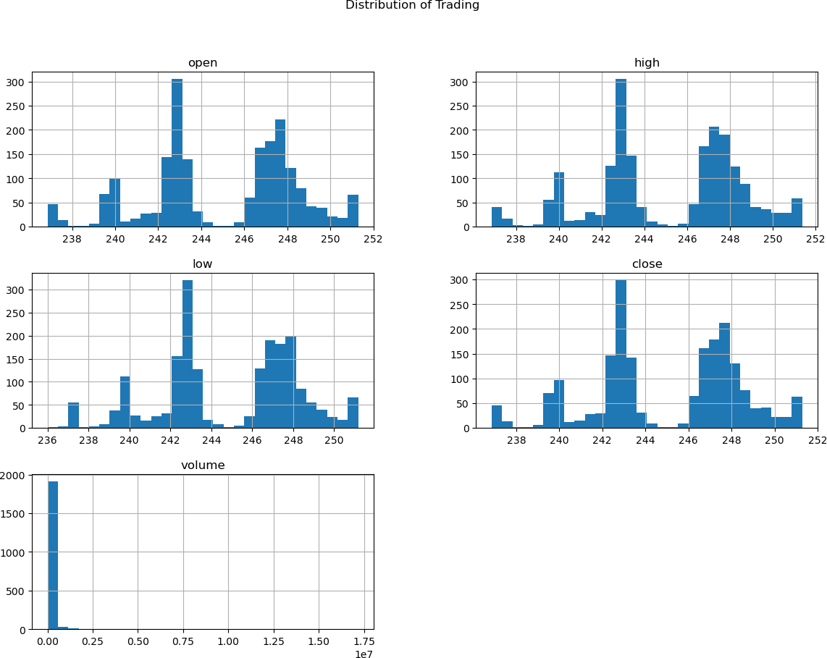

Developing a Trading Strategy
Components of a successful trading strategy: entry, exit, and stop-loss orders
A solid trading strategy requires clear guidelines for entering trades, securing profit through exit points, and limiting losses using stop-loss orders. These components help manage risk and ensure disciplined trading.
Risk management techniques: position sizing and diversification
Effective risk management includes position sizing, which determines how much capital to allocate per trade to prevent significant losses, and diversification, which spreads risk across different assets to minimize exposure to any single investment.
Backtesting strategies using historical data
Backtesting involves applying strategies to historical market data to evaluate their effectiveness. This process helps assess potential performance, optimize strategies, and increase confidence in trading decisions.
Photo by Arthur Mazi on Unsplash

Slide 7

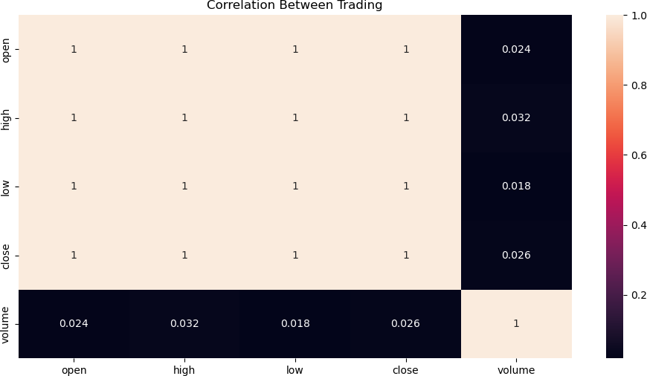
Behavioral Finance in Trading
Understanding common psychological biases in trading: overconfidence, loss aversion Behavioral finance examines how psychological biases, such as overconfidence in one’s predictions and loss aversion where traders prefer to avoid losses over acquiring gains, can influence trading decisions.
Strategies to mitigate emotional trading decisions
Implementing rules-based trading systems can help mitigate emotional biases. Techniques such as setting strict entry and exit rules or using automated trading systems can promote rational decision-making.
The importance of maintaining discipline and a trader's mindset
Maintaining discipline is essential for consistent trading success. A trader's mindset should focus on long-term goals, analytical thinking, and emotional control to navigate the market effectively.
Photo by Fabian Blank on Unsplash

Slide 8
Trading Tools and Platforms
Overview of popular trading platforms and their features
Popular trading platforms like MetaTrader, ThinkorSwim, and Interactive Brokers offer various features, including advanced charting tools, real-time data feeds, and customizable interfaces that enhance the trading experience.
The role of trading software in analysis and execution
Trading software aids in technical analysis, allowing traders to automate trades, backtest strategies, and analyze market trends more effectively, resulting in informed decision-making.
Utilizing algorithmic trading and automated systems
Algorithmic trading utilizes computer algorithms to execute trades based on predefined criteria. Automated systems can enhance efficiency and remove emotion from trading, leading to systematic performance.

Slide 9

Market Trends and Future Outlook
Current market trends affecting trading strategies
Identifying and analyzing trends such as increased volatility, interest rate changes, and geopolitical risks can influence trading strategies. Staying updated on these trends is essential for successful trading.
Evaluating the impact of emerging technologies: AI, blockchain
Emerging technologies like artificial intelligence and blockchain are reshaping financial markets. Understanding the impact of these technologies can help traders stay ahead and optimize their strategies.
Adapting trading strategies to changing market conditions
Traders must remain flexible and adaptive, altering strategies in response to market changes. Regularly reviewing and adjusting strategies ensures alignment with current market environments.

Slide 10

Conclusion and Q&A
Recap of key strategies and techniques discussed
In this presentation, we covered essential trading strategies and techniques, including fundamental and technical analysis, risk management, and the impact of behavioral finance on trading decisions.
Encouragement to implement learned strategies for enhanced performance
I encourage you to apply these strategies and techniques to enhance your portfolio performance. The integration of these practices can lead to more informed and successful trading outcomes.
Open floor for questions and further discussion
Now, I would like to open the floor for any questions or further discussion. I am here to provide clarity on any points we've addressed or to discuss specific trading strategies in more detail.

Slide 11
