Slide 1

HOUSING PRICE PREDICTION
POWER POINT PRESENTATION

Slide 2
Problem Statement
Houses are one of the necessary need of each and every person around the globe and therefore housing and real estate market is one of the markets which is one of the major contributors in the world’s economy. It is a very large market and there are various companies working in the domain. Data science comes as a very important tool to solve problems in the domain to help the companies increase their overall revenue, profits, improving their marketing strategies and focusing on changing trends in house sales and purchases. Predictive modelling, Market mix modelling, recommendation systems are some of the machine learning techniques used for achieving the business goals for housing companies. Our problem is related to one such housing company. A US-based housing company named Surprise Housing has decided to enter the Australian market.
The company uses data analytics to purchase houses at a price below their actual values and flip them at a higher price. For the same purpose, the company has collected a data set from the sale of houses in Australia. The data is provided in the CSV file below. The company is looking at prospective properties to buy houses to enter the market. You are required to build a model using Machine Learning in order to predict the actual value of the prospective properties and decide whether to invest in them or not.
For this company wants to know:
• Which variables are important to predict the price of variable?
• How do these variables describe the price of the house?

Slide 3
Domain Understanding
Domain Understanding :
• The real estate sector is an important industry with many stakeholders ranging from regulatory bodies to private companies and investors. Among these stakeholders, there is a high demand for a better understanding of the industry operational mechanism and driving factors. Today there is a large amount of data available on relevant statistics as well as on additional contextual factors, and it is natural to try to make use of these in order to improve our understanding of the industry.

Slide 4
Literature
The main steps in my research were the following.
• Exploratory Data Analysis (EDA): By conducting explanatory data analysis, we obtain a better understanding of our data. This yields insights that can be helpful later when building a model, as well as insights that are independently interesting.
• Feature Selection: In order to avoid overfitting issues, we select 25(according to PCA ) variables out of the original 81 by using methods Ridge , feature selection
• Modeling: We apply Decision Tree , Random Forest , Linear Regression , K-Neighbours models for prediction of the sale price

Slide 5
EXPLORATORY DATA ANALYSIS
Data exploration is the first step in data analysis and typically involves summarizing the main characteristics of a data set, including its size, accuracy, initial patterns in the data and other attributes. It is commonly conducted by data analysts using visual analytics tools, but it can also be done in more advanced statistical software, Python. Before it can conduct analysis on data collected by multiple data sources and stored in data warehouses, an organization must know how many cases are in a data set, what variables are included, how many missing values there are and what general hypotheses the data is likely to support. An initial exploration of the data set can help answer these questions by familiarizing analysts with the data with which they are working.

Slide 6
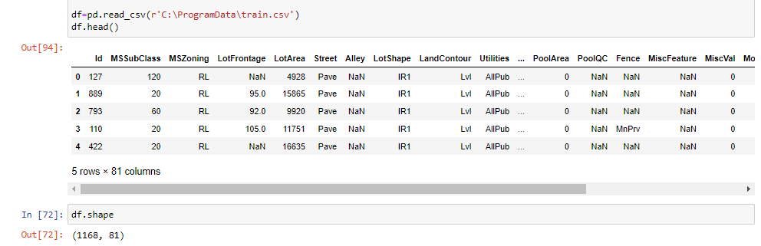
DATASET

Slide 7
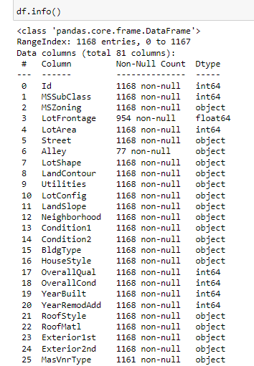

Slide 8
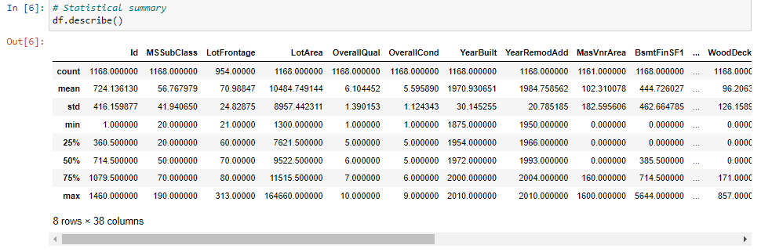
Statistical Summary

Slide 9
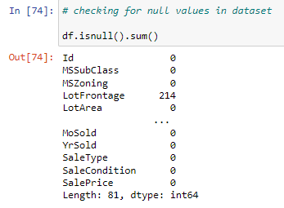
Checking null values in dataset

Slide 10
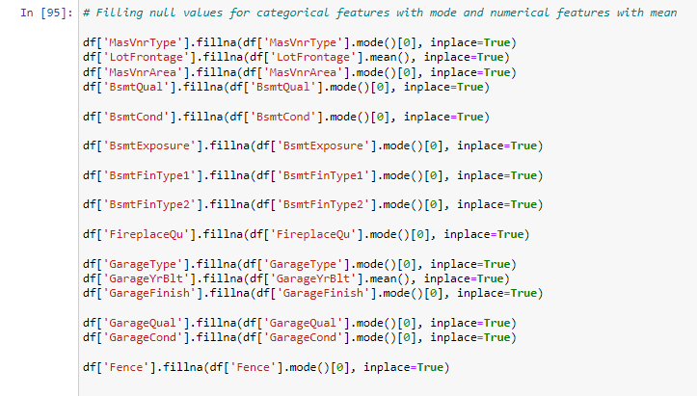
Filling null values in dataset

Slide 11
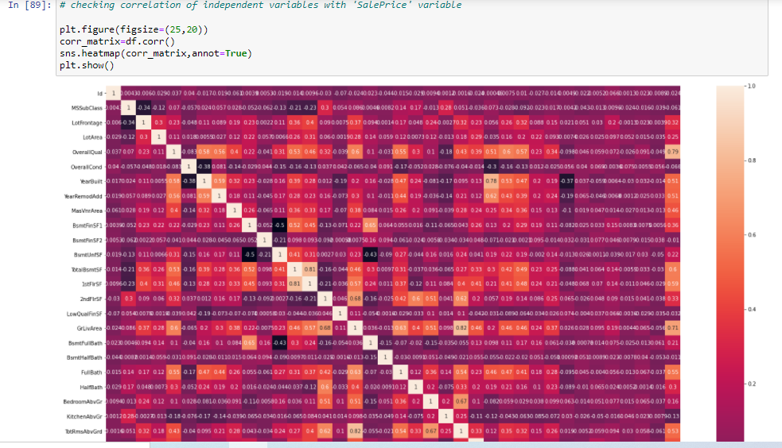
CORRELATION

Slide 12
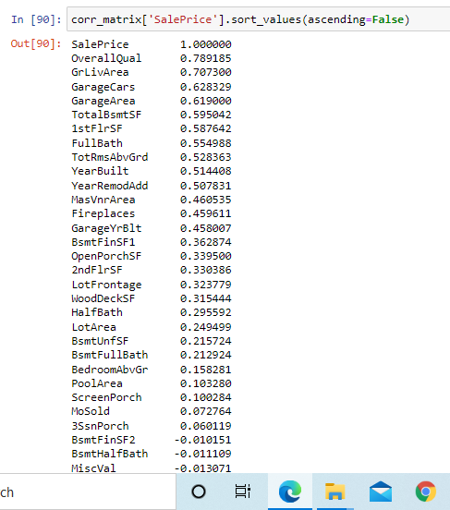

Slide 13
DATA VISUALIZATION
Data visualization is the graphical representation of information and data. By using visual elements like charts, graphs, and maps, data visualization tools provide an accessible way to see and understand trends, outliers, and patterns in data. In the world of Big Data, data visualization tools and technologies are essential to analyse massive amounts of information and make data-driven decisions.

Slide 14
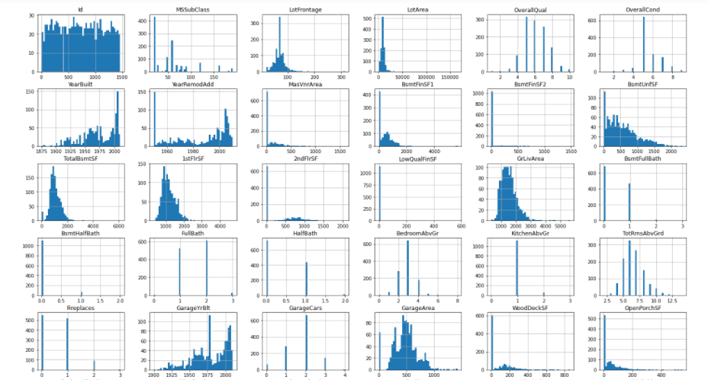
Distribution Plots

Slide 15
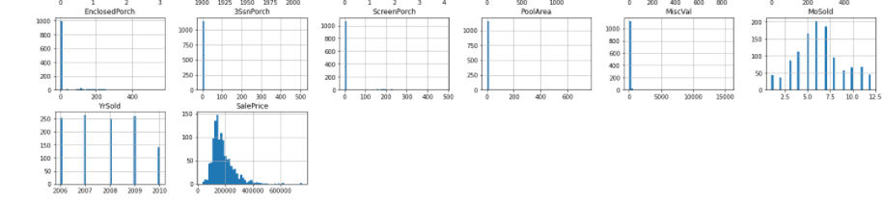
Distribution Plots

Slide 16
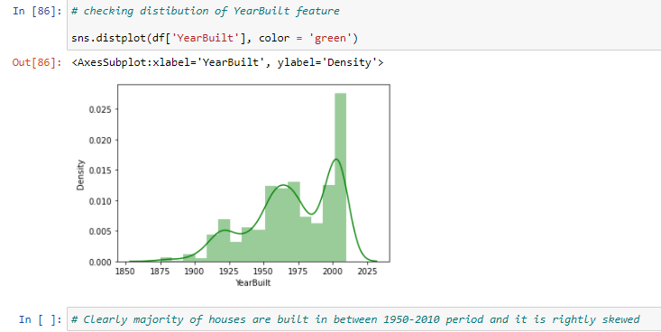
Distribution plot of YearBuilt Feature

Slide 17
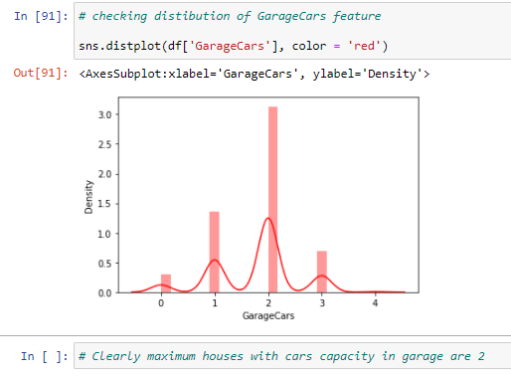
Distribution plot of GarageCars Feature

Slide 18
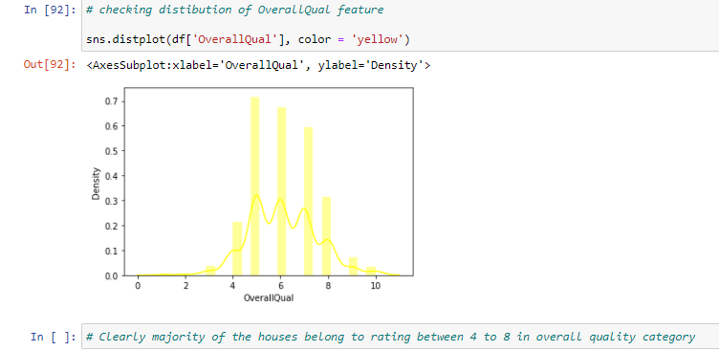
Distribution plot of OverallQual Feature

Slide 19
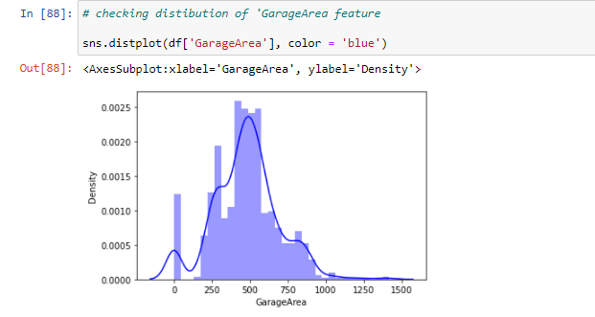
Distribution plot of GarageArea Feature

Slide 20
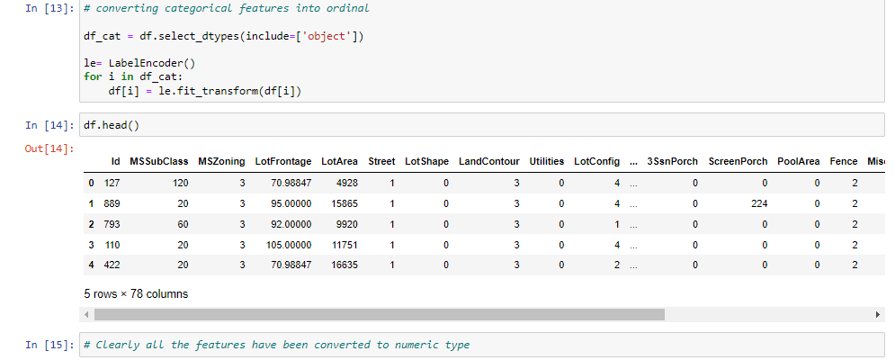
LABEL ENCODING

Slide 21

Splitting Dataset into X , Y

Slide 22
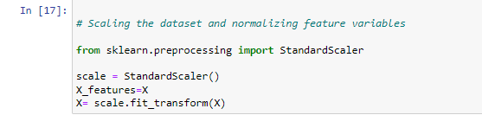
Scaling of Dataset

Slide 23
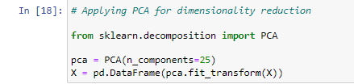
PCA

Slide 24
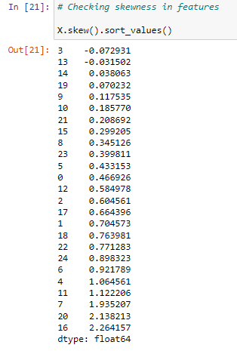
Skewness

Slide 25
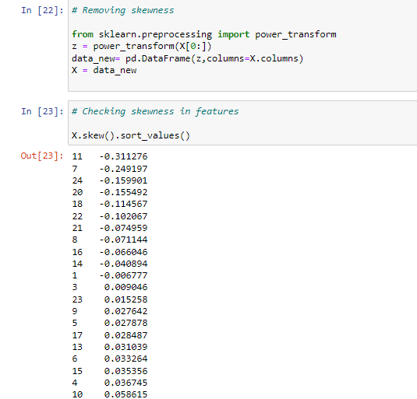
Removing skewness

Slide 26
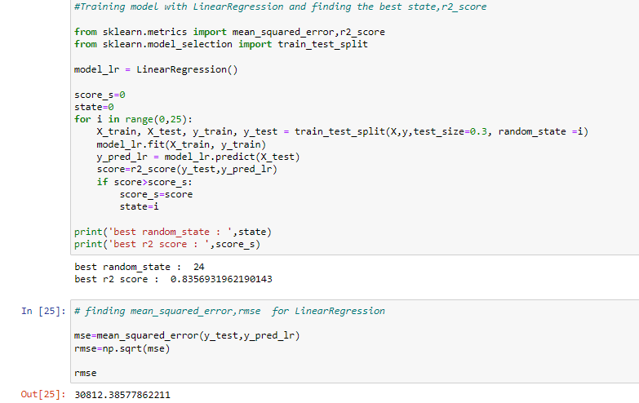
EVALUATION OF MODELS

Slide 27
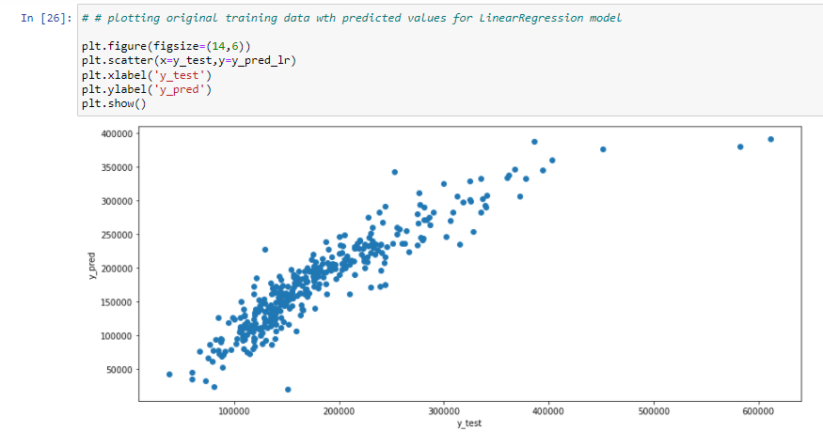

Slide 28
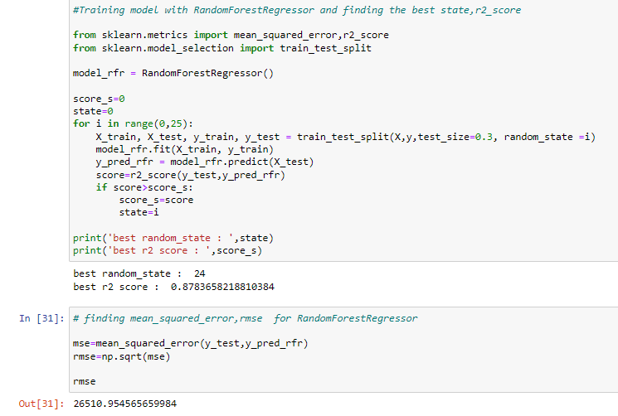

Slide 29
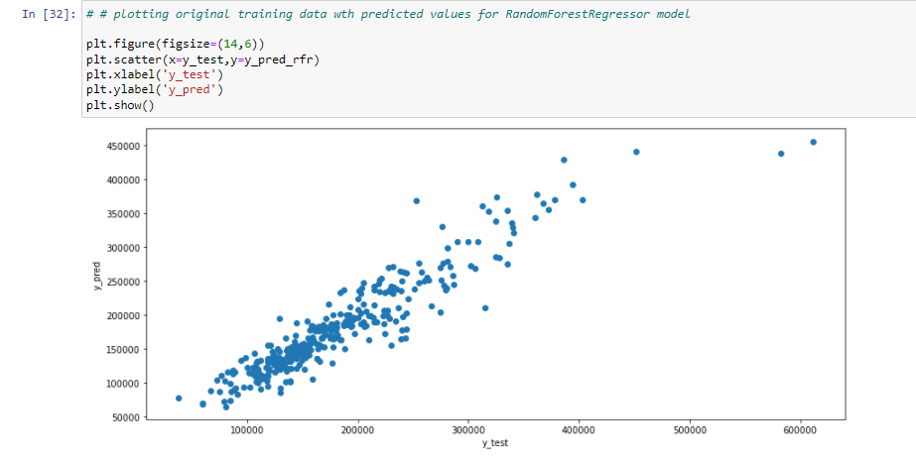

Slide 30
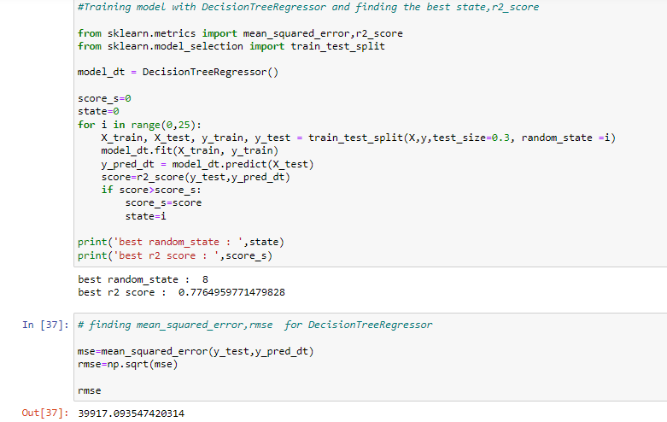

Slide 31
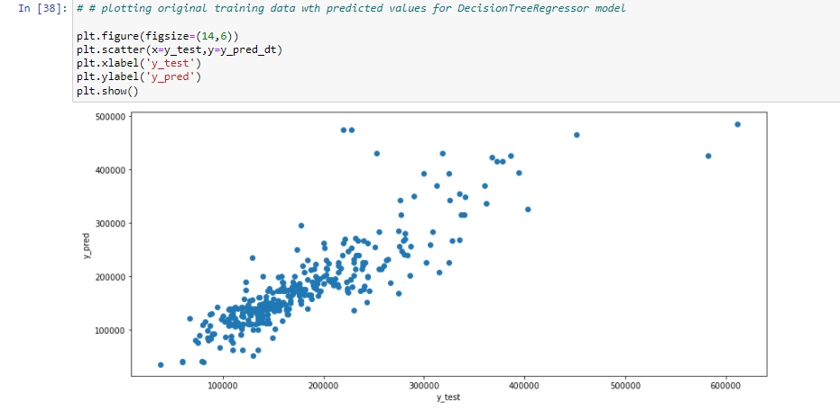

Slide 32
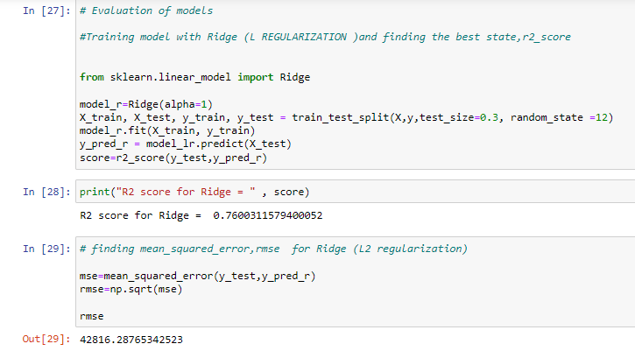

Slide 33
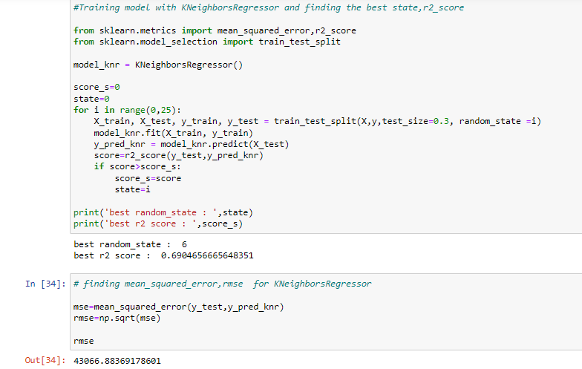

Slide 34
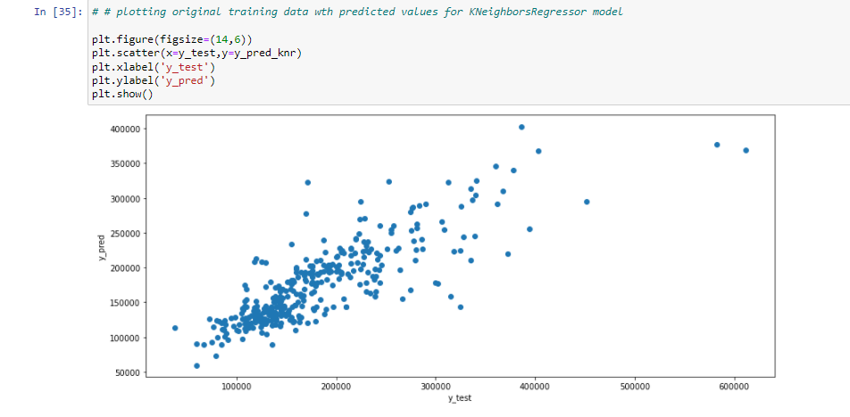

Slide 35
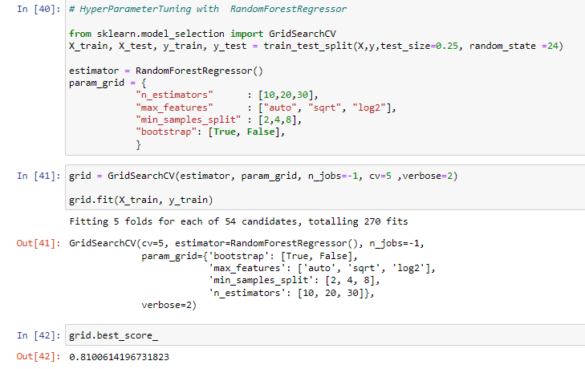
HYPERPARAMETER TUNING OF RANDOM FOREST REGRESSOR

Slide 36
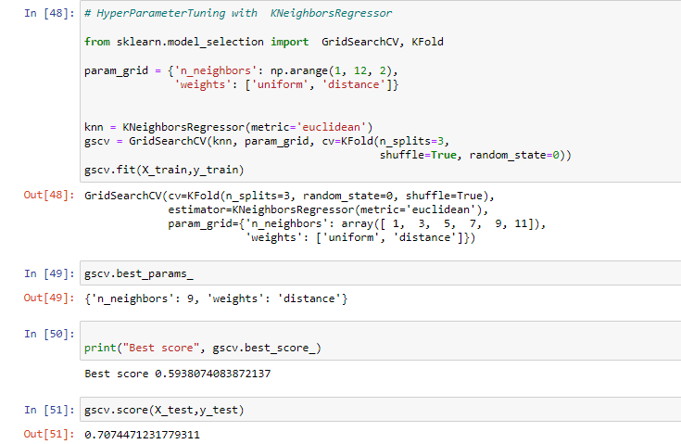
HYPERPARAMETER TUNING OF K-NEIHBOURS REGRESSOR

Slide 37
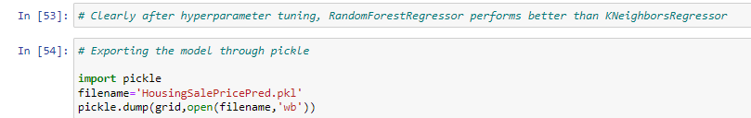
IMPORTING OF MODEL

Slide 38
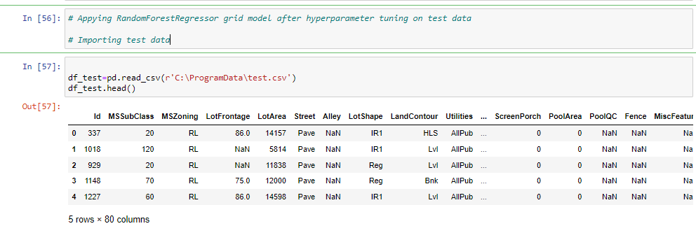
IMPORTING TEST DATA

Slide 39
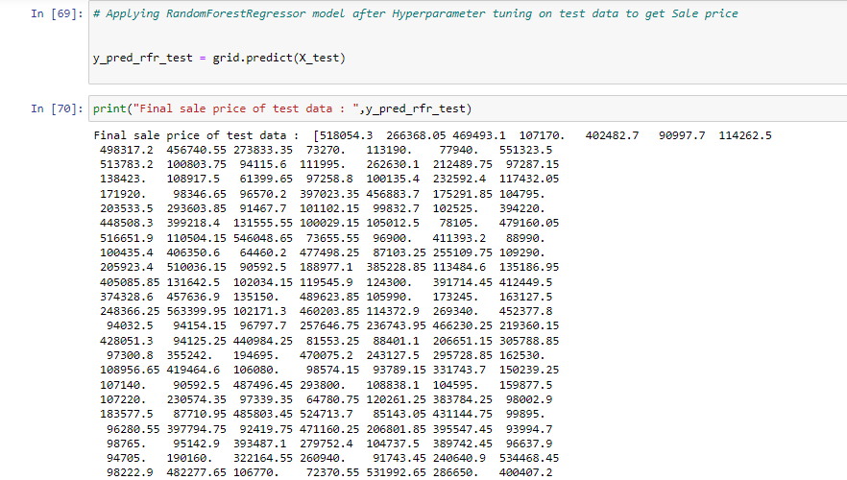

Slide 40
CONCLUSION

Slide 41


