Slide 1

CUSTOMER RETENTION DATA ANALYSIS
POWER POINT PRESENTATION

Slide 2
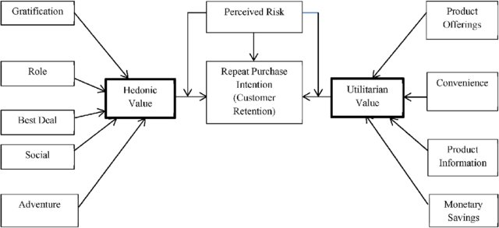
CUSTOMER SHOPPING LIFE CYCLE

Slide 3
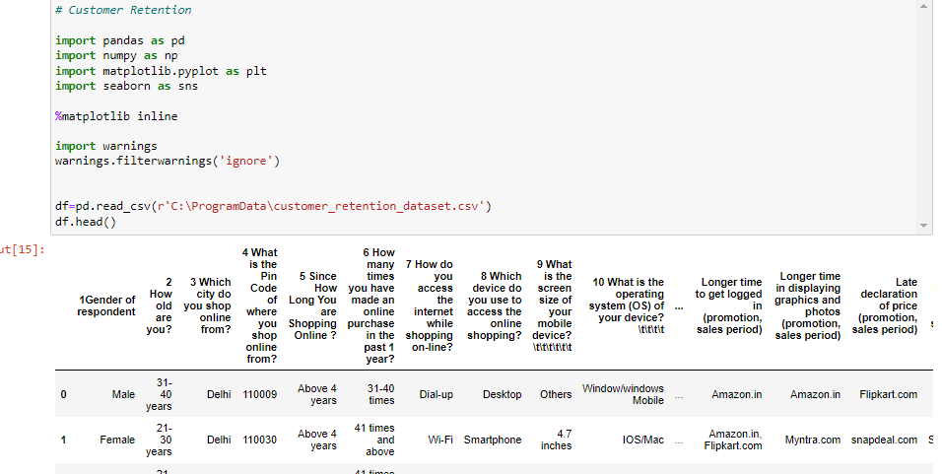

Slide 4
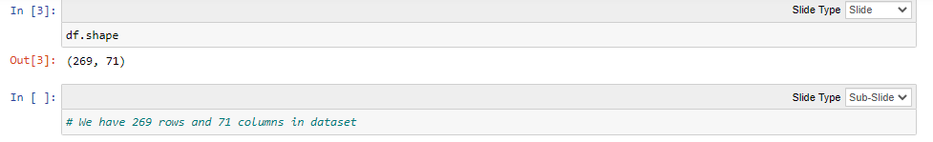

Slide 5
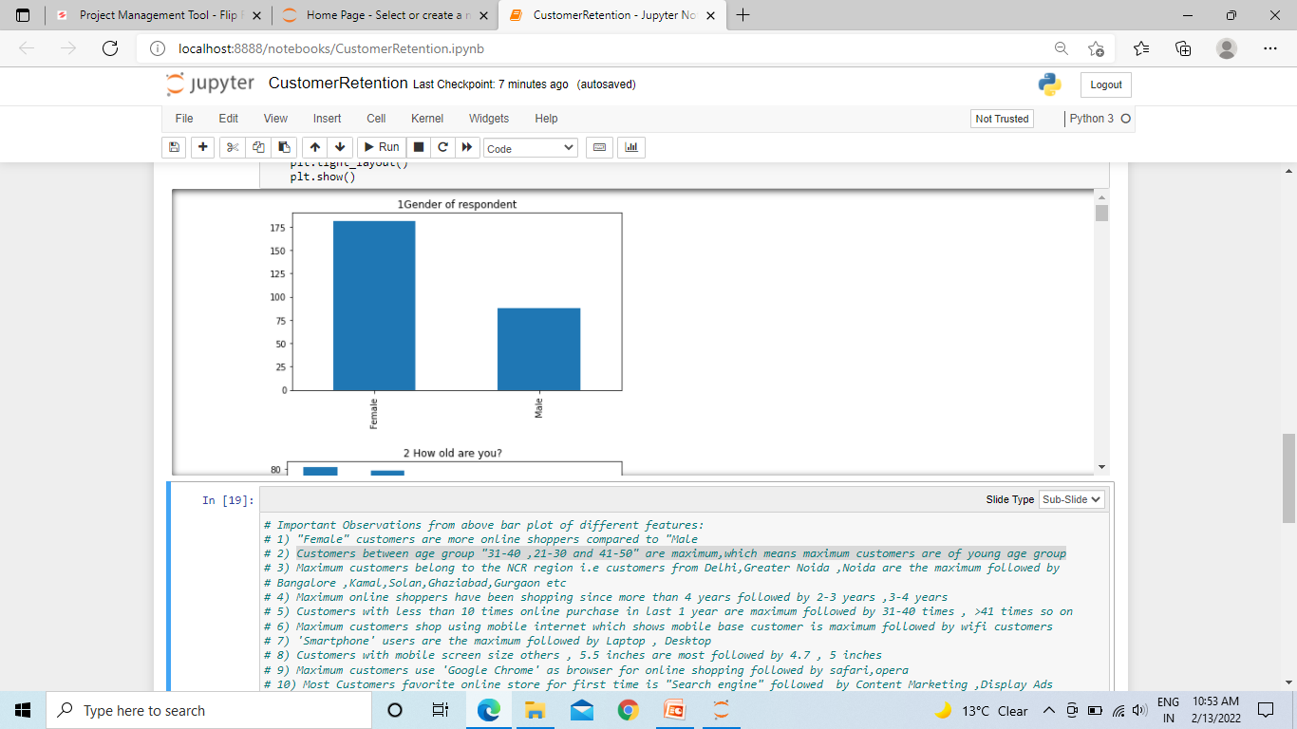
Female customers are more online shoppers compared to Male customers

Slide 6
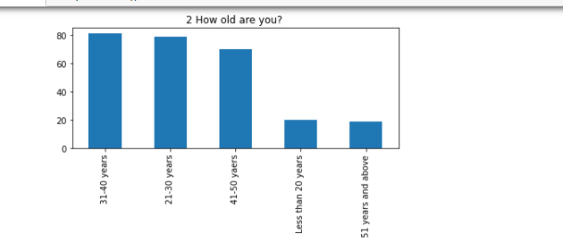
Customers between age group "31-40 ,21-30 and 41-50" are maximum,which means maximum customers are of young age group

Slide 7
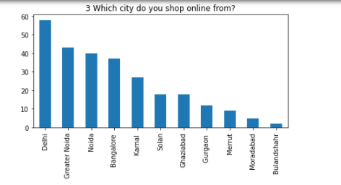
Maximum customers belong to the NCR region i.e customers from Delhi,Greater Noida ,Noida are the maximum followed by
Bangalore ,Kamal,Solan,Ghaziabad,Gurgaon etc

Slide 8
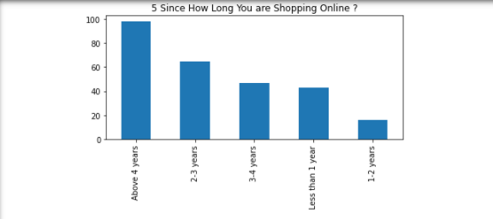
Maximum online shoppers have been shopping since more than 4 years followed by 2-3 years ,3-4 years

Slide 9
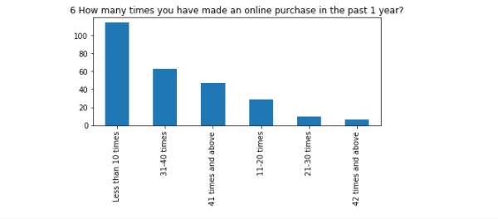
Customers with less than 10 times online purchase in last 1 year are maximum followed by 31-40 times , >41 times so on

Slide 10
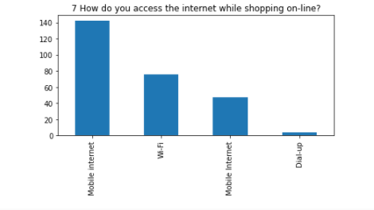
Maximum customers shop using mobile internet which shows mobile base customer is maximum followed by wifi customers

Slide 11
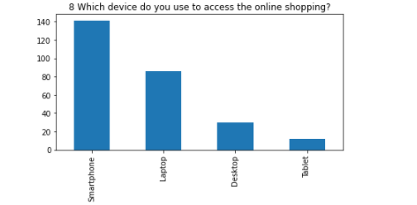
'Smartphone' users are the maximum followed by Laptop , Desktop

Slide 12
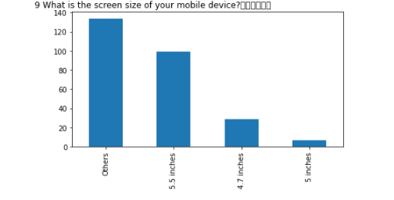
Customers with mobile screen size others , 5.5 inches are most followed by 4.7 , 5 inches

Slide 13
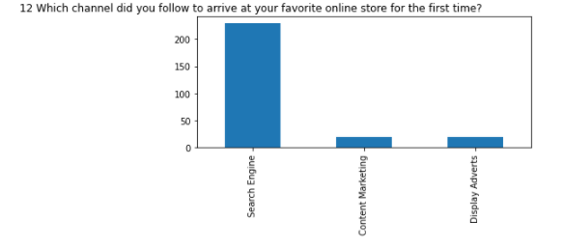

Most Customers favorite online store for first time is "Search engine" followed by Content Marketing ,Display Ads

Slide 14
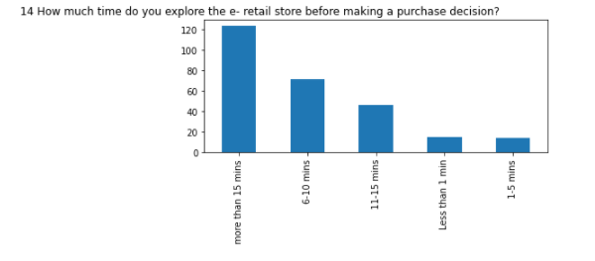
Maximum average time spent by customer in exploring the e-retail store before making a purchase decision is > 15 min followed by 6-10 min , 11-15 min

Slide 15
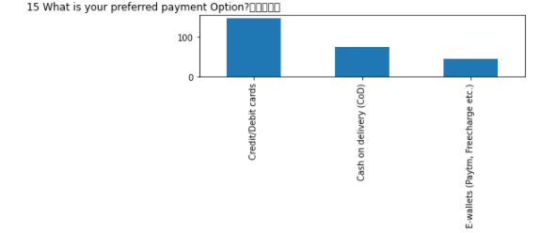
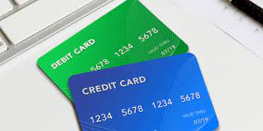
Most favorite payment option of most customers is credit/debit cards followed by COD,E-Wallets

Slide 16
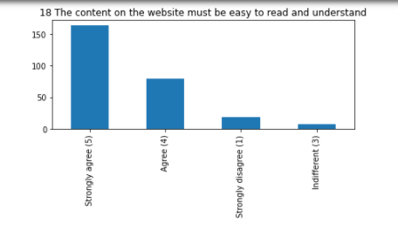
Most customers "strongly agree" that content on the website must be easy to read and understand followed by "agree"

Slide 17
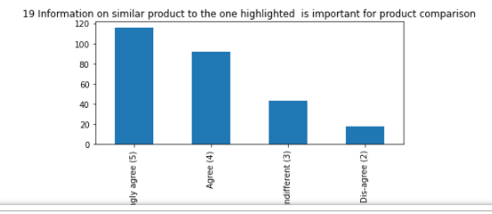
Most customers "strongly agree" for product comparision followed by "agree" ,"indifferent"

Slide 18
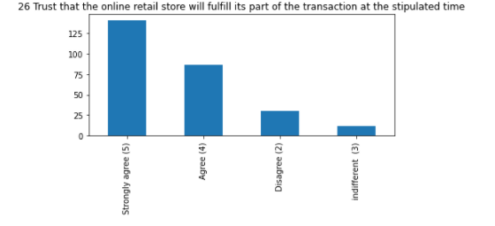
Most of the customers "stronly agree" with that privacy of the customer is important , empathy is important and Trust is extremely important

Slide 19
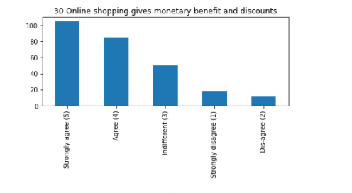
Most customers "strongly agree" with the fact that online shopping provides monetary benefits,discounts etc and that gaining access to loyalty programs is a benefit of online shopping

Slide 20
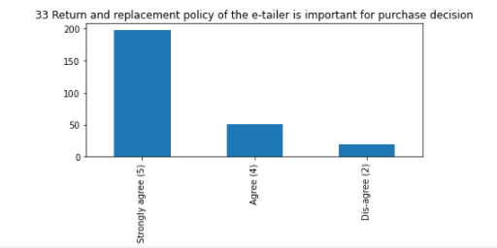
Maximum customers "stronly agree" with that return and replacement policy of e-retailer is important for purchase decision

Slide 21
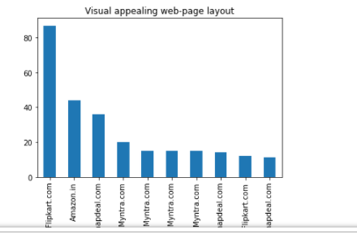
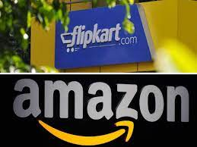
Majority of customers feel that amazon ,flipkart have best visual appealing web page layout

Slide 22
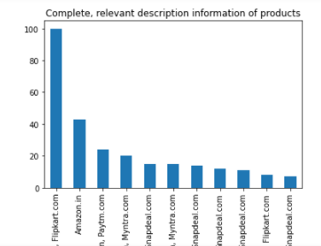

Majority of customers feel that complete and relevan information of products is listed on amazon,flipkart

Slide 23
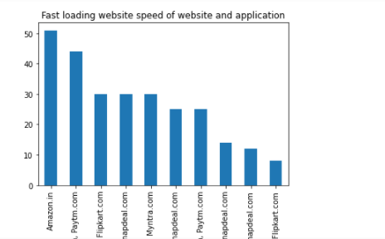


Majority of customers feel that amazon,paytm have fast loading websites

Slide 24
OTHER IMPORTANT OBSERVATIONS FROM DATASET
# Most customers feel that amazon , flipkart,paytm website are most quick to complete the purchase
# Most customers feel that amazon , flipkart,myntra ,snapdeal have availability of several payment options
# Majority of customers agree that amazon ,flipkart have fastest speedy order delivery
# Majority of customers agree that amazon ,flipkart,myntra maintain privacy of customers information
# Most customers feel that approx all websites maintain security of customer financial information
# MOst customers feel that "Flipkart" has fastest login in time during sales ,promotions period

